Slide 1

Introduction to Python
Shaowu Pan
MTech
University of Michigan

Slide 2

Life is too short....

Slide 3
A crash course on Practical Python
Shaowu Pan
MTech
University of Michigan

Slide 4
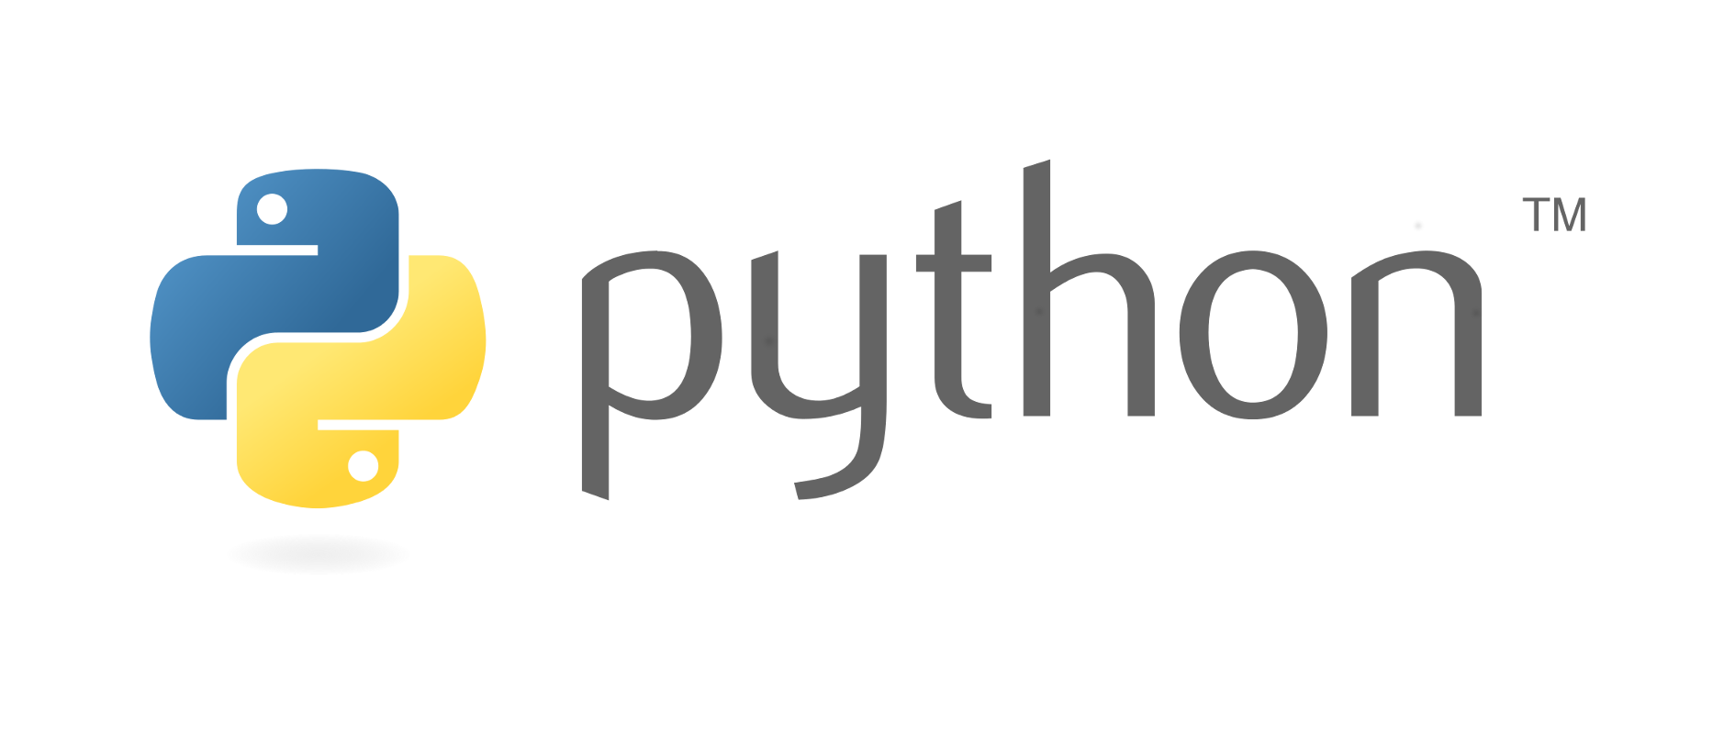
Python is a programming language
High-level
General purpose
Interpreted
Dynamic typing

Slide 5
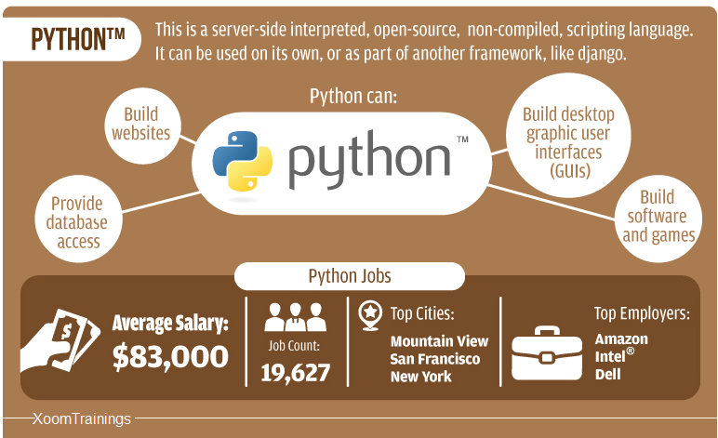
Why learn Python
Extensive library
Easy to read/work with others
Easy to handle, less prone to mistake
Concise

Slide 6
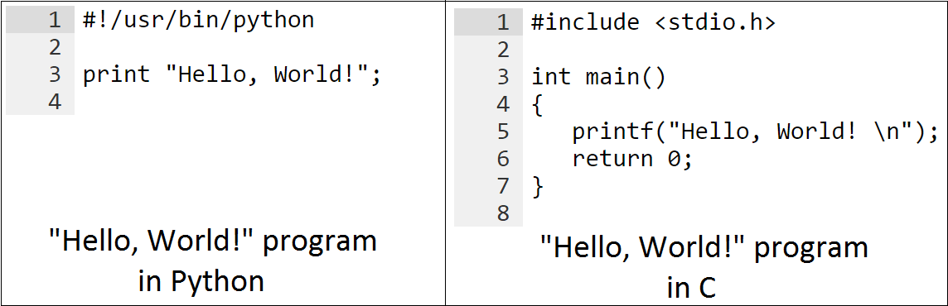
Different from C/C++
Python
shorter learning curve
automatic memory management
dynamic typing
C/C++
explicit memory management
easy to mess up with memory
static typing

Slide 7
Similar to Matlab
Python
dynamic typing
not very good at matrix operation
module based (.py)
Free + huge open-source library
Matlab
dynamic typing
fast at matrix operation
function based (.m)
Expensive + huge toolbox for scientific research

Slide 8
Difference between Matlab and Python
Matlab:
s =0;
x = [1 2 3];
for i = 1:3
s=s + x(i);
end
Python:
x = [1,2,3]
for i in range(3):
s= s + x[i]
Difference:
1. matlab: 1-indexing; python: 0-indexing
2. Python is more neat, not necessary semicolons, end
3. Python use tab in for-loop, which forces the format and readability

Slide 9
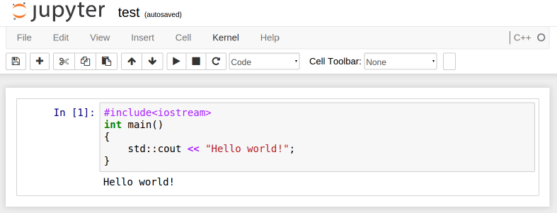
What is Jupyter Notebook?
web application
- allows you to create notebook for more than 40 languages
- python, javascript, Lua, perl, octave, matlab, bash, wolfram mathematica, scala, R, C++, java, etc....
- for more kernels
https://github.com/ipython/ipython/wiki/IPython-kernels-for-other-languages
Fig. jupyter notebook with C++ kernel: cling

Slide 10
What is the Element-like Type?
int -> signed integer
long -> long integer
float -> floating point real values
complex -> complex numbers
str -> string

Slide 11
Demenstration on jupyter notebook
1

Slide 12
What is the Array-like Type?
list -> flexible array-like type, similar to the vector in C++; []
tuple -> immutable array-like type; ()
set -> set in mathematics; no duplicate elements; {} or set()
dict -> hashmap, key-value pair {key1:value1,...}

Slide 13
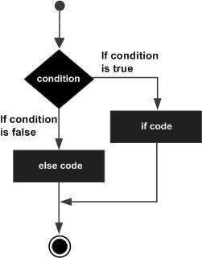
If statement
example:
a=0
if a < 0:
print 'a is negative'
elif a == 0:
print 'a is zero'
else:
print 'a is postitive'
tab

Slide 14
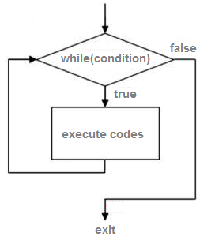
while loop
a = 5
while a > 0:
a = a-1
print a
4
3
2
1
0
tab

Slide 15
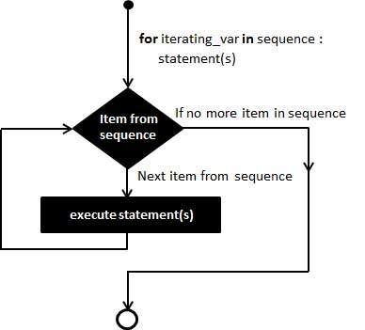
for loop
a_list = [1 2]
for a in a_list:
print a
1
2
Note: always need some sequence to loop
tab

Slide 16
loop control: break/continue
break
- jump out of this loop
continue
- jump to next loop iteration

Slide 17
File input/output
Manipulate file in hard disk
Notes:
ignore header

Slide 18
Demenstration on jupyter notebook
2

Slide 19
What is User-defined function?
tab
def functionName(args):
...
...
result = ...
return result
inline function
looks like matlab inline function
g = lambda x: x*x

Slide 20

Do I need to write a million packages?

Slide 21
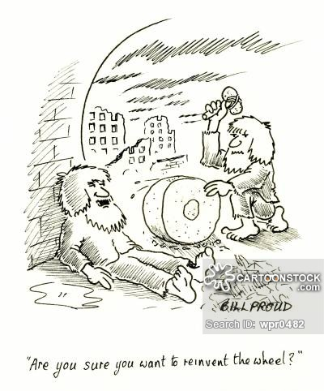
Stop re-inventing the wheels!!!
Use other's existing code
Use other's configuration
Don't be a hero...
Unless you do it for a living...

Slide 22
Places to find existing code!
PyPI - the Python Package Index
here you can find almost every possible python packages
https://pypi.python.org/pypi
github
http://www.github.com
Notes:
具体在你们的电脑上如何安装，阅读README文件。自己琢磨。

Slide 23
Use existing code written by others
Modules ("bag of functions")
Import a bag of function named "moduleFun"
e.g., import moduleFun
Use a function named "add" in "moduleFun"
e.g., moduleFun.add(args)
you can also...
import moduleFun as MF
from moduleFun import add as mfun_add
Notes:
now you can write multiple py files to construct a large python program

Slide 24
Common modules
numpy
the fundamental package for scientific computing with Python
matplotlib
a python 2D plotting library
.....
numpy + matplotlib = a simplified MATLAB
numpy + matplotlib + scipy = a medium MATLAB
Notes:
单纯的PYTHON并不包含许多很有用的包，毕竟只是一个语言而已。
推荐安装anaconda, 是一个python的开发平台，就好比是一个已经安装了许多库的C++ 开发平台。

Slide 25
debugging
code:
1)try:
except:
2)assert
debugger
pdg

Slide 26
profiling
Profiling
look into the code and evaluate the performance of algorithm
Tools
Cprofile

Slide 27
numpy & matplotlib
Loosly speaking they are the “Matlab in a pythonic way”
Numpy:
Fast implementation of matrix computation with implementation in C
Matplotlib
Visualization tool for scientific plotting even if you are not using python for computational intensive simulation

Slide 28
numpy & matplotlib

Slide 29
numpy & matplotlib

Slide 30
numpy & matplotlib

Slide 31
thanks

