Slide 1
Pre-requisites
1. Installed Python?
2. Jupyter notebook?

Slide 2

Introduction to Python
Shaowu Pan
Workshop series 1, MTech
University of Michigan

Slide 3
Who are we?
MTech是一个由密歇根大学工程院中 (AE/ME)的中国学生组成的的一个专注于专业知识和技能的分享和交流的俱乐部。我们创建这个俱乐部旨在促进工程专业中国学生之间技术层面的交流，搭建桥梁促进知识的分享和传播。
请关注我们的微信公众号（“密大MTech”）和我们的网站（mtechmae.webstarts.com）了解关于我们的更多信息。

Slide 4
Who are we?
成员：
黄大宁(AE)，李南(AE)，陈诗洋(ME)，何思澄(AE)，周欣(ME)，李兴宇(ME)，赵岩(ME)，潘韶武(AE)
advisor：
李四维

Slide 5

Thanks for NASCASE for sponsoring this event

Slide 6
Outline
- Overview
- Syntax
- Examples

Slide 7

Life is too short....

Slide 8
A crash course on Practical Python
Shaowu Pan
Workshop series 1, MTech
University of Michigan

Slide 9
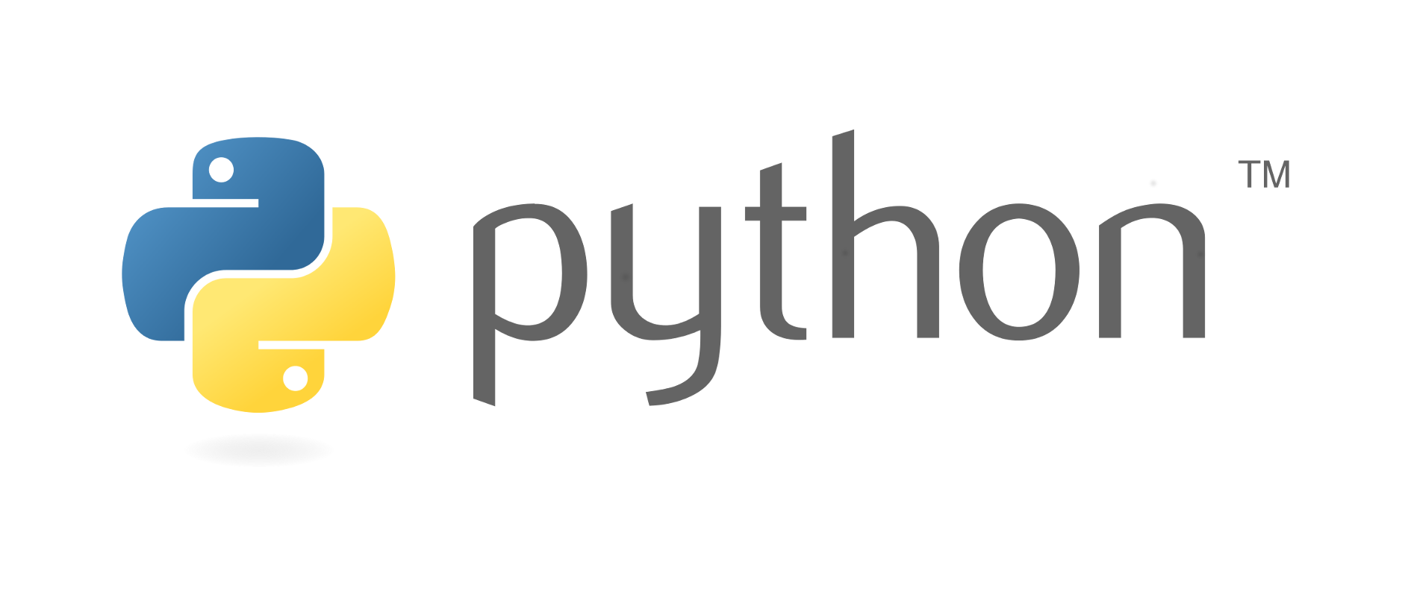
Python is a programming language
High-level
General purpose
Interpreted
Dynamic typing

Slide 10
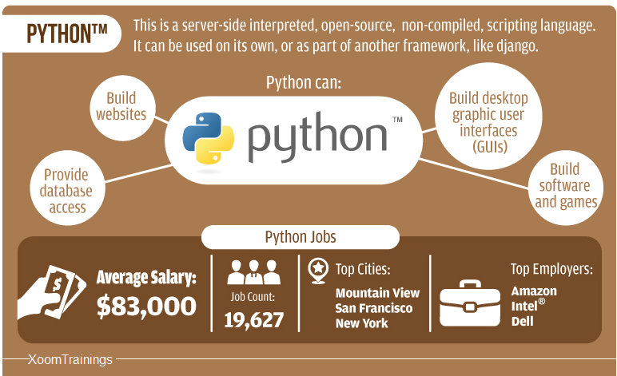
Why learn Python
Extensive library
Easy to read/work with others
Easy to handle, less prone to mistake
Concise

Slide 11
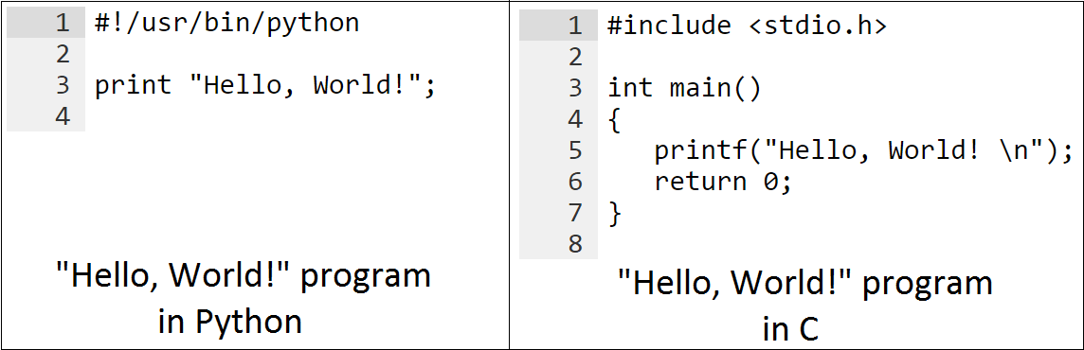
Different from C/C++
Python
shorter learning curve
automatic memory management
dynamic typing
C/C++
explicit memory management
easy to mess up with memory
static typing

Slide 12
Similar to Matlab
Python
dynamic typing
not very good at matrix operation
module based (.py)
Free + huge open-source library
Matlab
dynamic typing
fast at matrix operation
function based (.m)
Expensive + huge toolbox for scientific research

Slide 13
Difference between Matlab and Python
Matlab:
s =0;
x = [1 2 3];
for i = 1:3
s=s + x(i);
end
Python:
x = [1,2,3]
s=0
for i in range(3):
s= s + x[i]
# range(3) = [0,1,2]
Difference:
1. matlab: 1-indexing; python: 0-indexing
2. Python is more neat, not necessary semicolons, end
3. Python use tab in for-loop, which forces the format and readability

Slide 14
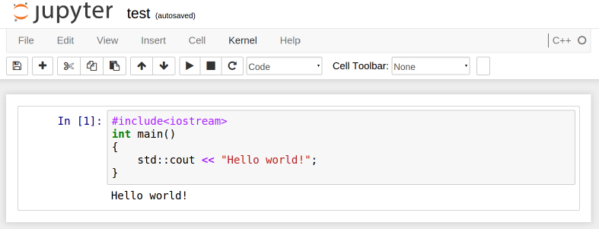
What is Jupyter Notebook?
Web application
- allows you to create notebook for more than 40 languages
- python, javascript, Lua, perl, octave, matlab, bash, wolfram mathematica, scala, R, C++, java, etc....
- for more kernels
https://github.com/ipython/ipython/wiki/IPython-kernels-for-other-languages
Fig. jupyter notebook with C++ kernel: cling
We use it as an editor for Python

Slide 15
What is the Element-like Type?
int -> signed integer
long -> long integer
float -> floating point real values
complex -> complex numbers
str -> string

Slide 16
Demenstration on jupyter notebook
1

Slide 17
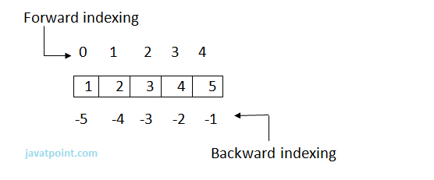
What is the Array-like Type?
list -> flexible array-like type, similar to the vector in C++; []

Slide 18
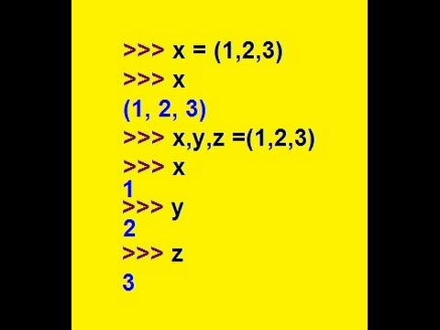
What is the Array-like Type?
tuple -> immutable array-like type; ()

Slide 19
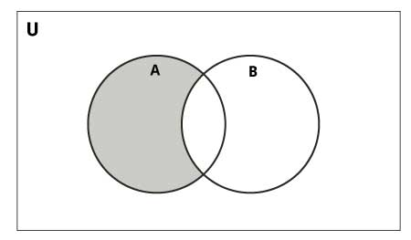
What is the Array-like Type?
set -> set in mathematics; no duplicate elements; set()

Slide 20
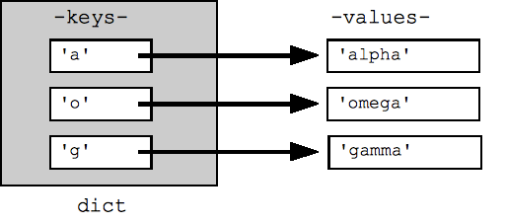
What is the Array-like Type?
dict -> hashmap, key-value pair {key1:value1,...} {}

Slide 21
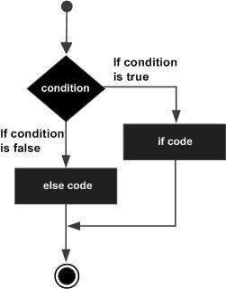
If statement
example:
a=0
if a < 0:
print 'a is negative'
elif a == 0:
print 'a is zero'
else:
print 'a is postitive'
tab

Slide 22
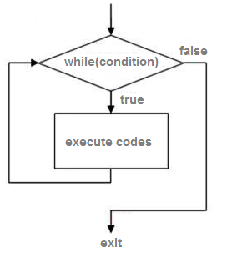
while loop
a = 5
while a > 0:
a = a-1
print a
4
3
2
1
0
tab

Slide 23
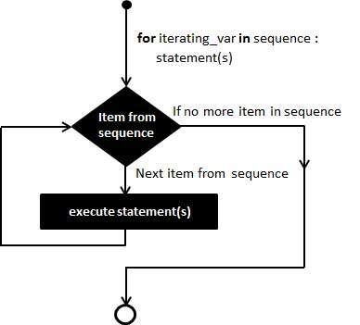
for loop
a_list = [1 2]
for a in a_list:
print a
1
2
Note: always need some sequence to loop
tab

Slide 24
loop control: break/continue
break
- jump out of this loop
continue
- jump to next loop iteration

Slide 25
What is User-defined function?
tab
def functionName(args):
...
...
result = ...
return result
inline function
looks like matlab inline function
g = lambda x: x*x

Slide 26
File input/output
Manipulate file in hard disk
Notes:
ignore header

Slide 27
Demenstration on jupyter notebook
2

Slide 28

Do I need to write a million packages?

Slide 29
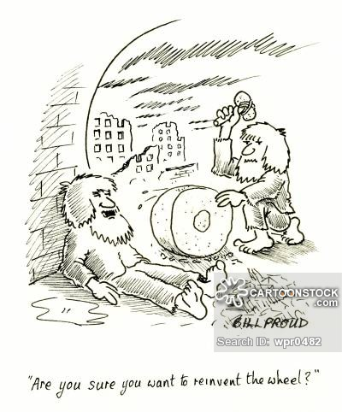
Stop re-inventing the wheels!!!
Use other's existing code
Use other's configuration
Don't be a hero...
Unless you do it for a living...

Slide 30
Places to find existing code!
PyPI - the Python Package Index
here you can find almost every possible python packages
https://pypi.python.org/pypi
github
http://www.github.com
Notes:
具体在你们的电脑上如何安装，阅读README文件。自己琢磨。

Slide 31
Use existing code written by others
Modules ("bag of functions")
Import a bag of function named "moduleFun"
e.g., import moduleFun
Use a function named "add" in "moduleFun"
e.g., moduleFun.add(args)
you can also...
import moduleFun as MF
from moduleFun import add as mfun_add
Notes:
now you can write multiple py files to construct a large python program

Slide 32
Common modules
numpy
the fundamental package for scientific computing with Python
matplotlib
a python 2D plotting library
.....
numpy + matplotlib = a simplified MATLAB
numpy + matplotlib + scipy = a medium MATLAB
Notes:
单纯的PYTHON并不包含许多很有用的包，毕竟只是一个语言而已。
推荐安装anaconda, 是一个python的开发平台，就好比是一个已经安装了许多库的C++ 开发平台。

Slide 33
numpy & matplotlib
Loosly speaking they are the “Matlab in a pythonic way”
Numpy:
Fast implementation of matrix computation with implementation in C
Matplotlib
Visualization tool for scientific plotting even if you are not using python for computational intensive simulation

Slide 34
debugging
debugger
pdg
embedded detection in your code
try + exception
try to run this command, if error turns out, use exception to handle error
assert
sanity check

Slide 35
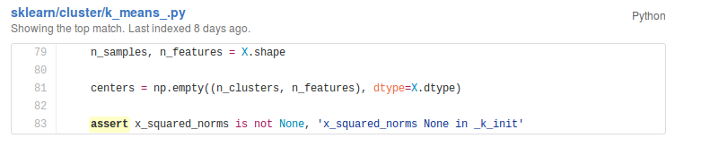
sanity check is used in real practice

Slide 36
profiling
Profiling
look into the code and evaluate the performance of algorithm -> look for "hot spot"
Tools
- cProfile
- kernprof
- memory_profiler
...

Slide 37
Thanks for NASCASE for sponsoring this event

Slide 38
Welcome!
To share your expertise with us!
To join/collaborate with us to promote a better engineering environment in Chinese!

Slide 39
Thanks
MTech wechat:
- umichmtech
MTech website:
- http://mtechmae.webstarts.com/

