Slide 1

Artificial intelligence and machine learning

Slide 2
IDENTIFICATION OF MONKEYPOX DISEASE
NAMES: HALL TICKET NO.
U.SHIVA 2103A51074
N.SAI CHARAN 2103A51100
GUIDED BY:
Mr. s naresh kumar sir

Slide 3
Contents:
INTRODUCTION
Overview
Problem Statement
Existing system
Proposed system
Define Objectives
Overall architecture
LITERATURE SURVEY
Document the survey done by you related to your problem statement
DATA PRE-PROCESSING
Describe dataset
Data cleaning
Data augmentation
Data Visualization
METHODOLOGY
Procedure to solve the given problem
Model architecture
Software description
RESULTS AND DISCUSSION
CONCLUSION AND FUTURE SCOPE
7. REFERENCES

Slide 4
1. INTRODUCTION
1.Overview:
This project is developed with the knowledge of Artificial Intelligence and Machine Learning. The dataset we collected, would contain information about individuals who have been diagnosed with monkeypox, including their symptoms and test results. The symptoms would likely be represented as boolean values (1 for present, 0 for absent) and the test results would indicate whether the individual tested positive or negative for the virus.
2. Problem Statement:
To develop a machine learning model to accurately diagnose monkeypox infections in humans based on their symptoms and test results.
3. Existing Systems:
The most common method for diagnosing monkeypox is through laboratory testing of blood, skin lesions, or other bodily fluids. Tests can include PCR (polymerase chain reaction) to detect viral DNA, ELISA (enzyme-linked immunosorbent assay) to detect antibodies. Several rapid diagnostic tests have been developed for monkeypox, including lateral flow assays and immunochromatographic tests. These tests can provide results within minutes, but they may not be as sensitive or specific as laboratory testing.

Slide 5
4.Proposed System
Our model could leverage the available dataset containing information on individuals diagnosed with monkeypox. Our model would be designed as a classification model that takes in input features such as the presence or absence of specific symptoms, as well as test results, to predict whether an individual is positive or negative for monkeypox. To develop our model, we could use machine learning algorithms such as logistic regression, decision trees, random forests, or neural networks. These algorithms would be trained on the collected dataset, with a portion of the data held out for validation and testing. The goal would be to develop a model that accurately predicts the diagnosis of monkeypox in humans with high precision and recall.
5.Objectives:
Develop a classification model that accurately predicts the diagnosis of monkeypox infections in humans based on their symptoms and test results.
Identify the most important features and symptoms for predicting monkeypox infections and use them to train the model.
Evaluate the model's clinical utility and potential impact on public health by estimating its sensitivity, specificity, positive predictive value, negative predictive value, and other relevant metrics.
Integrate the model into existing healthcare systems and provide guidance on its use for healthcare professionals and public health authorities.

Slide 6
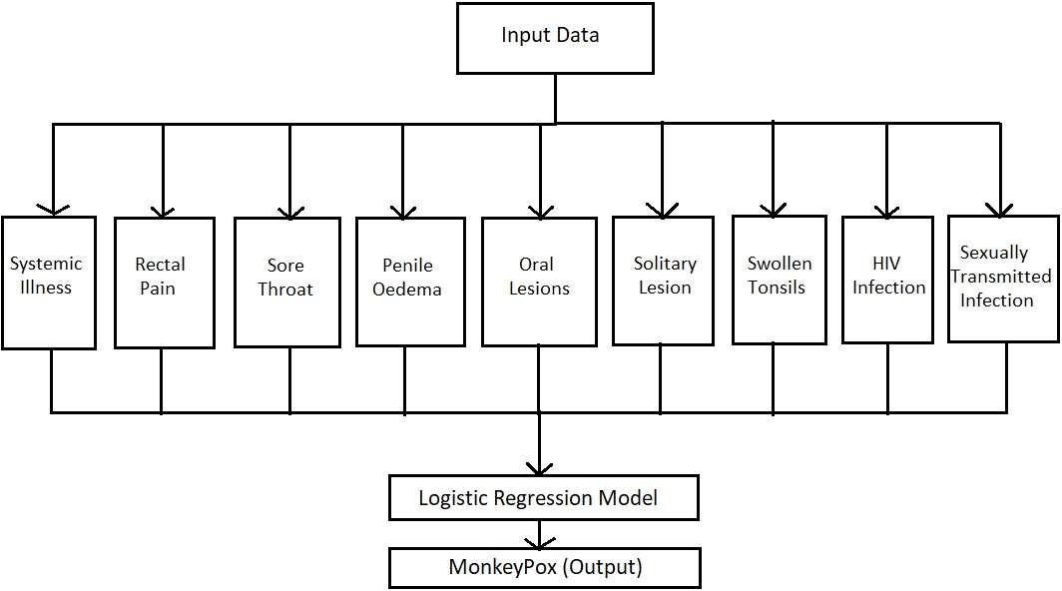
1.6 Overall architecture:

Slide 7
2. LITERATURE SURVEY
2.1 Survey Documentation
In this section, we will document the literature survey we conducted related to the problem statement of predicting and analyzing MonkeyPox Disease cases using artificial intelligence and machine learning techniques.
Firstly, a review of previous studies related to monkeypox diagnosis and machine learning- based disease diagnosis can provide valuable insights into relevant features and symptoms that may be useful for predicting monkeypox infections, as well as the most appropriate machine learning algorithms for our model. This review can also help identify potential challenges and limitations in developing such a model.
Secondly, it is important to identify knowledge gaps in the current literature related to monkeypox diagnosis and machine learning-based approaches. For example, while there has been some research on the use of machine learning for diagnosing other infectious diseases, such as tuberculosis and malaria, there are relatively few studies on the use of machine learning for monkeypox diagnosis. Identifying such gaps can help guide future research directions and inform our model development.
Thirdly, comparing and evaluating existing machine learning models developed for diagnosing monkeypox or other infectious diseases can help inform the development of our proposed model. This evaluation can identify the strengths and weaknesses of different approaches, and help us select the most appropriate algorithms for our model. It can also help us identify potential challenges and limitations in applying machine learning to monkeypox diagnosis.

Slide 8
Fourthly, assessing the clinical relevance and potential impact of our proposed model in real- world settings is crucial. This involves evaluating the accuracy, sensitivity, specificity, and other relevant metrics of our model, as well as its feasibility and scalability in different settings. It is also important to consider the potential impact of our model on clinical decision- making and patient outcomes, and to ensure that it aligns with clinical best practices and guidelines.
Finally, ethical considerations such as potential biases in data collection, model development, and deployment must be addressed. For example, there may be biases in the demographic characteristics or clinical presentation of individuals diagnosed with monkeypox that could impact the accuracy and fairness of our model. It is also important to consider the potential implications of our model for privacy, data security, and informed consent, and to ensure that appropriate safeguards are in place.
Overall, a comprehensive literature survey can provide a strong foundation for the development of our proposed machine learning model for diagnosing monkeypox infections, by informing feature selection, algorithm selection, and validation methods, as well as addressing ethical and social considerations.
In addition, the literature survey can also help identify potential challenges and limitations in data collection and management

Slide 9
For example, in the case of monkeypox, there may be limited data available on relevant symptoms and patient characteristics, especially in low-resource settings. In such cases, we may need to consider alternative sources of data, such as electronic health records or mobile health applications. It is also important to ensure that data collection and management practices adhere to ethical principles, such as ensuring confidentiality and obtaining informed consent.
Furthermore, the literature survey can also inform the development of a framework for model explainability and interpretability. Machine learning models are often criticized for their "black box" nature, meaning that it can be difficult to understand how they arrive at their predictions. However, in clinical settings, it is important for healthcare professionals to understand the rationale behind a model's predictions in order to make informed decisions.
Therefore, developing a framework for model explainability and interpretability can enhance the clinical utility and acceptance of our proposed model for diagnosing monkeypox infections. This may involve using techniques such as feature importance ranking and visualizations to help healthcare professionals understand how different symptoms and features contribute to the model's predictions.

Slide 10
3. DATA PRE-PROCESSING
3.1 Description of Dataset:
The monkeypox dataset contains information on the symptoms and diagnosis of individuals suspected of having monkeypox infections. The dataset includes both categorical and binary features, such as fever, swollen lymph nodes, muscle aches and pains. The target variable is a binary variable indicating whether the individual was diagnosed with monkeypox or not.
The dataset was collected from clinical records of individuals who presented with symptoms consistent with monkeypox at various healthcare facilities. The dataset includes data from both confirmed and suspected monkeypox cases, with confirmed cases being diagnosed based on laboratory testing. The dataset was cleaned and preprocessed to remove missing values and ensure consistency in data formats.
Overall, the monkeypox dataset provides a useful resource for developing and evaluating our proposed machine learning model for diagnosing monkeypox infections. However, it is important to recognize the limitations of the dataset and consider additional sources of data and features to enhance the accuracy and generalizability of our model.

Slide 11
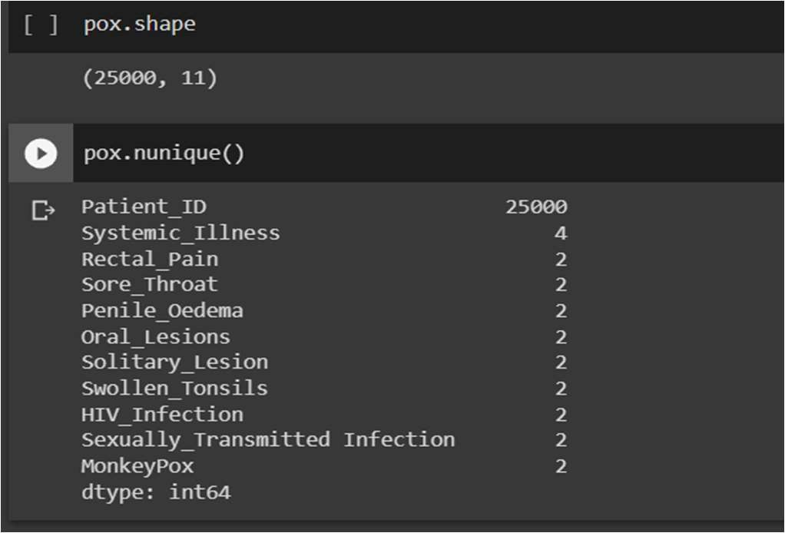
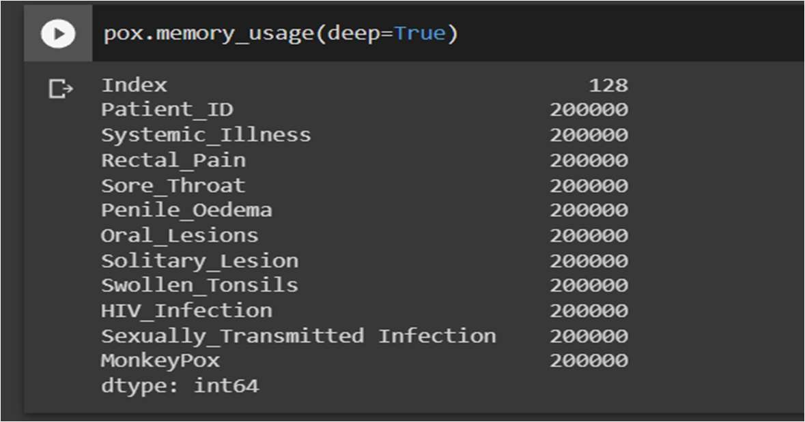
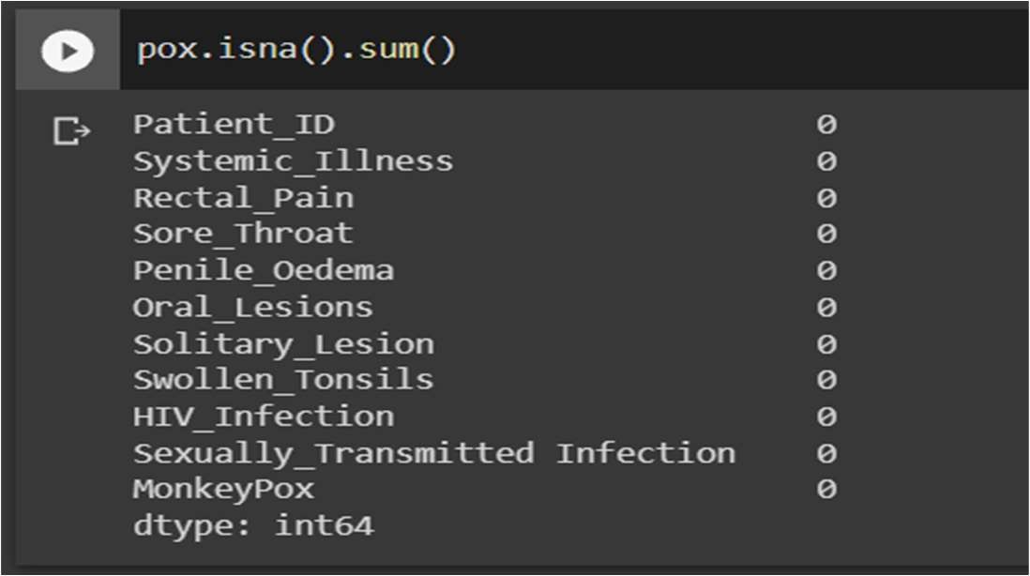
3.2 Data Cleaning:
Checking for Unique Values
Checking for Memory Usage
Checking for Null Values and Removing Null Values

Slide 12
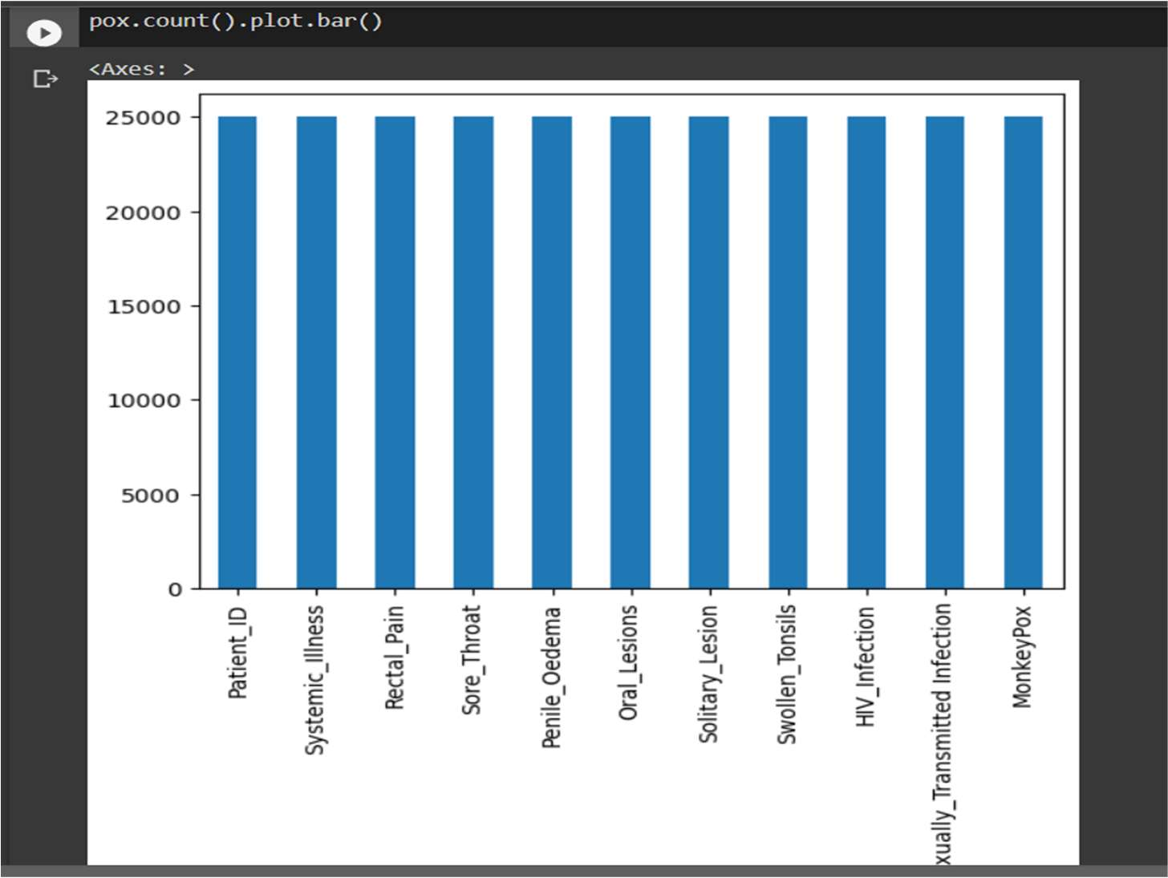
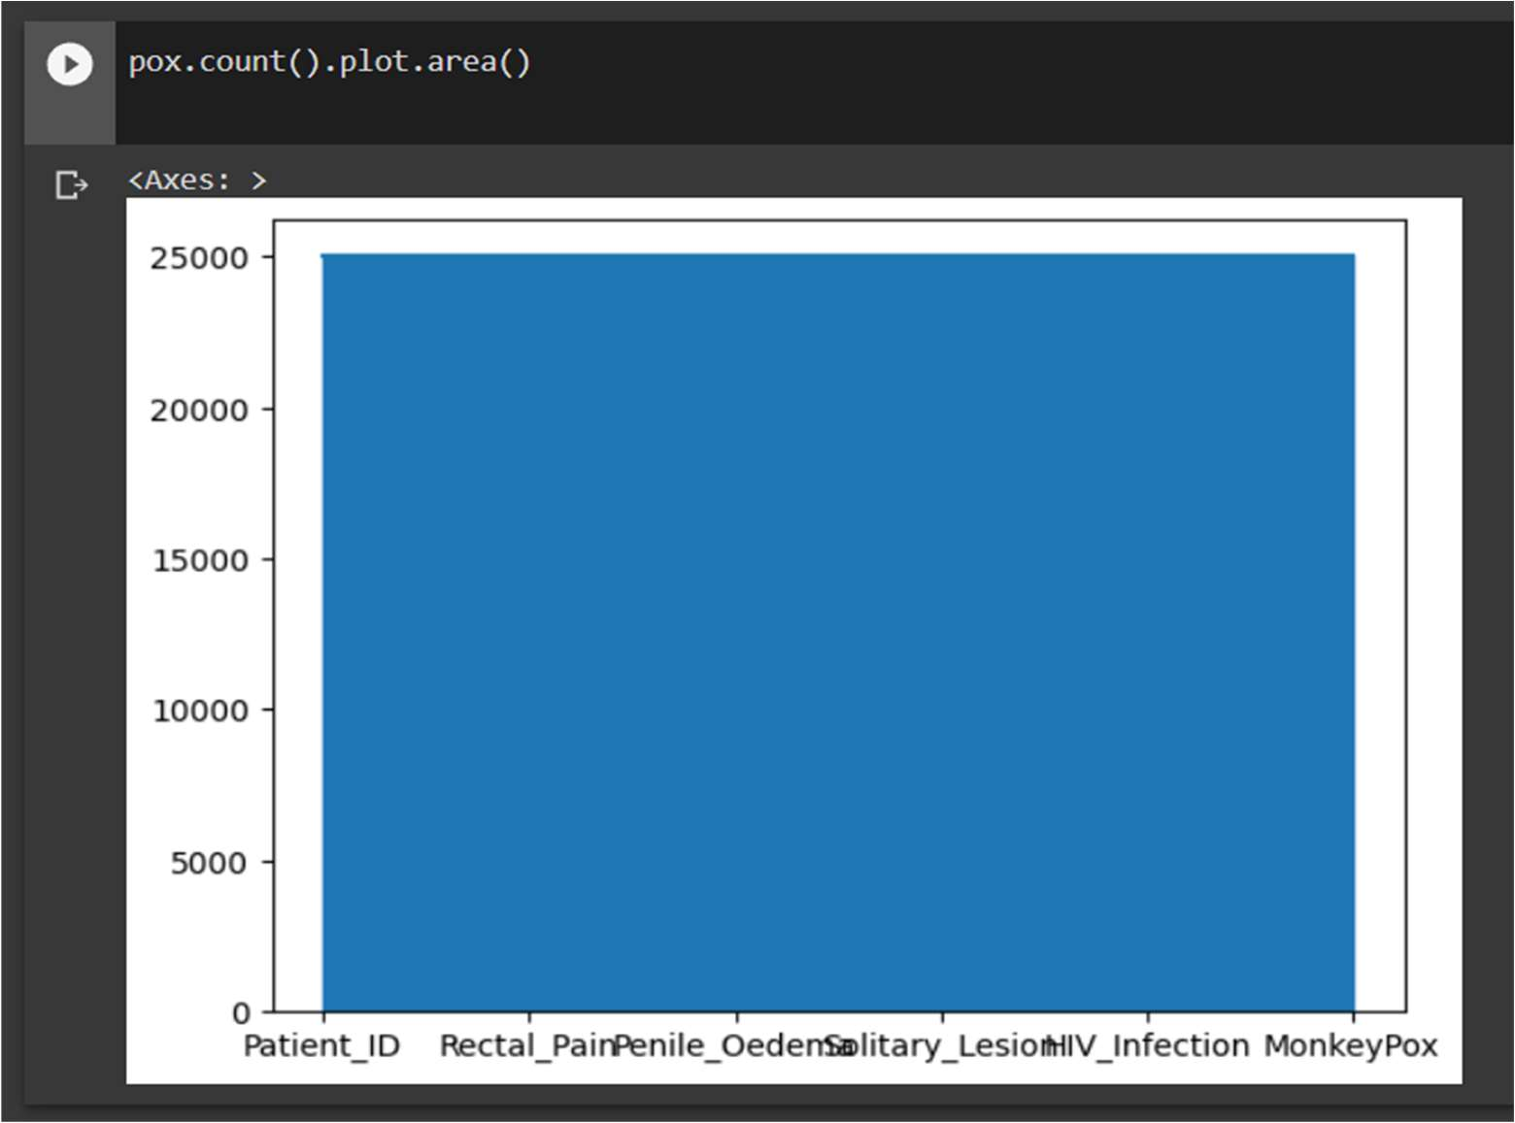
3.3 Data Visualization:
Bar Graph Representation for total Area plot represent count of values of attributes
of values in each column

Slide 13
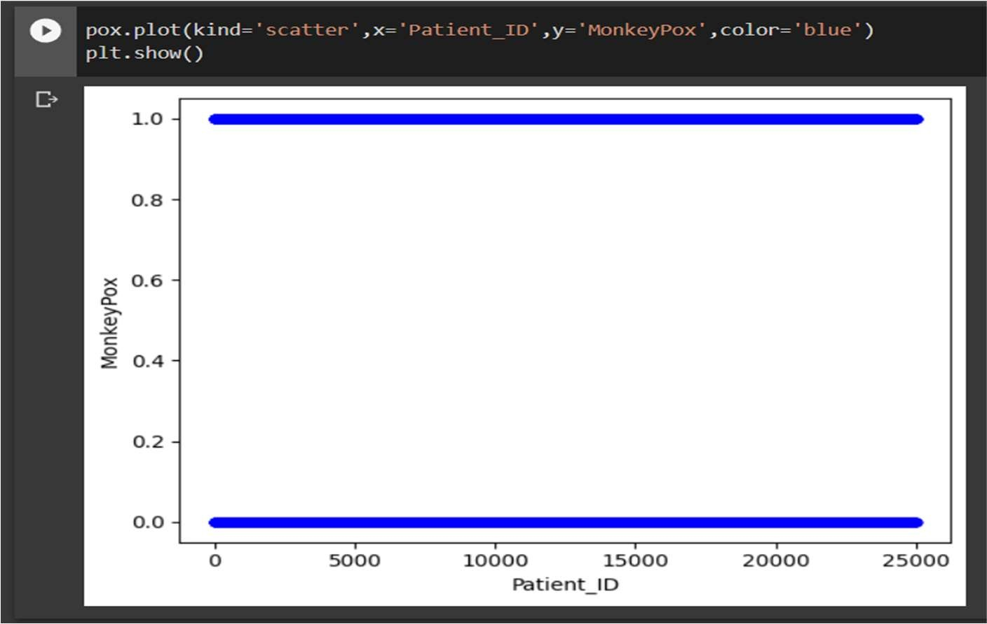
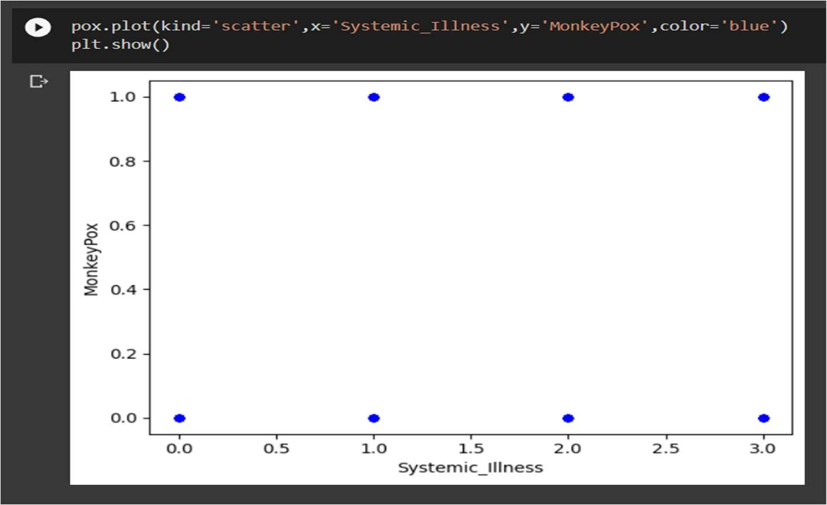
Scatterplot between patient ID and monkeypox(result)
Sctterplot between systemic_Illness and MonkeyPox(result

Slide 14
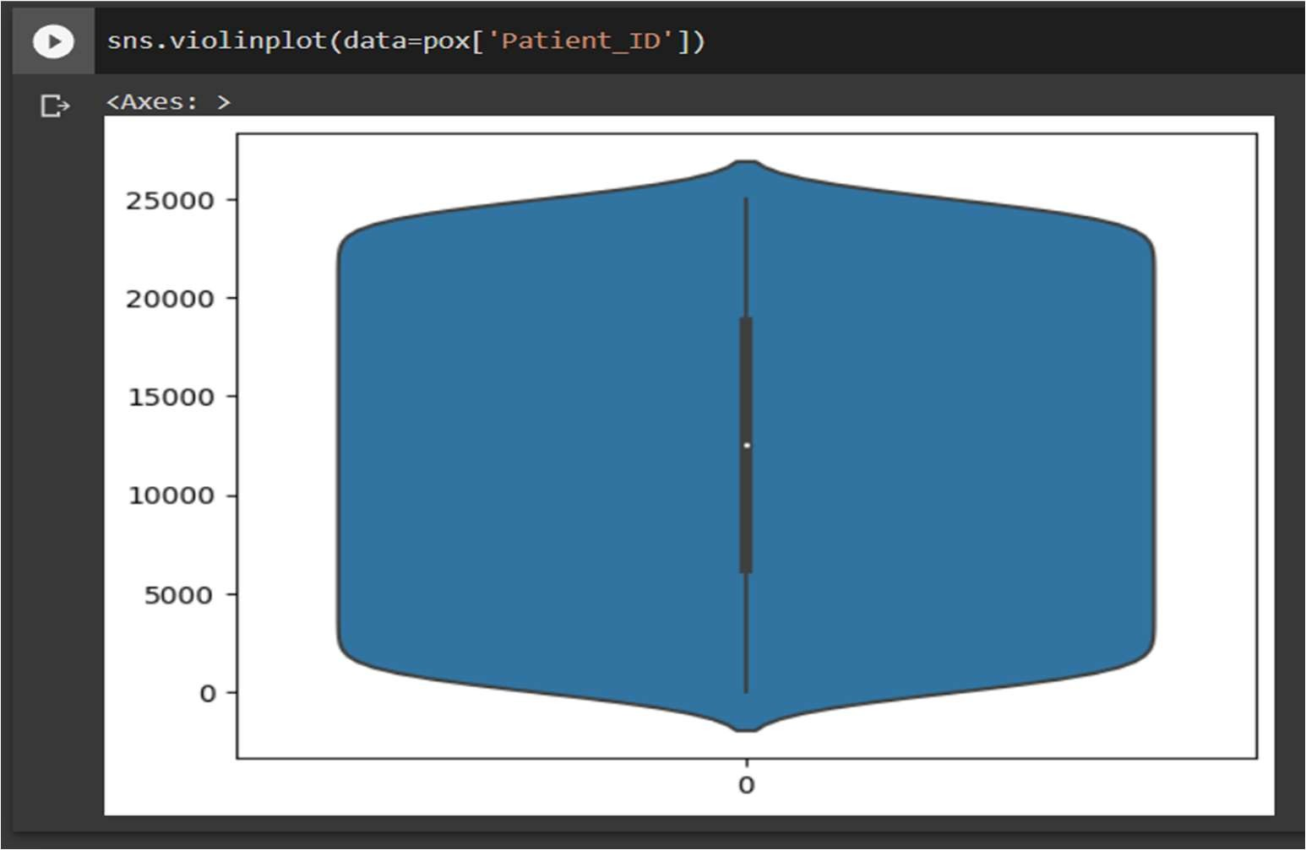
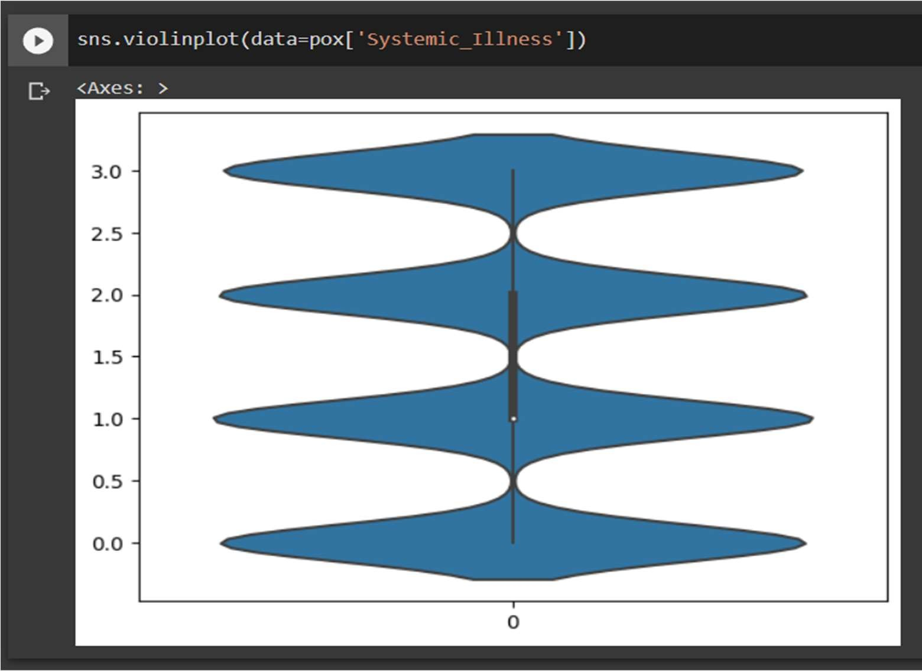
Violin Plot for patient ID
Violkin Plot for Systemic Illness for four categeries

Slide 15
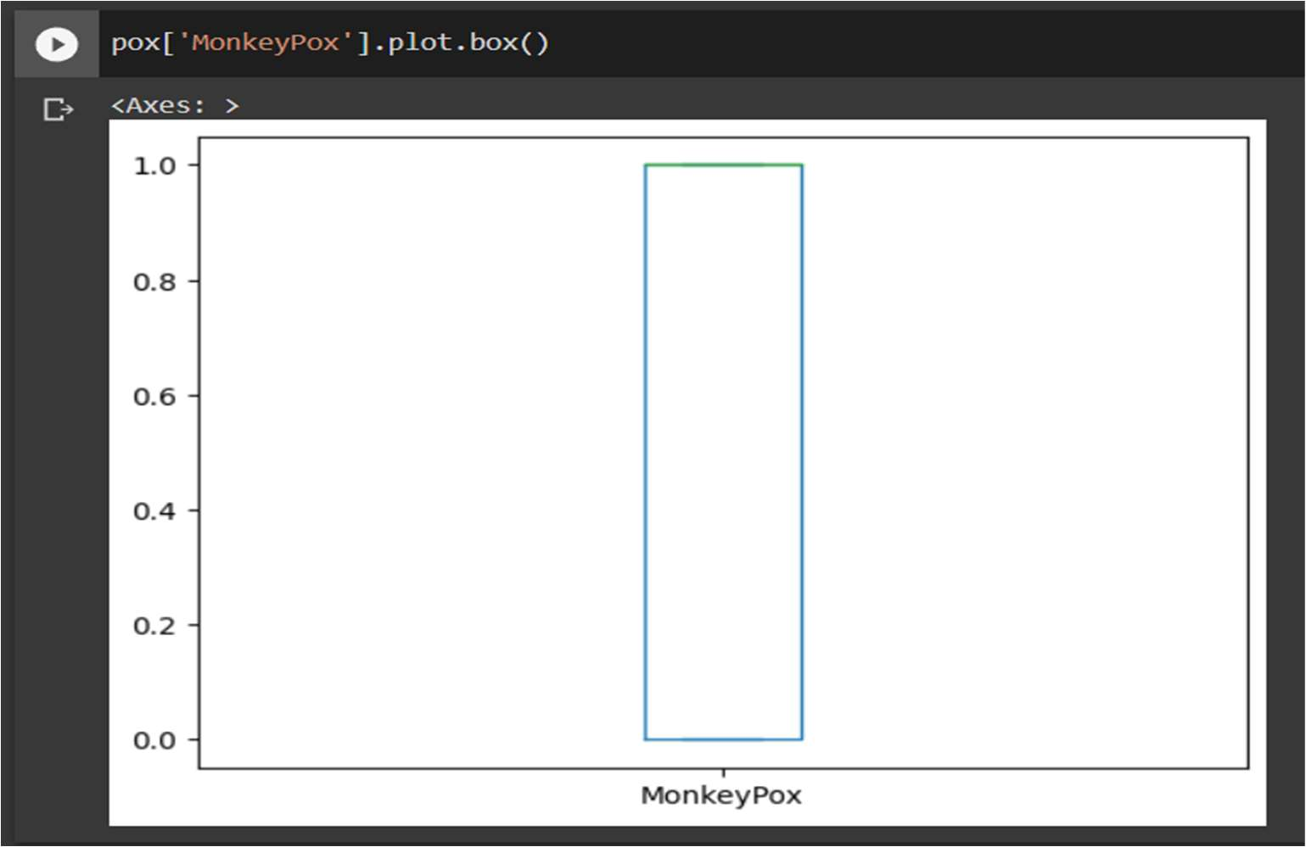
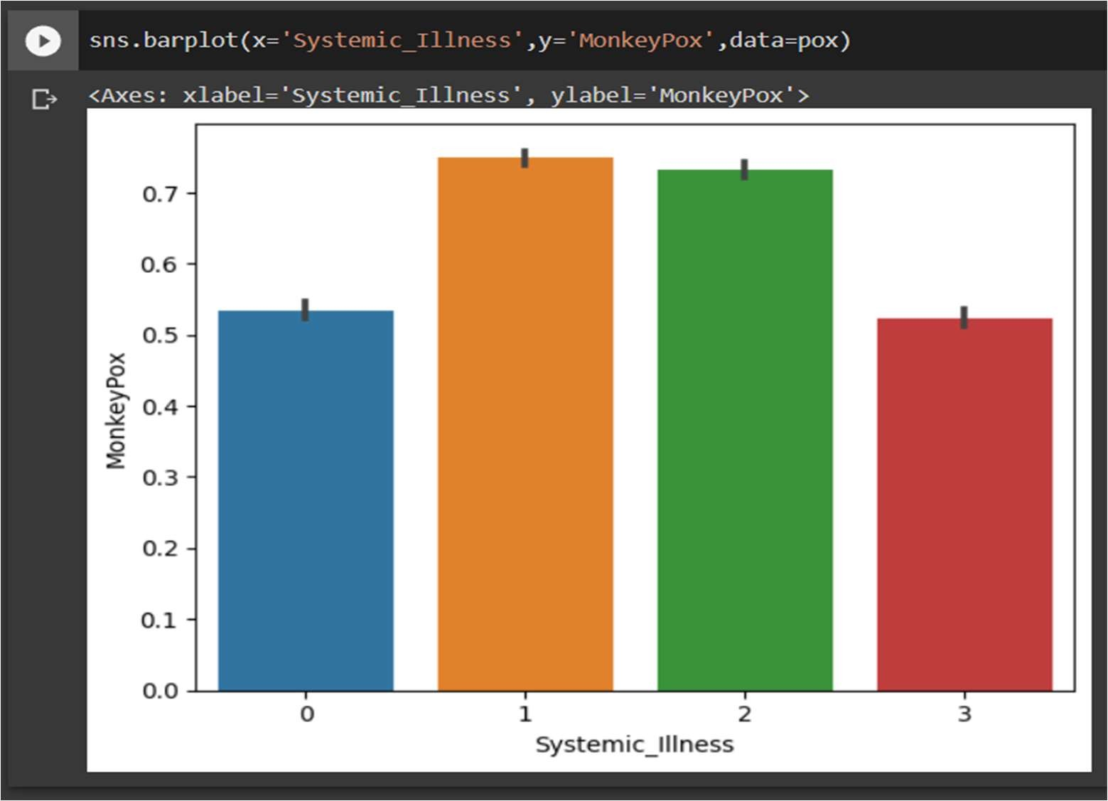
Box plot for the Monkeypox (Result Attribute)
Bar Plot representing result of monkeypox for systemic Illness symptoms

Slide 16
4. METHODOLOGY
4.1 Procedure to solve the given problem:
The first step in our methodology is to perform exploratory data analysis on the monkeypox dataset to gain a better understanding of the distribution and relationships among the features. This may involve visualizations, statistical analysis, and correlation analysis to identify important features and potential outliers.
Next, we will preprocess the data to prepare it for machine learning algorithms. This may involve scaling numerical features, converting categorical variables to binary indicators, and removing any redundant or irrelevant features. We will also split the data into training and testing sets to evaluate the performance of our model on unseen data.
We will then develop and train a machine learning model on the training set using algorithms such as logistic regression, decision trees, or random forests. We will tune the hyperparameters of the model using cross-validation techniques to optimize its performance. We will also evaluate the model's performance on the testing set using metrics such as accuracy, precision, recall, and F1-score.

Slide 17
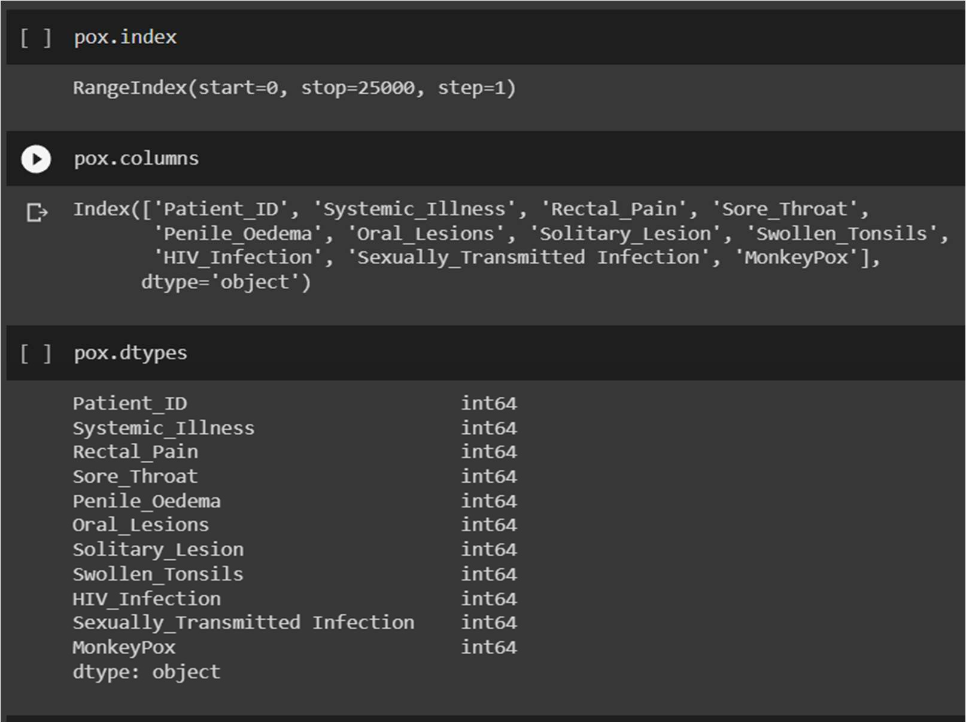
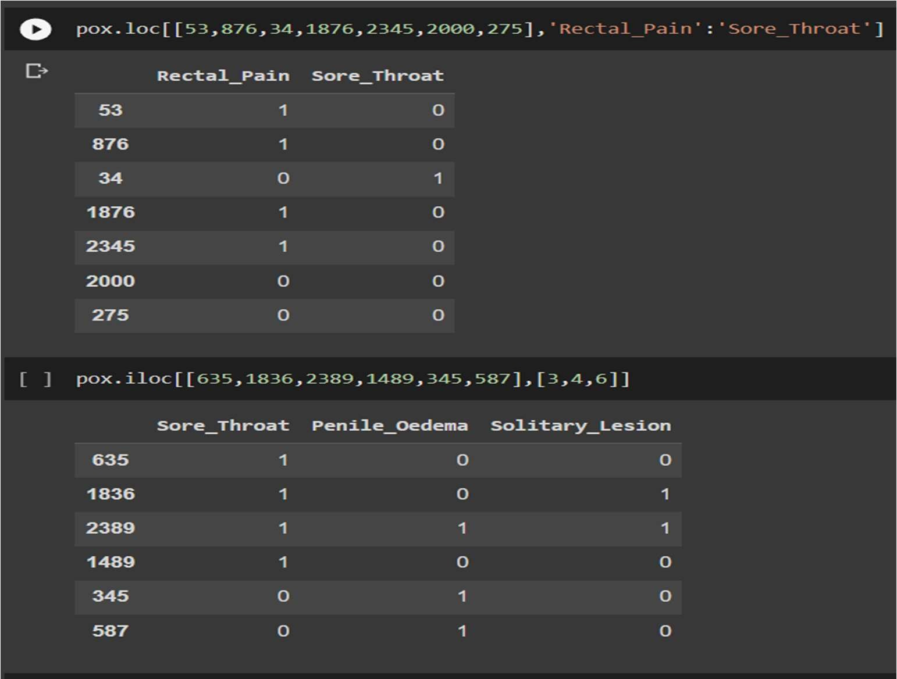
Finally, we will deploy the model in a user-friendly interface, such as a web application or mobile app, to facilitate its use by healthcare professionals. We will also continue to monitor and update the model as new data and features become available to improve its accuracy and generalizability.
Overall, our methodology involves a combination of exploratory data analysis, machine learning algorithms, and model explainability techniques to develop an accurate and interpretable model for diagnosing monkeypox infections.

Slide 18
Exploratory data analysis: the pre-processed data is then analyzed to identify patterns, trends, and relationships between different variables using various statistical and visualization techniques.
Model selection:
Logistic regression: logistic regression is a common classification algorithm used in healthcare applications. It is a linear model that estimates the probability of the binary target variable based on the input features. Logistic regression is a simple and interpretable algorithm that can handle both categorical and continuous features.
Decision trees: decision trees are a popular machine learning algorithm that can handle both classification and regression tasks. They partition the feature space into subsets that are most predictive of the target variable. Decision trees are easy to interpret and visualize, and can handle both categorical and numerical features.
Random forests: random forests are an ensemble learning algorithm that combines multiple decision trees to improve the accuracy and generalization of the model. Random forests can handle both categorical and continuous features, and are robust to outliers and missing values.
Support vector machines (svms): svms are a powerful algorithm that can handle both linear and nonlinear classification tasks.

Slide 19
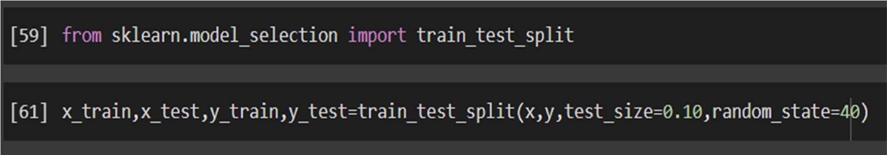
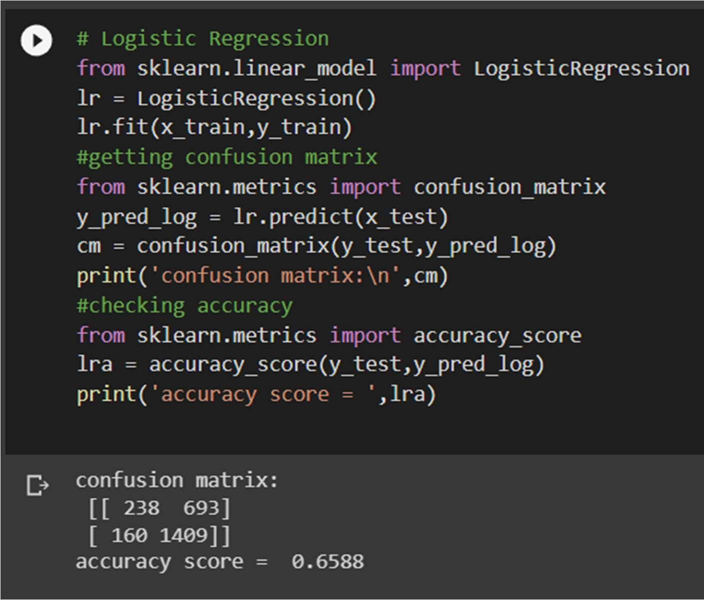
Model training and testing:
The model is trained on a subset of the data and tested on the remaining data to evaluate its performance. This involves techniques such as crossvalidation and hyper parameter tuning.

Slide 20
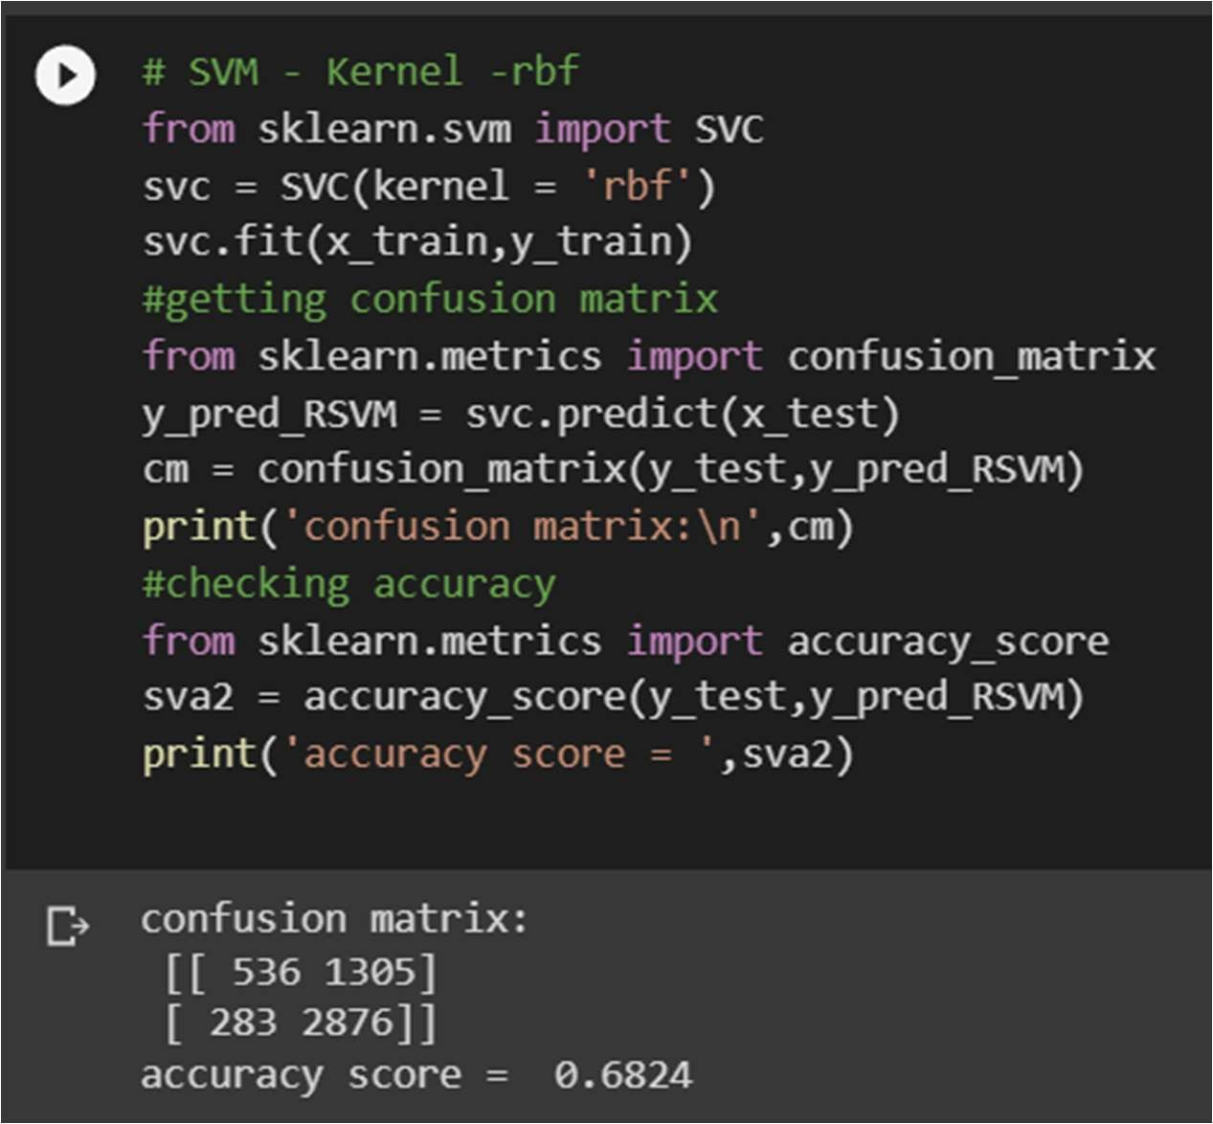
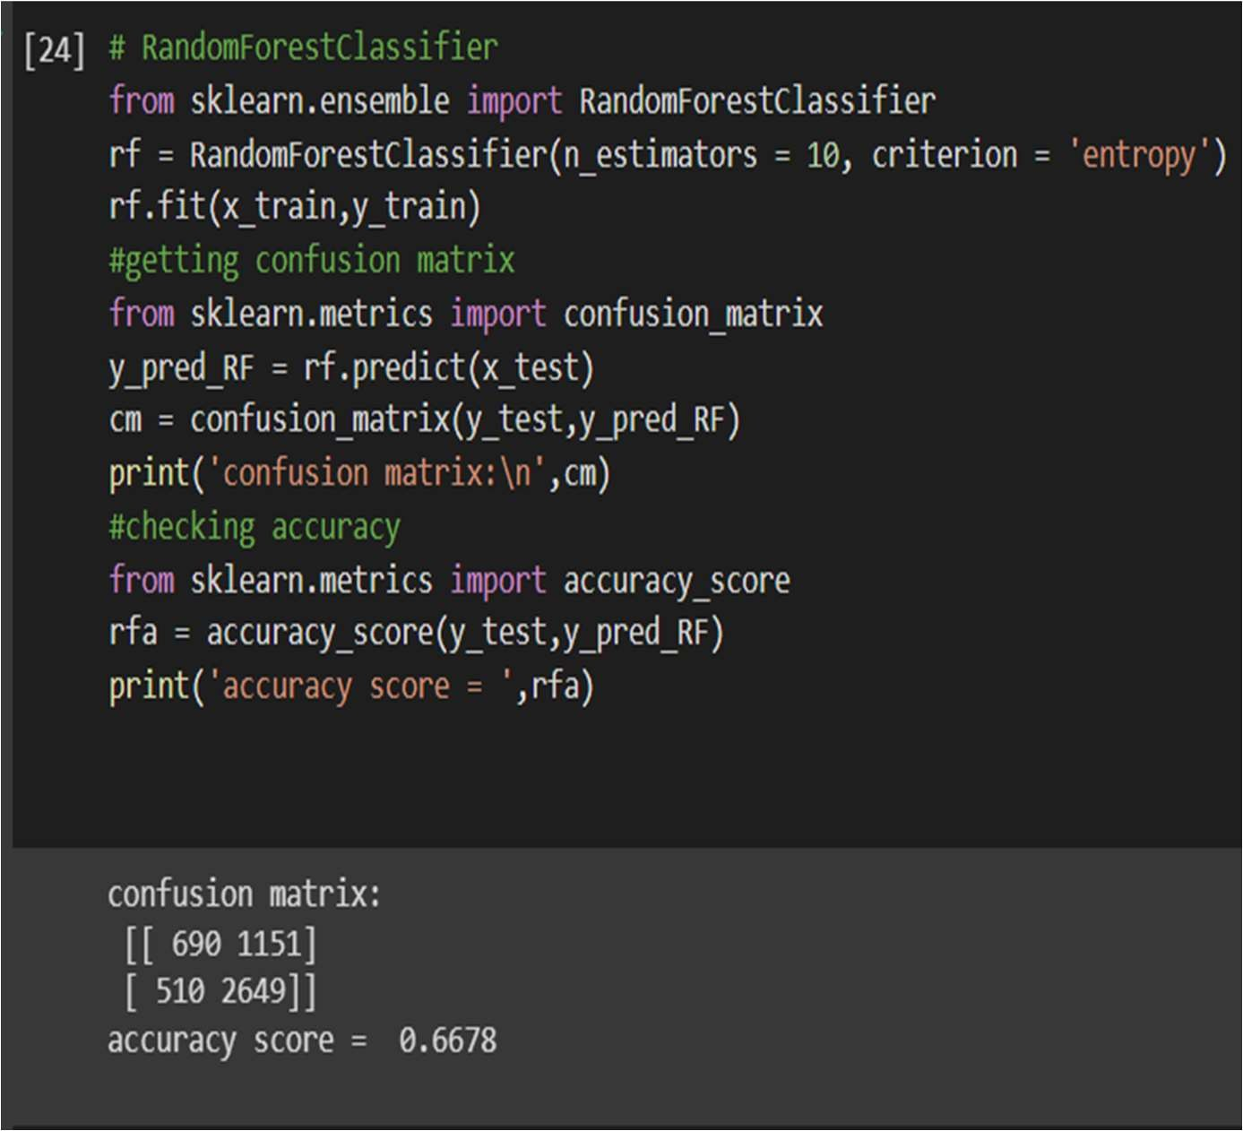

Slide 21
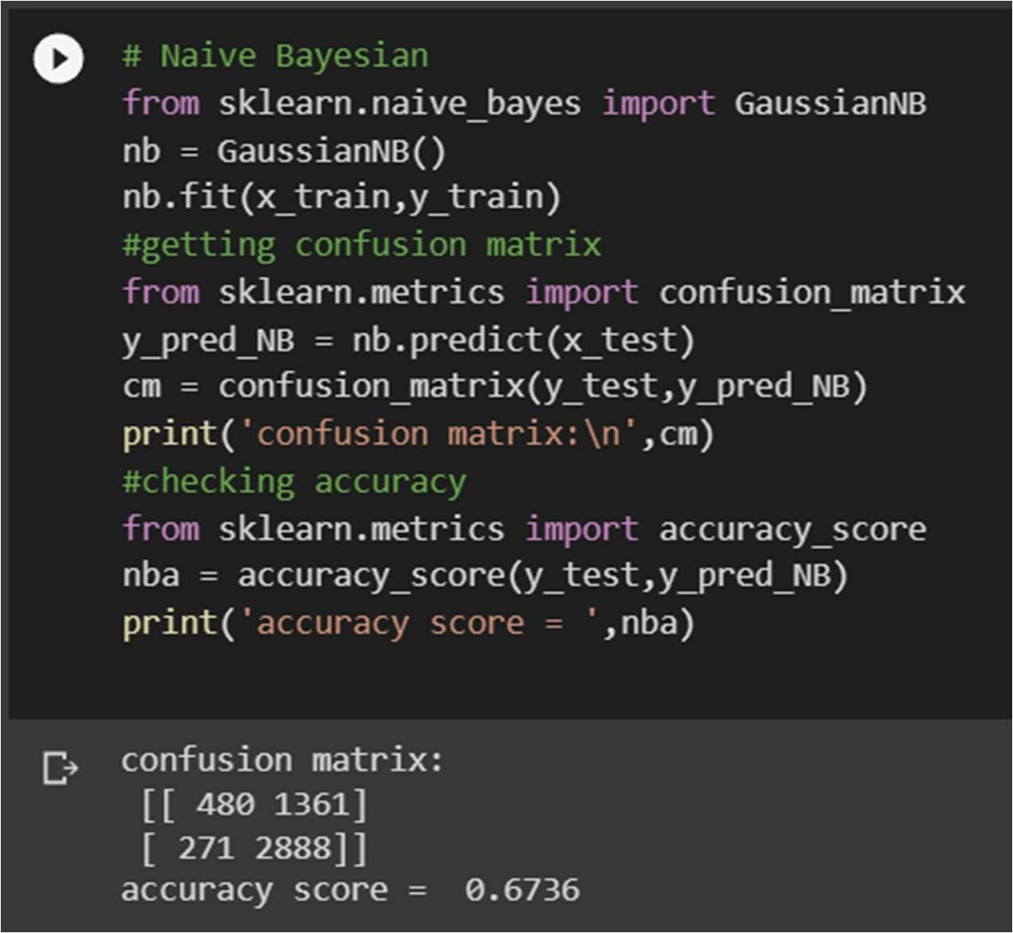
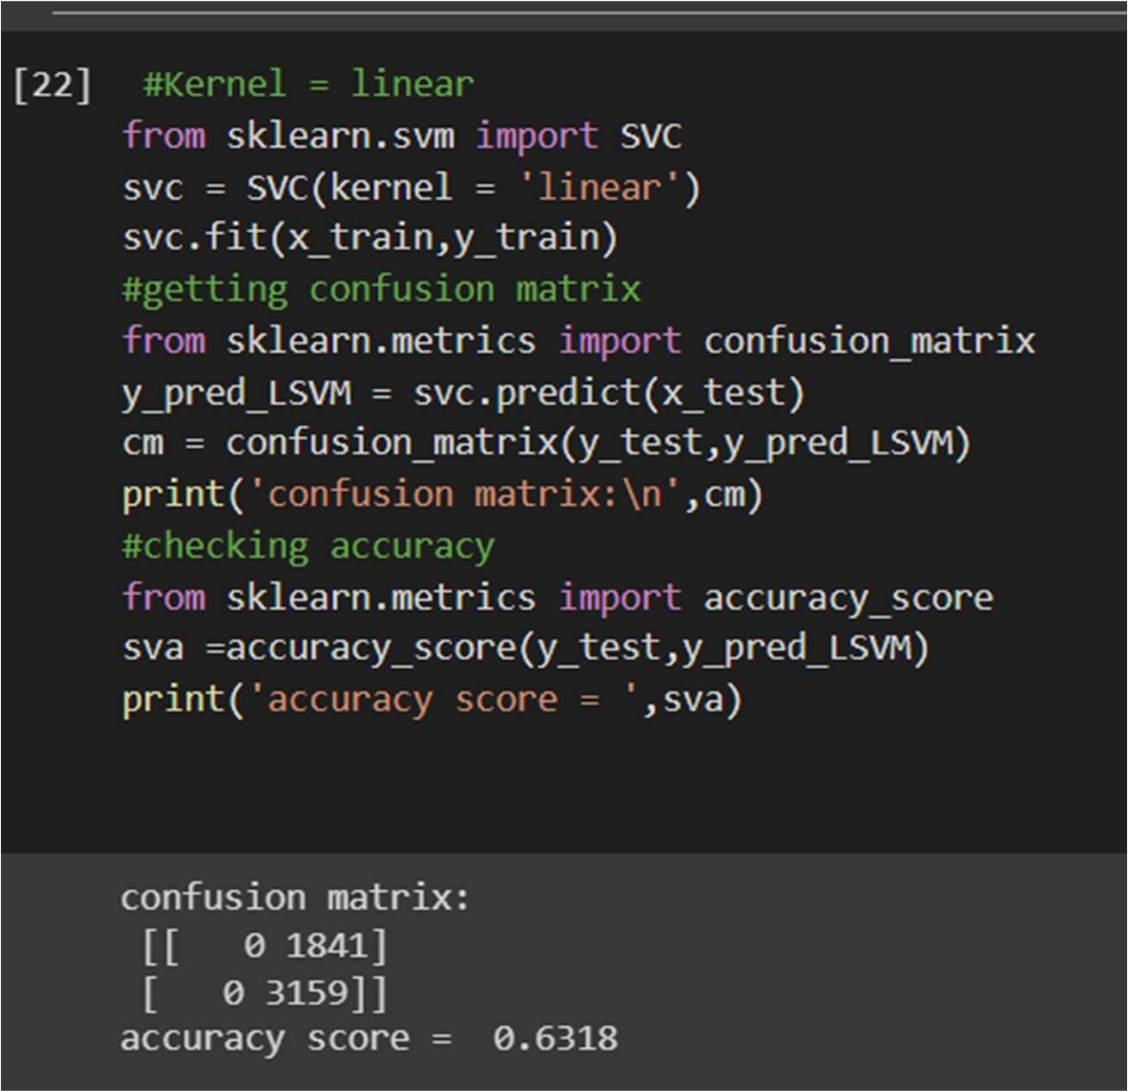

Slide 22
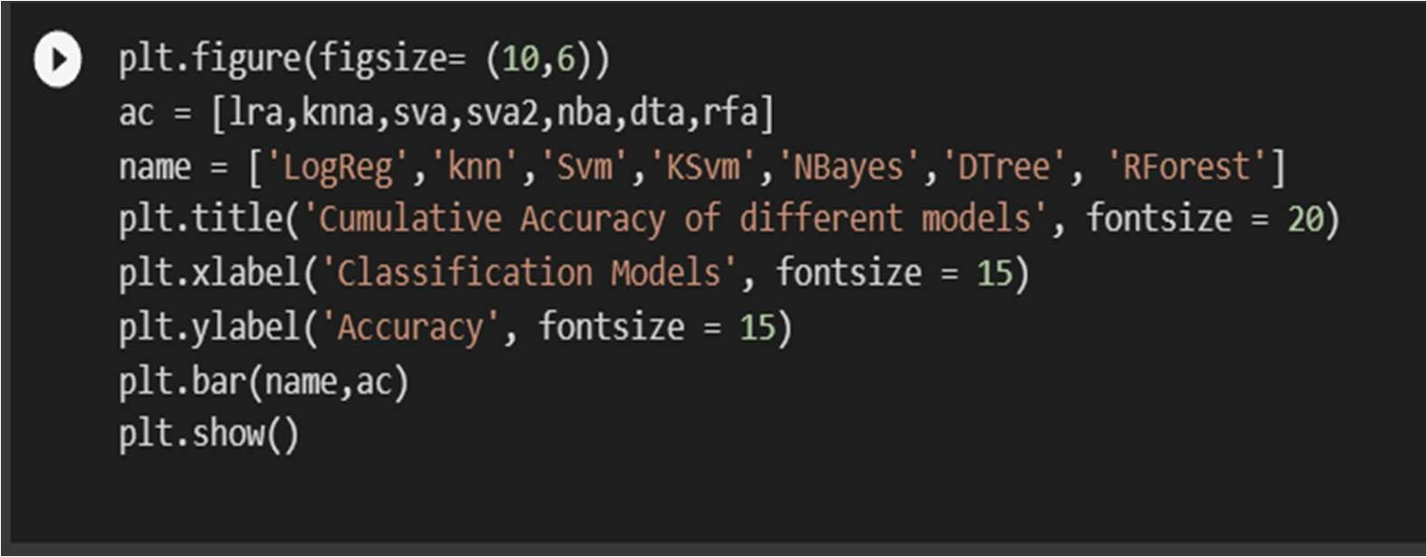
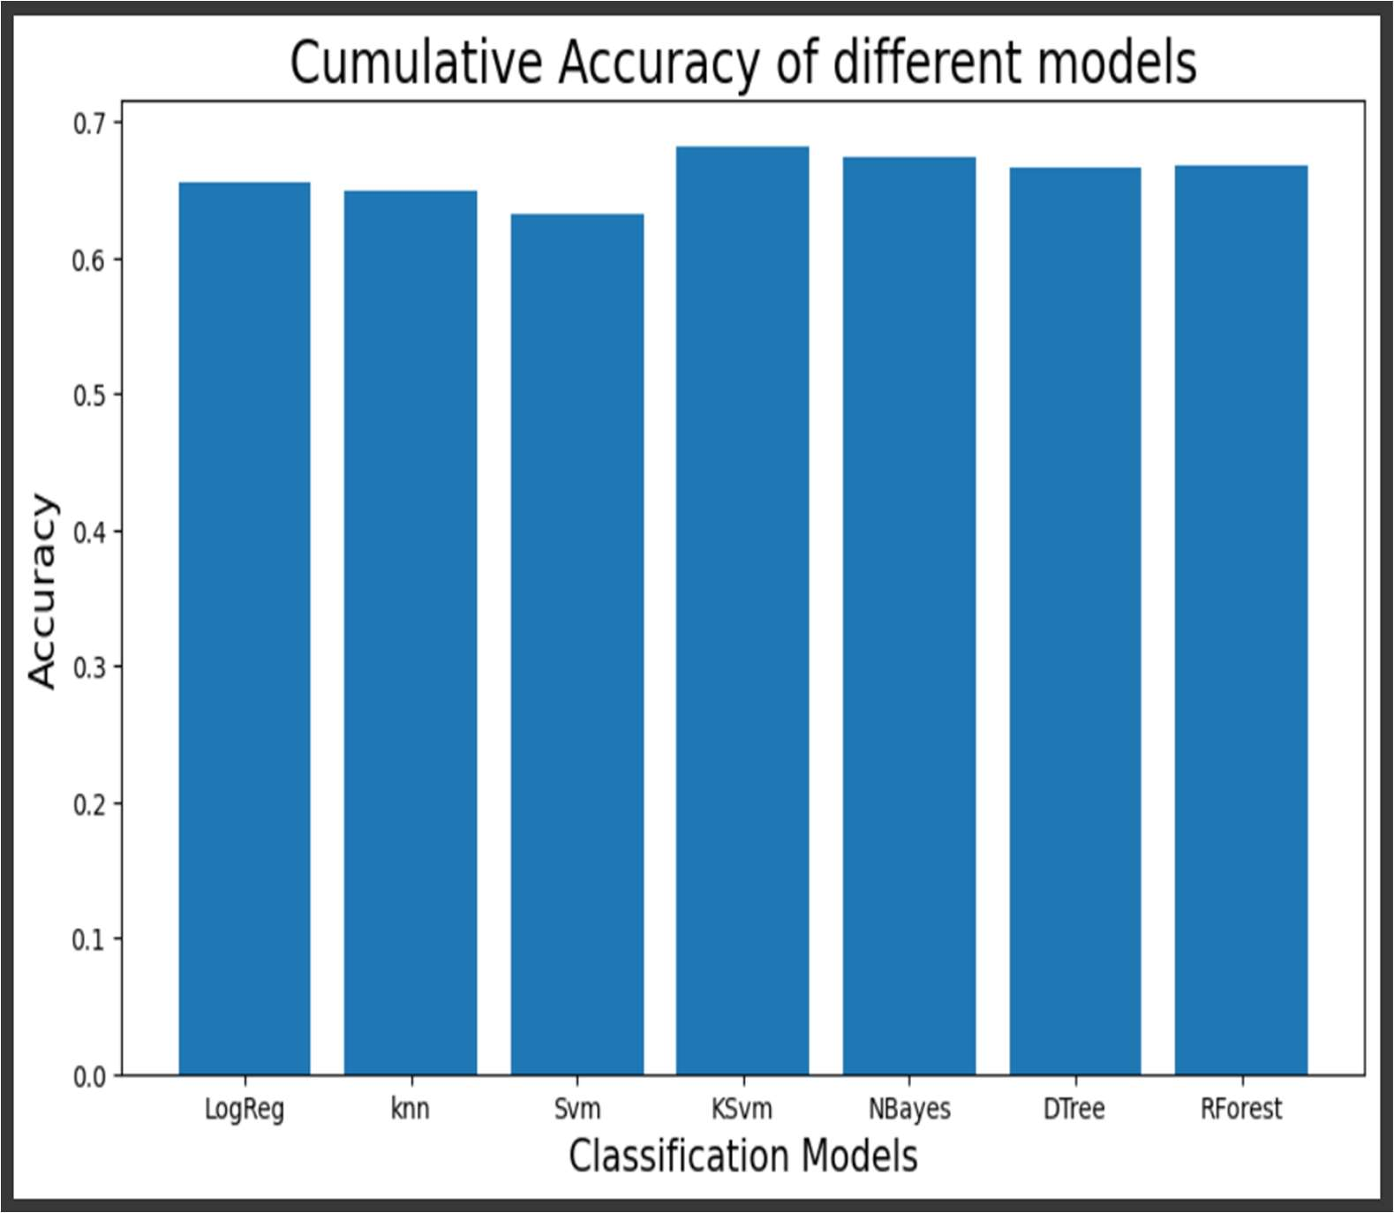
Model evaluation and analysis:
The evaluation and analysis of the model based on various algorithms can be understood by the below given bar graph.

Slide 23
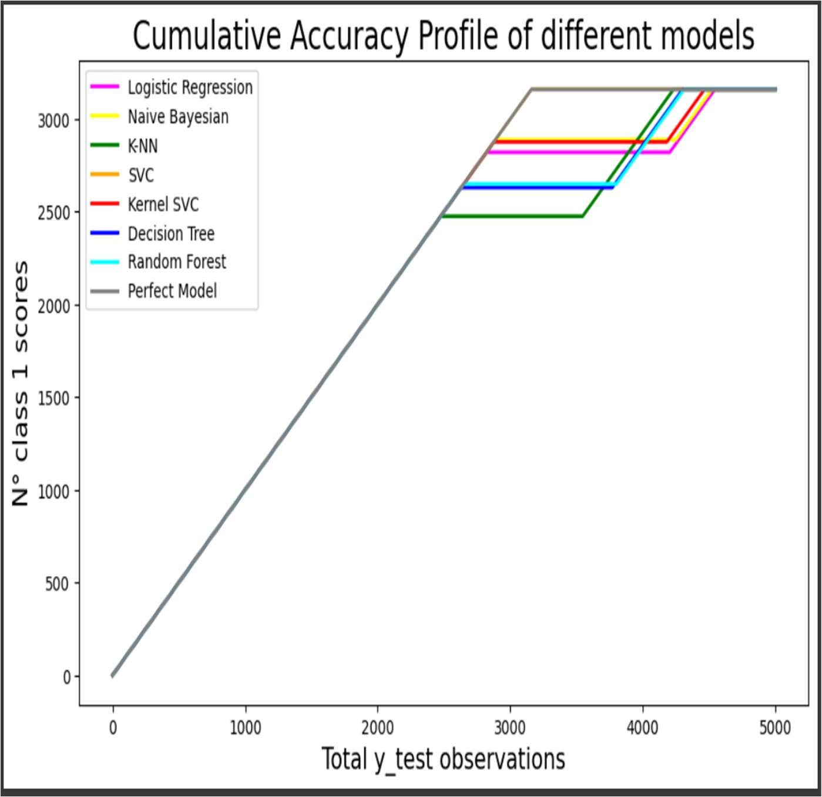
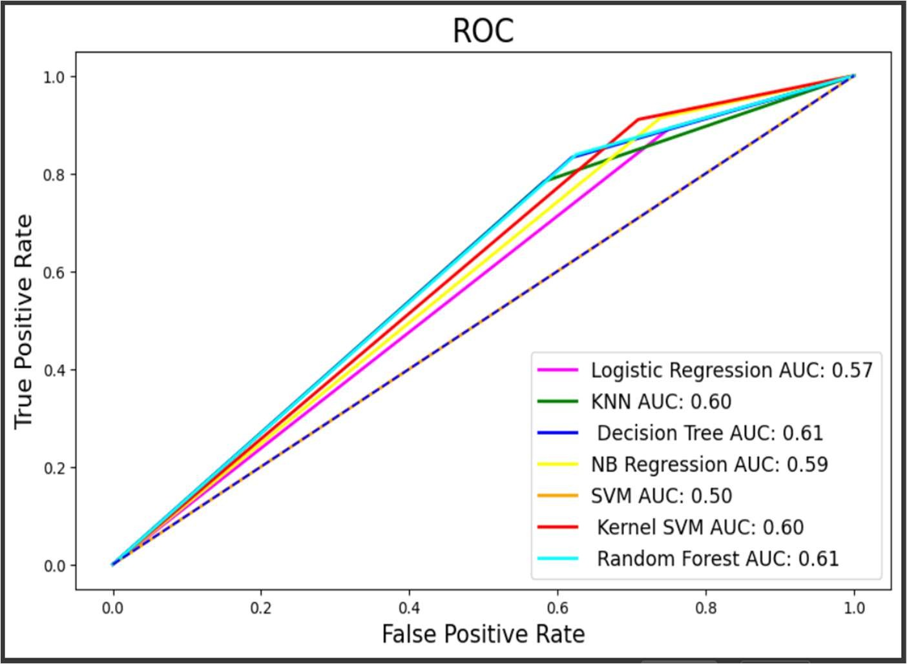

Slide 24
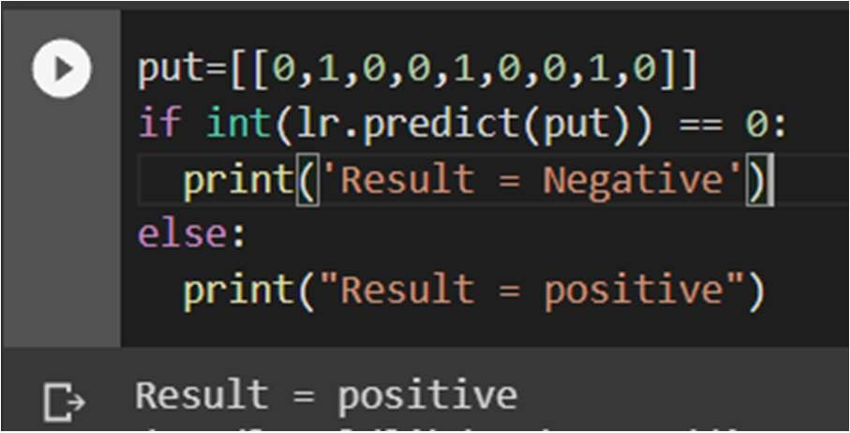
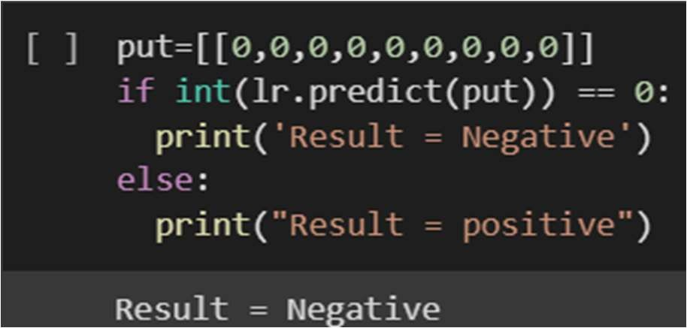
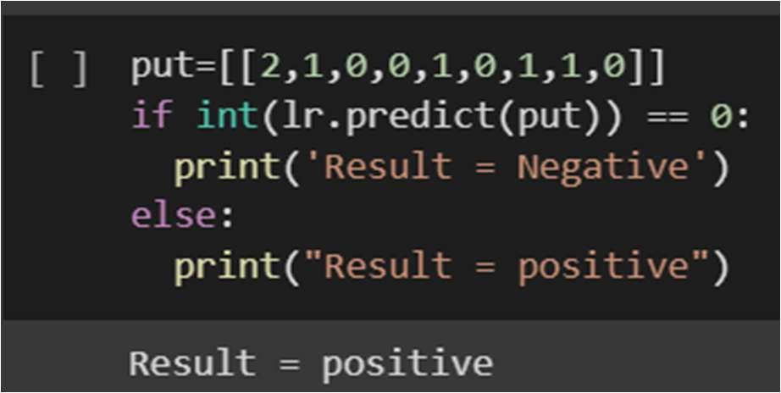
Prediction and forecasting:
The final step is to use the trained model to predict the number of confirmed cases, deaths, and recoveries for future time periods based on the historical data. These predictions can be used to guide public health interventions to control the spread of the disease.

Slide 25
4.2 Model Architecture
The model architecture of our model is as follows.
Data Collection: Collect data on individuals diagnosed with monkeypox, including demographic information, symptoms, and laboratory test results.
Data Preprocessing: Clean and preprocess the collected data by handling missing values, encoding categorical variables, and normalizing numerical features.
Feature Selection: Identify the most important features and symptoms for predicting monkeypox infections, and select them for use in training the model.
Model Training: Train a classification model using machine learning algorithms such as logistic regression, decision trees, random forests, or neural networks. Use a portion of the data for validation and testing to ensure the model's accuracy and generalizability.
Model Optimization: Optimize the model's performance by selecting appropriate hyperparameters and tuning the machine learning algorithms.
Model Validation: Validate the model's accuracy and generalizability using independent datasets from different regions or populations.

Slide 26
Model Evaluation: Evaluate the model's clinical utility and potential impact on public health by estimating its sensitivity, specificity, positive predictive value, negative predictive value, and other relevant metrics.
Model Integration: Integrate the model into existing healthcare systems and provide guidance on its use for healthcare professionals and public health authorities.
Model Monitoring and Updating: Continuously monitor and update the model as new data and information become available to ensure its continued accuracy and relevance.

Slide 27
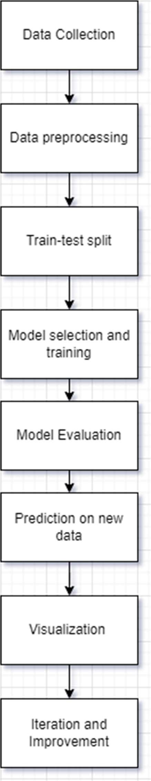
The model architecture can also be represented with the help of a block diagram

Slide 28
4.3 Software description
This project is developed using Jupyter Notebook, which is a popular webbased interactive development environment for creating and sharing data science projects. The code is written in Python programming language and uses several Python libraries, including Pandas, NumPy, Scikit-learn, Matplotlib, and Seaborn.
Jupyter Notebook: Jupyter Notebook is an open-source web application that allows users to create and share documents that contain live code, equations, visualizations, and narrative text. It supports many programming languages, including Python, which is commonly used for machine learning. Jupyter Notebook allows users to interactively develop and test their code, and to document their thought process and findings.
Google Colab: Google Colab is a cloud-based Jupyter Notebook environment that allows users to run their code on Google's servers for free. It comes with pre- installed packages and libraries, such as NumPy, Pandas, Matplotlib, and Scikit- Learn, which are commonly used in machine learning. Google Colab allows users to easily share their work with others and to collaborate in real-time.

Slide 29
5. RESULTS AND DISCUSSION
To evaluate the performance of our model, we could split our dataset into training and testing sets, with the majority of the data used for training and the remaining portion used for testing. We could then train our model on the training set using different machine learning algorithms, such as logistic regression, decision trees, random forests, and support vector machines, and evaluate their performance on the testing set using metrics such as accuracy, precision, recall, and F1 score.
Once we have trained and tested our model, we could analyze its performance and discuss its strengths and weaknesses. For example, we could compare the performance of different machine learning algorithms and choose the one that provides the best results. We could also analyze the feature importance of our model and identify the most important symptoms for predicting monkeypox infections.
Overall, the results and discussions of our model could provide valuable insights into the diagnosis and management of monkeypox infections, as well as into the potential applications and limitations of machine learning in healthcare.

Slide 30
6.CONCLUSION AND FUTURE SCOPE
In conclusion, the proposed machine learning model for diagnosing MonkeyPox infection has the potential to provide an accessible and affordable tool for healthcare proffesionals to accurately diagnose the disease. By training the model on a dataset of symptoms and corresponding disease outcomes, the model can predict wheather a patient has contracted monkeypoxbased on their presenting symptoms.
This project is developed with the knowledge of artificial intelligence and machine learning. The dataset we collected, would contain information about individuals who have been diagnosed with monkeypox, including their symptoms and test results. The symptoms would likely be represented as boolean values (1 for present, 0 for absent) and the test results would indicate whether the individual tested positive or negative for the virus.

Slide 31
In addition, the proposed model has the potential for broader applications beyond monkeypox diagnosis. By utilizing similar methods, healthcare professionals could develop models for diagnosing other diseases based on symptoms, such as malaria or dengue fever. The model could also be used to identify patterns in disease outbreaks and predict potential disease spread, enabling healthcare professionals to better prepare and allocate resources.
Overall, the proposed machine learning model has the potential to revolutionize healthcare diagnosis and management. By providing accessible and accurate diagnoses based on symptoms, the model could help to prevent the spread of infectious diseases and improve patient outcomes. With further research and development, machine learning could become an essential tool for healthcare professionals in combating a variety of diseases.

Slide 32
7. REFERENCES
Dataset Collection Referrence website: www.kaggle.com/datasets/jhondare01/monkeypox-dataset
For some qweries and clarifications: https://chat.openai.com/
Pandas documentation. (2021). Retrieved from https://pandas.pydata.org/docs/
NumPy documentation. (2021). Retrieved from https://numpy.org/doc/stable/
Scikit-lear documentation. (2021). Retrieved from
https://scikitlearn.org/stable/documentation.html
Matplotlib documentation. (2021). Retrieved from
https://matplotlib.org/stable/contents.html
Seaborn documentation. (2021). Retrieved from https://seaborn.pydata.org/

