Slide 1
Link Prediction in Multiplex Networks
An Attention-Based Graph Neural Network
Umm E Farwa Syeda
Notes:
My thesis is on link prediction in multiplex networks using an attention-based graph neural network. I will walk you through what I did, from the dataset to my proposed model and results.

Slide 2
What problem am I solving?
The task
• Predict future collaborations between researchers — like 'people you may know', but for research.
The setting a multiplex network
• The same researchers are connected across 13 research-domain layers (physics, math, biology, ...).
• Each layer is one domain a link means two researchers co-authored a paper.
The hard, valuable case
• Bridge links pairs from different fields with no collaborators in common yet the most interesting to predict.
Notes:
In simple terms, I built a system that looks at two researchers and predicts whether they will collaborate. The data is multiplex: the same people connected across 13 research fields. The most valuable and hardest links are bridges - between people from different fields who have no common collaborators yet.

Slide 3
Why is this hard? (The gap)
Old methods count shared connections
• Classical heuristics score a pair by how many neighbours (collaborators) they share.
• On bridge links there are NO shared neighbours, so they score zero and become RANDOM (ROC-AUC = 0.5).
They ignore the cross-layer structure
• Most methods look at each field separately and waste the information shared across fields.
So I needed a model that:
• (1) can see bridge links, (2) combines all 13 layers, (3) stays interpretable.
Notes:
The problem is that old methods rely on shared neighbours. On bridges there struggles, so they are basically guessing. They also treat each field separately. So I needed a model that can handle bridges, combine all layers, and still be understandable.

Slide 4
The dataset
arXiv Net science multiplex co-authorship network
• 13 layers each a research domain (physics, math, condensed matter, quantitative biology, ...).
• About 14,065 researchers (nodes); links = co-authorships.
• The same researcher keeps the same identity across all 13 layers.
The challenge
• The dataset has NO node attributes no ready-made information describing each researcher.
Notes:
I used the arXiv Netscience multiplex dataset - 13 research domains, about 14 thousand researchers. The same person appears in every layer. The challenge was that it has no node attributes, so I had to create the features myself.

Slide 5
Node features I engineered them from the graph
Since there were no attributes, I built 6 structural (graph) features per researcher:
• Degree centrality — how many collaborators a researcher has.
• PageRank — how important they are, based on their collaborators' importance.
• Clustering coefficient — how tightly their collaborators are connected.
• K-core number — how deep in the dense core of the network they sit.
• Betweenness centrality — how often they act as a bridge between others.
• Eigenvector centrality — how connected they are to other important researchers.
Why this matters:
• These describe each researcher's role in the network and I gave the SAME 6 features to every model, so the comparison is fair.
Notes:
Because the dataset had no features, I engineered six structural features from the graph itself - degree, pagerank, clustering, k-core, betweenness, and eigenvector centrality. These describe each researcher's position in the network. Importantly, I gave the same six features to every model, so any difference in results comes from the model, not from better input.

Slide 6
How I set up a fair experiment
Train / Validation / Test split (per layer)
• 70% train (model learns), 10% validation (tune settings), 20% test (final, hidden exam).
Negative edges
• I created fake (non-existing) links, so each model is judged on separating real links from fake ones.
Leakage-free & fair
• All structure computed on the training graph only decision thresholds tuned on validation, never on test.
Notes:
For each layer I split the links into train, validation, and test. I also created fake links as negative examples. Everything was leakage-free - I used only training data to build the graph, and tuned thresholds on validation, never on the test set.

Slide 7
Baselines
How I built each one, and what I learned
Notes:
Now the baselines. I did not build these only to compare - each one taught me something that shaped my final model.

Slide 8
Classical baselines (similarity-based)
Method — score a pair by shared neighbours:
• Common Neighbours = count of shared collaborators.
• Jaccard = shared / total collaborators.
• Adamic–Adar = shared neighbours weighted by 1 / log(degree).
• Preferential Attachment = degree(u) × degree(v).
Runs: deterministic — a single run (no randomness).
Results (avg ROC-AUC): AA / CN / Jaccard ≈ 0.87; Pref. Attachment ≈ 0.60.
What I learned strong on ordinary links, but RANDOM (0.5) on bridge links.
Notes:
The classical methods score pairs by shared neighbours. They are deterministic - one run. They reached about 0.87 ROC-AUC on ordinary links, but I found their key weakness: on bridges they are exactly 0.5, random. This insight motivated my whole thesis.

Slide 9
Node2Vec (embedding baseline)
Method
• Learns a 64-number embedding for each node from biased random walks (like word embeddings).
• The embeddings of two nodes are combined and a logistic-regression classifier predicts the link.
Runs: 5 seeds.
Result: ROC-AUC ≈ 0.849 (also strong on PR-AUC and F1).
What I learned: embeddings help, but Node2Vec ignores node features, is not trained for the task, and treats each layer separately.
Notes:
Node2Vec learns embeddings from random walks, then a classifier predicts links. I ran it with 5 seeds. It reached 0.849 ROC-AUC and was strong on PR-AUC and F1. But it ignores the node features, isn't trained directly for link prediction, and treats each layer separately.

Slide 10
GNN baselines: GCN and GAT
Method — learn node embeddings by combining neighbours' information:
• GCN — combines neighbours with EQUAL weight.
• GAT — uses ATTENTION to weight neighbours differently (some matter more).
• Both used the same 6 features + an MLP decoder to score links.
Runs: 5 seeds each.
Results (avg ROC-AUC): GAT ≈ 0.822, GCN ≈ 0.767.
What I learned: GAT (attention) was my strongest baseline — but both still process each layer alone and have no sense of bridges.
Notes:
Then the graph neural networks. GCN combines neighbours equally; GAT uses attention to weight them. Both got the same six features and were run with 5 seeds. GAT was my strongest baseline at 0.822. But even GAT processes each layer alone and has no explicit sense of bridges.

Slide 11
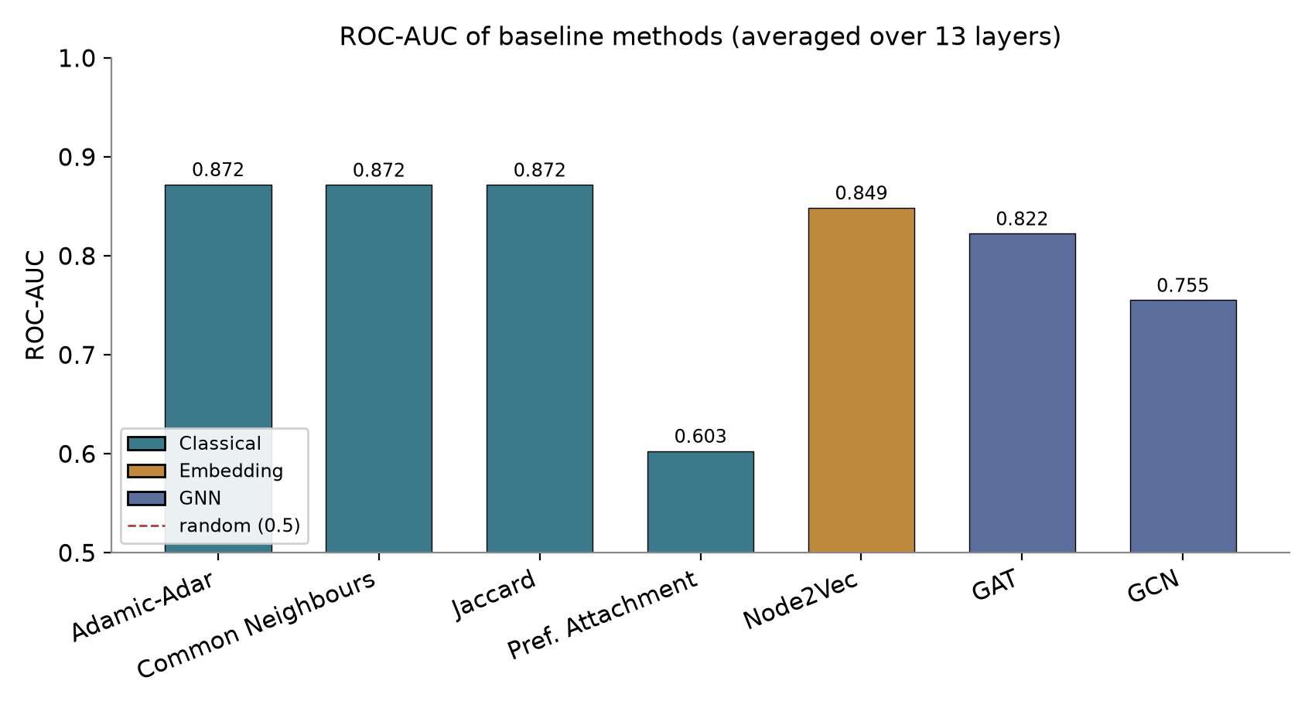
Baseline results & what they taught me
The lessons that shaped my model:
• Classical → fail on bridges.
• Node2Vec → ignores features & layers.
• GCN → treats neighbours equally.
• GAT → attention helps, but single-layer, no bridges.
→ I need: attend to bridges + combine all layers + interpretable.
Notes:
This chart shows all the baselines. The pattern is clear. Each one taught me a lesson: classical fail on bridges, Node2Vec ignores features and layers, GCN treats neighbours equally, GAT has attention but is single-layer. Together these told me exactly what my model needed.

Slide 12
My Proposed Model
Attention across layers, with a weak-tie signal for bridges
Notes:
Based on those lessons, I designed my model.

Slide 13
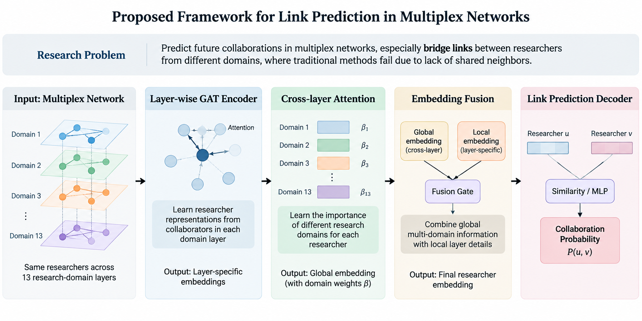

Slide 14
My model — three components
1. Weak-tie GAT encoder (per layer)
• Builds a profile of each researcher; injects a weak-tie score (1 − Jaccard) into the attention, so it pays special attention to bridging connections.
2. Cross-layer attention (β)
• Combines each researcher's 13 layer-profiles into one, learning how important each domain is — this also makes it interpretable.
3. Fusion gate
• Blends each domain's local profile with the global cross-layer profile (sparse layers borrow strength, keep their own detail).
A decoder then compares two profiles → collaboration score. Trained end-to-end, with 5 seeds.
Notes:
My model has three parts. First, a weak-tie-aware GAT encoder for each layer - the novel part is that I inject a weak-tie score into the attention, so it focuses on bridges. Second, a cross-layer attention that combines all 13 domains and learns which matter most - this makes it interpretable. Third, a fusion gate that blends local and global information. A decoder then compares two profiles and outputs a score. It's trained end-to-end with 5 seeds.

Slide 15
How a prediction is made (the flow)
1
6 structural features (per researcher, per layer)
↓
2
Weak-tie GAT encoder — message passing (2 hops) → 13 profiles
↓
3
Cross-layer attention (β) → 1 fused profile
↓
4
Fusion gate (local + global) → final profile per layer
↓
5
Decoder compares two profiles → collaboration score (0–1)
Notes:
Here is the flow. Each researcher starts with 6 features. The encoder builds 13 profiles through message passing. Cross-layer attention merges them into one fused profile. The fusion gate blends local and global. Finally, the decoder compares two researchers and gives a score. This is the same pipeline for training and testing.

Slide 16
How I evaluated everything
Five metrics, from three different angles:
• ROC-AUC — overall separation of real vs fake links (main metric).
• PR-AUC — focuses on the rare positive links (honest under imbalance).
• F1-score — quality of the final yes/no decision (threshold tuned on validation).
• Hits@K and MRR — ranking quality (is the true link near the top?).
Statistical rigour
• Neural models run with 5 random seeds; a paired t-test checks the improvement is real, not luck.
Notes:
I evaluated with five metrics from three angles - probability separation, decision quality, and ranking - so no single metric could bias the conclusion. And I ran 5 seeds with a paired t-test to make sure my improvement is statistically real, not luck.

Slide 17
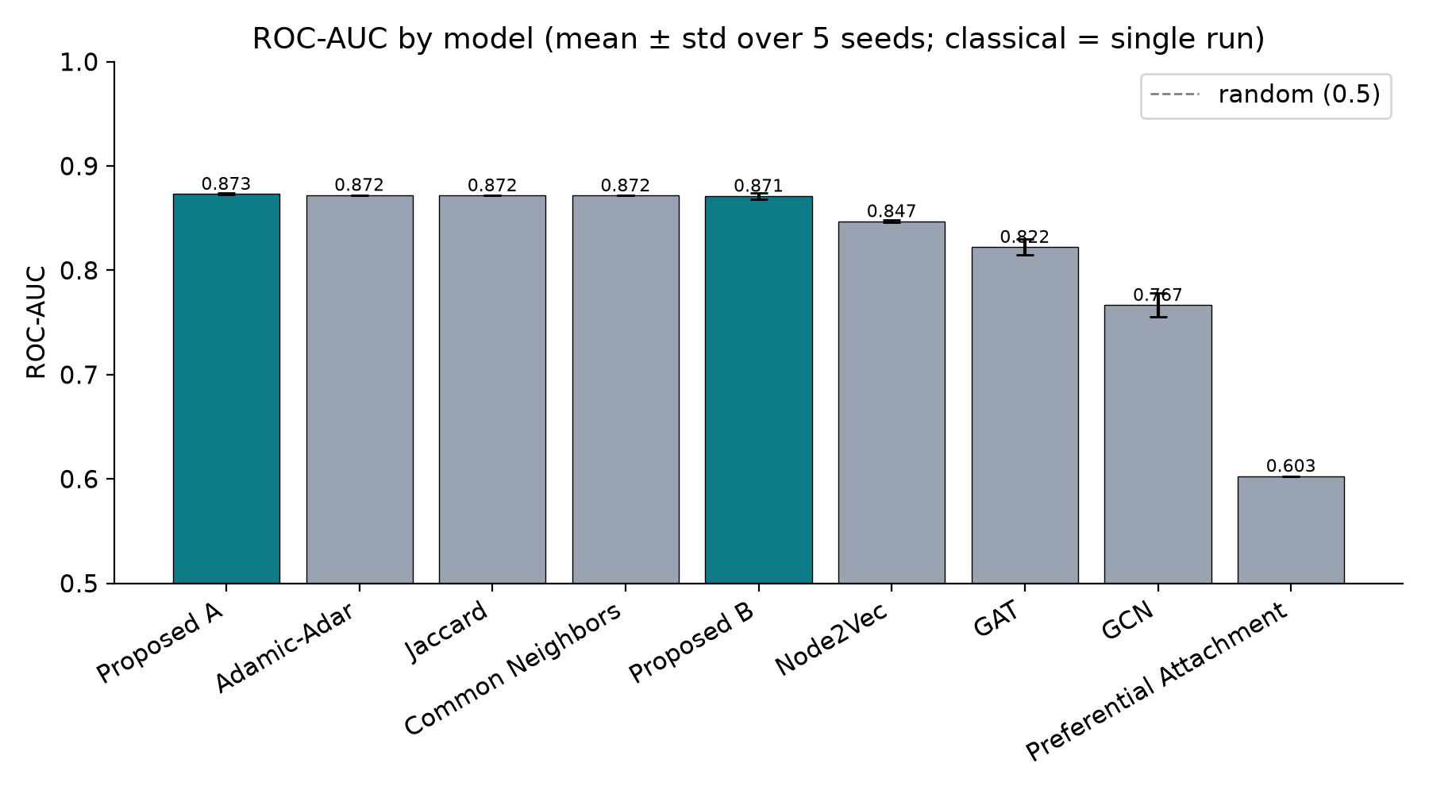
Overall results
My model leads on ROC-AUC:
• Proposed ≈ 0.873
• GAT 0.822 · GCN 0.767
Significantly beats GAT & GCN on all 3 metrics (paired t-test, p < 0.001).
Small ± std → very stable across seeds.
Notes:
On the main metric, ROC-AUC, my model leads at 0.873. It significantly beats the neural baselines GAT and GCN on all three classification metrics, with p below 0.001. The error bars are tiny, so it is very stable across seeds.

Slide 18
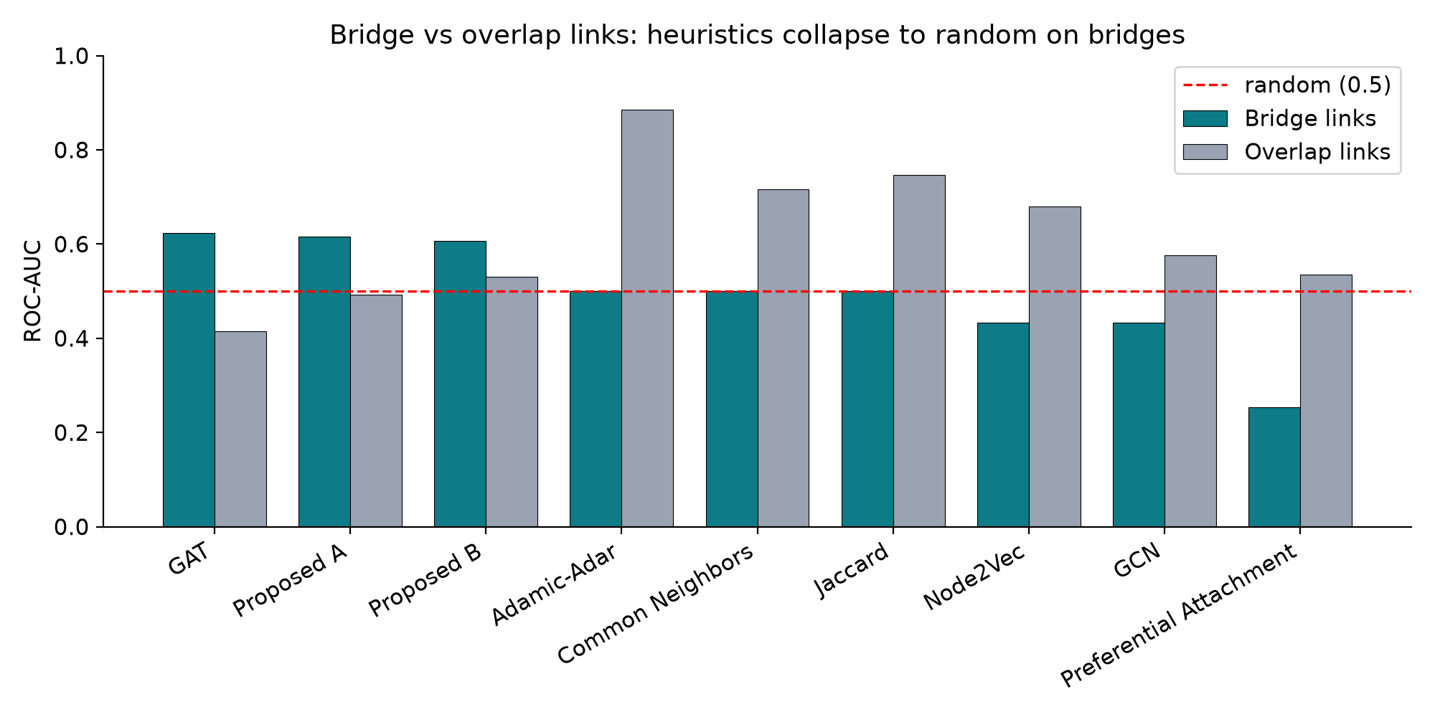
The key finding — bridge links
On bridge links:
• Classical = 0.5 (random)
• Node2Vec = 0.43
• My model = 0.615
It captures real signal exactly where the others fail.
Notes:
This is my most important result. On bridge links, the classical methods are exactly 0.5 - random - and Node2Vec is even below random. My model reaches 0.615. It captures real signal exactly where the others are blind. This is not just a small margin - it's the difference between working and not working.

Slide 19
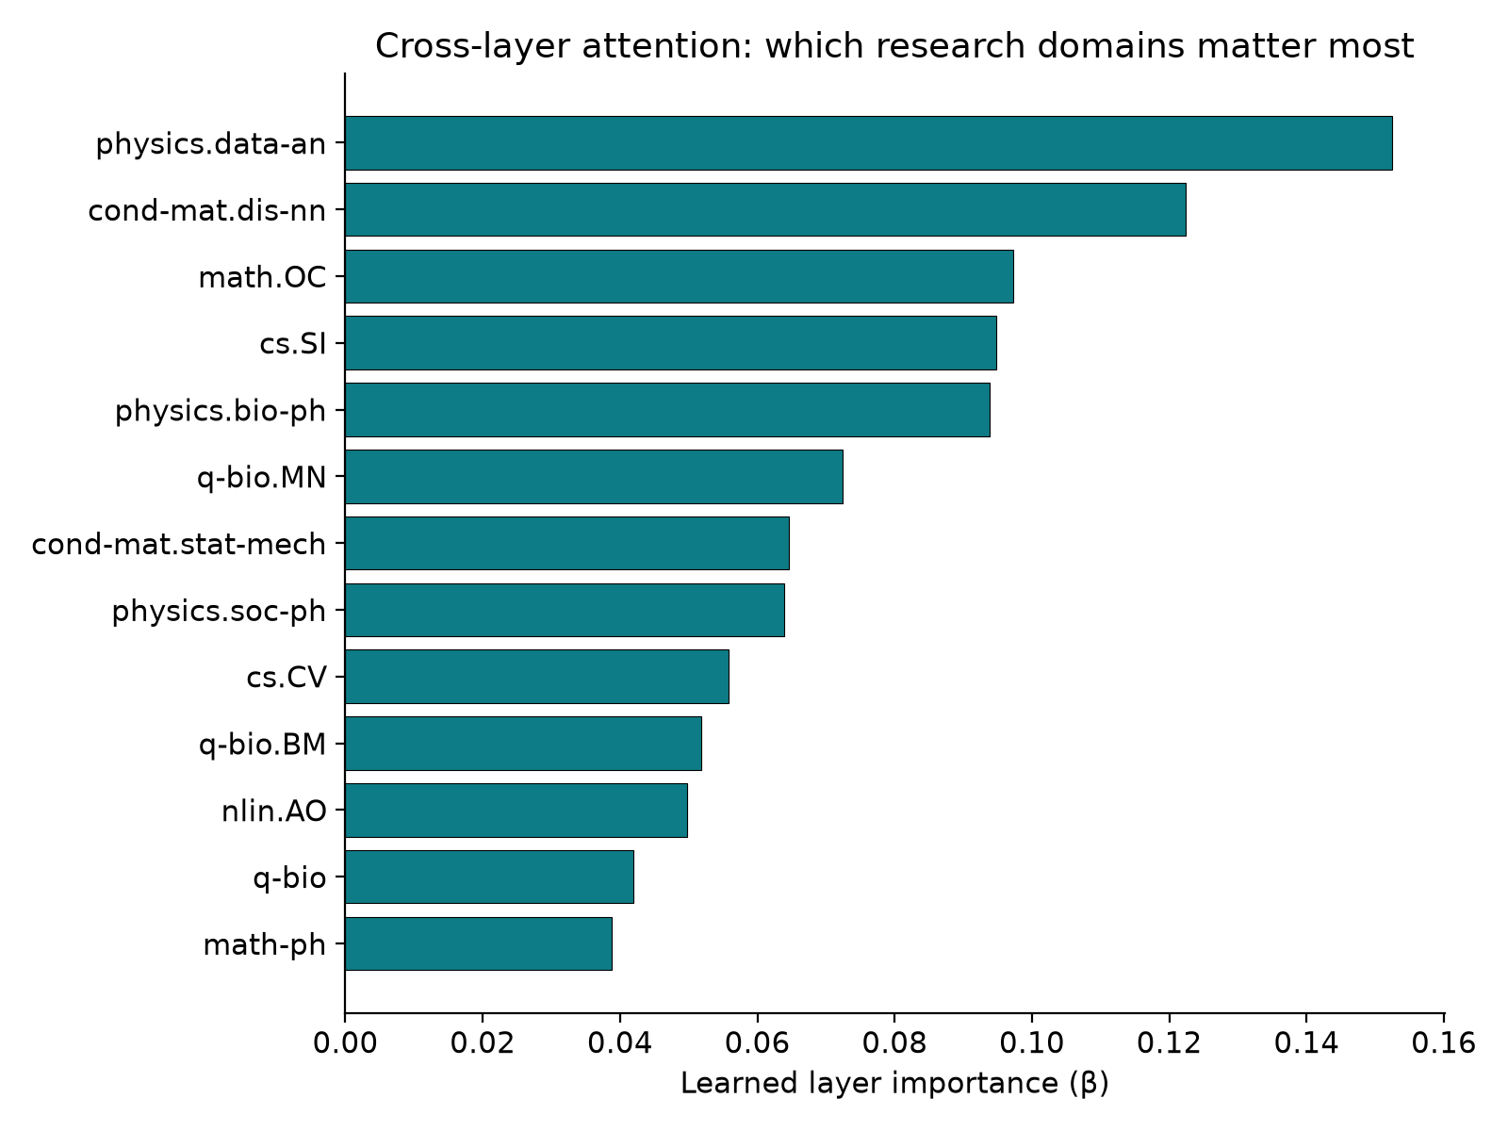
My model is interpretable
The cross-layer attention learns a weight (β) per domain.
• So I can show which research domains the model relies on most.
• e.g. physics.data-an (0.15) matters most math-ph (0.04) least.
Unlike a black-box GNN, this gives a clear explanation.
Notes:
Unlike most deep-learning models, mine is interpretable. The cross-layer attention learns an importance weight, beta, for each domain, so I can show which research fields the model relies on most. That is a clear, dataset-level explanation, not a black box.

Slide 20
Honest limitations
Where others win:
• On overall ROC-AUC I roughly tie the strongest classical methods.
• Node2Vec is better on PR-AUC and F1 (it ranks easy, dense pairs very well).
But — those methods collapse on bridges (0.5 or below).
So my contribution is:
• Best overall balance + genuine bridge prediction + interpretability + a significant, verified win over the neural baselines.
Notes:
To be honest about the limits: on overall ROC-AUC I roughly tie the classical methods, and Node2Vec wins on PR-AUC and F1. But those methods fail completely on bridges. So my contribution is the best overall balance, real bridge prediction, interpretability, and a significant, verified win over the neural baselines.

Slide 21
Conclusion
• I built an attention-based GNN for link prediction in multiplex networks.
• It attends to bridge links, combines all 13 layers, and is interpretable.
• It significantly beats the neural baselines (p < 0.001) and predicts bridges where classical methods are random.
Thank you.
Notes:
In conclusion, I built an attention-based GNN that attends to bridges, combines all 13 layers, and is interpretable. It significantly beats the neural baselines and predicts bridges where classical methods are random. Future work includes a ranking loss, hard-negative sampling, and testing on more datasets. Thank you - I'm happy to take questions.

