Slide 1

IUBAT-International University of Business Agriculture & Technology
Development of Bus Ticket Management System
Prepared for
Practicum Defense Committee
Department of Computer Science and Engineering , IUBAT
Date: /08/2023
Supervised by | Prepared By
Abdur Rahman | Md. Tanvir Hossain
Lecturer, Department of CSE | ID# 19303038

Slide 2
Table of Contents
Introduction
Project Objective
Organization Overview
Software Process Model
Requirement Engineering
System Planning & Scheduling
Analysis and Design
Live Demonstration
System Limitation and Future Works
Conclusion

Slide 3
Introduction
View Booking details
Book tickets
Payment in online
Print book ticket
Manage bus information
Manage counter information
Manage trip information
Generate Report
Bus Ticket Management System

Slide 4
Project Objective
To provide a user-friendly system for everyone.
To make automated system processes.
To minimize the length of work process.
To help admin manage bus and ticket.
To assist customer to view and book tickets without extra effort.

Slide 5

Organization Overview
Logic infotech Ltd is a full featured web solution, software development, digital marketing service providing company in Dhaka, Bangladesh.
Organization Services
Web Design & Development
Custom Web Applications
Mobile Application:
Domain and Hosting Service Provider
Digital Marketing:

Slide 6
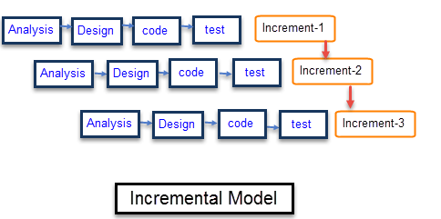
Software Process Model
Multiple Development Cycles take place in incremental model.
Customer can response to each build.
Flexible and less costly to change scope and requirements
Easy to manage risks and errors.

Slide 7
Requirement Engineering
User Requirements
System Requirements
Functional Requirements
Non-Functional Requirements

Slide 8
User and System Requirements
Admin
Customer
Customer need to do registration.
Customer need to login.
Customer can search ticket according to their demand.
Customer can book ticket.
Customer can give payment through online.
Customer will get ticket invoice in PDF.
Admin can view customer information.
Admin can view & print the report of customer.
Admin can add terminal information for each bus.
Admin can add bus information.
Admin can view bus information.
Admin can update bus information.
Admin can soft delete bus information.
Admin can generate sales report.

Slide 9
System Requirements
1. Admin can view customer information
First of all, admin will login into the system
Check whether it is admin or not
Admin can view customer information by clicking on Users Booking Information
2. Admin can search customer information
First of all, admin will login into the system.
Check whether it is admin or not.
If admin click on Booking Report option, system will show individual customer info.
3. Admin can view & print the report of sales
First of all, admin will login into the system.
Check whether it is admin or not.
Admin can view whole report of sales info from a given date range.
Admin can download/print the report by click on download & print option.
4. Admin can add bus information
First of all, admin will login into the system.
Check whether it is admin or not.
Select Bus Information option and click on Add Bus

Slide 10
System Requirements
5. Admin can view bus information
First of all, admin will login into the system.
Check whether it is admin or not.
Select Bus Information option admin can view bus information.
6. Admin can update bus information
First of all, admin will login into the system.
Check whether it is admin or not.
Admin can update bus info by click on update option.
7. Admin can delete bus information
First of all, admin will login into the system.
Check whether it is admin or not.
Admin can soft delete bus info by click on delete option.
8. Customer needs to do registration
Customer need to click on Registration option from customer login panel
Fill up all the required filed & click on submit button
System will take the user to the login panel

Slide 11
System Requirements
9. Customer need to login
Customer need to click on Login option from the homepage for enter into the system
Fill up all the required filed & click on submit button
System will show a message for invalid data
10. Customer can search ticket according to the demand
First of all customer will login into the system
For new customer, registration is needed
From the book ticket panel customer will select departure & destination according to the date
Then click on Search option
After clicking Search option system will bus information
From the bus information customer can view seat
11. Customer can book ticket
First of all customer will login into the system
For new customer, registration is needed
Need to choose an bus information and view seat for that
Customer need to select seat and boarding point from the seat view then click on Continue
Then system will show form where journey details will display, then click on Book Ticket.

Slide 12
System Requirements
13. Customer will get ticket invoice as PDF
Whenever customer will book ticket hi/she will get an invoice ticket in his /her panel.
14. Admin can generate report of booked bus
Admin can generate report of booked bus information’s by giving a date range.

Slide 13
Functional Requirements
Admin
Admin can maintain whole system.
Admin can create, view, search, edit & delete bus information.
Admin can create, view, search, edit & delete city information.
Admin can create, view, search, edit & delete bus information.
Admin can create, view, search, edit & delete Schedule information.
Admin can generate and print sales report.
Customer
Customer can book ticket.
Customer can give payment in online.
Customer will get ticket invoice/Ticket in his/her panel.
Customer can print the booked ticket info

Slide 14
Non- Functional Requirements
Admin can log in by using username and password.
Customer can log in by using phone number and password.
Only admin can maintain the whole system.
Admin can manage only cancellation of booking process.
This system supports Windows 7/8/10/11.

Slide 15
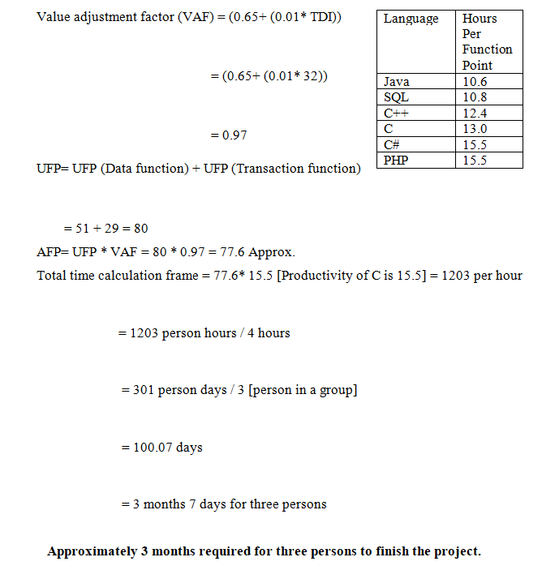
System Planning and Scheduling
Function Point Estimation

Slide 16
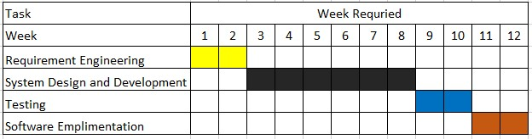
Project Scheduling Chart
Project Schedule Chart

Slide 17
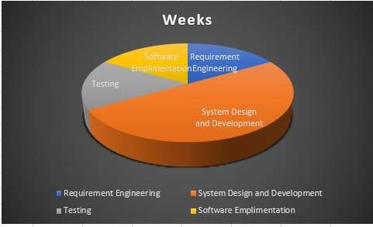
Effort Based Estimation

Slide 18
Cost Estimation (Total Cost)
Personal cost
Designation | Person | Month | Salary | Total
Coder | 1 | 3 | 30209 | 93,000 BDT
System analyst | 1 | 3 | 15130
Designer | 1 | 3 | 23436
Tester | 1 | 3 | 9375
Software Cost
Software | Quantity | Price | Total
Windows 11 | 1 | Free | 0 BDT
Visual Studio | 1 | Free
Others | 1 | Free
Other Cost
Pen and paper | 300 | 1000 BDT
Mobile | 200
Transport | 500
Hardware cost
Name of the Hardware | Quantity | Price | Total
Laptop ,Modem , Printer | 1 | 45,000 | 45,000 BDT
Total Cost : 132650 BDT

Slide 19
Analysis and Design
Activity Diagram
Data Flow Diagram
Entity Relationship Diagram

Slide 20
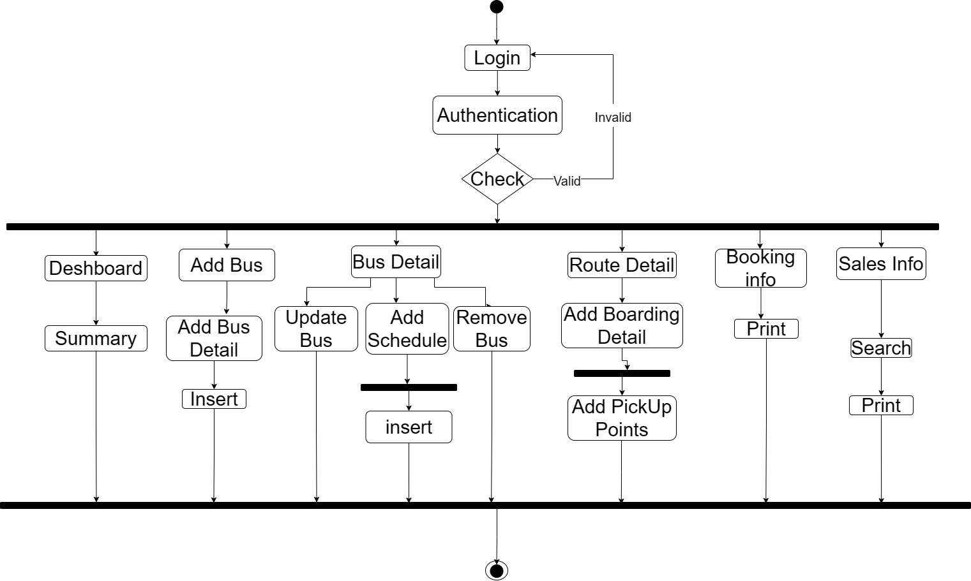
Activity Diagram ( Admin )

Slide 21
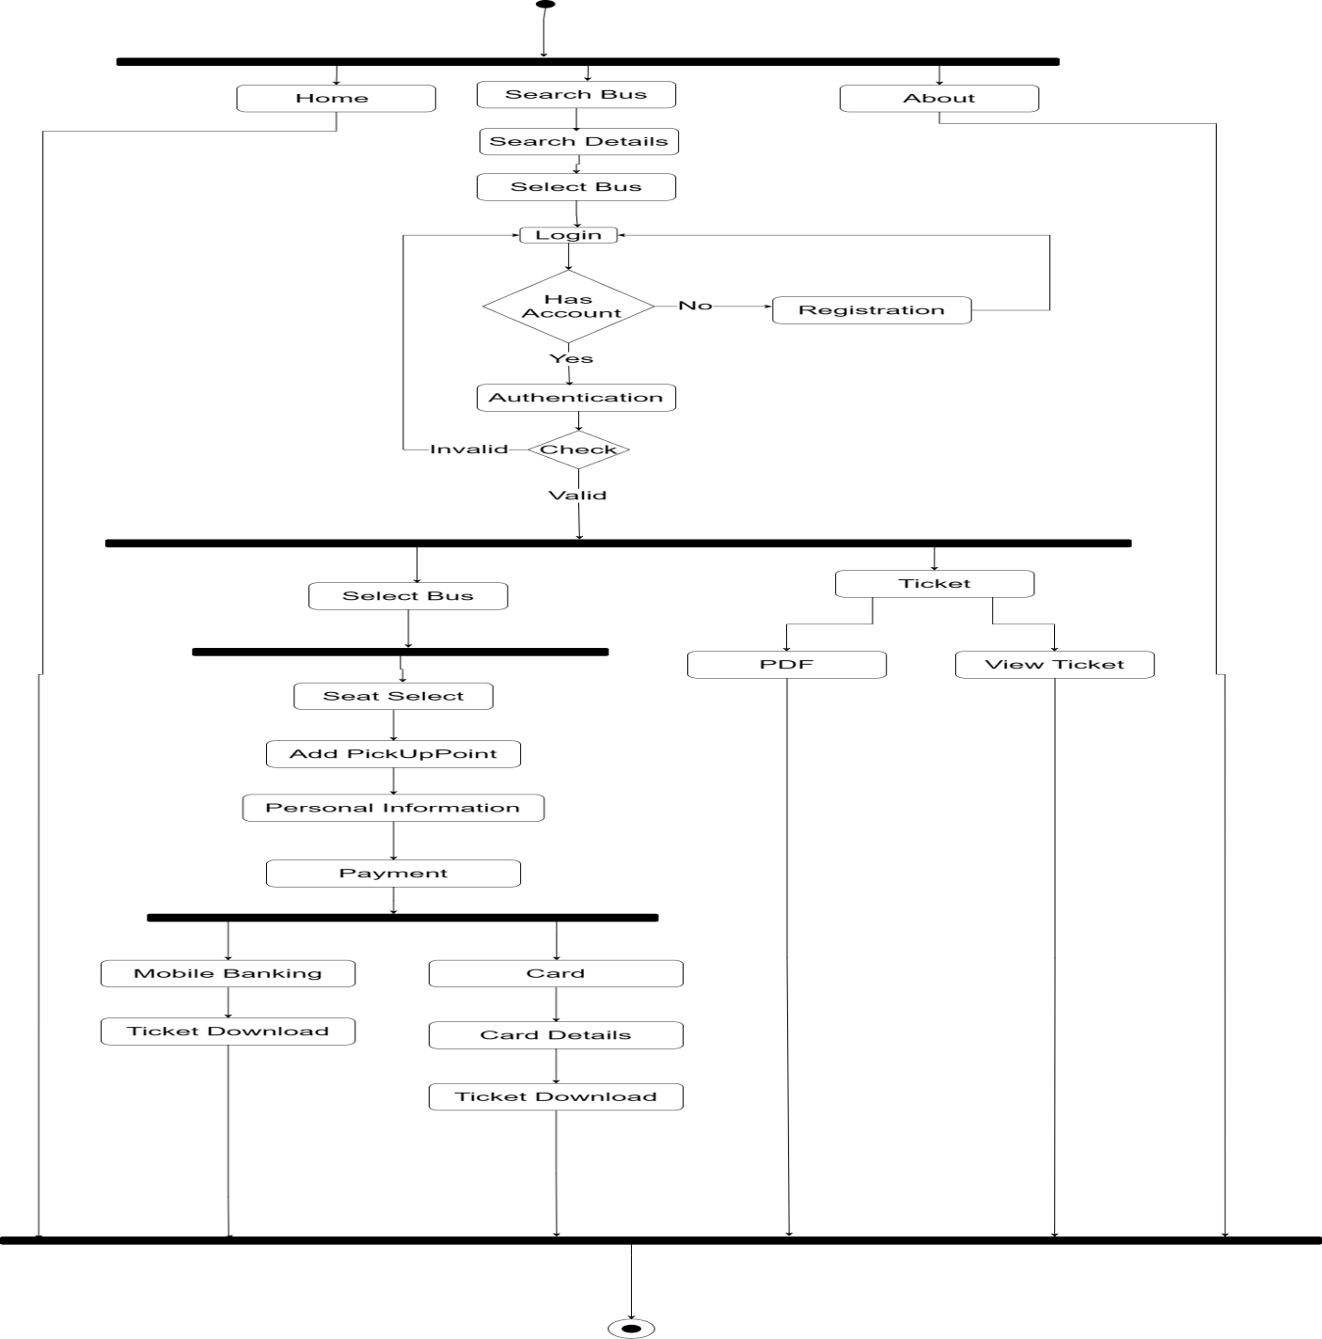
Activity Diagram (Unregistered Customer)

Slide 22
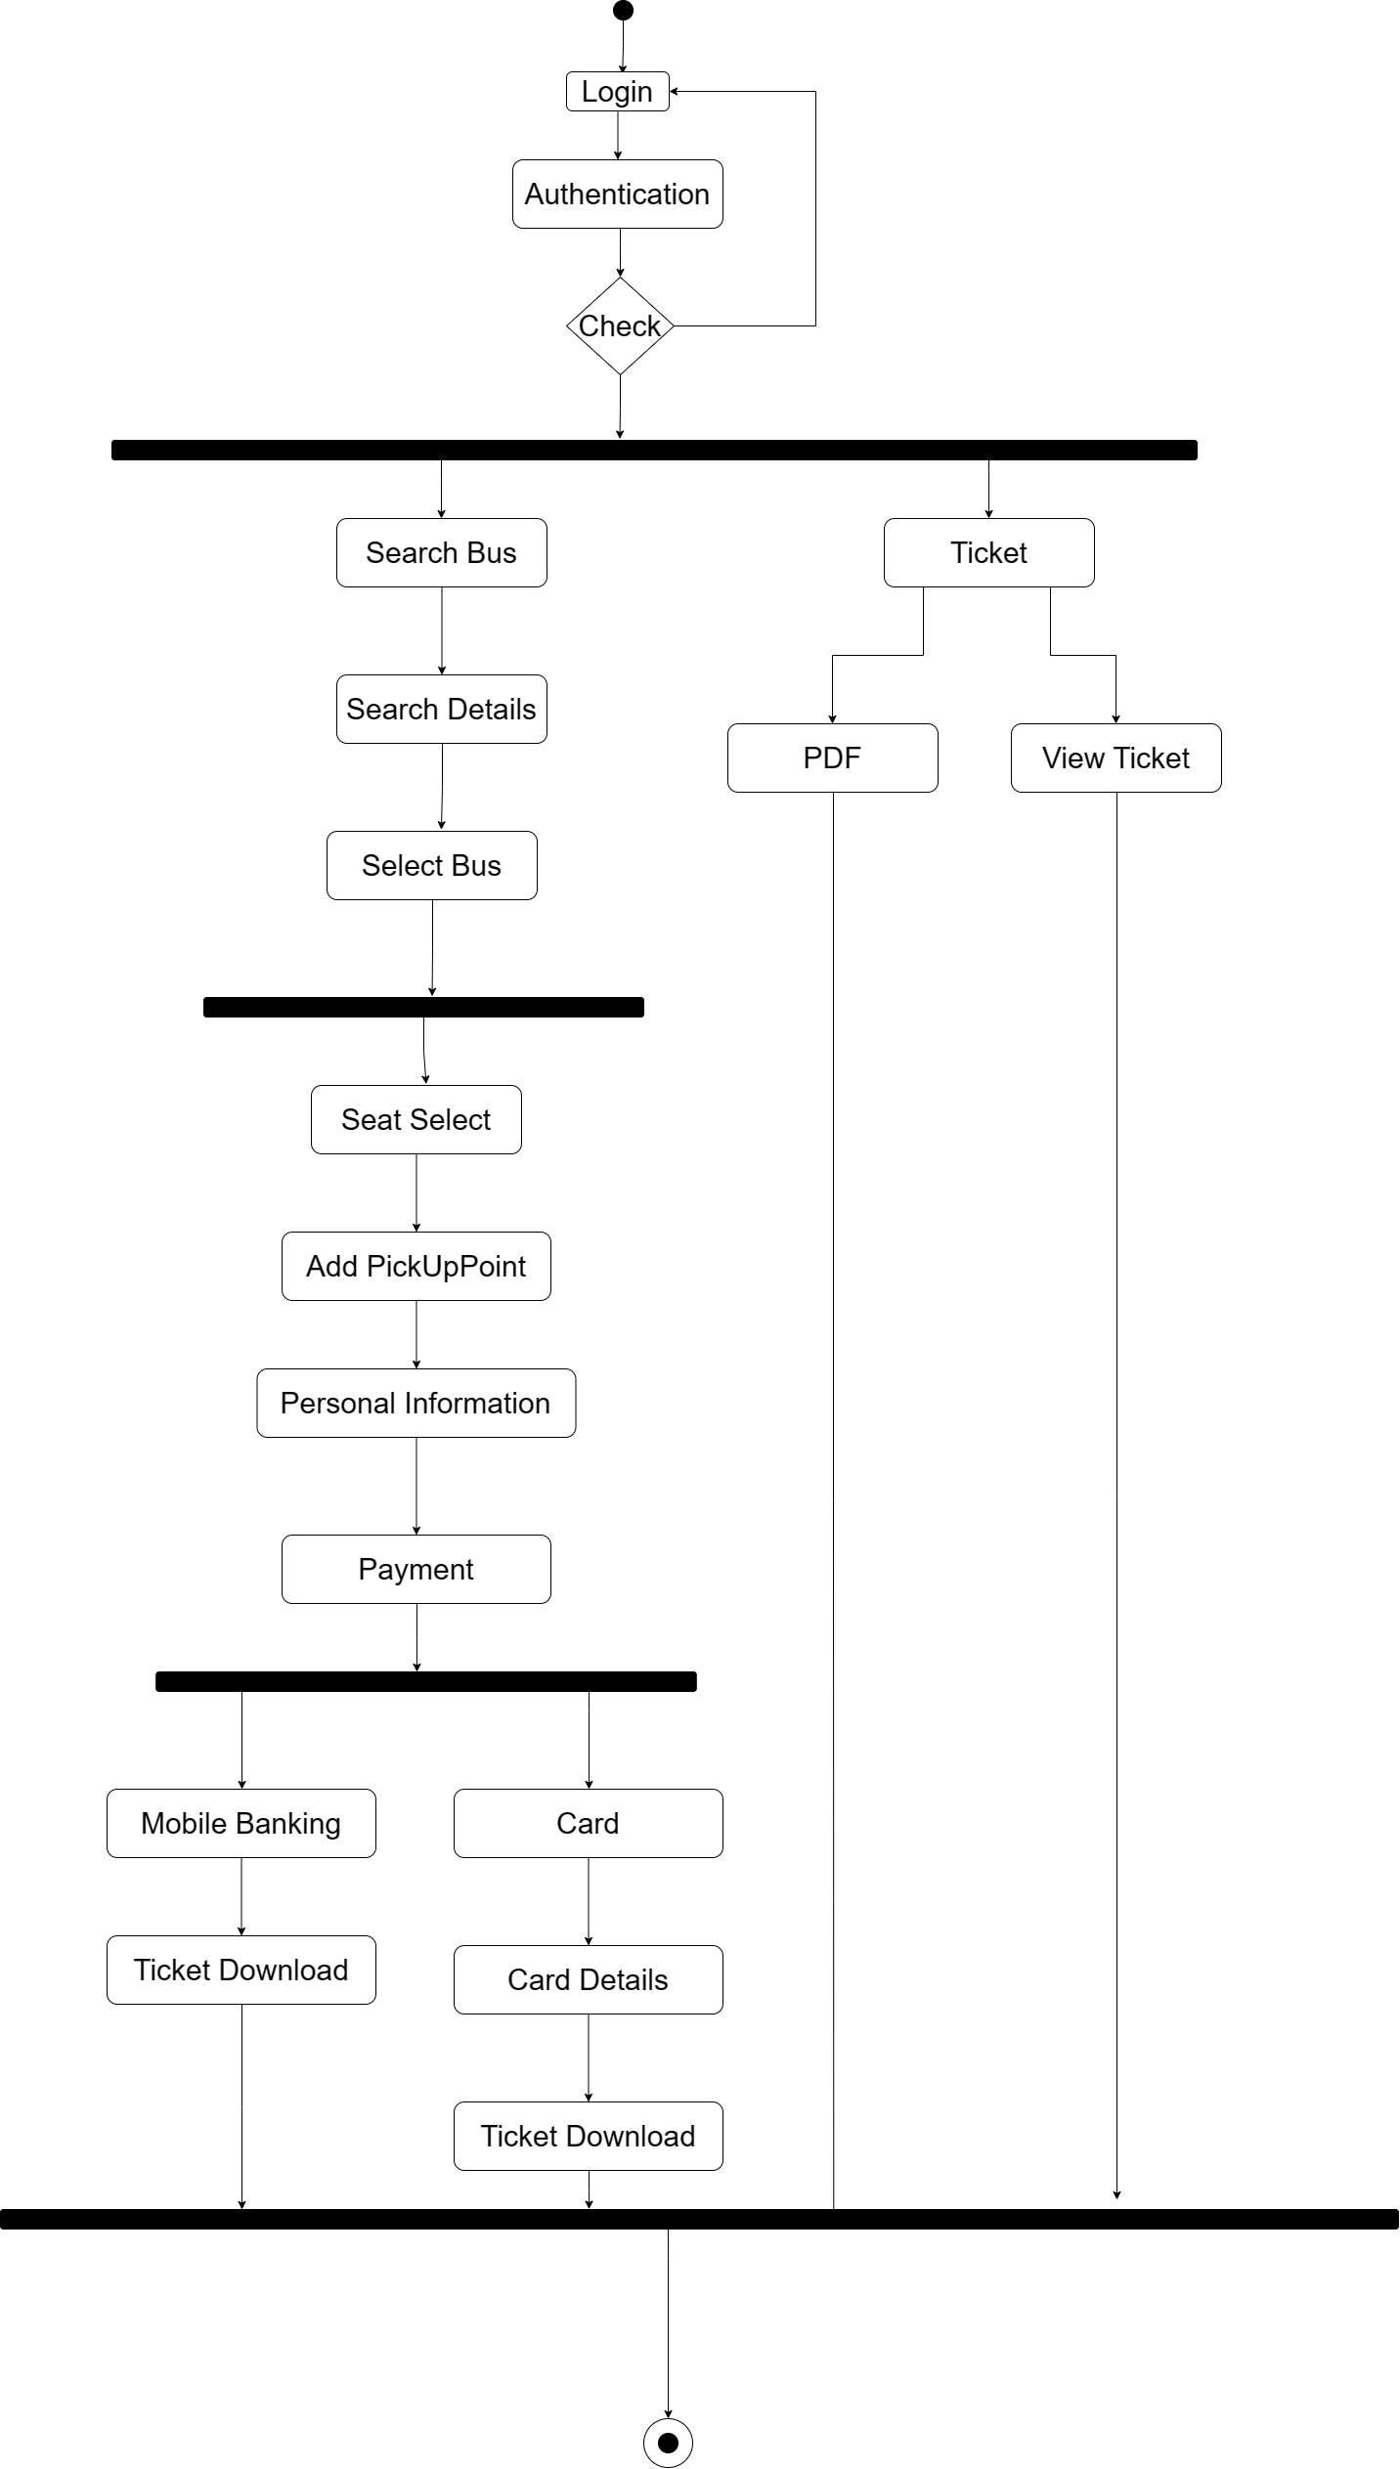
Activity Diagram (Registered Customer)

Slide 23
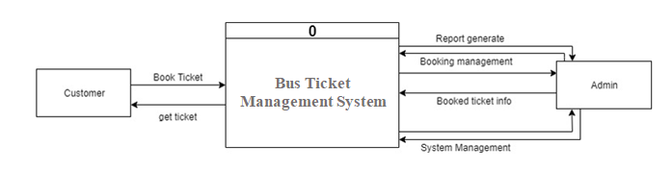
Data Flow Diagram (Context Level)

Slide 24
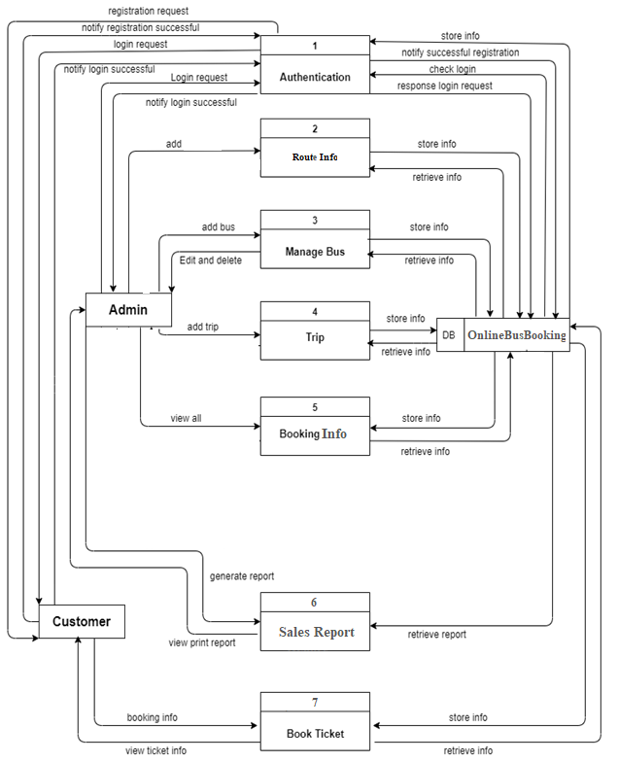
Data Flow Diagram (Level 1)

Slide 25
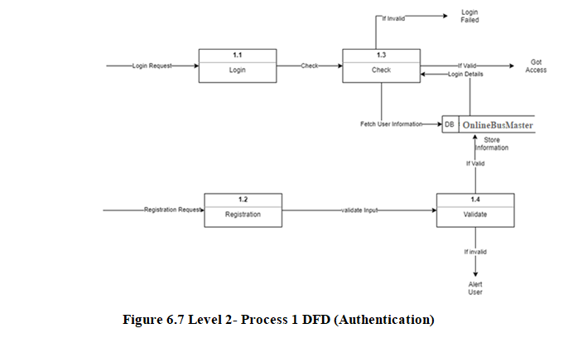
Data Flow Diagram (Level 2)

Slide 26
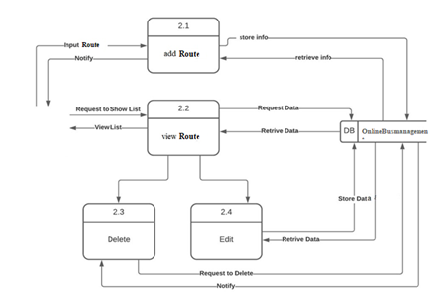
Data Flow Diagram (Level 2)

Slide 27
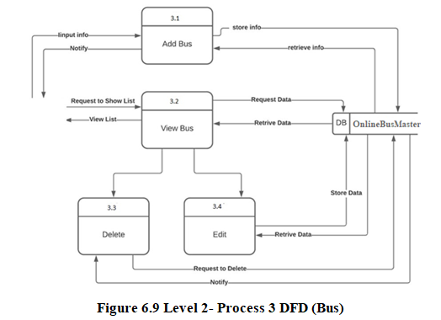
Data Flow Diagram (Level 2)

Slide 28
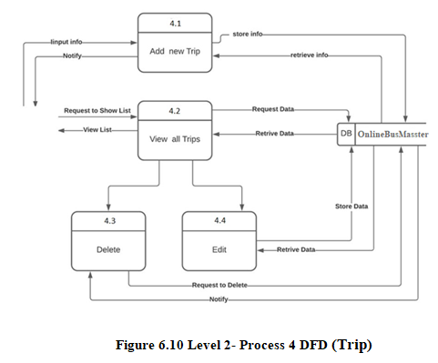
Data Flow Diagram (Level 2)

Slide 29
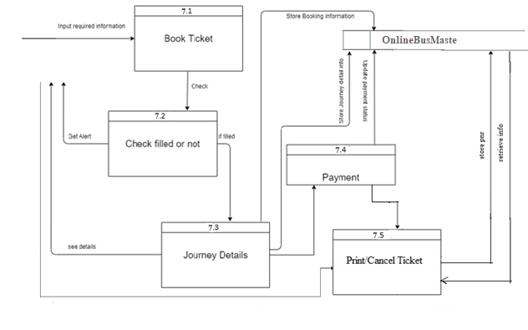
Data Flow Diagram (Level 2)

Slide 30
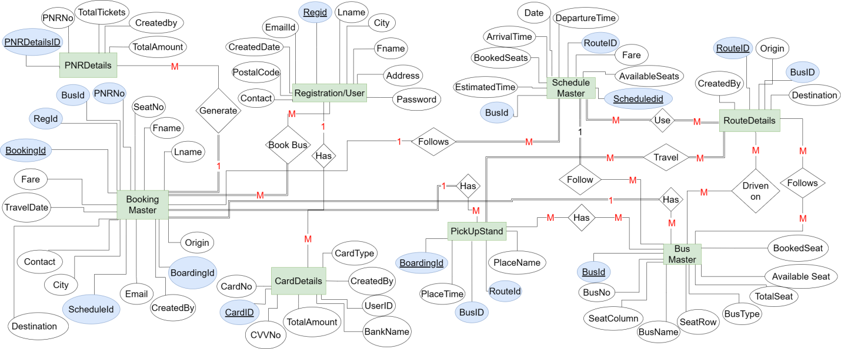
Entity Relationship Diagram (ERD)

Slide 31
Project Live Demonstration

Slide 32
Limitations & Future Works
Limitations
There is no agency connected with the system.
In this system there is no forget password function.
Admin need to input more information’s into the system
Future Works
Other payment gateway will be included.
Online chatting system will be included(ChatBot).
Ticket Cancellation will be included

Slide 33

Conclusion
Technical issues I learned :
Design strategy of a web-based project
Analysis strategy of a web-based project
New environment of programming language.

Slide 34
Thank you.

