Slide 1

What is AngularJS ?
AngularJS is a JavaScript framework
AngularJS extends HTML with new attributes.
Perfect for Single Page Applications (SPAs)
AngularJs is a MVC based framework
AngularJS is a competitor of ReactJS

Slide 2
What we going to learn?
Directives,
Expressions
Filters
Modules
Controllers
Events
DOM
Forms
Input
Validation
Http Request
More….
Small Project

Slide 3
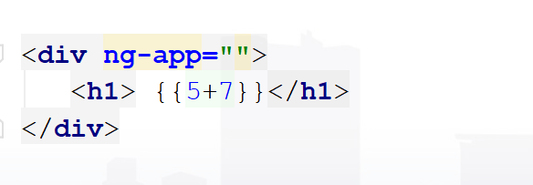
My First AngularJS Application
ng-app represent angular app
{{5+7}} is a JavaScript expression

Slide 4
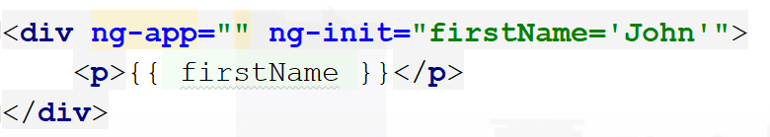
Directives
AngularJS lets you extend HTML with new attributes called Directives.
ng-app directive initializes an AngularJS application.
ng-init directive initializes application data.

Slide 5
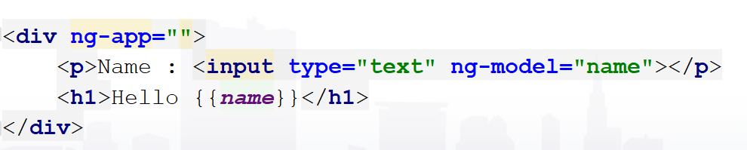
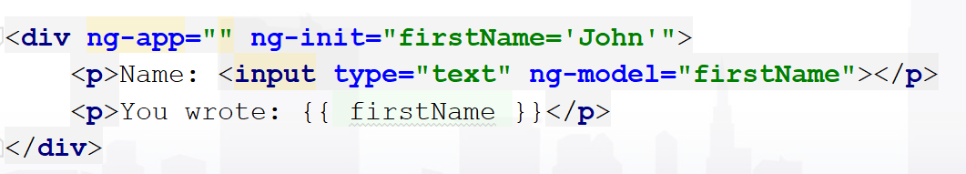
Directives
ng-model directive binds the value of HTML controls.

Slide 6
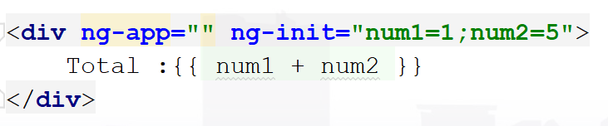
Directives
ng-init directive with multiple data

Slide 7
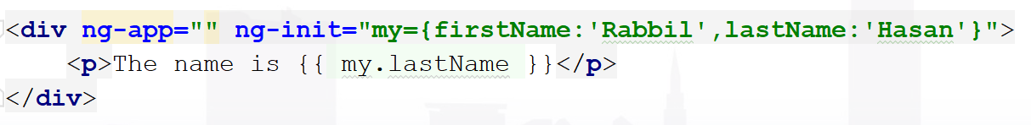
Directives
ng-init directive with object

Slide 8
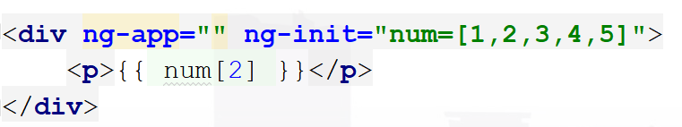
Directives
ng-init directive with array

Slide 9
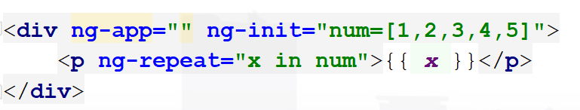
Directives
ng-init directive with array
ng-repeat directive repeats an HTML element

Slide 10
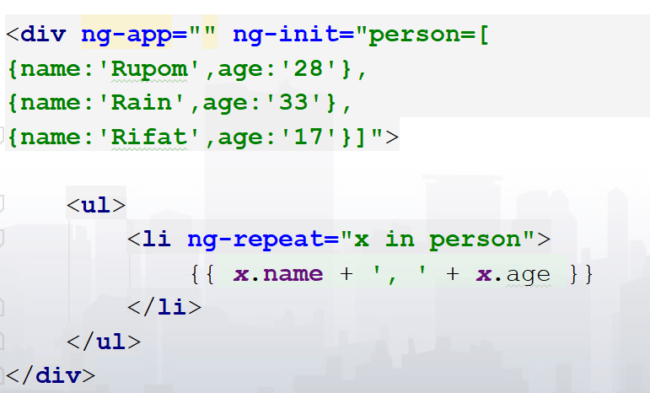
Directives
ng-init directive with json array
ng-repeat directive repeats an HTML element

Slide 11
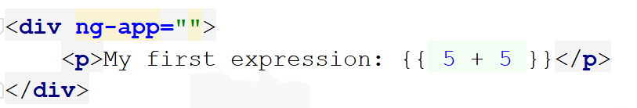
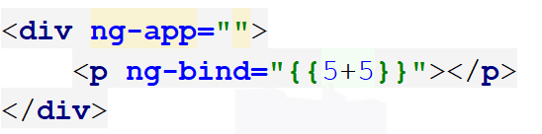
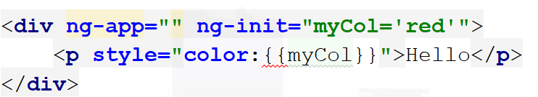
Expressions
Can be written inside double braces: {{ expression }}.
Can also be written inside a directive: ng-bind="expression“
Can also as css values

Slide 12
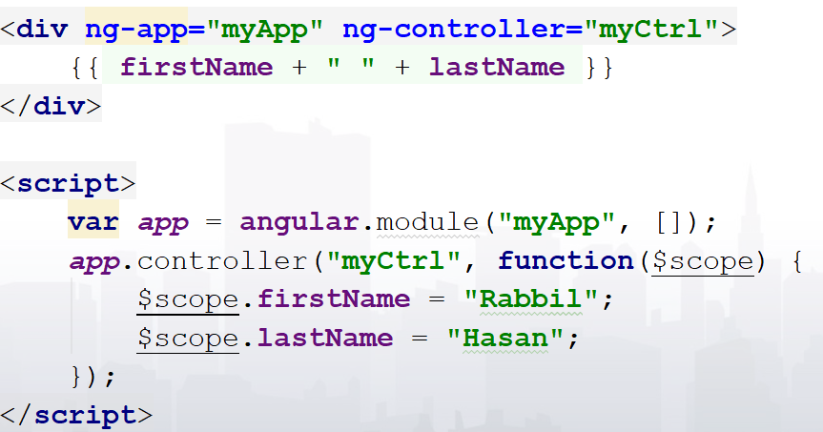
Modules + Controllers
Container for the different parts of an application.
Container for the application controllers.
Controllers always belong to a module.

Slide 13
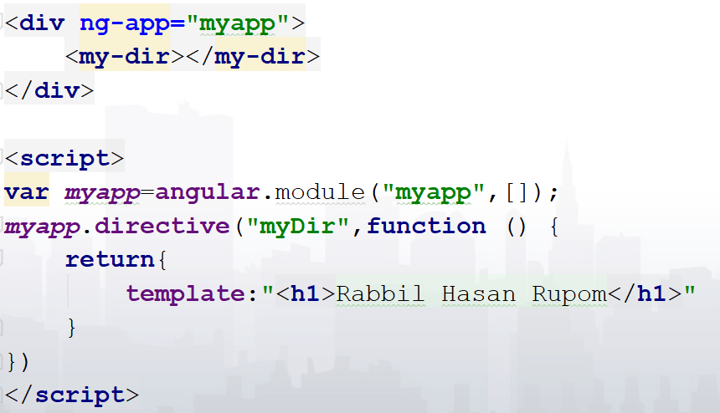
Modules + Directives
AngularJS has a set of built-in directives
You can use the module to add your own directives.
The legal restrict values are:
E for Element name
A for Attribute
C for Class
M for Comment

Slide 14
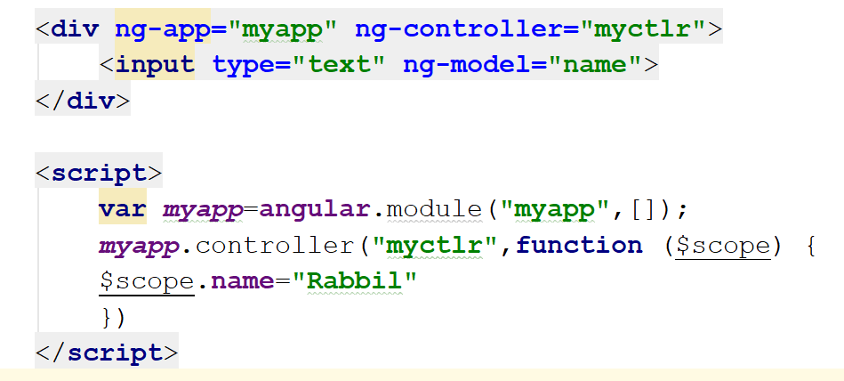
AngularJS ng-model Directive
ng-model directive binds the value of HTML controls (input, select, textarea) to application data.

Slide 15
Two-Way Binding
If the user changes the value inside the input field, the AngularJS property will also change its value:

Slide 16
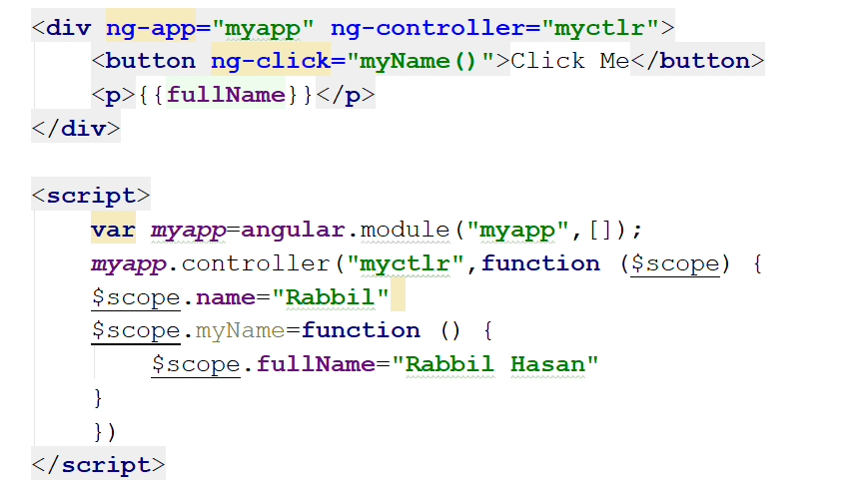
Function Among Controller
If the user changes the value inside the input field, the AngularJS property will also change its value:

Slide 17
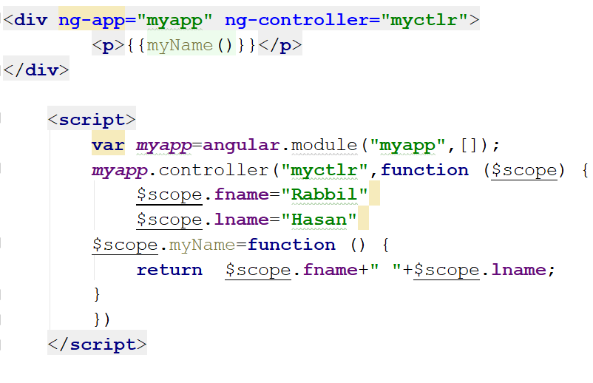
Controller Methods
A controller can also have methods (variables as functions)

Slide 18
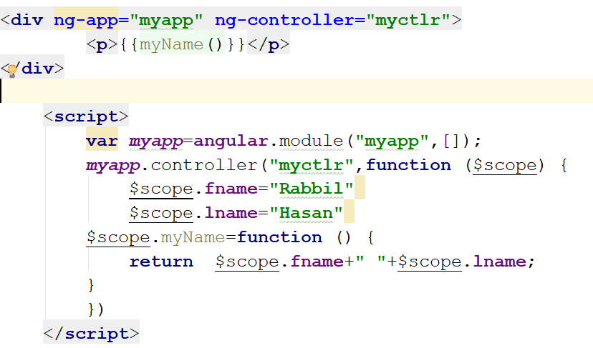
AngularJS Scope
The scope is the binding part between the HTML (view) and the JavaScript (controller).
The scope is an object with the available properties and methods.
The scope is available for both the view and the controller.

Slide 19
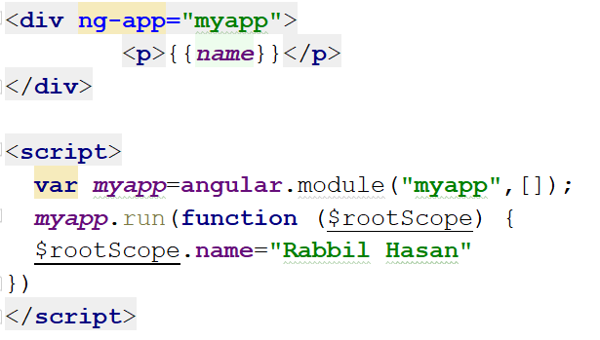
Root Scope
All applications have a $rootScope which is the scope created on the HTML element that contains the ng-app directive.
The rootScope is available in the entire application.
If a variable has the same name in both the current scope and in the rootScope, the application uses the one in the current scope.

Slide 20
AngularJS Filters
currency Format a number to a currency format.
date Format a date to a specified format.
filter Select a subset of items from an array.
json Format an object to a JSON string.
limitTo Limits an array/string, into a specified number of elements/characters.
lowercase Format a string to lower case.
number Format a number to a string.
orderBy Orders an array by an expression.
uppercase Format a string to upper case.

Slide 21
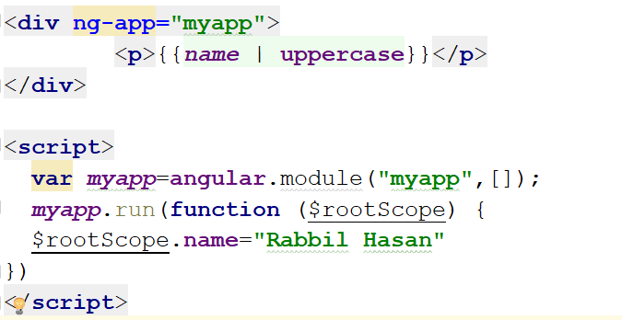
Filter uppercase

Slide 22
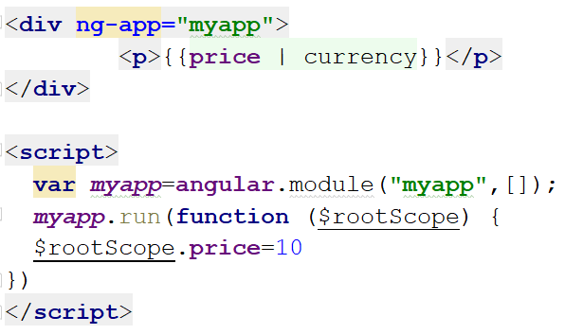
Filter currency

Slide 23
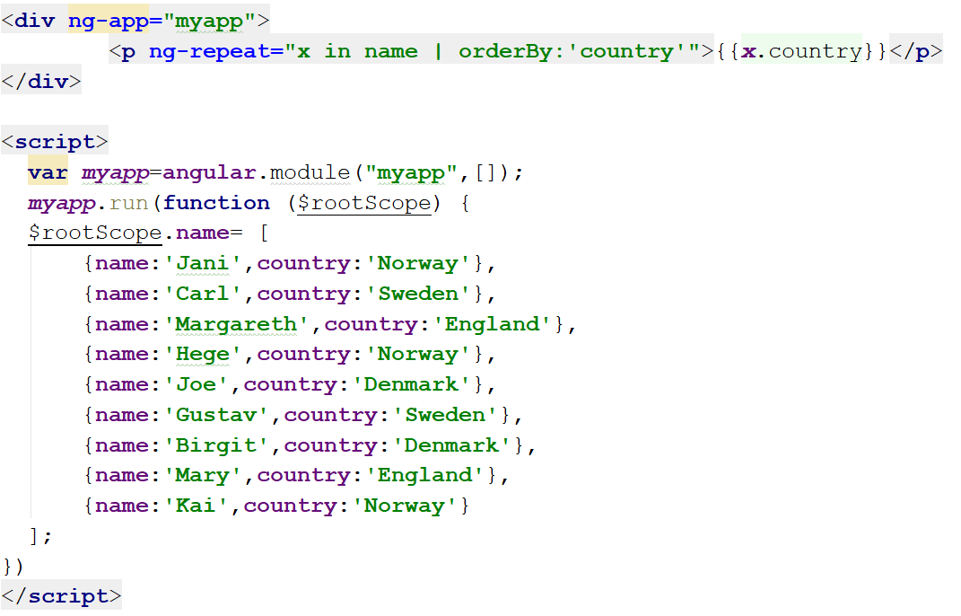
Filter orderBy: ‘name’

Slide 24
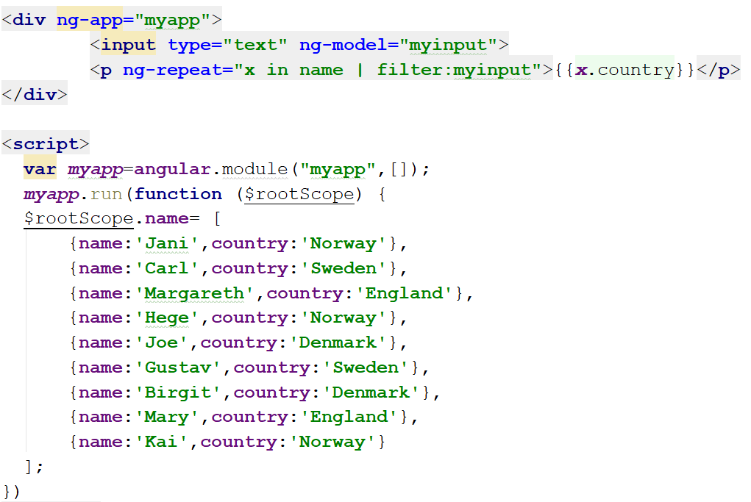
Filter By User Input

Slide 25
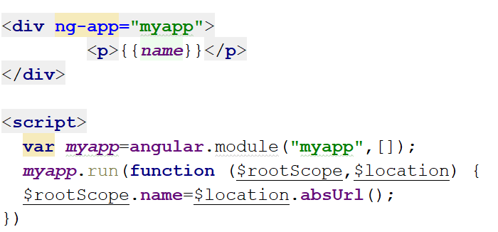
$location service

Slide 26
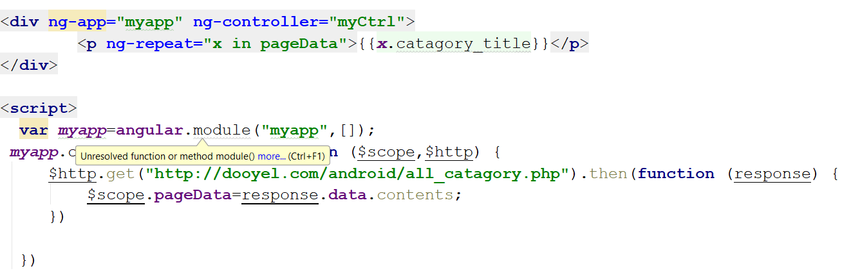
$http Service

Slide 27
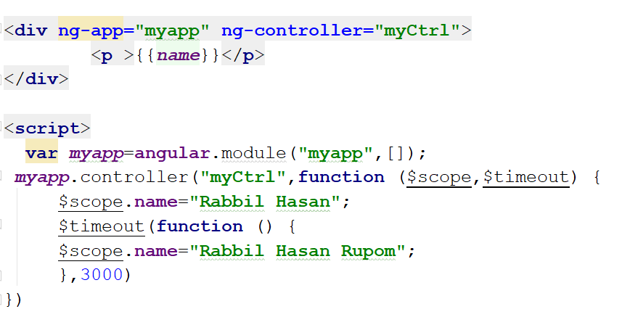
$timeout Service

Slide 28
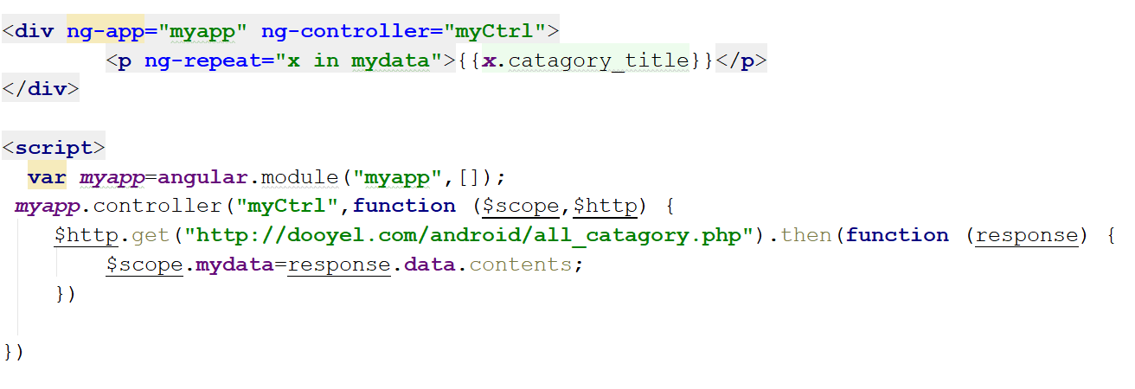
AngularJS AJAX - $http

Slide 29
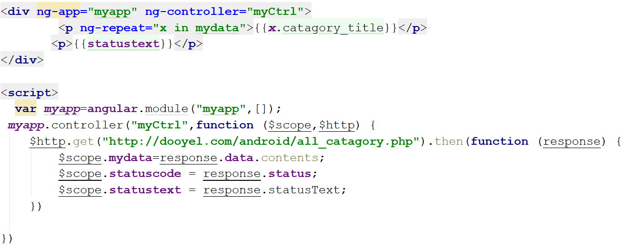
AngularJS AJAX - $http with status text

Slide 30
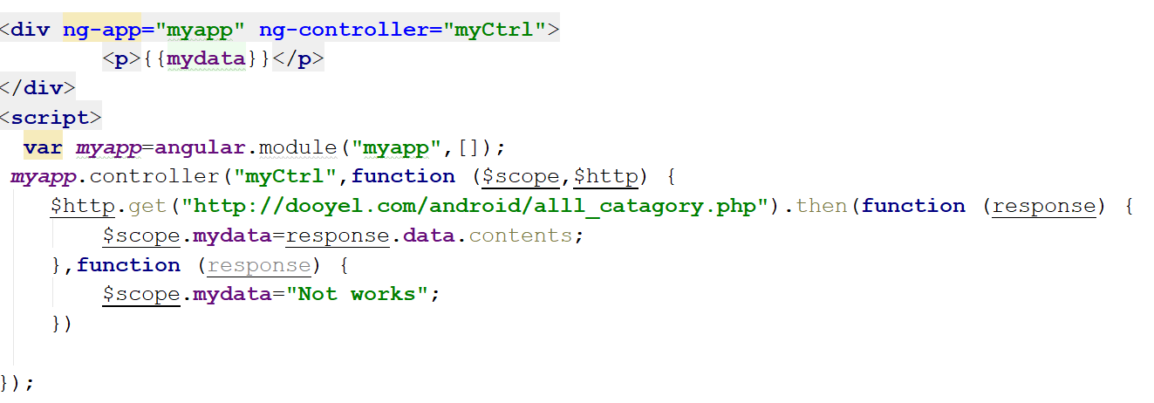
AngularJS AJAX - $http Error Handling

Slide 31
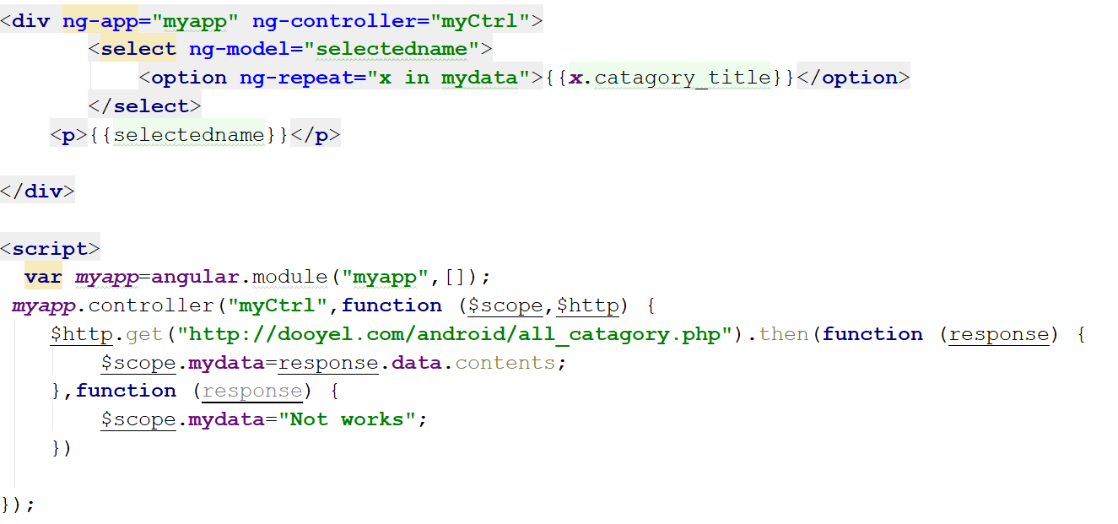
AngularJS Select Boxes

Slide 32

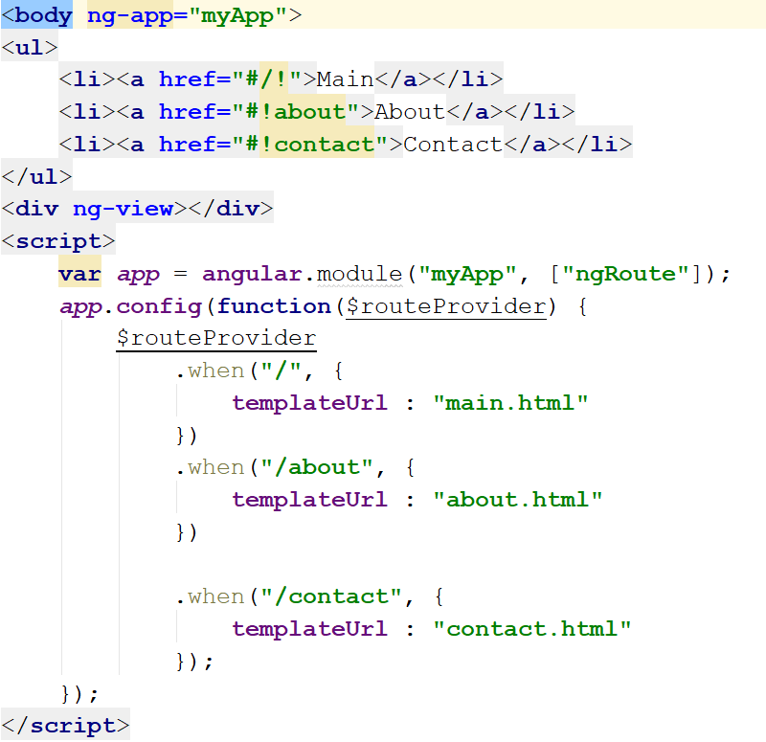
AngularJS Routing
The ngRoute module routes your application to different pages without reloading the
entire application.

Slide 33
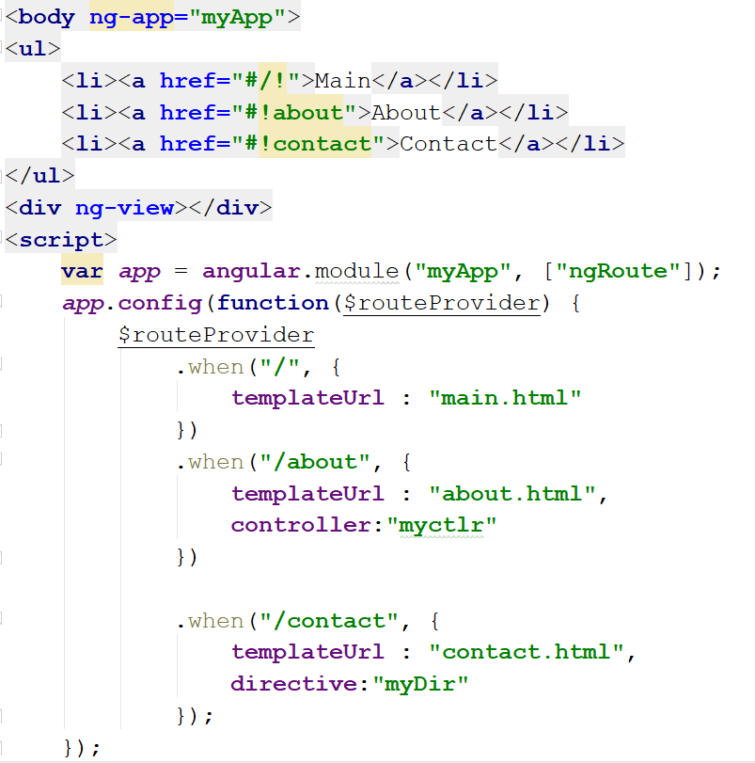
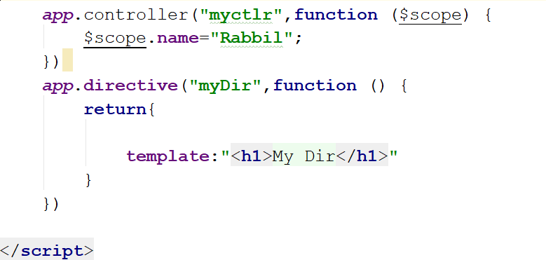
AngularJS Routing with directive and controller

Slide 34
AngularJS Animations

