Slide 1




Code Metric
Calculator
Submitted by:
Umme Kulsum Tumpa
Roll: BSSE 1307
Supervised by:
Abdus Satter
Assistant Professor
Welcome!

Slide 2


Table of Contents:
Project Description
Motivation
Working Methodology
Technology
Progress
Future Scope
Challenges

Slide 3

Project Description

Slide 4
Project Description
This will be a software Tool that will measure some aspect of quality or performance of a Java source code. This software tool will show some basic code metrics named LOC(Line of Code), CC(Cyclomatic Complexity), WMC(Weighted Methods per Class), NMC(Number of Methods in a Class) and NFC(Number of Fields in a Class).

Slide 5

Motivation

Slide 6
Motivation
Help in measuring the code's complexity, maintainability, and readability, which are key indicators of the code's quality
Make it easier to identify the parts of the code that are hard to maintain, allowing developers to focus their efforts on fixing those areas
Can help in detecting potential bugs early on in the development process, reducing the cost and effort required to fix them later

Slide 7
Motivation
Provide insight into the size and complexity of the code, allowing for better resource allocation and prioritization of tasks
Provide information about the code structure, making it easier for new developers to understand and work with the code.

Slide 8


Working Methodology

Slide 9
Working Methodology
A simple overview of the process
Takes Java Source code as input
Reads file
Generates Metrics
Shows result as output

Slide 10
Working Methodology
LOC Metrics
Java Source code
Reads file
Generates LOC Metrics
Physical Lines
Logical Lines
Comment Lines

Slide 11
Working Methodology
Tokenization
Reads Java Source code
Removes white spaces and Comments
Identifies tokens
Writes tokens in a text file
Classifies tokens
Stores tokens

Slide 12
Working Methodology
Cyclomatic Complexity Weighted Method per Class
cc=e-n+2p
Where,
cc=cyclomatic complexity
e=number of edges in the CFG
n=number of nodes in the CFG
p=number of connected components in the CFG
WMC = ΣCCi
Where,
WMC is the weighted methods per class
CCi is the cyclomatic complexity of the i-th method in the class

Slide 13


Technology

Slide 14

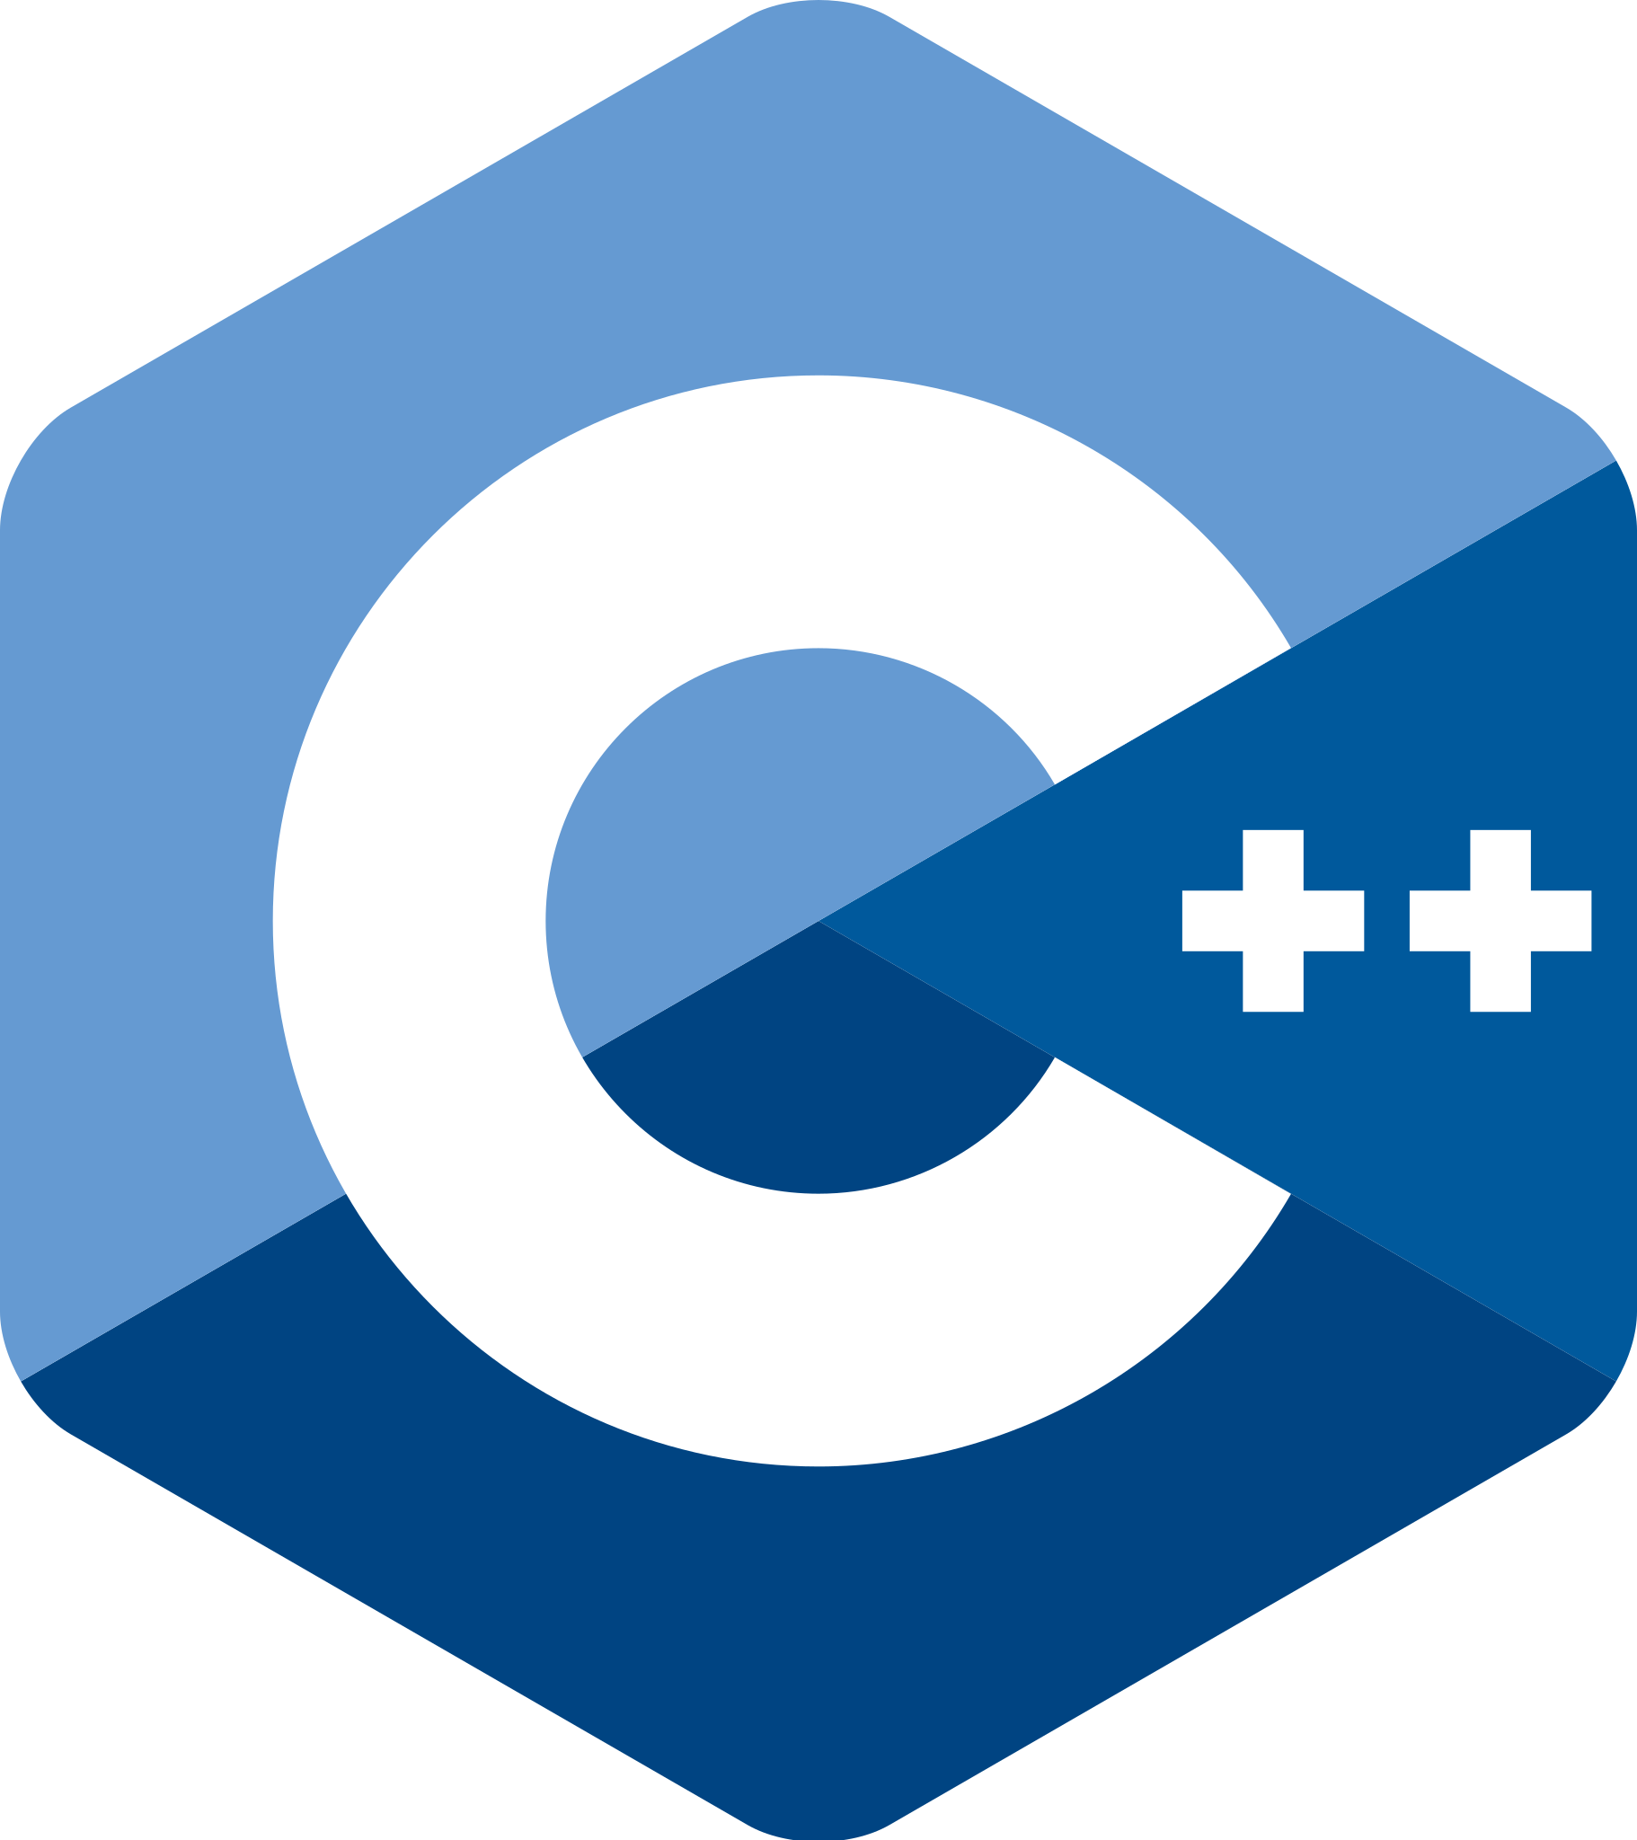

Technology

Slide 15

Progress

Slide 16
Progress
Metrics
LOC
(Line of Code)
CC
(Cyclomatic Complexity)
SLOC
(Source Line of Code)
LLOC
(Logical Line of Code)
CLOC
(Comment Line of Code)
Tokenization

Slide 17
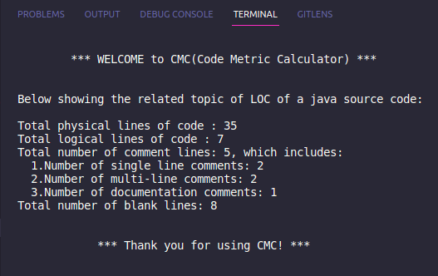
Progress
LOC Metrics

Slide 18
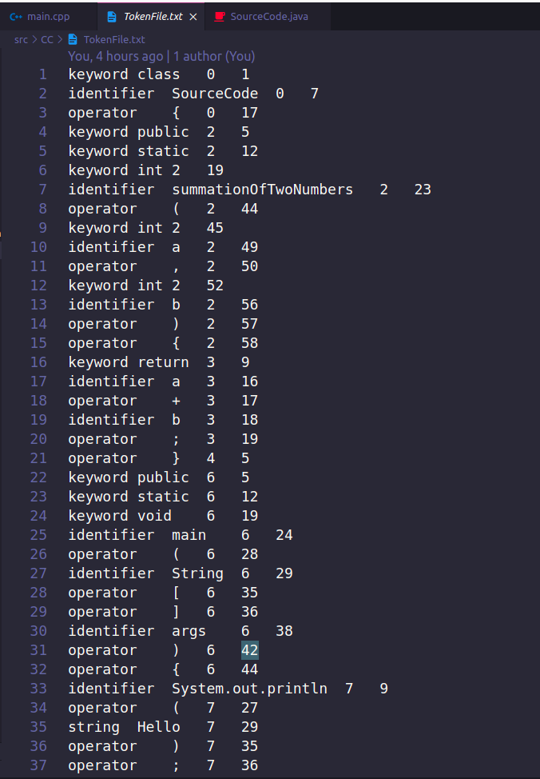
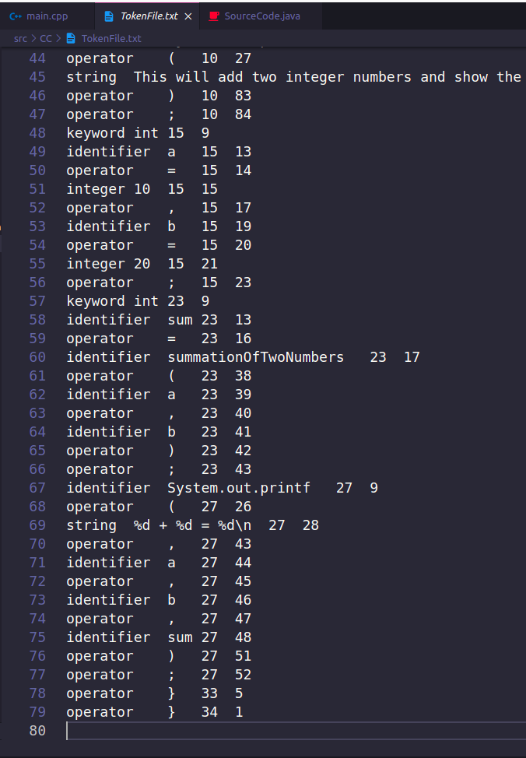
Progress
Tokenization

Slide 19

Future
Scope

Slide 20
Future Scope
Calculate the Cyclomatic Complexity
Calculate weighted method per class
Count the Number of methods in a class
Count the number of fields in a class
If I can successfully add all the features listed above, I’ll try to work with multiple classes of a Java code and add some concepts of OOP including coupling, cohesion etc.

Slide 21

Challenges

Slide 22
Challenges
Handling a large project with so many lines of code for the first time
Tokenization of source code
Handling header files
Further challenges I may face:
Parsing the source code
Building a Control Flow Graph to calculate CC
Finding the number of Connected Components in the Control Flow Graph

Slide 23


GitHub Repository Link:
SPL-1

