Slide 1
Adobe Illustrator
DES526/DES307

Slide 2
What is Adobe Illustrator
Adobe Illustrator is a vector graphics software application developed and marketed by Adobe Inc. It's primarily used for creating and editing vector-based artwork.
Adobe Illustrator has a wide range of applications across various industries. Here are some key areas where it's commonly used:

Slide 3
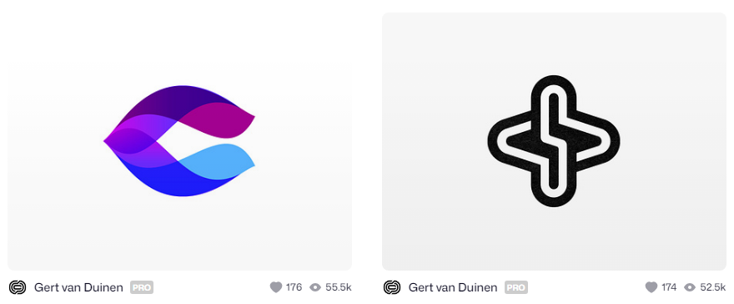
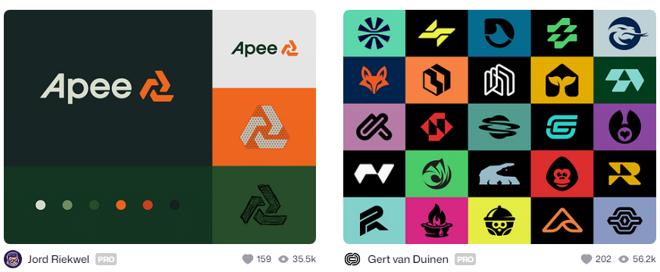
Logo Design: Creating scalable, versatile logos for businesses and brands.

Slide 4
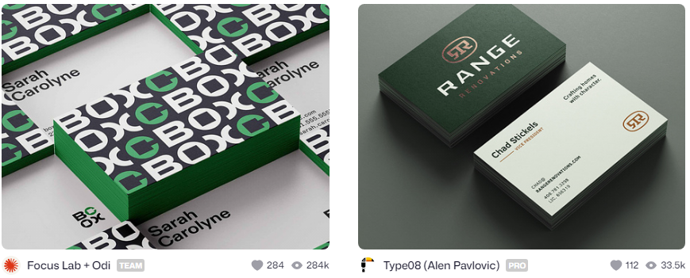
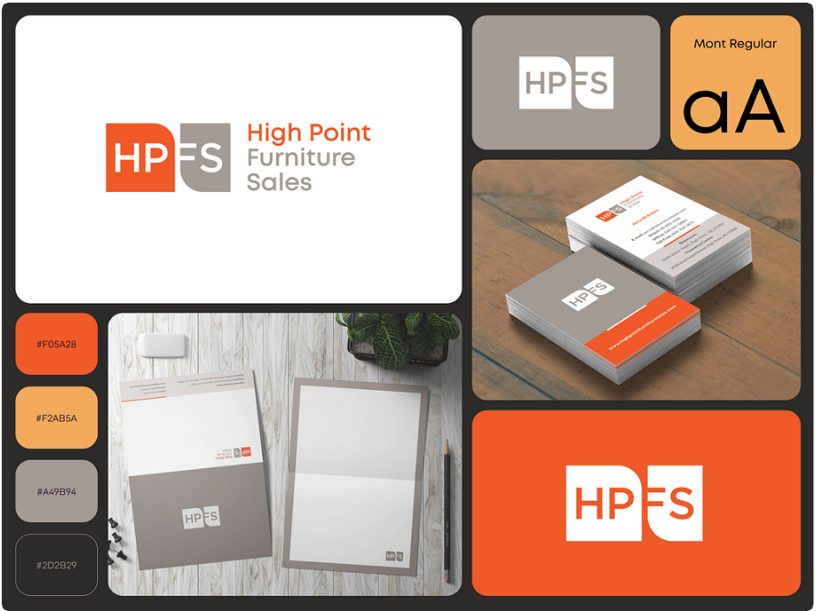
2. Branding: Developing comprehensive brand identities, including business cards, letterheads, and other collateral.

Slide 5
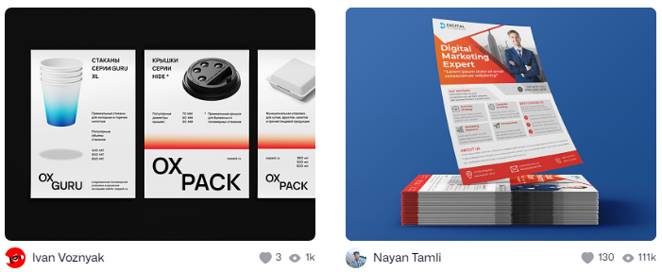
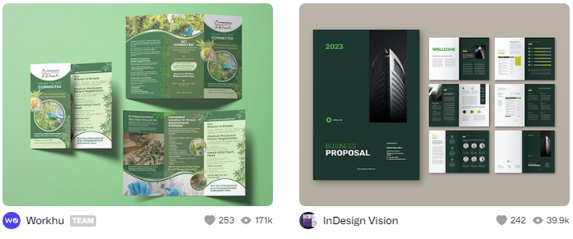
3. Print Design: Designing posters, flyers, brochures, magazine layouts, and other print materials.

Slide 6
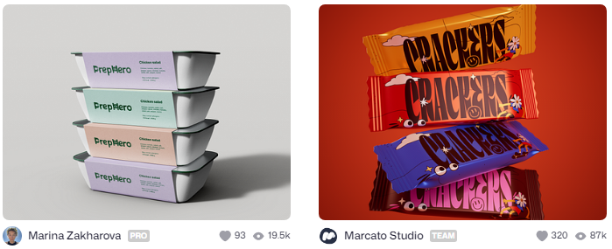

4. Packaging Design: Creating product packaging, labels, and mockups.

Slide 7
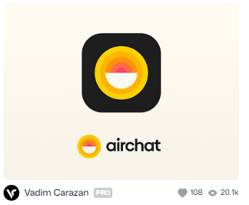
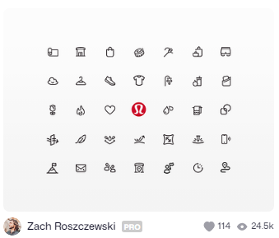
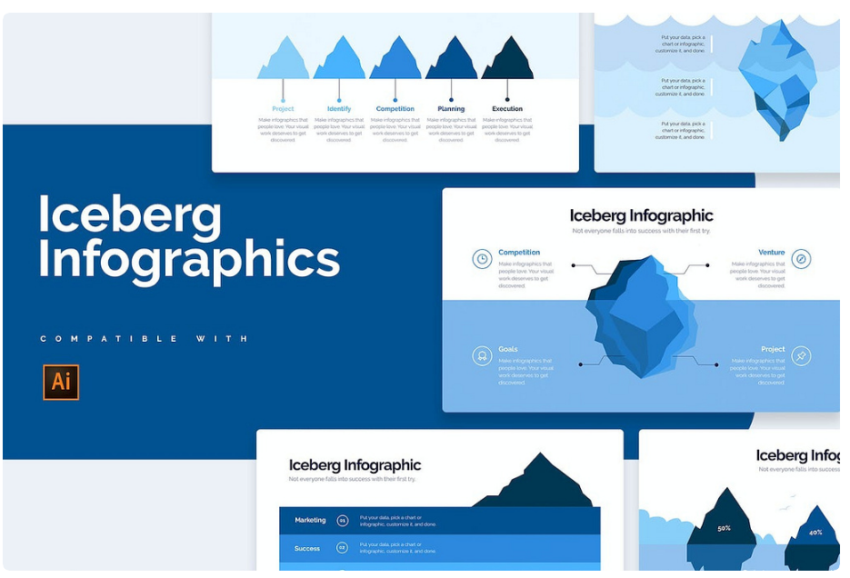
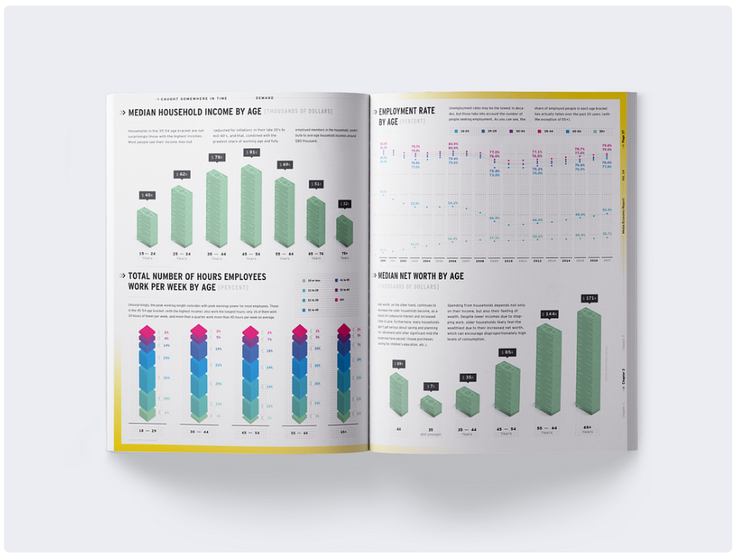
5. Icon Design: Developing icons for apps, websites, and user interfaces.
6. Infographic Creation: Designing informative and visually appealing infographics.

Slide 8
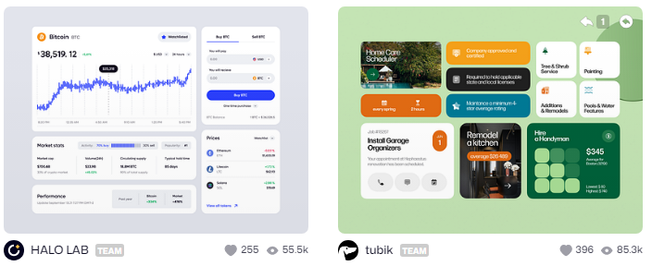
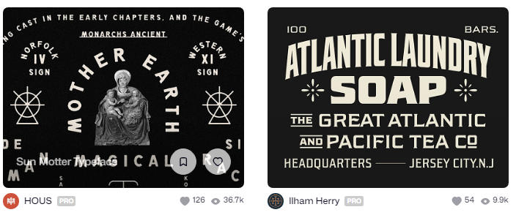
7. Web and UI Design: Creating web graphics, buttons, and other interface elements.
8. Typography and Lettering: Designing custom typefaces and lettering.

Slide 9
Vector Artwork
Vector-based art refers to a type of digital graphic that uses mathematical equations to define shapes, lines, and colors. Here's a more detailed explanation:
Vector graphics are made up of paths, which are defined by a start and end point, along with other points, curves, and angles along the way. These paths can be used to create simple shapes or complex illustrations.
Common file formats:
AI (Adobe Illustrator)
SVG (Scalable Vector Graphics)
EPS (Encapsulated PostScript)
PDF (Portable Document Format, when created from vector software)

