Slide 1
Project name: UNIVERSITY COMMUNICATION SYSTEM
Group member: C131232
C131245

Slide 2
CONTENTS
OBJECTIVE.
APPLICATION.
SOFTWARE REQUIREMENTS.
OVERVIEW OF THE PROJECT.
ERD.
USE CASE.
DFD.
Some INTERFACES.
PROJECT DELIVERABLE.
ADVANTAGE.
CONCLUTION

Slide 3
OBJECTIVES
Students faces problems in collecting slides , projects , questions , books specially the students of first semester .
If students get necessary course related tools like hand note , slides , pdf link of books ,questions and solution of problems they will have clear knowledge about the course.
Students will be able to communicate with the teachers through the system.
Students and teachers will be notified about recent news.

Slide 4
APPLICATION
Will be applicable in any university or college .
Inter communication.

Slide 5
SOFTWARE REQUIREMENTS
Operating System: Windows XP/2000/2007/2008.
Developing requirement: Dreamweaver , Xampp server.
Designing tool: Smart Draw.
Language: HTML, CSS, PHP.
Database: My SQL.
Browser: Mozilla Firefox, Internet Explorer, Google chrome

Slide 6
OVERVIEW OF THE PROJECT
Admin controls the user activity.
Teachers and students must register first.
They will insert their information in database.
They can upload files.
PDF link of books , articles published by the teachers, slides, projects of the students etc will be included.
There will be a notice board where any kind of notice related to class delay , rescheduling of classes ,tests ,assignments ,contests , conferences will be available.

Slide 7
ERD
NAME
STD_ID
NAME
TECH_ID
EMAIL
STUDENTS
TEACHER
PASSWORD
EMAIL
PASSWORD
CONTROLS
CONTROLS
ADMIN
PASSWORD
ID

Slide 8
USE CASE
STUDENTS
Login
Upload
Register
TEACHER
Get Data

Slide 9
USE CASE
Login
ADMIN
Control

Slide 10
Context Diagram:
User
Info Center
University Communication
System
0
query
User info
Data retrieval
User control
Admin

Slide 11
Level 0 DFD:
1.0
User info
Receive
User data
&
Processing
Info Center
query
User
Login
Retrieval data
Uploaded Data
User query
3.0
2.0
Updating
System
DataFile
Handling
User
Query
Processed Data
Processed Query
D2 System DataFile
D1 User InfoFile
4.0
System data access
Controlling
User
Data
Admin
User info access
User Control

Slide 12
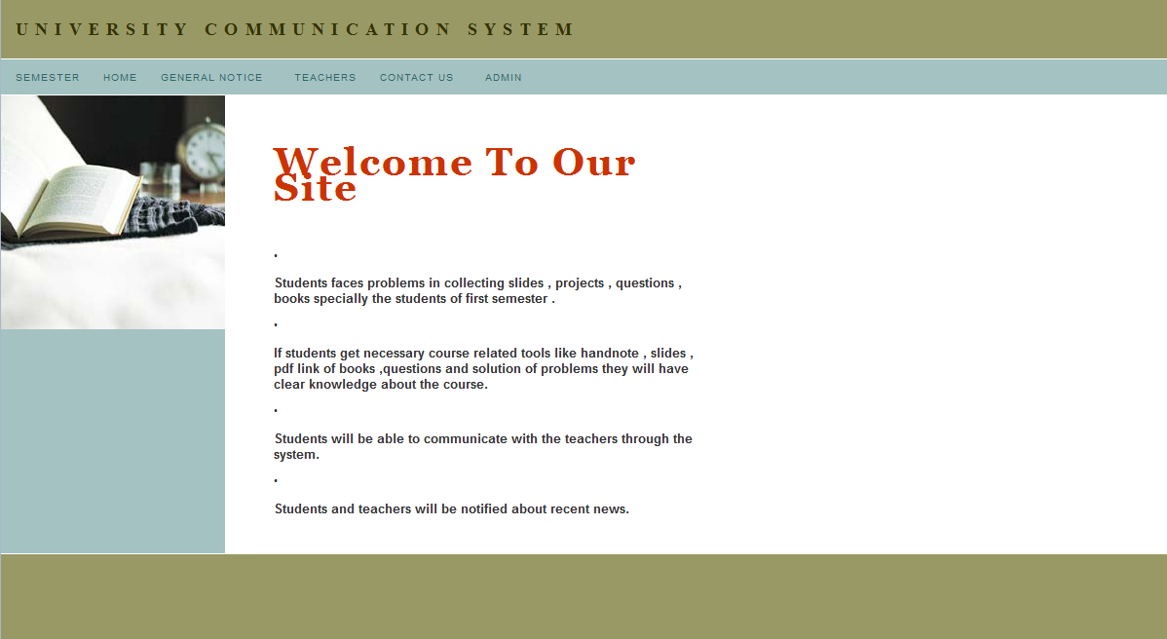
Interfaces

Slide 13
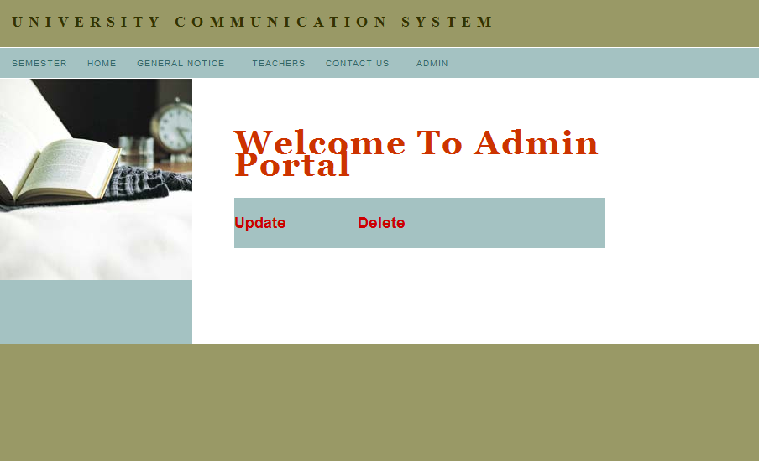

Slide 14
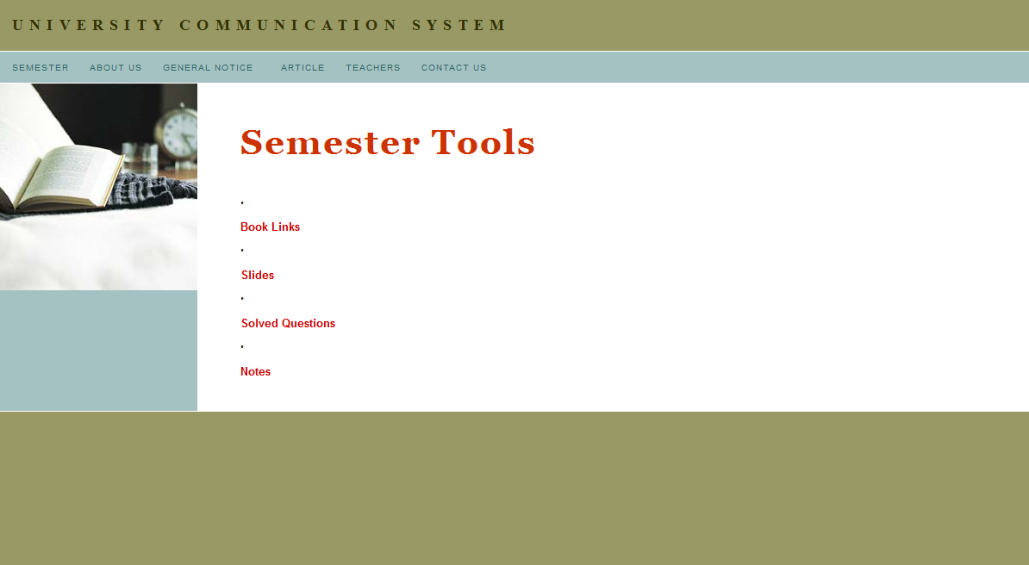

Slide 15
Project deliverables:
User friendly.
Different access level for different user.
Provide flexibility to maintain data and information.
This web based software offers students to get their necessary tools.
Security.

Slide 16
ADVANTAGE
Easy to understand .
Easy to use.
Helpful to communicate with teachers .
Records all the details about any course and thus it is of great help for the new teachers.

Slide 17
CONCLUTION
Ensures an efficient way to improve institutional qualification.

Slide 18
Any Question??

Slide 19
THANK YOU

