Slide 1
Agile Project Management- Final Project
Msmsd 5213

Slide 2

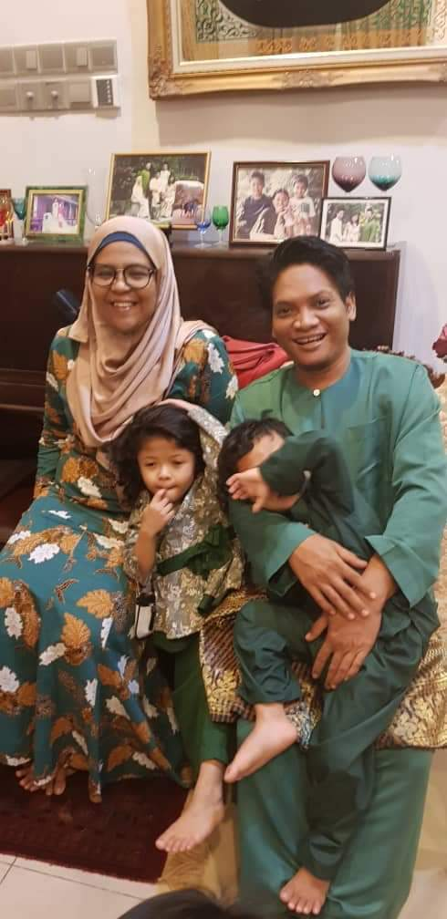
Team Member
UMMI IZZATI BINTI MUSTAPHA
MASTER OF SOFTWARE ENGINEERING (MOBILE DEVELOPMENT)
NIK INTAN HAZURA BINTI N ABDUL HALIM
MASTER OF SOFTWARE ENGINEERING (MOBILE DEVELOPMENT)

Slide 3
MSMD 5213 : Agile Project Management Proposal 1
Project Name :
How tools contribute toward Agile Project Management
Project Scope :
To share the experience of using Agile methodology via a short video.
…..
Proposal :
Using GitHub Project as tools
All project task and documentation recorded and added in tools
Benefits
Effective handling for project and releases
Well organized project and bug fix implementation

