Slide 1
BACKEND REST API
Architecture with AWS Component

Slide 2
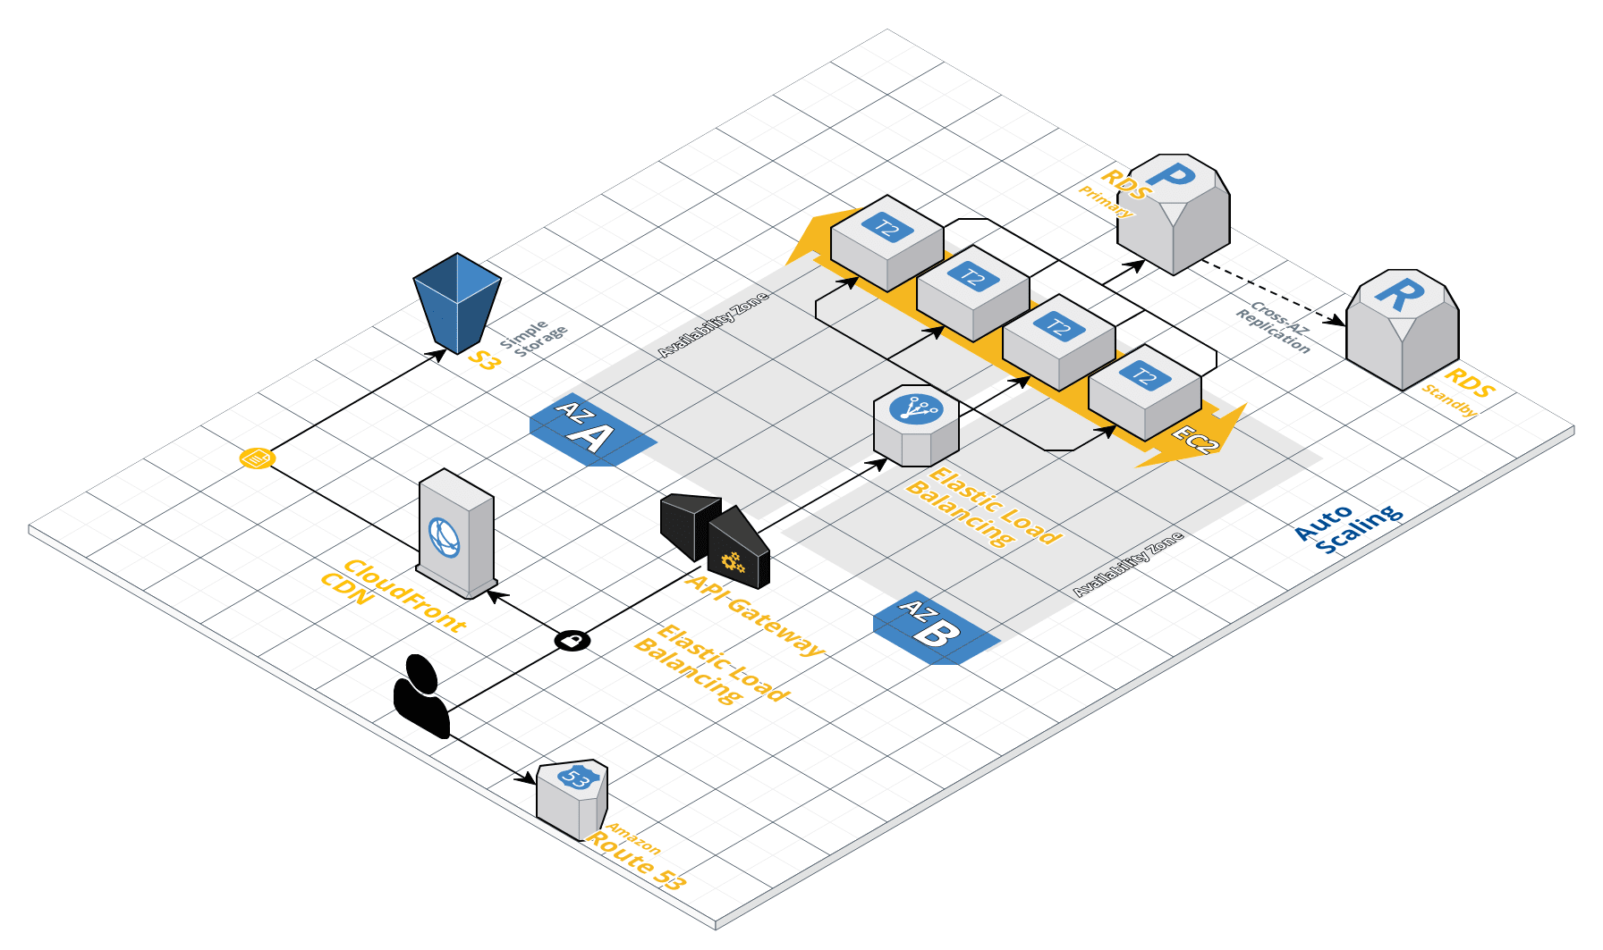
Architecture

Slide 3
AWS Services
AWS Component | Description
Amazon Route 53 | A highly available and scalable cloud Domain Name System (DNS) web service. Amazon Route 53 effectively connects user requests to infrastructure running in AWS – such as Amazon EC2 instances, Elastic Load Balancing load balancers, or Amazon S3 buckets – and can also be used to route users to infrastructure outside of AWS.
Amazon S3 | An object storage service that offers industry-leading scalability, data availability, security, and performance.
Amazon Cloud Front | A fast content delivery network (CDN) service that securely delivers data, videos, applications, and APIs to customers globally with low latency, high transfer speeds, all within a developer-friendly environment. CloudFront is integrated with AWS – both physical locations that are directly connected to the AWS global infrastructure, as well as other AWS services.
API Gateway | A mobile application running on a user’s smartphone and API Gateway Amazon API Gateway opens up a variety of presentation tier possibilities. An Internet-accessible HTTPS API can be consumed by any client capable of HTTPS communication.

Slide 4
AWS Services
AWS Component | Description
Elastic Load Balancer | Elastic Load Balancing automatically distributes incoming application traffic across multiple targets, such as Amazon EC2 instances, containers, IP addresses, and Lambda functions. It can handle the varying load of your application traffic in a single Availability Zone or across multiple Availability Zones.
EC2 | Setup in Multiple Available Zone to with highly scalable backend infrastructure to support the variable usage created by mobile users.
Amazon RDS | The basic building block of Amazon RDS is the DB instance. A DB instance is an isolated database environment in the AWS Cloud. Setup in high availability with a primary instance and a synchronous secondary instance that you can fail over to when problems occur.

Slide 5
Budget
Category | Type | Instance Type | Size | Volume Type | Role | Count | Unit Price | Total Count
Compute | EC2 | T2-Burst | Medium |  |  | 4 | $33.87 | $135.49
Storage | S3 |  |  | Standard |  | 1 | $8.87 | $8.87
Networking | Load Balancer |  |  |  |  | 1 | $22.27 | $22.27
Database | RDS | T2-Burst | small |  | Primary | 1 | $49.64 | $49.64
Database | RDS | T2-Burst | small |  | Read Replica | 1 | $49.64 | $49.64
App Service | API Gateway |  |  |  |  | 1 | $45.24 | $45.24
TOTAL BUDGET |  |  |  |  |  |  |  | $311.14

Slide 6
