Slide 1
NORTHWIND
SALES PERFORMANCE & BUSINESS ANALYSIS
CEO Presentation
An interactive five-page Power BI report examining revenue, products, customers, markets, and operations.
TOOLS & DATA
Power BI Desktop | DAX | Northwind database via SQLite ODBC
Prepared as a capstone business analysis

Slide 2
Executive Summary
02
What the dashboard shows at a glance
TOTAL SALES
TOTAL ORDERS
CUSTOMERS
PRODUCTS
$1.35M
830
93
77
Headline findings
Management takeaway
• April 1998 recorded $134,630.56, the peak identified in the monthly analysis.
• Beverages leads category revenue in the current dashboard.
• The USA leads the visible country sales ranking.
Use the dashboard to monitor sales trends, category performance, customer contribution, and operational patterns. Investigate drivers before committing to changes.
Note: 1998 is a partial year in this dataset.
Northwind Sales Performance | Power BI Capstone

Slide 3
Data & Methodology
03
From relational database to interactive business report
DATA SOURCE
ANALYTICAL APPROACH
Northwind sample business database, connected through SQLite ODBC and loaded into Power BI Desktop.
• Reviewed tables and field types before analysis.
• Built relationships across orders, customers, products, categories, employees, and shippers.
• Created DAX measures for sales, orders, average order value, quantity, customers, products, and freight.
• Built five interactive report pages with slicers and ranked visuals.
SALES CALCULATION
Order-line sales = Unit Price × Quantity × (1 − Discount), aggregated across order details.
Results describe the available dataset; observed associations do not establish causation.
Northwind Sales Performance | Power BI Capstone

Slide 4
Sales Performance & Trend
04
Revenue scale, year comparisons, and monthly movement
1996 SALES
1997 SALES
1998 SALES
$226.30K
$658.39K
$469.77K
152 orders
408 orders
270 orders, partial year
What stands out
Recommended follow-up
• 1997 has the highest full-year sales among the years shown.
• April 1998 reached $134,630.56, the peak identified in the monthly trend.
• Dips around February 1997 and January 1998 warrant investigation, not an assumption of recurring seasonality.
• Break down April 1998 by product, customer, and order count.
• Check whether monthly changes align with order volume or product mix.
• Avoid direct full-year comparisons with partial-year 1998.
Northwind Sales Performance | Power BI Capstone

Slide 5
Product & Category Performance
05
Revenue and unit volume answer different questions
PRODUCTS
QUANTITY SOLD
TOTAL SALES
77
51K
$1.35M
Finding
Recommendation
Beverages leads category revenue in the current report. Quantity and product-level views provide a second lens for reviewing volume and individual product performance.
• Review sales and quantity together before inventory decisions.
• Investigate high-revenue and high-volume products separately.
• Check margin and stock data before prioritizing products; sales alone do not establish profitability.
Northwind Sales Performance | Power BI Capstone

Slide 6
Customer Contribution
06
Customer base, key accounts, and revenue concentration
CUSTOMERS
COUNTRIES SERVED
TOP ACCOUNT
93
22
$117,483
QUICK-Stop
Evidence
Recommended action
• QUICK-Stop generated $117,483.39, or 8.7% of total sales.
• Save-a-lot Markets generated $115,673.39, or 8.5%.
• The USA leads the visible country sales ranking.
• Monitor sales and order frequency for major accounts.
• Identify customers outside the leading group with repeat-purchase potential.
• Review country-level customer count and revenue together before setting market priorities.
Northwind Sales Performance | Power BI Capstone

Slide 7
Geographic Market Performance
07
Understand where revenue and customers are located
CURRENT OBSERVATION
QUESTIONS FOR MANAGEMENT
The USA leads the visible country sales ranking and has the highest visible customer count (13). Northwind serves 93 customers across 22 countries.
• Are high-revenue markets also generating repeat orders?
• Which markets have customer counts or sales that are growing or declining?
• Do shipping costs or delivery performance differ by market?
Caution: Country sales leadership shows where sales are recorded; it does not by itself explain market potential, profitability, or customer satisfaction.
Northwind Sales Performance | Power BI Capstone

Slide 8
Employee & Shipping Operations
08
Order workload and freight expenditure
TOTAL ORDERS
TOTAL FREIGHT
TOP ORDER-VOLUME SHIPPER
830
$64.94K
United Package
What the report indicates
Recommended follow-up
• Employee-associated sales and order counts vary.
• United Package handles the highest order volume in the current chart.
• Total freight is approximately $64.94K across the dataset.
• Compare employee sales and order counts before interpreting performance.
• Compare shipper costs, delivery times, and service quality before reallocating orders.
• Investigate freight spikes alongside order volume and shipment patterns.
Northwind Sales Performance | Power BI Capstone

Slide 9
Prioritized Recommendations
09
Actions grounded in the analysis; validate before execution
Investigate the April 1998 peak
Break the $134,630.56 peak down by product, customer, and order count.
01
Strengthen account monitoring
Track revenue and order frequency for QUICK-Stop and Save-a-lot Markets.
02
Use two product lenses
Compare category revenue and quantity sold before stock or assortment decisions.
03
Review shipping economics
Compare freight expense and delivery service across shippers and periods.
04
Monitor markets over time
Track country revenue and customer activity, accounting for partial-year 1998.
05
Northwind Sales Performance | Power BI Capstone

Slide 10
Conclusion & Next Steps
10
Turning dashboard evidence into an ongoing management routine
CONCLUSION
NEXT STEPS
The five-page dashboard provides a unified view of Northwind sales, products, customers, markets, and operations. It helps management explore patterns and prioritize questions for further analysis.
• Review KPI and customer/category movements regularly.
• Investigate significant changes before taking operational action.
• Add margin, inventory, delivery-time, and satisfaction data if available.
LIMITATIONS
1998 is a partial year. Sales figures alone do not establish profitability, delivery quality, customer satisfaction, or causes of monthly changes. Recommendations should be validated with additional operational evidence.
Northwind Sales Performance | Power BI Capstone

Slide 11
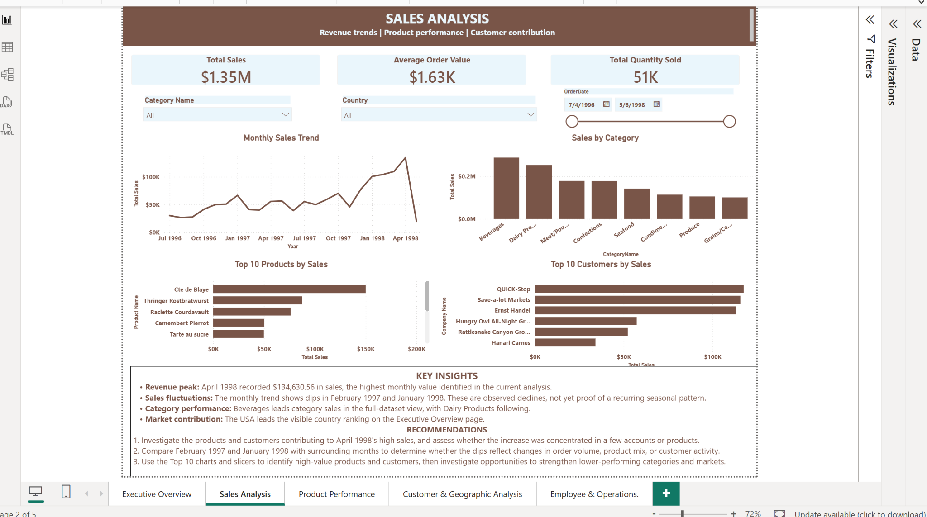
DASHBOARD EVIDENCE | Sales Analysis Dashboard

Slide 12
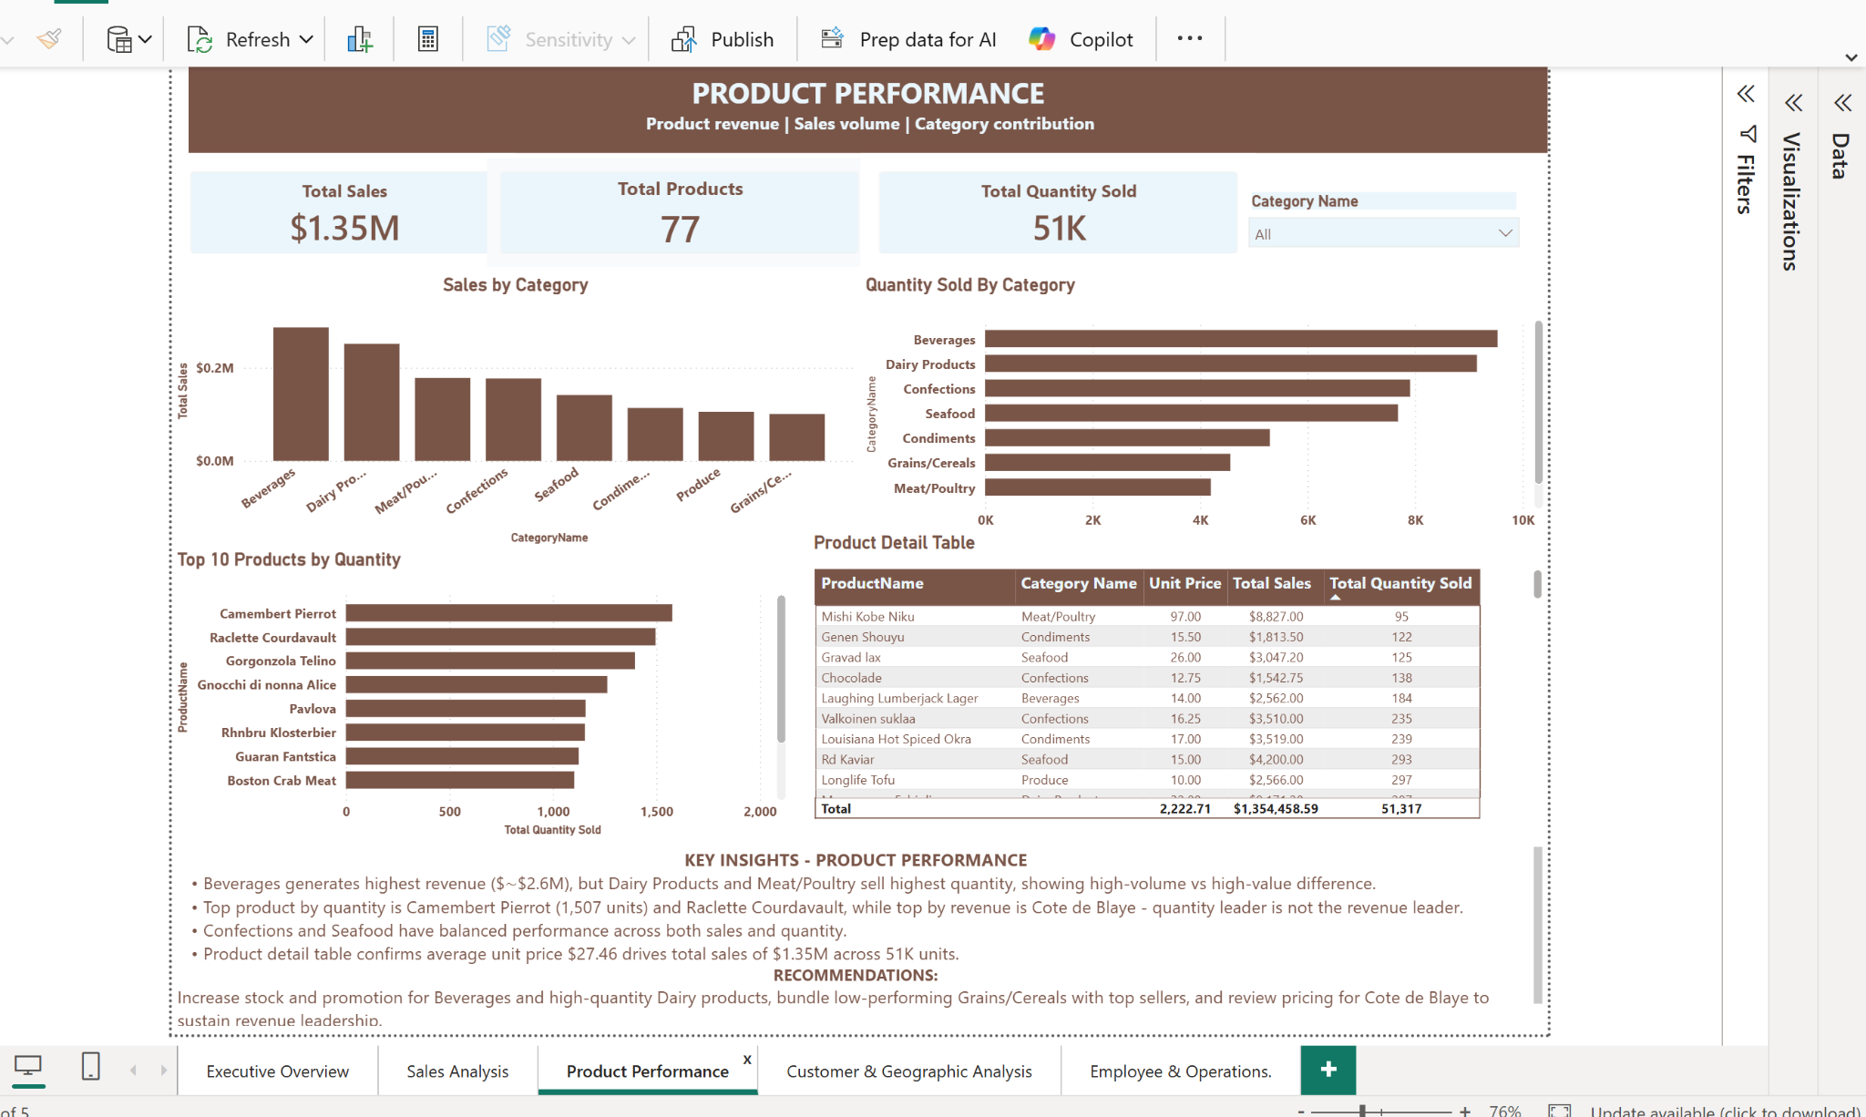
DASHBOARD EVIDENCE | Product Performance Dashboard

Slide 13
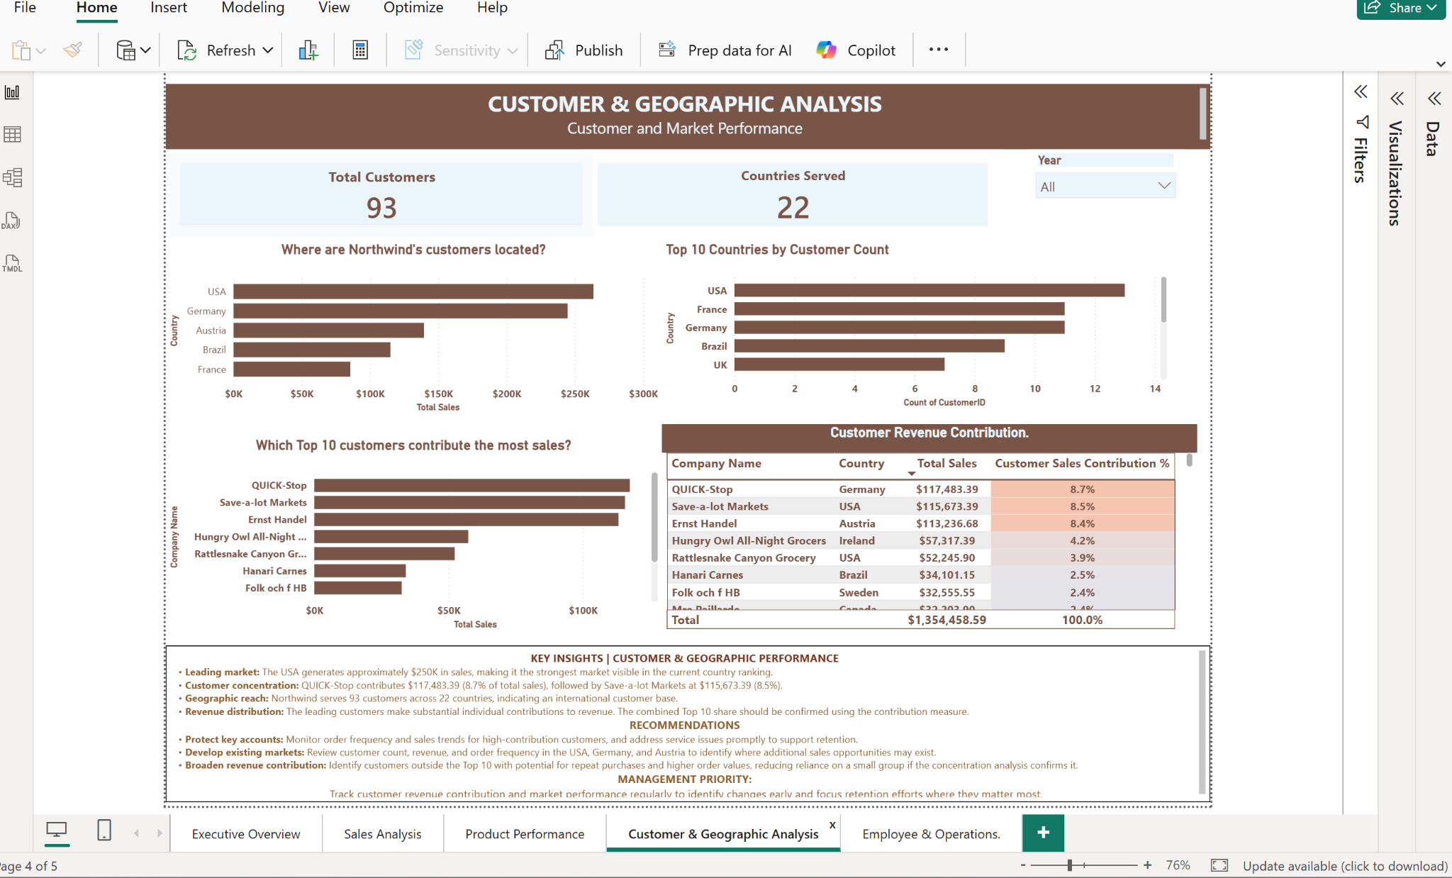
DASHBOARD EVIDENCE | Customer & Geographic Analysis Dashboard

Slide 14
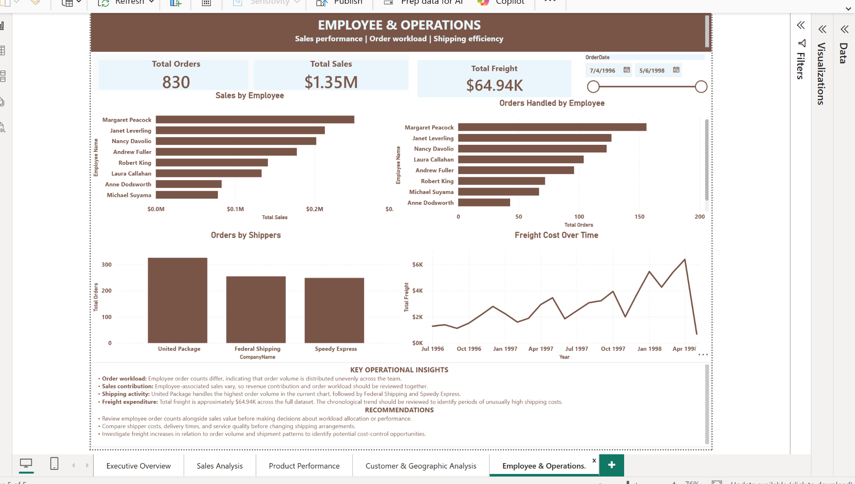
DASHBOARD EVIDENCE | Employee & Operations Dashboard

