Slide 1

GOVERNANCE, RISK & COMPLIANCE
GRC Audit
Report
NVIDIA Regional R&D and Production Hub — Network Infrastructure Assessment
DATE
September 2026
PROJECT ID
NVIDIA-REG-RD-2026-1106
PREPARED BY
CONFIDENTIAL
Our Group Name — BeCode GRC Final Project

Slide 2
Agenda
What this report covers
01
Audit Scope & Objectives
What was assessed, and against which requirements
02
Regulatory Applicability
Which laws and frameworks govern this deployment
03
Checklist Results
Pass / fail outcome across 14 controls
04
Risk Register & Priorities
Severity distribution and the top risks
05
Recommendations & Next Steps
What must happen before production go-live
NVIDIA-REG-RD-2026-1106 · Confidential
2

Slide 3



Audit Scope & Objectives
OBJECTIVES
Governance
Assess the delivered network design against NVIDIA’s RFQ requirements
Identify compliance and control gaps
Compare documented configurations with the Packet Tracer implementation
Establish whether security controls are present where documented
Provide clear, actionable recommendations before go-live
Accountability, security ownership, and documented operational processes.
Risk
Threats, vulnerabilities, and architectural weaknesses affecting CIA.
Compliance
Whether controls satisfy RFQ requirements and recognised standards.
EVIDENCE BASE
NVIDIA RFQ
Network Design Document
Cisco Packet Tracer File
Asset Inventory
NVIDIA-REG-RD-2026-1106 · Confidential
3

Slide 4
Regulatory Applicability
Assessed against the purpose and activities of the Regional Hub, not technology alone
Regulation / Standard | Status | Basis
GDPR | Applies | 48 employees; processes personal data in an EU Member State
NIS2 / Belgian NIS2 Act | Applies — Important Entity | R&D and manufacturing are sectors covered by NIS2
CyFun (CCB) | Applies | Belgian framework supporting Belgian NIS2 alignment
ISO/IEC 27001 / 27005 | Voluntary | Not compulsory, but a recognised security-management route
AI Act | Uncertain | NVIDIA's provider/deployer role is not yet established
Cyber Resilience Act | Does not apply | Obligations sit with device manufacturers, not NVIDIA
DORA | Does not apply | Not a financial-sector entity or service
SOC 2 | Does not apply | No US client-facing service identified
NVIDIA-REG-RD-2026-1106 · Confidential
4

Slide 5
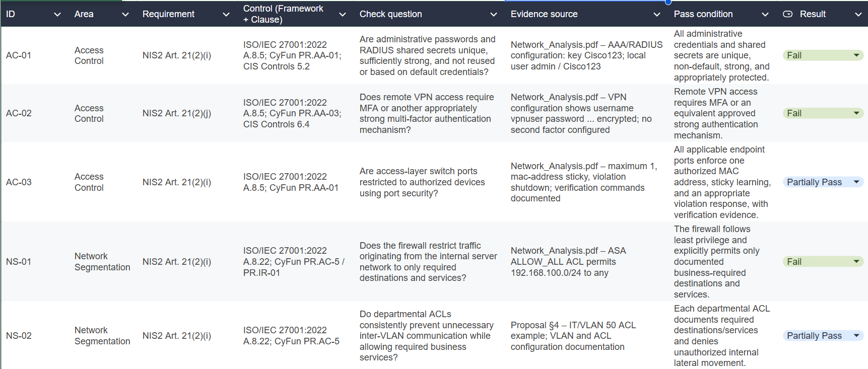
Audit Checklist

Slide 6


Audit Checklist Results
14 controls assessed across access control, network segmentation, logging & monitoring, data protection, supply chain, governance, documentation, and configuration management.
10
5
0
FAILED
PARTIALLY PASSED
FULLY PASSED
OVERALL CONCLUSION
Unsatisfactory — High Remediation Priority
No control could be confirmed as fully compliant based on the evidence reviewed. Material weaknesses exist in both the technical security baseline and supporting governance and documentation.
NVIDIA-REG-RD-2026-1106 · Confidential
5

Slide 7
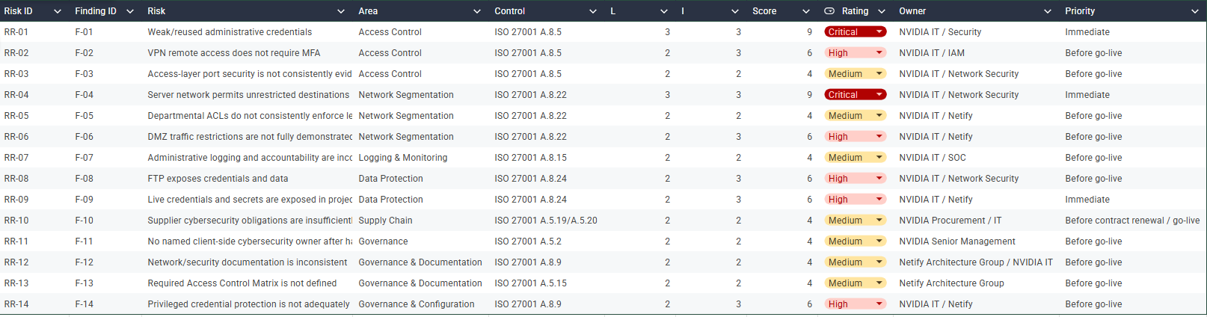
Risk Register

Slide 8
Risk Register — Severity Distribution
14 risks identified, derived from failed and partially-passed controls
14
TOTAL RISKS
IDENTIFIED
TOP 3 PRIORITIES
AC-01
Weak, reused administrative credentials
NS-01
Server network permits unrestricted traffic
DP-02
Credentials exposed in project documentation
NVIDIA-REG-RD-2026-1106 · Confidential
6

Slide 9

Recommendations & Immediate Priorities
Actions to complete before production go-live
AC-01
NS-01
Replace weak, reused administrative credentials and RADIUS shared secrets; rotate anything exposed.
Replace the ALLOW_ALL firewall rule with documented least-privilege rules and default deny.
DP-02
AC-02 / DP-01
Remove credentials and secrets from project documentation and rotate them immediately.
Implement MFA for VPN access and replace FTP with an encrypted transfer protocol (SFTP/FTPS).
GV-01
Remaining High and Medium risks must be remediated, or formally risk-accepted by the appropriate NVIDIA authority, before production deployment.
Appoint a named NVIDIA cybersecurity owner before handover.
NVIDIA-REG-RD-2026-1106 · Confidential
7 / 8

Slide 10
WITH APPRECIATION
Thank You
Questions & Discussion
PROJECT ID
PREPARED BY
NVIDIA-REG-RD-2026-1106
Our group name — BeCode GRC Final Project
CLASSIFICATION
DATE
Confidential
September 2026
AUDIT COMPLETE

