Slide 1


Slide 2

Access Form
Accessible Web-Based Survey Builder
Final Year Project
CS619 - Fall 2025
Submitted by: Umer Farooq
VU ID: bc210423727
Supervisor: Mr. Abdullah Qamar

Slide 3
Group Members Introduction
  Name: Umer Farooq
  VU ID: bc210423727
  Role: Project Lead & Full Stack Developer
  Responsibilities:
  Backend API development (Node.js/Express)
  Frontend development (HTML/CSS/JS)
  Database design (MongoDB)
  Accessibility implementation (WCAG 2.1)
  Voice & SMS integration
  Documentation & Presentation

Slide 4

INTRODUCTION OF PROJECT
The Access Form project is focused on creating a web-based survey builder that is easy to use for everyone, including people with disabilities. Unlike many standard survey tools, Access Form is designed with accessibility in mind to support users with visual, hearing, motor, or cognitive impairments.
This project follows important international guidelines like WCAG 2.1 and WAI-ARIA to make sure surveys can be navigated using keyboards, screen readers, voice commands, and even SMS messages. This ensures that all users, regardless of their device or ability, can participate equally.
Access Form also provides an accessible analytics dashboard that allows survey creators to view and export results in formats that are easy to understand and use. By focusing on accessibility at every stage, this project aims to make online surveys more inclusive and help gather better data from a diverse group of people.

Slide 5
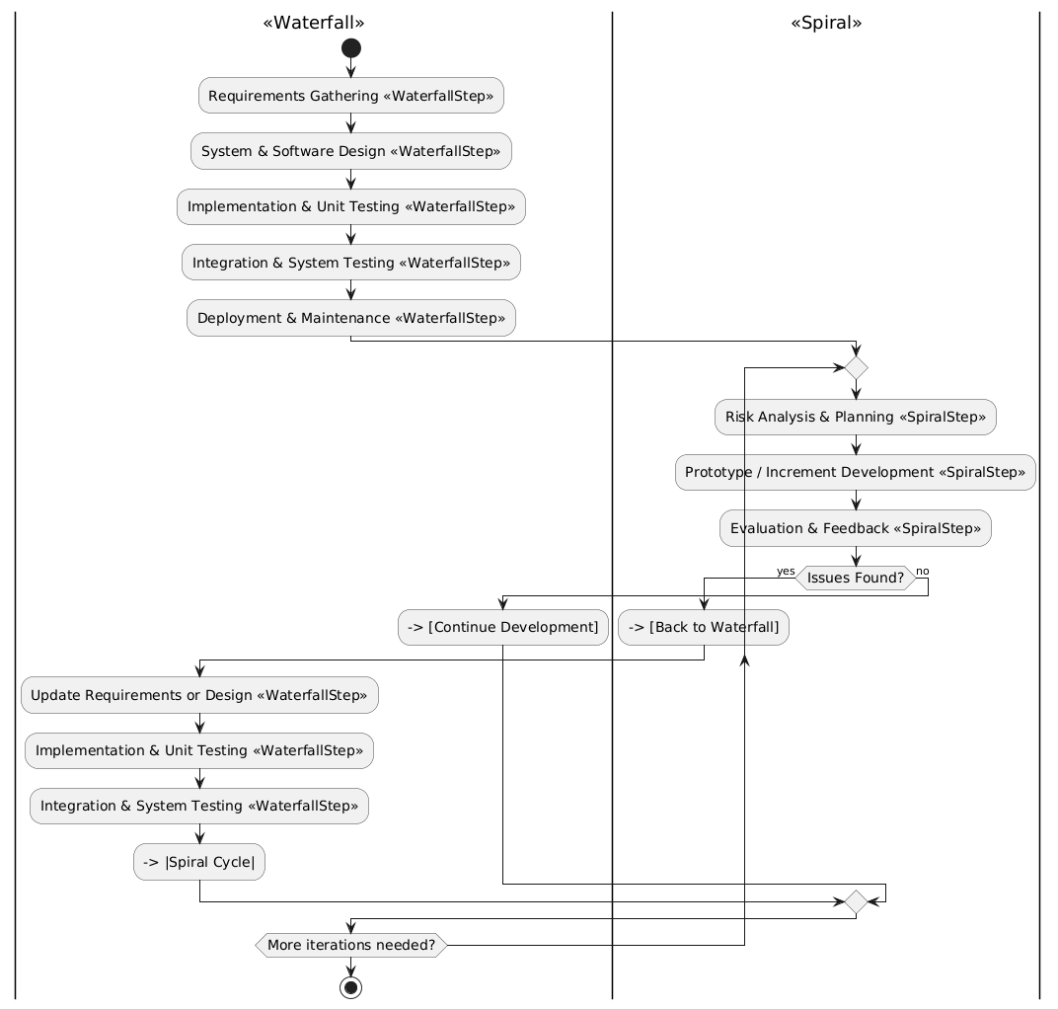
Process Model

Slide 6
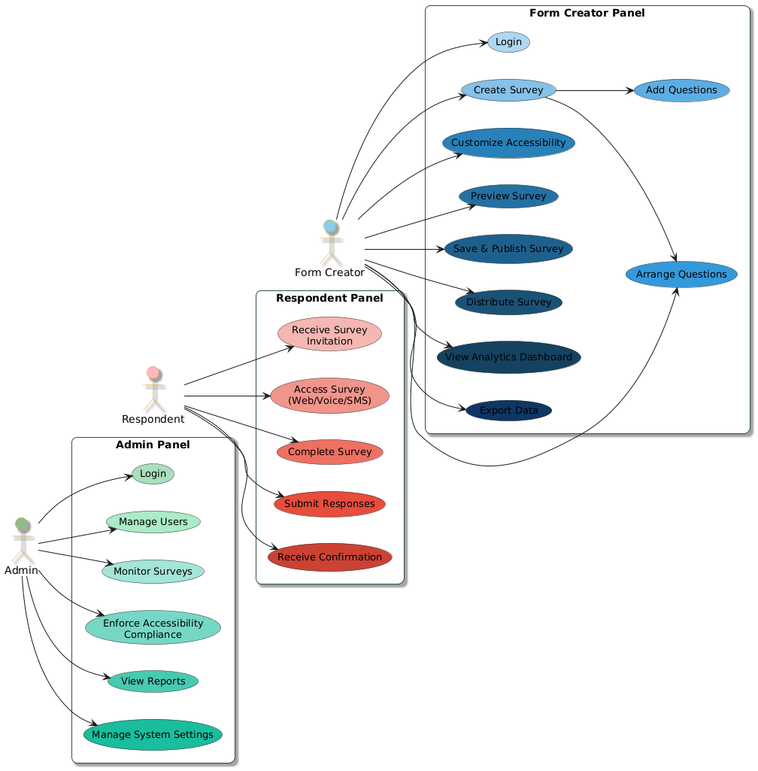
Use Case Diagram

Slide 7
Functional Requirements
ID | Requirement | Description
FR1 | User Role Management | Admins can manage users, assign roles, and monitor accessibility compliance.
FR2 | Survey Creation | Form Creators can build surveys with drag-and-drop interface and support multiple question types.
FR3 | Survey Participation | Respondents can complete surveys via web, voice (speech-to-text), or SMS.
FR4 | Accessibility Features | Support keyboard navigation, ARIA attributes, high-contrast themes, alt text, and captioned videos.
FR5 | Analytics and Reporting | Accessible dashboard with screen reader-friendly data visualizations and export options (CSV, Excel, PDF).
FR6 | Security and Authentication | Secure login with role-based access control and protection of sensitive data.

Slide 8
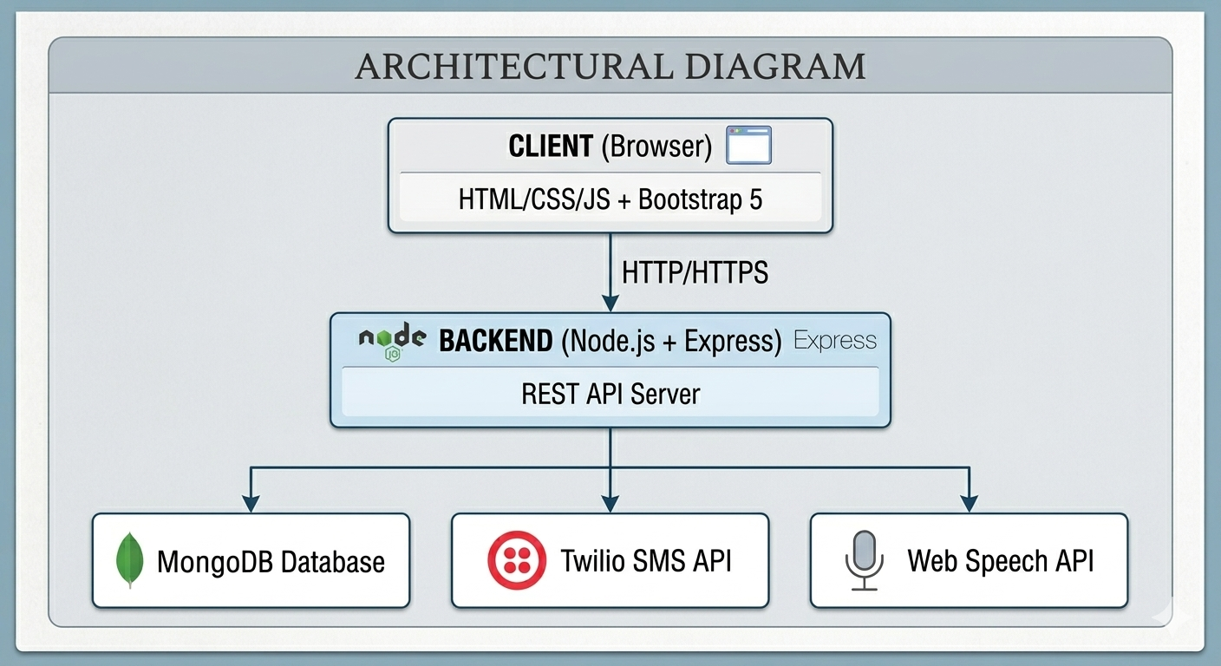
Architectural Design

Slide 9
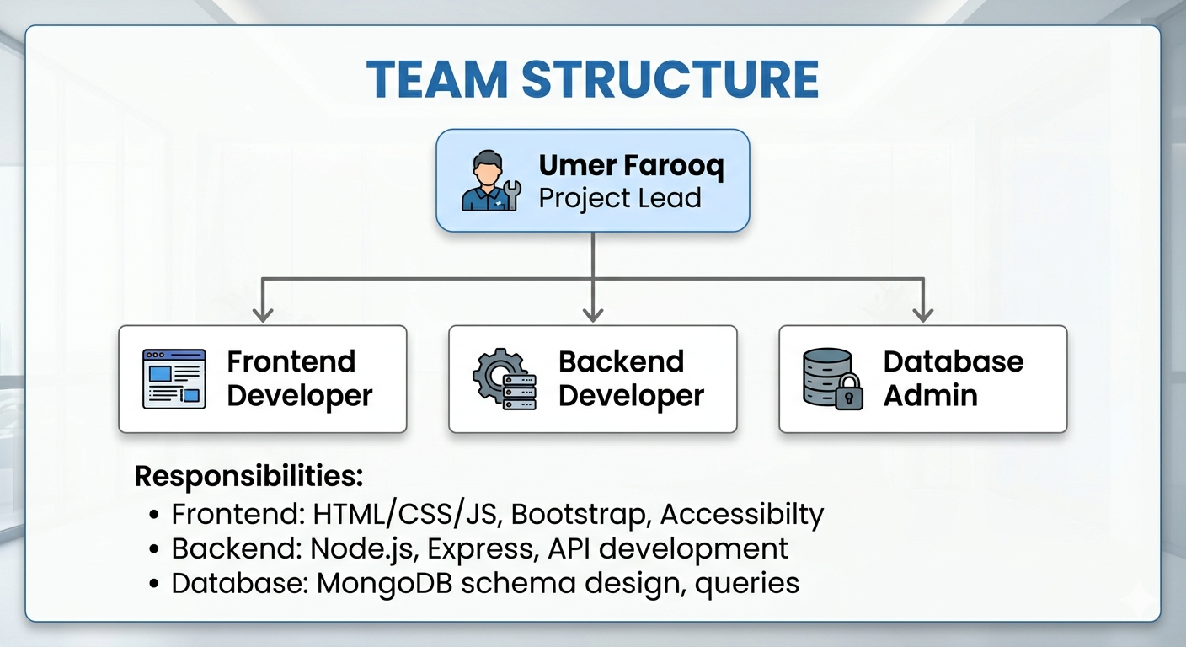
Team Structure

Slide 10
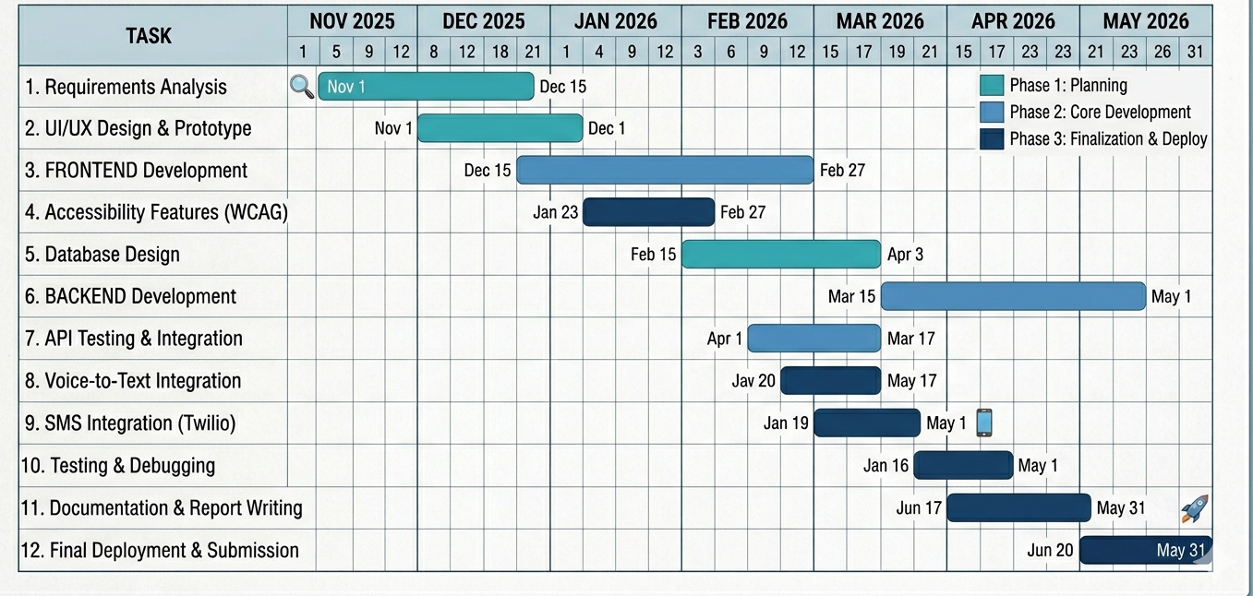
Project Schedule

Slide 11
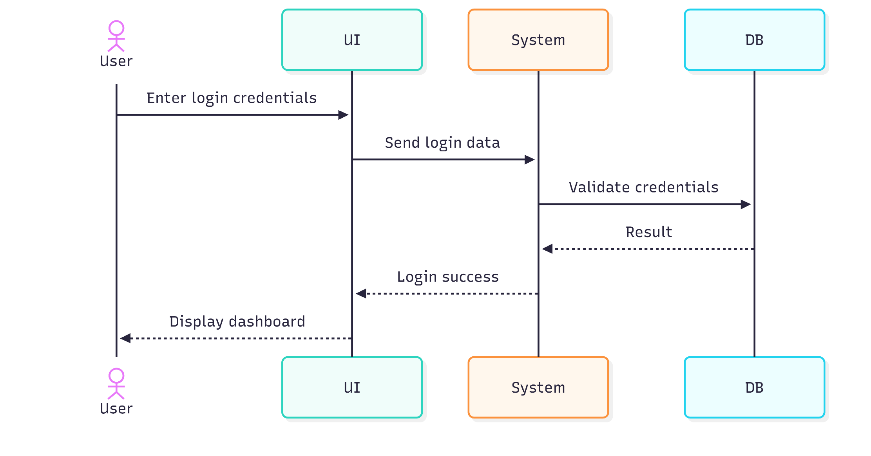
Sequence Diagrams

Slide 12
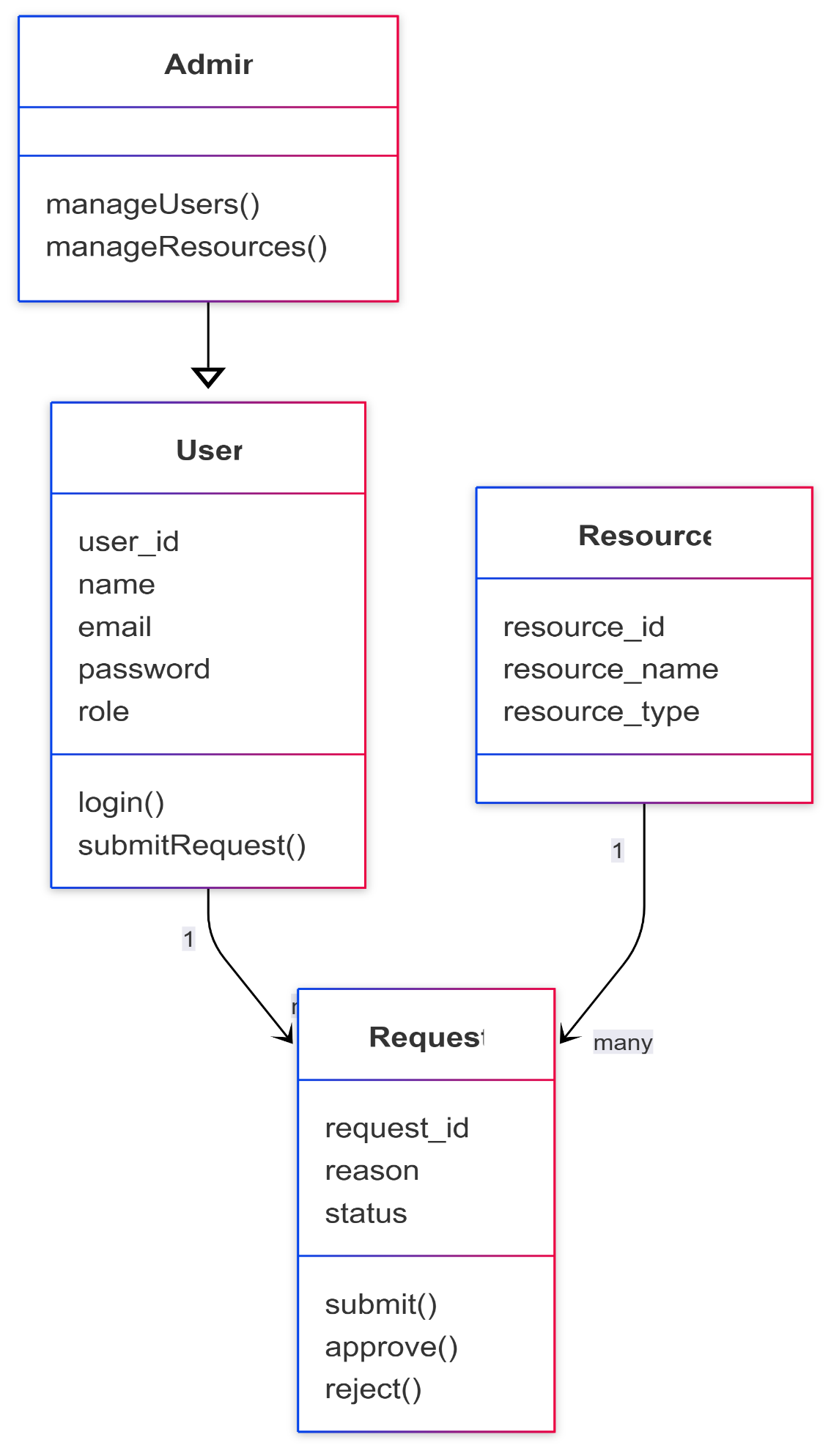
Logical Model/Class Diagram

Slide 13
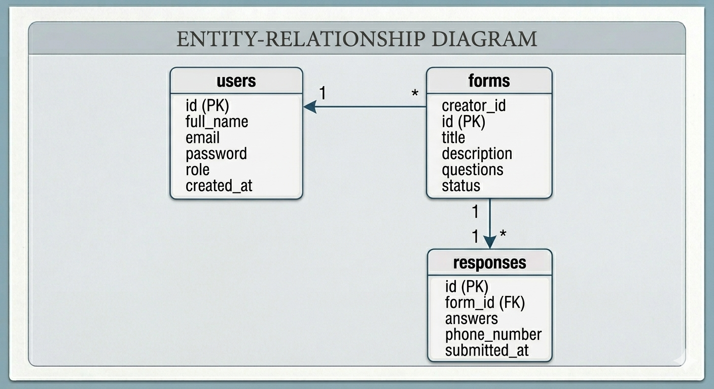
Entity-Relationship Diagram

Slide 14
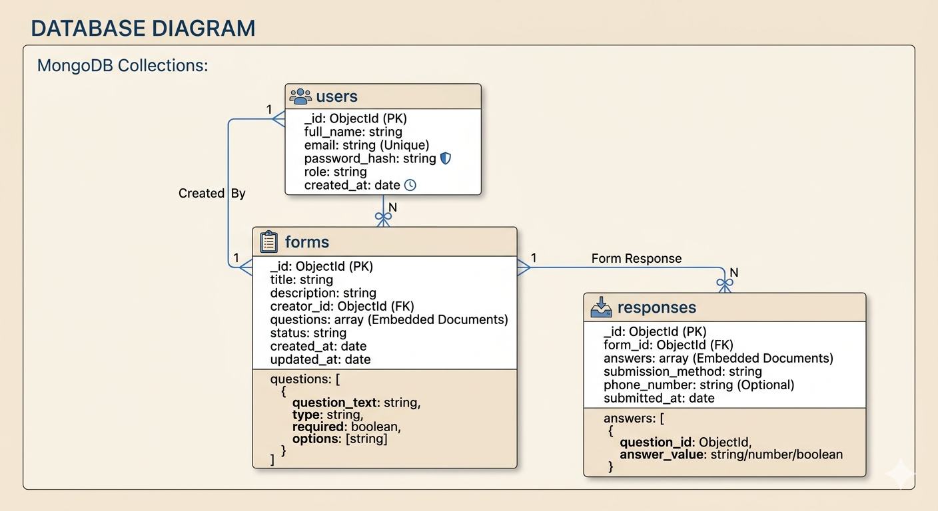
Database Diagram

Slide 15
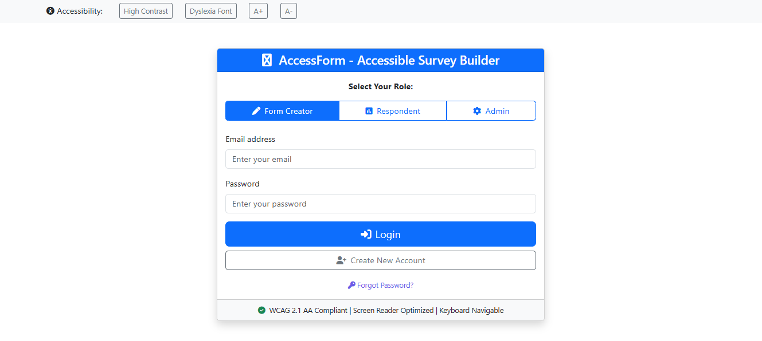
User Interfaces

Slide 16
Tools
Frontend:
• HTML5, CSS3, JavaScript (ES6)
• Bootstrap 5 - Responsive design
• Font Awesome 6 – Icons
Database:
• MongoDB - NoSQL database
• Mongoose - ODM for MongoDB
• MongoDB Compass - GUI
APIs & Services:
• Web Speech API - Voice-to-text
• Twilio API - SMS messaging
Development Tools:
• Visual Studio Code - Editor
• Git & GitHub - Version control
• Chrome DevTools - Debugging
• Postman - API testing

