Slide 1


E-commerce BI & Data Warehousing Solution
Analysis of the Brazilian E-Commerce Public Dataset by Olist (2016-2018)
Student: Sneha Umrikar
Notes:
1

Slide 2
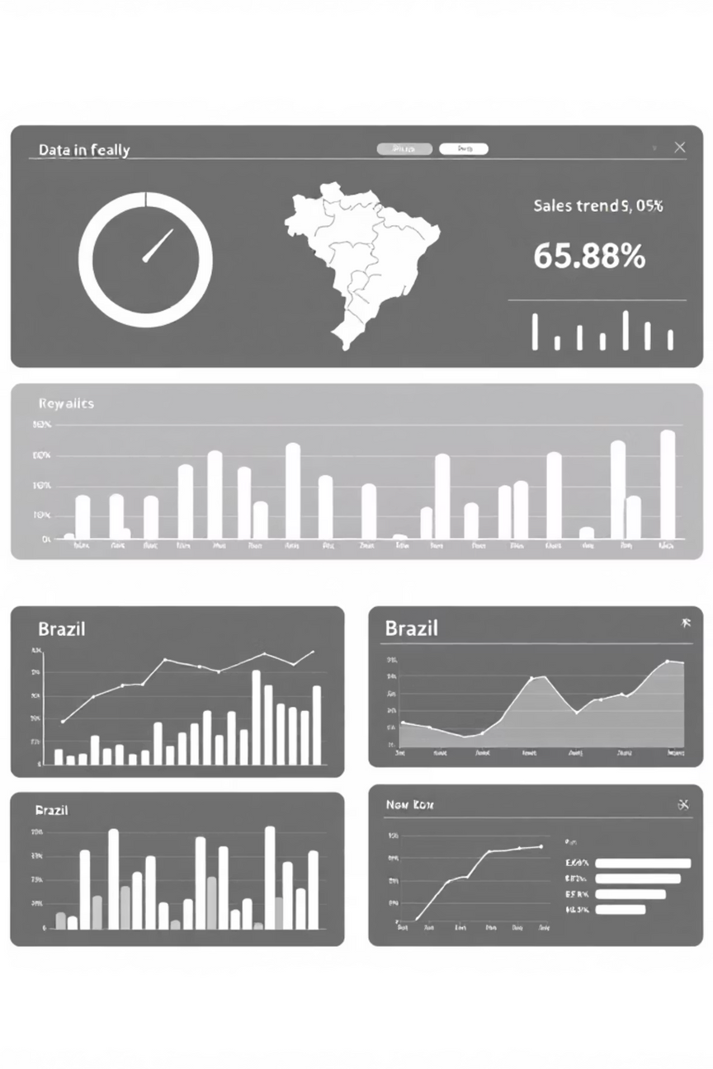
Executive Summary: Key Findings & Recommendations
A comprehensive BI/DW solution utilizing Snowflake, Python ETL, and Power BI for Olist data analysis.
Key Findings
Revenue peaks on weekdays and in November.
High customer/seller concentration in Southeastern Brazil (e.g., São Paulo).
Dominant product categories: Health & Beauty.
Strong link between delivery timeliness and review scores.
Strategic Recommendations
Optimize logistics to reduce delivery delays.
Promote installment payments for high-value purchases.
Target regional markets for increased revenue generation.
Notes:
2

Slide 3
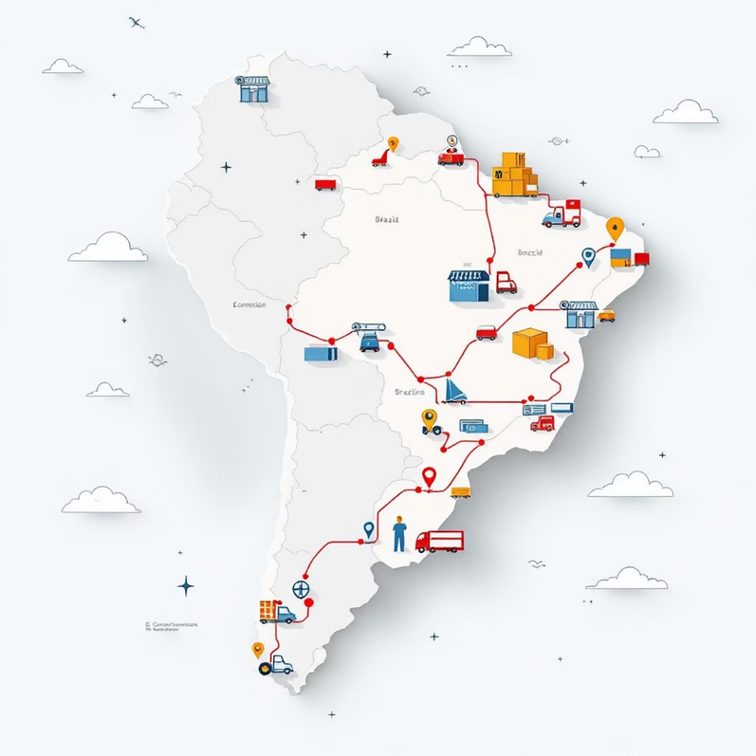
Project Scope and Dataset Justification
This project addresses e-commerce analytics challenges using the Olist dataset, supporting evidence-based decision-making.
The Olist Dataset
Source: Brazilian E-Commerce Public Dataset by Olist (Kaggle).
Content: Over 100,000 orders from 2016-2018 across multiple Brazilian marketplaces.
Data Volume: 9 CSV files (approx. 100MB), 15,000+ records, mixed data types (timestamps, categorical, numeric).
Relevance: Covers the full e-commerce lifecycle (customer, product, payment, review, delivery logistics).
The transactional nature and public availability justify its use for demonstrating
scalable BI solutions, despite limitations like data anonymization.
Notes:
3

Slide 4
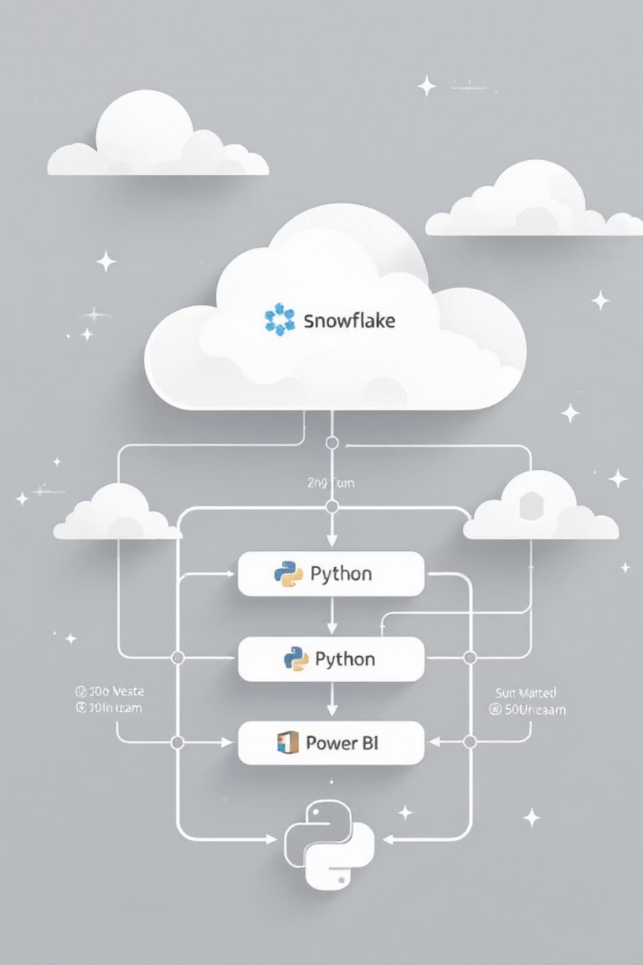




Methodology and Tool Rationale
A structured approach using industry-standard tools for scalability and usability.
Data Warehouse: Snowflake
ETL: Python (Pandas)
Selected for cloud-based architecture, elastic scaling, strong security, and efficient handling of large datasets.
Chosen for flexible scripting, robust open-source libraries, and efficient data manipulation (cleaning, transformation).
Visualization: Power BI
Used for interactive dashboards, native Snowflake integration, and DAX measures (e.g., Gross Merchandise Value).
Notes:
4

Slide 5
Data Storage Evaluation: Why Snowflake?
Comparing storage methods for handling the Olist dataset, prioritizing scalability and integrity for analytics.
Method
Scalability
Integrity Risks
Rationale for Olist
Relational DB (PostgreSQL)
Medium (Vertical)
Duplicates, weak referential integrity
Scaling problems for 100k+ records.
Data Warehouse (Snowflake)
High (Elastic, Multi-cluster)
Data loading errors, version conflicts
Optimized for analytics, parallel processing, security.
Cloud Storage (AWS S3)
High (Infinite)
File corruption, no built-in validation
Ideal for initial storage, but not for direct querying/analytics.
Snowflake minimizes integrity risks with automated backups and enhances security with certifications like SOC 2, ensuring a secure, scalable solution for Olist-like platforms.
Notes:
5

Slide 6





Technical Implementation: DW Design & ETL
The solution uses a snowflake schema in Snowflake, with Python managing the ETL pipeline.
TransformPython ETL
Load to Snowflake
Extract9 CSVs
Clean • Merge • Validate
Notes:
6

Slide 7
DW Design
Snowflake schema: Fact_Order_Items linked to dimension tables
(Dim_Orders, Dim_Products, etc.) for referential integrity.
Extraction & Loading
Transformation
Python extracts data from 9 CSVs into Pandas DataFrames;
Snowflake's COPY INTO used for efficient bulk loading.
Cleaning (duplicates, nulls, invalid data), type conversion, and
integration (merging products with translations).
Validation
Post-loading checks (row counts, null keys, referential integrity)
ensure data quality before analysis.

Slide 8

Data Transformation Impact Analysis
ETL steps enhance data clarity, specificity, and strategic relevance for accurate insights.
Key Transformation Examples
Imputing medians for missing product dimensions.
Removing accents in city names (unicodedata).
Merging products with English category translations.
Creating custom columns in Power BI (e.g., Delivery_Delay_Days).
Without cleaning, duplicates or orphaned records would skew counts (e.g., inflated reviews).
ETL increases data credibility, transforming 100k+ raw records into actionable visuals.
Notes:
8

Slide 9
Risk Management and Mitigation
Proactive strategies to ensure data integrity, system integration, and scalability.
Data Integrity
System Integration
Scalability
Risk: Missing values/duplicates skew results (e.g., orphaned seller_id).
Risk: Mismatched IDs between sources leading to incomplete datasets.
Risk: Lagging query performance as the dataset grows.
Mitigation: Automated primary/foreign key checks and post-loading validation scripts.
Mitigation: Dependency-ordered loading and merge validations; rollback scripts for contingency.
Mitigation: Snowflake's auto-scaling, partitioning, and indexing features.
Effectiveness is proven by successful integration and minimal critical errors in validation, adhering to industry standards like ISO 27001.
Notes:
9

Slide 10




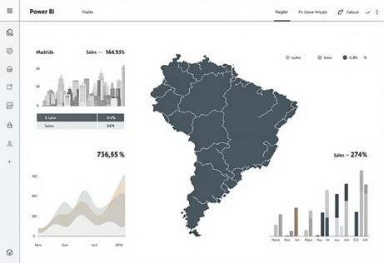
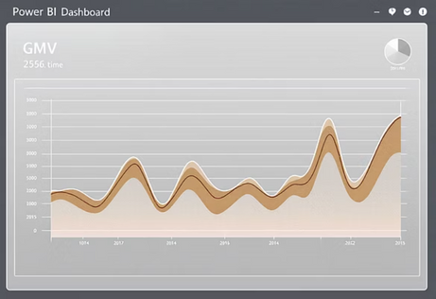
Data Analysis Results: E-commerce Patterns
Key insights derived from Power BI visualizations on transformed Olist data.
Revenue Trends
Geographic Concentration
GMV is smaller on weekends but higher during weekdays, growing monthly until August.
São Paulo (48k orders, highest GMV), Rio de Janeiro, and Minas Gerais lead in customer and seller locations.
Product Performance
Delivery & Reviews
Health & Beauty and Watches/Gifts are highest revenue earners. Bed Bath & Table has 4.04 average reviews.
Minimal cancellations (~550). Delayed deliveries are directly associated with lower customer review scores.
Notes:
10

Slide 11




Strategic Recommendations & Conclusion
Actionable steps to enhance efficiency and customer satisfaction based on data analysis.
Upgrade Logistics
Targeted Marketing
Minimize "Very Late" deliveries using regional carriers and AI forecasting to boost customer satisfaction by 20%.
Target Southeastern Brazil with weekday ads and promote high-revenue products (Health & Beauty).
Payment Enhancements
Seller Management
Offer installments for high-value items and include debit/voucher options to access non-credit users.
Track on-time rates and provide training to low-reviewed sellers to ensure retention and quality.
Conclusion
This project successfully delivered a robust BI/DW solution, transforming raw Olist data into strategic intelligence that supports data-driven decisions for enhanced efficiency and customer satisfaction.
Notes:
11

