Slide 1

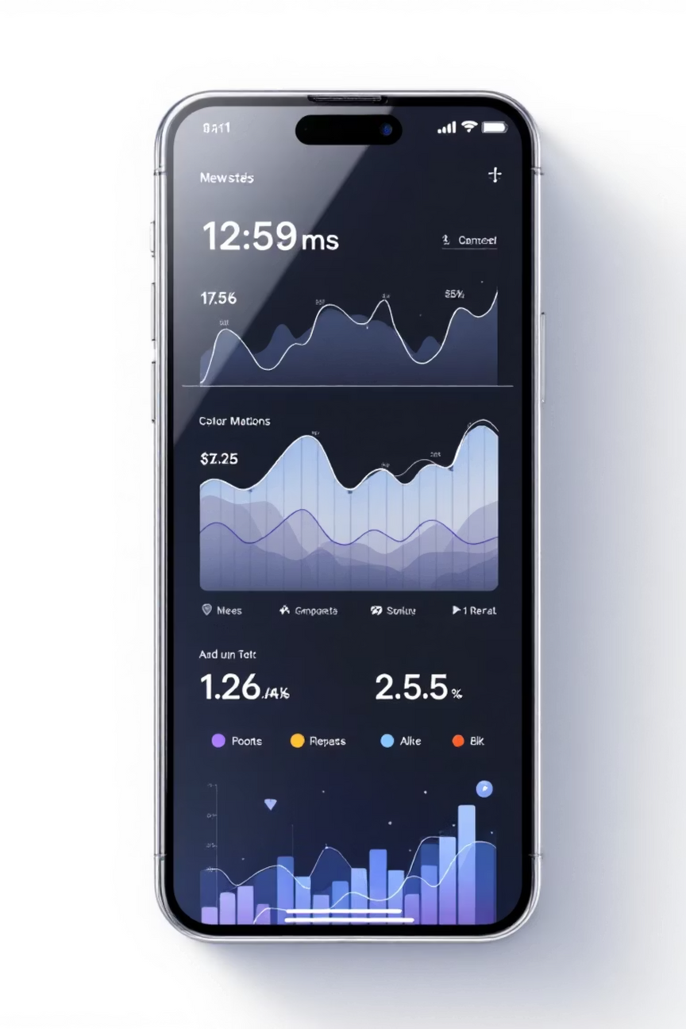
Sentiment and Thematic Analysis of "My One NZ" Mobile Application User Reviews
A Business Data Analytics Project
Student: Sneha Umrikar | Course: MBI806B | Date: October 19, 2025
Notes:
1

Slide 2
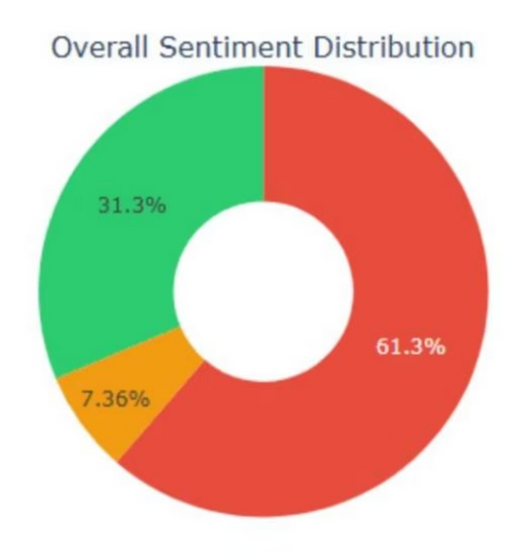
1. Introduction & Problem Identification
Context: The Competitive Telecom Landscape
Overall Sentiment Distribution
One NZ (rebranded from Vodafone) operates in a highly competitive New Zealand telecom market. Mobile apps are now critical customer touchpoints, with 90% of users expecting a smooth experience. Poor app performance directly impacts customer lifetime value and competitive advantage.
The Business Challenge
The My One NZ app faces a customer satisfaction crisis due to persistent issues: authentication failures, instability, and billing inconsistencies. This results in low ratings and potential churn.
61%
$9-15M
Negative Sentiment
Annual Financial Exposure
The majority of reviews (61.3%) express negative sentiment, indicating widespread user dissatisfaction.
Notes:
2

Slide 3


Key Questions Addressed
What specific issues drive negative sentiment and
their frequency?
Which application versions demonstrate highest
dissatisfaction?
How effective are current customer response strategies?
Can we predict negative reviews for early intervention?
What actions will maximize satisfaction within
resource constraints?
Notes:
3

Slide 4






2. Literature Review: Analytical Foundations
Sentiment Analysis in BI
NLP Techniques
Leveraging customer feedback for competitive advantage and product prioritization. Ensemble methods often outperform individual techniques.
Computational methods for text interpretation, including VSM, TF-IDF, and contextual embeddings from neural language models.
ML for Text Classification
App Analytics
Progression from rule-based (VADER) to deep learning models (BERT, RoBERTa) that capture bidirectional context for sentiment.
Reviews are vital unstructured data. Functional failures (35% of negative reviews) and feature-level sentiment provide actionable insights.
Notes:
5

Slide 5
3. Methodology: Model Architecture & Data Pipeline
Data Collection & Preprocessing
9,386 Google Play Store reviews (Dec 2011–Sep 2025) were collected. Raw data was processed through a four-stage NLP pipeline to optimize for different analyses.
The study uses quantitative secondary data analysis, combining descriptive statistics, supervised classification, and unsupervised topic discovery for robust validation.
Data Collection
9,386 public Google Play Store reviews (Dec 2011–Sep 2025).
Preprocessing & NLP
Normalization, tokenization, stopword removal, and lemmatization to structure raw text.
Sentiment Analysis
Comparative analysis using VADER, TextBlob, and RoBERTa deep learning model.
Supervised ML
TF-IDF vectorization used to train five algorithms (Logistic Regression, Random Forest, SVM, Naive Bayes, and Gradient Boosting).
Topic Modeling
Latent Dirichlet Allocation (LDA) and Non-Negative Matrix Factorization (NMF) to discover latent thematic structures (e.g., update, data, billing). Keyword Analysis to identify the issues related to telecom domain
Notes:
6

Slide 6

4. Tools Used and Data Visualization
Programming & Analytics Tools
Python 3.10, Pycharm, Jupyter
Core environment for development and interactive analysis.
Pandas & NumPy
Data manipulation and numerical operations.
NLTK, TextBlob, Hugging Face
Natural Language Processing and deep learning models.
Scikit-learn & Gensim
Machine learning classification and topic modeling (LDA/NMF).
Visualization Techniques
A variety of visuals were used to convey complex data clearly:
Word Clouds (TF-IDF weighted frequency)
Time Series Charts (with moving averages)
Stacked Area Charts (sentiment breakdown)
Violin Plots and Annotated Heatmaps (Confusion Matrices)
Notes:
7

Slide 7
5. Critical Findings - Sentiment Crisis
61.3%
2.73
79.1%
6000+
Negative Sentiment
Mean Rating
RoBERTa Accuracy
Low Response Rate
5,756 reviews show crisis-level negative sentiment.
Significantly low compared to competitor Spark NZ (4.4).
Deep learning model achieved the highest sentiment classification accuracy.
A high volume of reviews received no official response.
Version 3.x generated the most negative reviews, while Version 7.x currently holds a low 2.45 rating.
Notes:
8

Slide 8
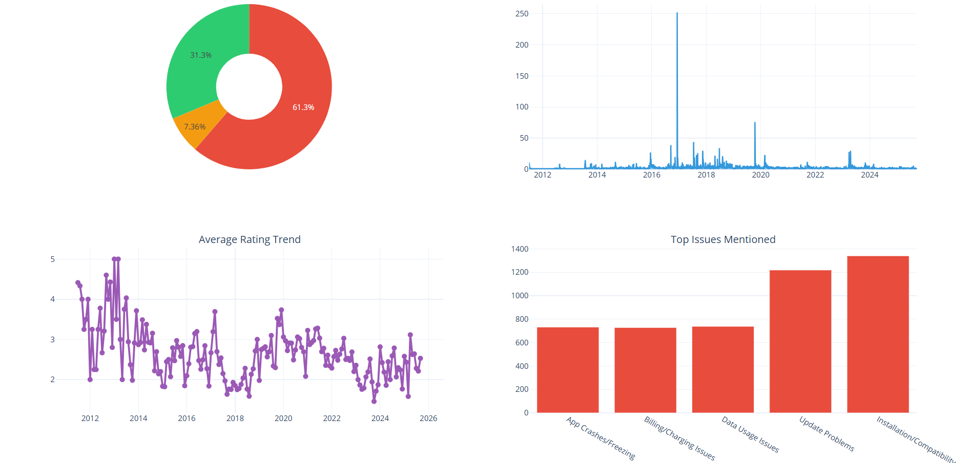

Slide 9
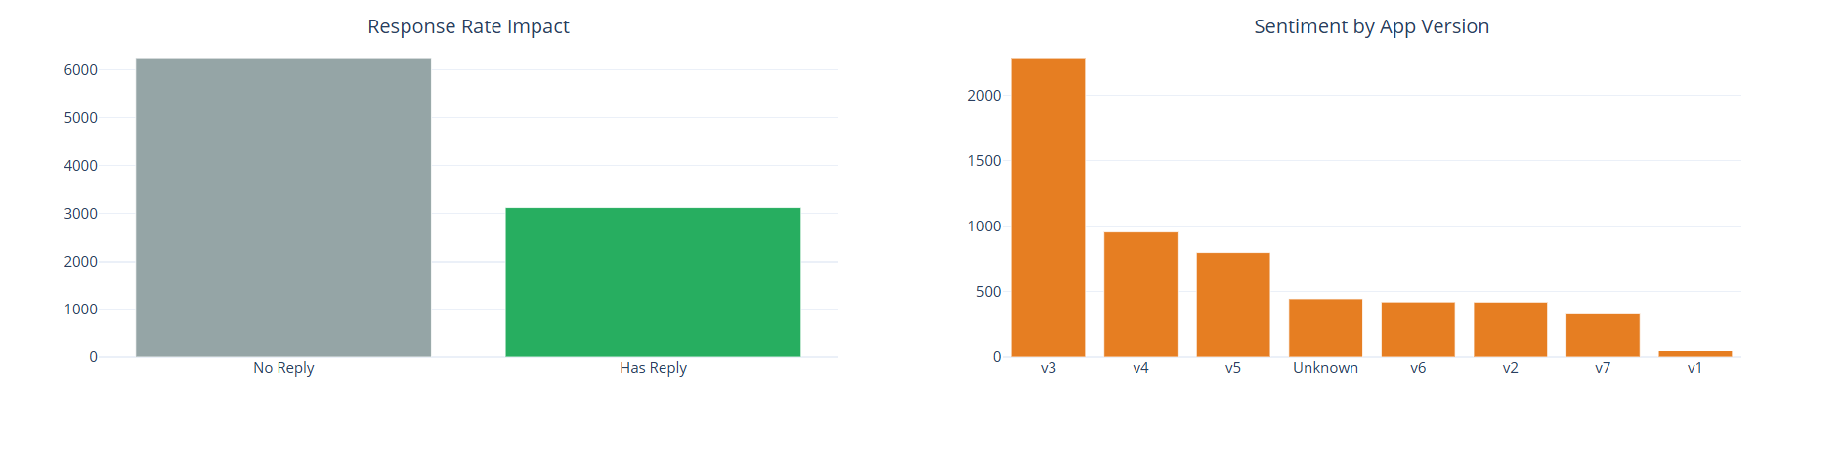

Slide 10
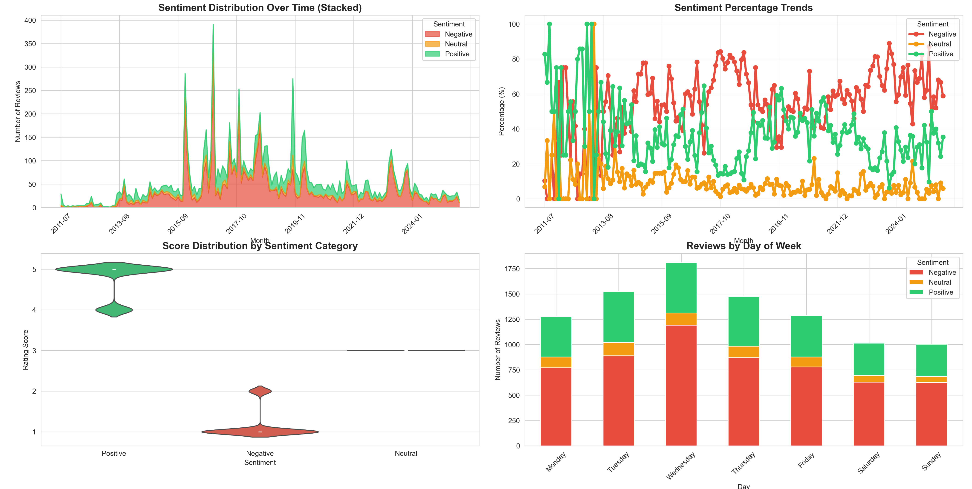

Slide 11
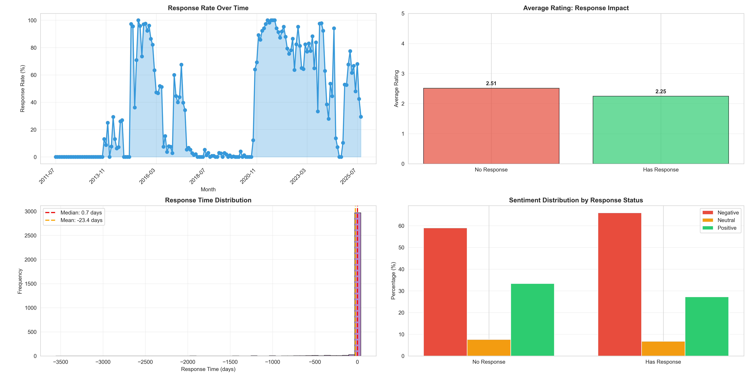

Slide 12
Top Issues in Negative Feedback
23.28%
21.17%
12.82%
Installation/Compatibility
Update Problems
Data Usage Issues
1,340 mentions of issues during setup.
1,219 reviews citing issues following app updates.
Complaints related to data tracking and consumption.
12.71%
12.64%
App Crashes/Freezing
Billing/Charging Issues
Stability issues impacting user experience.
Inconsistencies and lack of clarity in billing.
Notes:
11

Slide 13
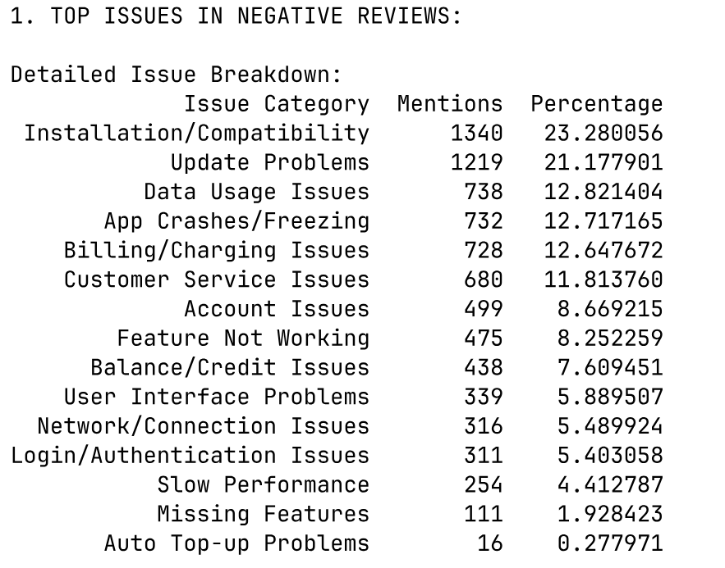

Slide 14
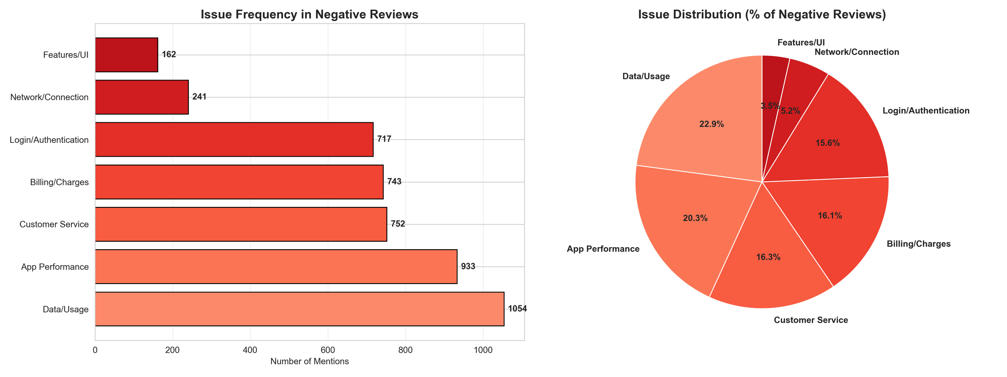

Slide 15
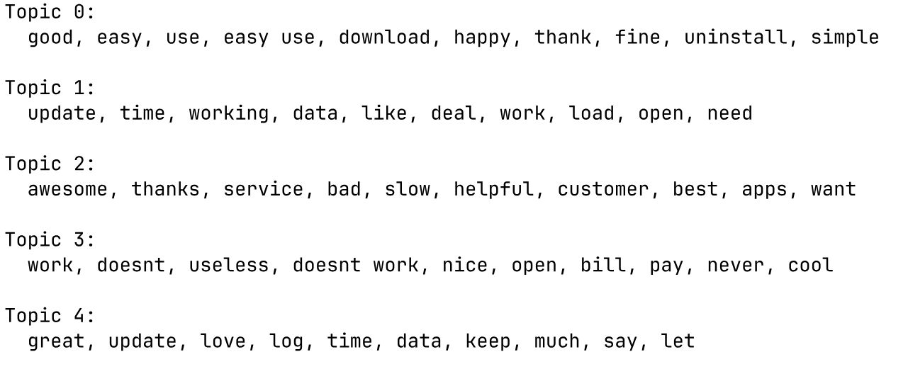
Topic Modeling
Topic modeling identified five dominant themes.
Notes:
14

Slide 16
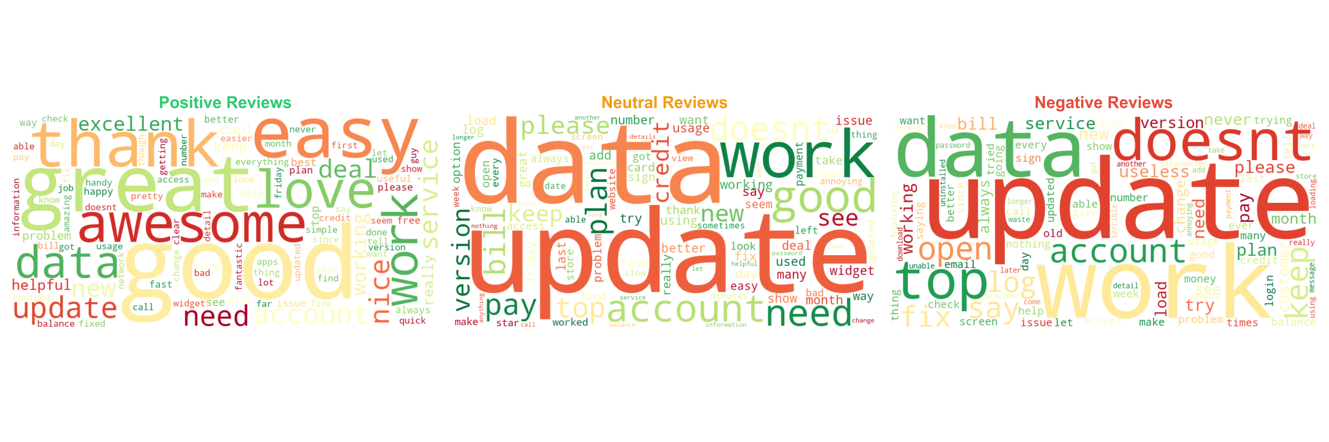

Slide 17
Statistical Significance
Topic 0 shows no significant correlation (d = 0.04, p = 0.059)
Topic 1 (Updates/Working) shows the strongest negative impact with 5,195 reviews (55.3%) average 1.84/5.0 versus 3.14/5.0 for others
Topic 2 (Service Quality) shows negligible practical impact (d = -0.19, - 0.32 stars).
Topic 3 (Non-Functionality) affects 3,939 reviews (41.9%), averaging 1.78/5.0 versus 2.89/5.0 for others, a 1.10-star decrease (d = -0.69, medium-large, p = 0).
Topic 4 (Sarcasm) consisting of 5,383 reviews (57.3%) and has an average of 2.02/5.0 despite positive words, a decrease of 0.94-stars (d = -0.58, medium, p = 0)
These incredibly small p-values (1.63e-302, 1.84e-246, 4.82e-155) attest beyond any doubt that these differences are true differences and not due to random chance
The three major issues appear interconnected, recent application updates introduced bugs therefore breaking functionality and prompting users to use sarcastic language to express frustration
Notes:
16

Slide 18
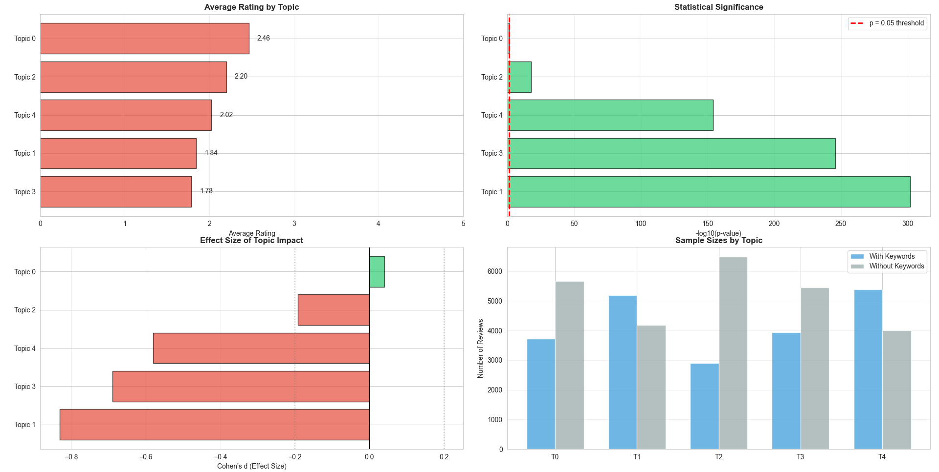

Slide 19
Version Analysis: The Catastrophic Rating Decline
Version 7.x
Version-level analysis shows a dramatic decline in user satisfaction, suggesting systematic defects introduced in recent updates.
The top priority is to stabilize the update and release process to prevent further degradation.
Version 7.5 Average Rating: 2.45 (64.7% Negative)
Baseline Version 1.x Rating: 3.78 (35.1% Positive)
Version 3.x: Most negative reviews
Notes:
18

Slide 20
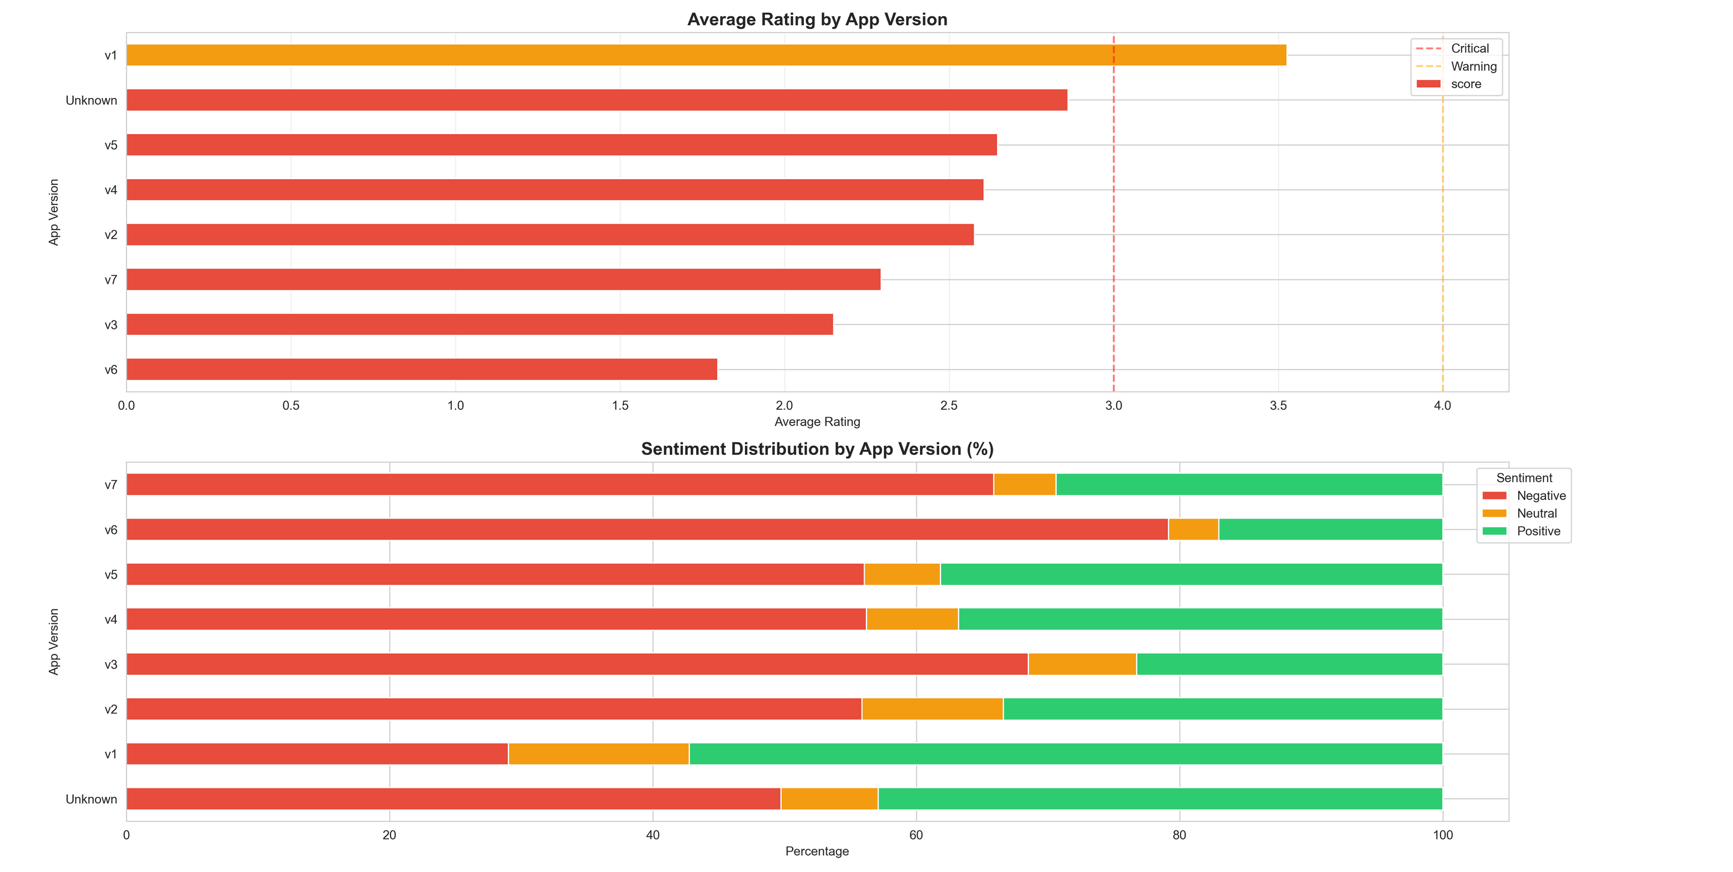

Slide 21
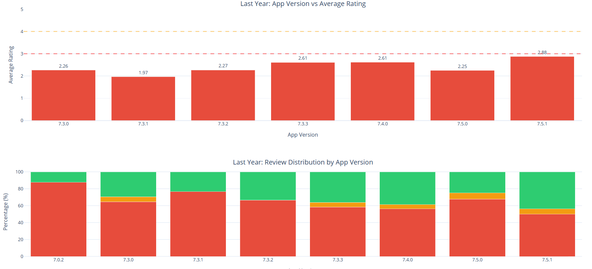

Slide 22
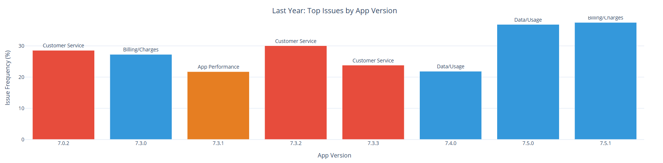

Slide 23
Unsupervised Sentiment Classification
RoBERTa reached 79.1% accuracy, improvement from VADER, and fairly consistent
precision in all the classes, namely, negative 88.58%, neutral 25.90% and positive 72.83%.
Much lower precision of neutral class (25.90%) also corresponds to an innate difficulty
of neutral sentiment classification, which itself incorporates true mixed feelings
and mild positive/negative sentiments
Notes:
20

Slide 24
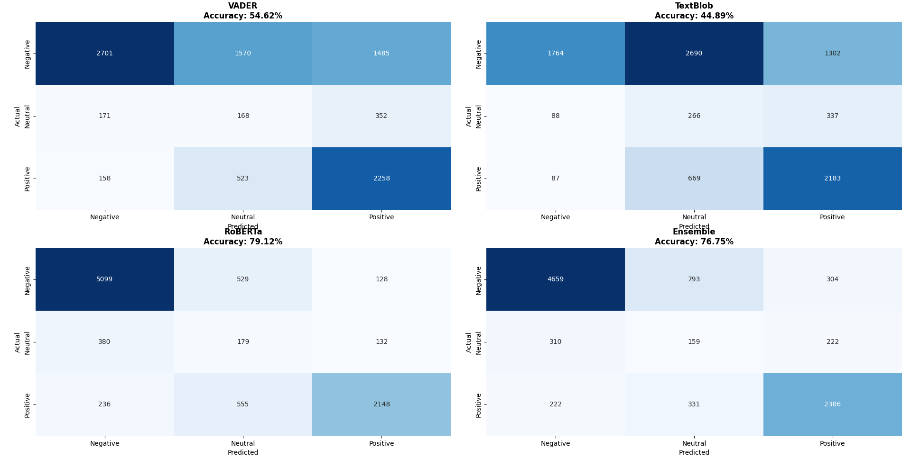

Slide 25
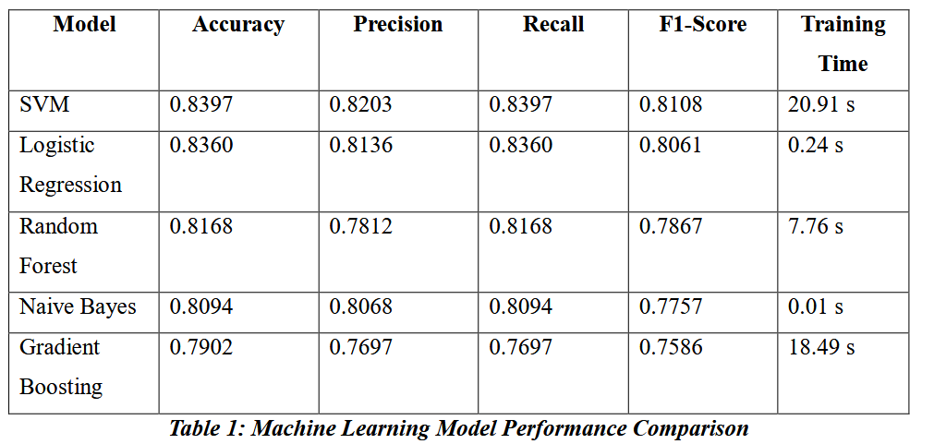
Model Performance
The Support Vector Machine (SVM) model achieved the highest accuracy, demonstrating strong potential for automated sentiment monitoring.
Notes:
22

Slide 26
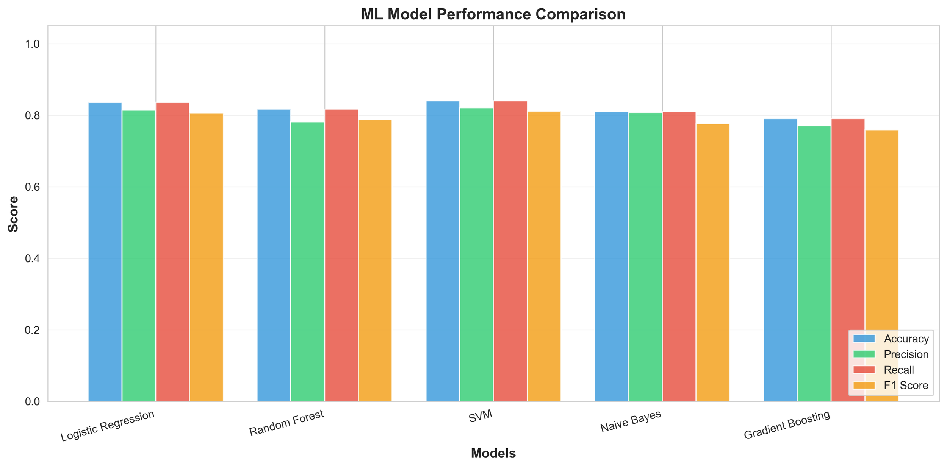

Slide 27
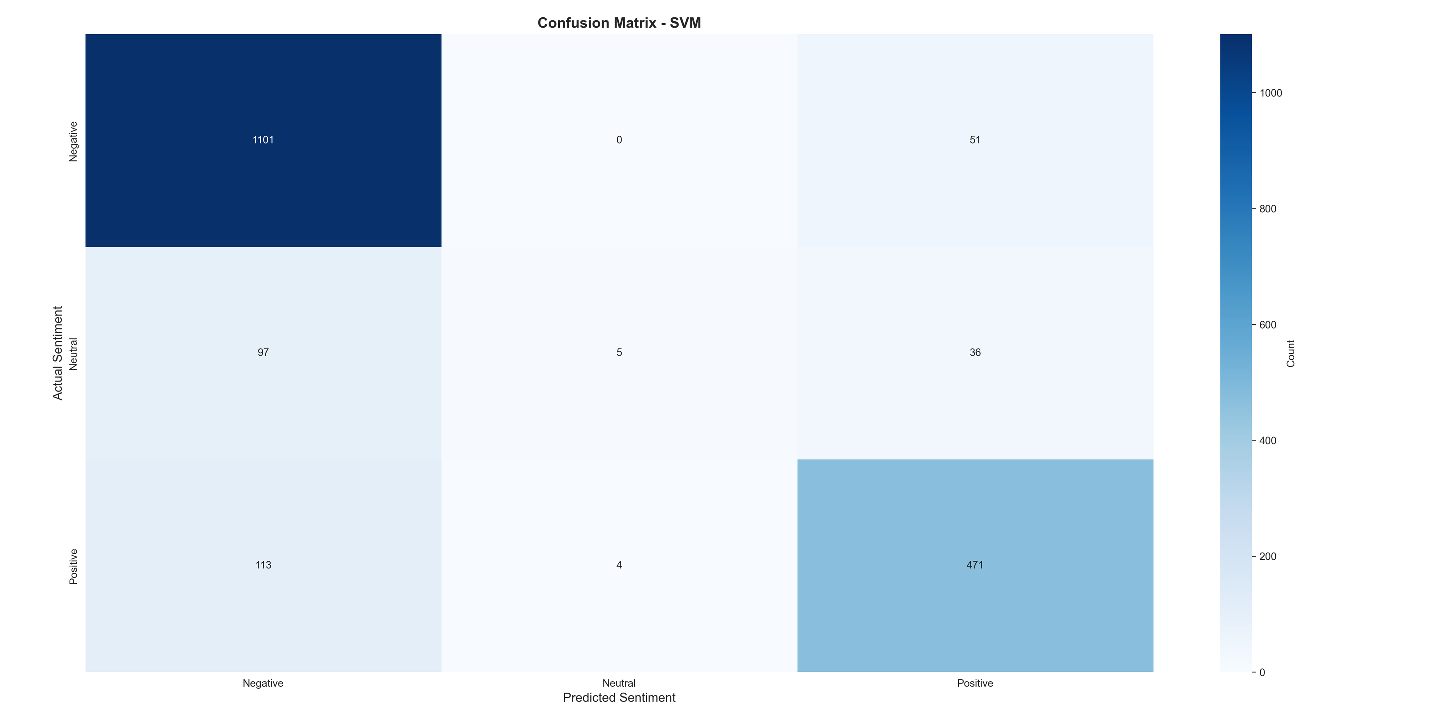

Slide 28

7. Ethical Practices and Limitations
Data Privacy and Ethics
Analysis used only publicly available reviews, excluding PII. Anonymization was applied to usernames, and methodological transparency was maintained for reproducibility.
Algorithmic Bias Mitigation
Bias was mitigated using ensemble techniques and validation against ground truth. Interpretable models (SVM) were favored for transparency.
Limitations
Single-platform focus (Google Play only) and self-selection bias in reviewers limit generalizability. Correlation does not imply causation.
Measurement Error
Sentiment accuracy of 79.12% means approximately 1 in 6 reviews is misclassified, contributing to measurement error.
Notes:
25

Slide 29




6. Strategic Recommendations
Stabilize Update Process
Implement staged rollouts and increased testing. This could address ~70% of complaints and raise ratings from 2.42 to 3.72/5.0.
Response Rate Recovery
Staff managers and train staff for empathy and technical escalation. Set a response time goal of <24 hours (down from 7-day median).
Billing Transparency
Enhance in-app billing with itemized charges, proactive notifications (3-day advance notice), and simplified dispute resolution.
Beta Testing Program
Shift from reactive firefighting to proactive validation. Incentivize negative reviewers to test and provide feedback.
Notes:
26

Slide 30

Long-Term Strategy: Modernization
& Quality Culture
Infrastructure Modernization
Predictive Analytics Platform
Address technical debt for a sustainable platform.
Automated Sentiment Monitoring for real-time issue detection.
Implement CDN for geographic optimization.
Predictive Churn Modeling to identify at-risk customers.
Ensure Infrastructure Redundancy (99.99% uptime target).
Feature Request Extraction to prioritize enhancements.
Adopt Microservices Architecture for independent updates.
Competitive Intelligence tracking.
Innovation Lab
Quality-First Cultural Transformation
Focus on competitive differentiation.
Establish a specialized QA Team.
Explore Augmented Reality for service visualization.
Define a clear "Definition of Done."
Implement Executive Quality Reviews.
Develop Voice Control for hands-free operation.
Notes:
27

Slide 31
Ethical Considerations & Limitations
Study Limitations
Ethical Data Handling
Platform Coverage
Adhered to strict data privacy: using only public, anonymized data, reporting aggregated statistics, and avoiding individual user identification or demographic inference.
Only Google Play reviews were analyzed; iOS user differences are unknown.
Causation vs. Correlation
Observational design cannot prove causation; confounding factors may exist.
Algorithmic Bias Mitigation
Representativeness
Self-selection bias means reviewers are a motivated subset; the "silent majority" is not represented.
Mitigation strategies address Demographic Bias (ensemble methods), Language Bias (social media-trained RoBERTa), and Domain Adaptation (validation against in-domain ground truth).
Classification Accuracy
79.12% accuracy means measurement error is present (~1 in 6 reviews misclassified).
Notes:
28

Slide 32
THE END
Notes:
26

