Slide 1


The Housing Crisis in Austin
Andrew Price
Min C Kim
Umu Lamboi
Tania Mukherjee
Data Analytics and Visualization Bootcamp
UT Austin
Dec 2017

Slide 2
Motivation & Summary
Most of our teammates went or going through home buying experience and we have found the frustration about housing price is very common
We picked three major counties in Austin to look at (2007-2017), U.S. Census data
1. Hays County
2. Travis County
3. Williamson County
Analyze different contributing factors (population, wage, occupancy)
We came up with a list of questions that we wanted to answer using data viz
Notes:
Occupancy, housing tenure, year household moved in, value of houses, mortgage status, % of salary used for mortgage, gross rent, % of salary used for rent

Slide 3
Data & Data cleanup
Data collection form census data
Export the data to excel and transforms to csv files
We dropout some data due to major discrepancies
Fixed differences in the mortgage status
Combined all csv into single dataframe

Slide 4
Data Analysis
How does the population growth compare to the rising housing costs?
What is Austin’s housing availability over the past ten years?
How have rising costs affected personal finances? With housing costs increasing, have average wages increased as well?
What ultimately is driving housing costs up?

Slide 5
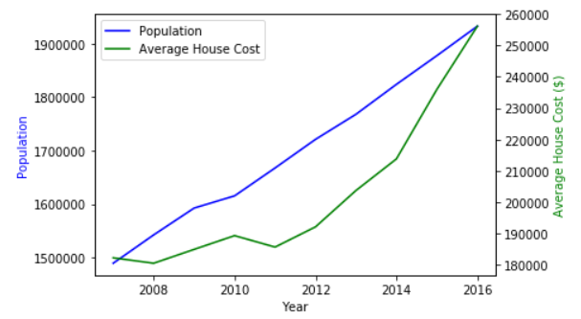
Population vs. Housing Costs
Austin is one of the fastest growing cities and as a result, cost of living has increased
Since 2007, population has grown by 30% and average housing cost has increased by 41%*
*Source: U.S. Census Bureau

Slide 6
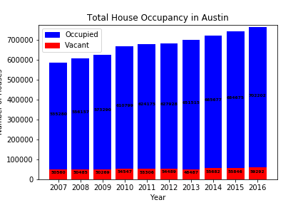
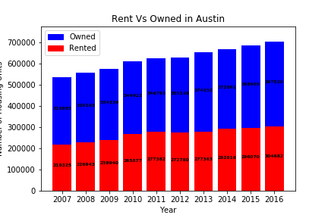
Total Housing Situation
Influx of population in the past decade
Vacancies stagnant shows people not moving out of Austin
*Source: U.S. Census Bureau

Slide 7
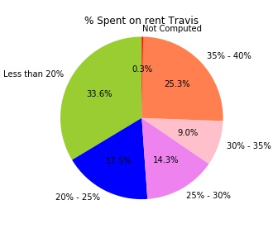
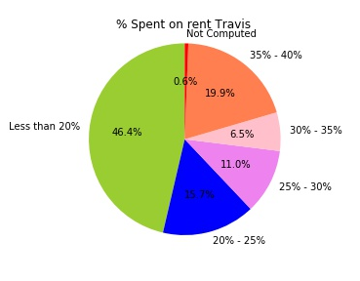
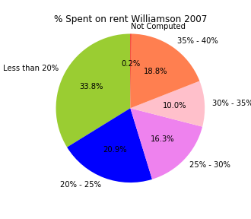
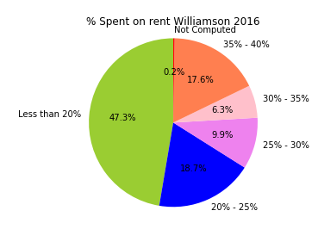
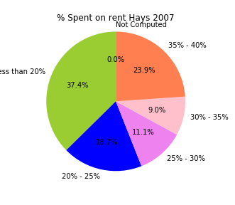
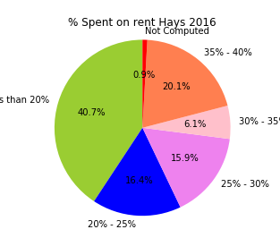
Gross rent spent as % of income
2007
2016
People using less money for rent is increasing over the years
*Source: U.S. Census Bureau

Slide 8
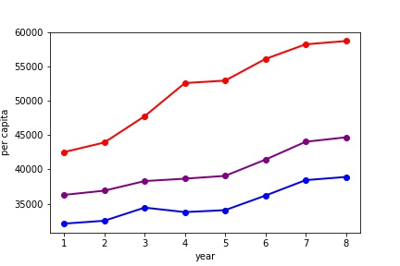
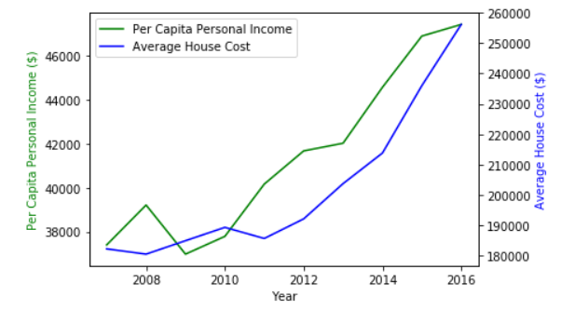
Per Capita Income vs. Housing costs
Have houses become less affordable despite rising wages?
Travis
Will
Heys
Using the pearson coefficient comparing average house cost to average income, we get a coefficient 0.9255198 which indicates a strong correlation
What this means is that house costs have increased relatively in-line with wage growth
*Source: U.S. Census Bureau
Notes:
With the Austin market growing as more and more employers are moving here and scaling, it seems like houses are becoming less affordable. However, average wages have also increased over time. So…

Slide 9
Conclusion
Despite the rising housing costs, people living more frugal lives, making smarter housing choices with technologies like Craigslist/Zillow, and making higher wages
Total occupied houses are growing rapidly over time while vacant houses remain flat, showing that demand has become much higher than supply
Ultimately it is supply vs. demand which is driving housing costs up. There are more people moving to Austin (110 per day*) than there are houses being built
*https://www.bizjournals.com/austin/news/2017/03/22/how-many-people-moved-to-austin-in-2016.html
**Source: U.S. Census Bureau

Slide 10
Post Mortem
Obtaining the data we wanted
Originally wanted to use Zillow’s API, encountered issues
Issues with city data from U.S. Census Bureau
Data cleaning
Issues with csv outputs, here is an example:
sep=“\t” fixes the above by separating the values allowing us to read the csv properly
Notes:
Originally wanted to use Zillow’s API to pull data, however there is a low daily limit for API queries
U.S. Census Bureau provided data for “Austin County, TX” and “Austin City, TX”, neither source provided data we needed for greater Austin area
We determined we can get Austin data by pulling data points by county instead (Travis, Williamson, and Hays) and merging county data into single dataframes
We encountered some issues with the formatting of the csv outputs, here is an example:
We were able to use python to clean this data, in this case the sep=“\t” fixes the above allowing us to read the csv properly

Slide 11
Q&A

