Slide 1
Early Prediction of Diabetes Risk: Leveraging Various Models for Improved Detection
Project Presentation
Tejaswi Neelapu, Maelice Yamdjieu, Saluwa Umuhoza

Slide 2
Contents
Introduction
Data Preparation
Question for the problem
Analysis Methods
Modeling
Results
Conclusion

Slide 3
Introduction
Research Objective:
This approach involves identifying individuals who are at a higher risk of developing diabetes based on various factors, allowing for targeted monitoring and interventions.
Factors under Consideration:
Our analysis focuses on key health indicators, including blood pressure, cholesterol levels, and lifestyle ,BMI etc
Approach:
The investigation involves establishing connections between individuals' health report cards and identifying potential indicators of diabetes.
Prediction Scale:
We will categorize the predictions into two classes: 0 indicating no diabetes and 2 signifies a high likelihood of diabetes.
Selective Health Factors:
Our predictive model will specifically consider health factors directly associated with the occurrence of diabetes, streamlining the analysis for greater accuracy.

Slide 4
Data Preparation
Data Types:
The dataset contains a mix of categorical and numerical data.
All data has been categorized in various ways, with different ranges, except for BMI.
Binary Data:
The dataset has binary (yes/no) information converted to numerical (1/0) values.
Data Set Size:
The dataset is substantial, totaling approximately 541 MB in size.
It comprises 253,680 rows and 22 columns.
Data Source:
The dataset is derived from the 2015 BRFSS (Behavioral Risk Factor Surveillance System).
BRFSS is a project by the Centers for Disease Control and Prevention (CDC).
Data Collection:
BRFSS collects data through surveys conducted via both landline and cellular telephones.
Data Availability:
The dataset has undergone cleaning and is available on Kaggle, making it accessible for analysis.

Slide 5
Data Structure and Contents:
An initial exploration involved checking the first few rows of the dataset.
Identified variable types and examined how values are distributed.
Data Cleanliness:
The dataset has already been cleaned, making it suitable for analysis.
Comprehensiveness:
The dataset appears comprehensive, covering a wide range of health-related variables.
Relevance of Variables:
Identified variables not directly related to predicting diabetes.
Proposing to remove these variables to enhance the efficiency of the study.
Duplicate Entries:
Discovered 23,899 duplicate entries in the dataset.
Decided to remove duplicates to consider each individual's health profile only once.
Categorical Variables:
Categorical variables have been appropriately categorized.
Missing Values:
No missing values were found in the dataset.
Outliers:
Recognized the importance of identifying and considering outliers during the analysis to prevent misguidance.

Slide 6
Data Split:
The data has been divided into training and testing sets.
The training set includes all variables except for physical activity, fruit consumption, vegetable consumption, heavy alcohol consumption, education, income, and diabetes.
These variables were excluded as they were deemed not beneficial to the study.
The testing set is specifically reserved for the variable related to diabetes.
Excluded Variables:
Physical activity, fruit consumption, vegetable consumption, heavy alcohol consumption, education, income, and diabetes were removed from the training set due to their perceived lack of contribution to the study.
Informed Consent:
Emphasizes the importance of obtaining informed consent from all participants.
Informed consent is an integral part of the research process, ensuring that participants are aware of and agree to their involvement in the study.
Certificates of Confidentiality (CoC):
The CDC has implemented Certificates of Confidentiality (CoC) to safeguard the privacy of research subjects.
CoCs prohibit the disclosure of identifiable and sensitive research information to individuals not connected to the research, except under specific circumstances.

Slide 7
Questions for the problem
Number of Predicting Variables and Observations:
The number of predicting variables in the training set is not explicitly mentioned.
The training set includes all variables except for physical activity, fruit consumption, vegetable consumption, heavy alcohol consumption, education, income, and diabetes.
The total number of observations in both the training and testing sets is not specified.
Predictive Value of Variables:
It's not explicitly stated whether the remaining variables in the training set can help answer the question of the occurrence of diabetes. This would depend on the correlation and significance of these variables.
Variables to Exclude for Meaningful Study:
Variables excluded from the training set include physical activity, fruit consumption, vegetable consumption, heavy alcohol consumption, education, income, and diabetes.
The rationale for excluding these variables is not explicitly provided.
Duplicate Rows and Missing Values:
Duplicate rows have been identified and removed from the dataset (23,899 duplicates).
No mention of missing values in the cleaned dataset.

Slide 8
Values of the Variable to Predict (Diabetes):
The values of the variable to predict (diabetes) in the testing set are not explicitly mentioned.
Correlation with Output Variable:
No information is provided regarding which prediction variables are highly correlated with the output variable (diabetes).
Presence of Outliers:
It's mentioned that outliers may misguide the study, but there is no specific information about the presence or handling of outliers in the data.
Models for Prediction:
The choice of models for prediction is not specified. Common models for predicting binary outcomes like diabetes include logistic regression, decision trees, random forests, and support vector machines.
External Factors Influencing Diabetes:
There is no information about additional external factors that may influence the chances of diabetes. Consideration of external factors such as genetics, lifestyle, and environmental factors could enhance the predictive accuracy of the model.

Slide 9
Analysis Methods
Type of Problem:
Supervised learning classification problem.
Method(s) Used:
Classification methods are applied to predict the occurrence of diabetes. Specific algorithms include Quadratic model, logistic regression and decision trees.
Outcome Variable: Occurrence of diabetes (binary: yes or no).
Predictor Variables: Various health attributes from the 2015.csv dataset.
Goal: Train a model to accurately predict whether an individual is likely to develop diabetes or not.

Slide 10
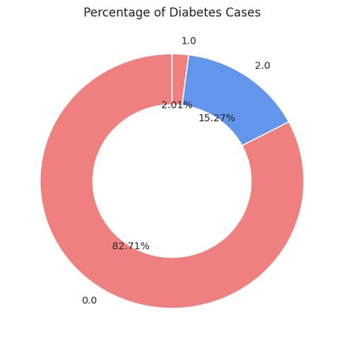
Exploratory Data Analysis
0 = No diabetes or only during pregnancy (82.71%)
1 = Pre-diabetes borderline diabetes (2.01%)
2 = Yes, diabetes (15.27%)

Slide 11
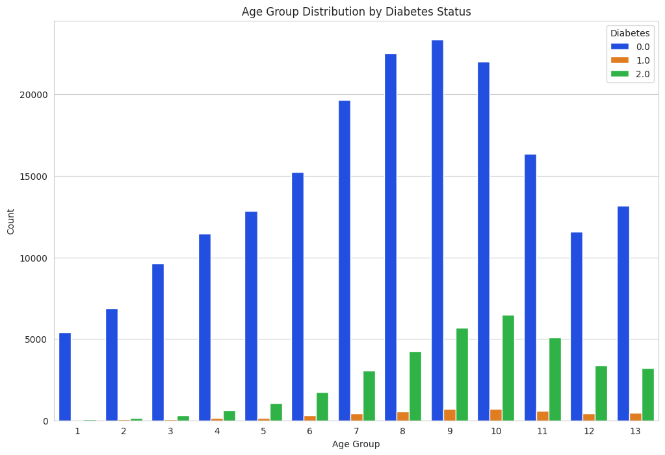

Slide 12
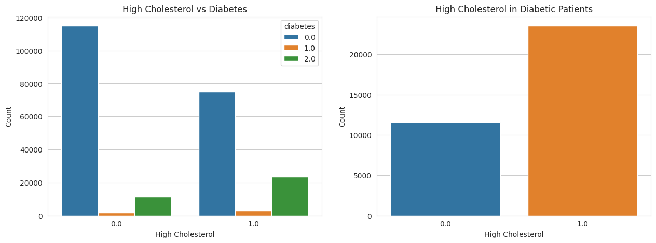
Cholesterol and Diabetes

Slide 13
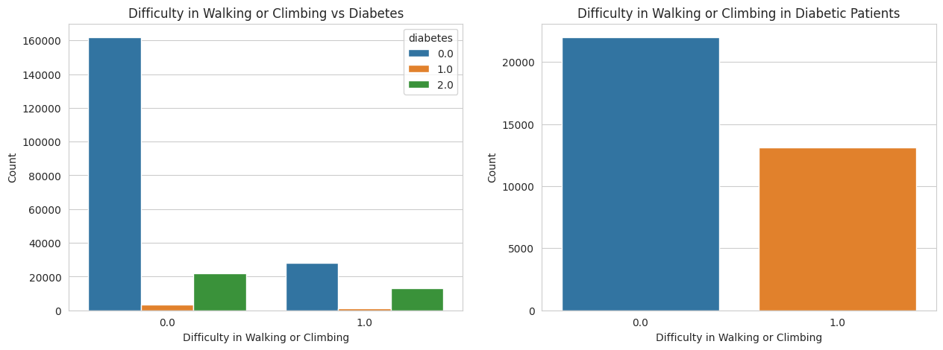
Difficulty walking vs Diabetes

Slide 14
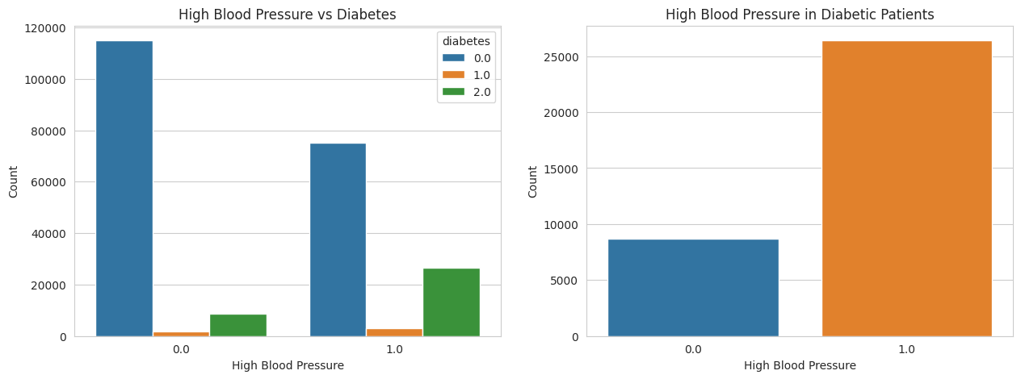
Blood Pressure vs Diabetes

Slide 15
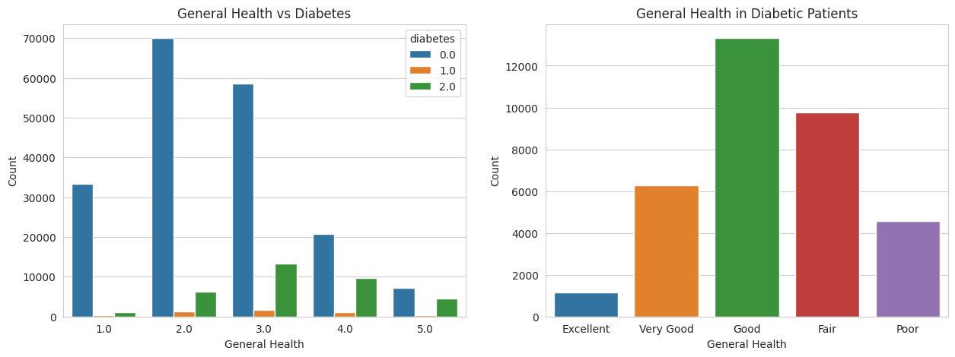
General Health vs Diabetes

Slide 16
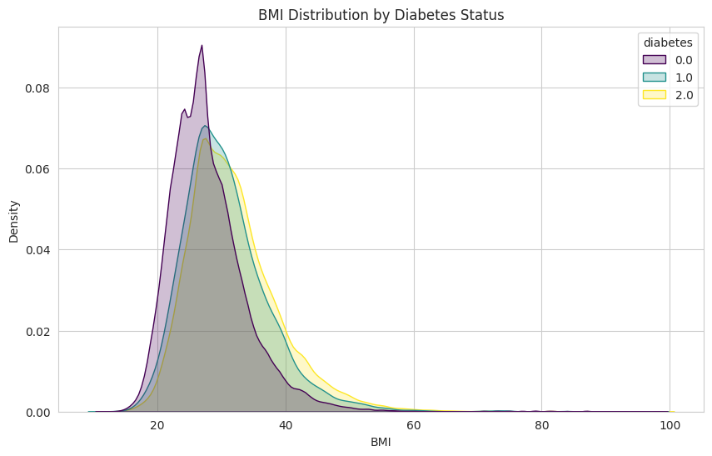
BMI Distribution by Diabetes status

Slide 17
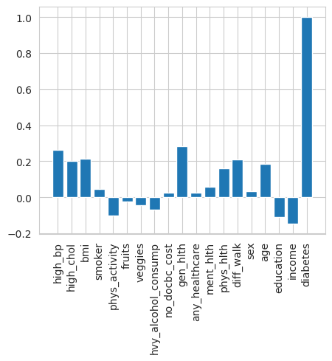
Feature Selection

Slide 18
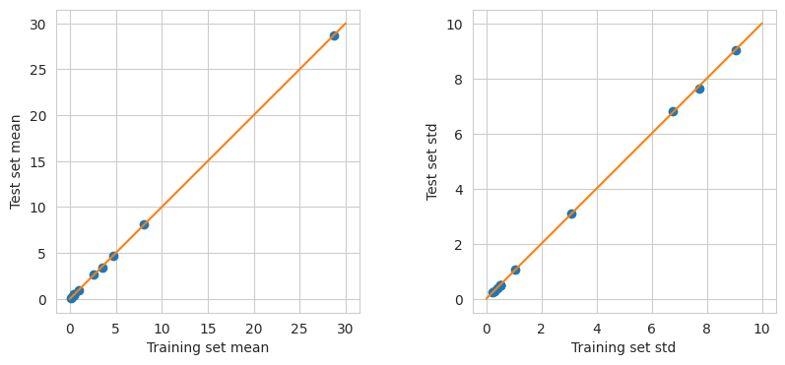
Train Test Split

Slide 19
Modeling
Three distinct machine learning models to predict diabetes based on classification metrics.
Decision Tree Classification Metrics for Diabetes (Class 2):
Precision: 0.8711530006594856
Recall: 0.8317504460069263
F1 Score: 0.8509958662157084
Logistic Regression Classification Metrics for Diabetes (Class 2):
Precision: 0.8436002892524632
Recall: 0.9794049742890125
F1 Score: 0.9064442501942502
Quadratic Regression Classification Metrics for Diabetes (Class 2):
Precision: 0.9066839527513685
Recall: 0.8256637632490292
F1 Score: 0.8642792409304368

Slide 20
Results
Forms of Fitted Models:
Utilized various classification models, including logistic regression, quadratic model and decision trees, to predict diabetes occurrence based on health attributes.
Analysis of Model Quality:
Conducted cross-validation of the model .
Examined statistical measures such as accuracy, precision, recall, and F1-score to get the overall quality of the fitted models.
Results of Statistical Tests:
Applied statistical tests to evaluate the significance of predictor variables.
Tested for model significance and reliability, ensuring that the chosen models provide high accuracy.
Model Performance and Assessment:
Overall models, Logistic Regression is the best fit.
Provided a comprehensive evaluation of how well the models answered the primary question of predicting diabetes occurrence based on health attributes.

Slide 21
Conclusion
Factors Influencing Diabetes Risk:
HighChol (High Cholesterol)
BMI (Body Mass Index)
Age
Diabetes.HighBP (High Blood Pressure)
GenHlth (General Health)
DiffWalk (Difficulty Walking)
(While difficulty in walking is observed among diabetes patients, it is not considered a causative factor but rather a characteristic associated with the condition.)

