Slide 1
Ensemble Machine Learning for Risk-Based Survival Prediction
GROUP4

Slide 2
Motivation & Safety-Critical Context
Safety-critical systems demand high reliability and low false-negative risk.
Survival prediction supports decision-making under uncertainty.
Single models are unstable in high-risk environments.
Ensemble learning improves robustness and trust.

Slide 3
Dataset & Case Study
Titanic survival dataset (binary survival outcome).
Features: Age, Sex, Class, Fare, Family size, Embarked.
Represents real-world risk-based survival scenarios.
Used as a benchmark for safety-aware ML pipelines.

Slide 4
Code: Data Preprocessing
import pandas as pd
from sklearn.model_selection import train_test_split
from sklearn.preprocessing import StandardScaler
df = pd.read_csv("train.csv")
df['Age'].fillna(df['Age'].median(), inplace=True)
df['Embarked'].fillna(df['Embarked'].mode()[0], inplace=True)
df = pd.get_dummies(df, columns=['Sex', 'Embarked'], drop_first=True)
X = df.drop('Survived', axis=1)
y = df['Survived']
X_train, X_test, y_train, y_test = train_test_split(
X, y, test_size=0.2, random_state=42
)

Slide 5
Code: Individual Models
from sklearn.linear_model import LogisticRegression
from sklearn.tree import DecisionTreeClassifier
from sklearn.ensemble import RandomForestClassifier, GradientBoostingClassifier
lr = LogisticRegression(max_iter=1000)
dt = DecisionTreeClassifier(max_depth=5)
rf = RandomForestClassifier(n_estimators=100, random_state=42)
gb = GradientBoostingClassifier(n_estimators=100, random_state=42)

Slide 6
Code: Ensemble (Voting Classifier)
from sklearn.ensemble import VotingClassifier
ensemble = VotingClassifier(
estimators=[
('lr', lr),
('dt', dt),
('rf', rf),
('gb', gb)
],
voting='soft'
)
ensemble.fit(X_train, y_train)

Slide 7
Mathematical Foundation: Logistic Regression
Probability of survival:
P(y=1|x) = 1 / (1 + e^{-(β₀ + βᵀx)})
Decision rule: classify as survivor if P(y=1|x) ≥ τ
τ is risk threshold (adjusted for safety).

Slide 8
Mathematical Foundation
Soft voting combines predicted probabilities:
P_ensemble(y=1|x) = (1/M) Σᵢ Pᵢ(y=1|x)
M = number of models in ensemble.
Reduces variance and model-specific bias.

Slide 9
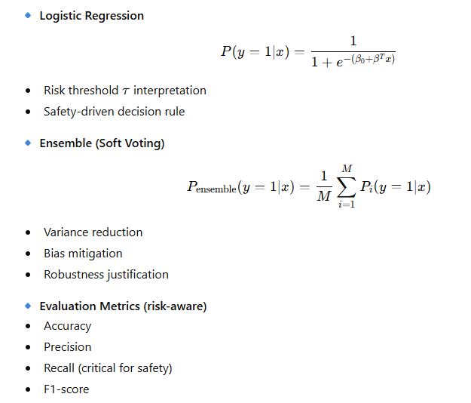
Mathematical Foundation

Slide 10
Evaluation Metrics (Risk-Oriented)
Accuracy = (TP + TN) / (TP + TN + FP + FN)
Precision = TP / (TP + FP)
Recall (Sensitivity) = TP / (TP + FN)
F1 = 2 × (Precision × Recall) / (Precision + Recall)

Slide 11
Results
Ensemble achieved higher accuracy than individual models.
Significant reduction in false negatives (critical risk cases).
More stable performance across random splits.
Best model saved for deployment using joblib.

Slide 12
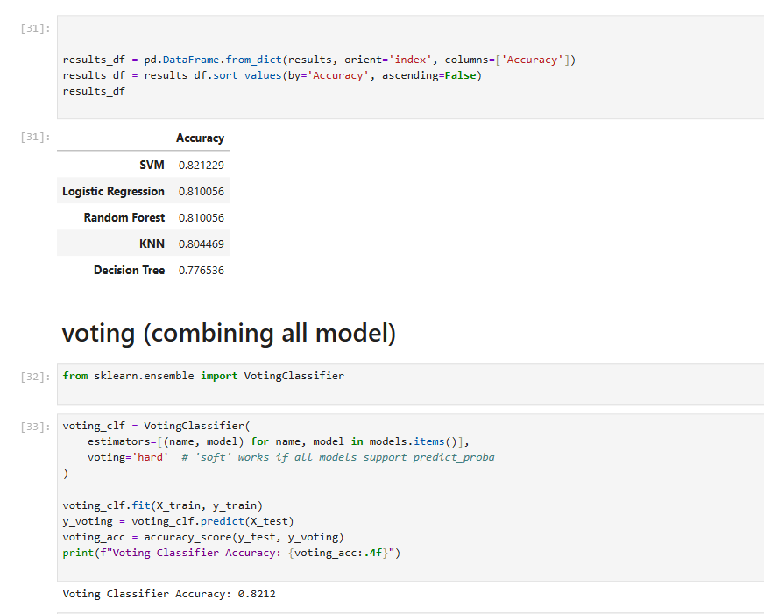
Results

Slide 13
Risk-Based Decision Interpretation
Model outputs survival probability, not only class label.
Low probability → high-risk individual.
Thresholds tuned to minimize catastrophic errors.
Supports human-in-the-loop decisions.

Slide 14
System Architecture Overview
Input data ingestion.
Preprocessing & feature engineering.
Ensemble model inference.
Risk-aware decision support output.

Slide 15
Applications in Safety-Critical Domains
Healthcare: patient survival & triage.
Transportation: accident risk systems.
Disaster management & evacuation planning.
Industrial safety monitoring.

Slide 16
Conclusion
Ensemble ML improves reliability in survival prediction.
Risk-based probabilities are vital in safety-critical systems.
Approach balances accuracy, robustness, and interpretability.
Strong foundation for real-world deployment.

