Slide 1
Final Project Regulation

Slide 2
Mechanics
Meet with shareholder at the latest on Monday
If the project start from scratch, then we determine the technology
Not all project required mobile platform, then you are not required to develop the corresponding mobile platform
In case the client has started initial development. Then all joined team need to determine whether to continue the development with initial platform or rewritten again with different platform.
Development are progressed per iteration/sprint. Each sprint is deemed as a week.

Slide 3
Mechanics
Obtain access to development server
For all teams, at least a team double role as integrator.
Integrator team hold access to central Github repo, responsible to manage and integrate all codes
The rest of the team, fork central Github repo. Manage his own team access.
Integration done through pull request from fork repo.
All repo are split per iteration/sprint. Named each branch according to sprint-i, i=1...n

Slide 4
Sprint 1 Priority
Conduct meeting with Alumni
Understand and analyzing all required features.
Confirm whether all features have clear & specific business process.
Agreed upon underlying technology for all teams
In case the development had started, find out what has been implemented.
Take a feature to implement for Sprint 2
Design accompanying mockup for whatever you choose for sprint 2
Day 1 of each sprint is Monday, closing at Sunday.
Document which briefed job distribution across all team for sprint 2
Create a central repo & fork repo. Also report integrator team.

Slide 5
Job distribution Across Team
Since all team could be tackle the same project
Integrator team responsible to
manage all code integration across all fork repos
Development still accounted but with a lesser work portion
In case of more than 3 team per project, integrator team should only responsible for integration

Slide 6
Job distribution Across Team
Job distribution should be allocated based on module or feature.
Sprint 1 shall target at least a module implementation per team
A module must not be split based on front-end & backend
Since its common to implement a module, you play both.

Slide 7
Job Distribution Within Team
All members must commit to internal team Github
Only contributions done through Github push are acknowledged
Commit all counted contributions, including non-code jobs.

Slide 8
Sprint 1 evaluation
Front-end & Back-end repo
Each forked from a central repo
Create sprint 1 branch
Summary of meeting result with Alumni
List of participants
Features Summary of the developed app
Focus of current sprint module implementation
Activity Diagram for currently implemented module
Mockup of at least 2 Sprint (Current sprint & the following)

Slide 9
Sprint 1 evaluation
Database Diagram of the application
URL Routing Table for the current sprint including web service API
Web Service API interface documentation, following Postman API standard
Integrator Team
List of all targeted features for the current Sprint
Other team
List of the features the team is responsible for the current Sprint

Slide 10
Sprint 1 evaluation
Development started from Monday – Friday
Integration happens during Saturday – Monday
Code freeze for the rest of the team
Image mockup of the 2 Sprint features
List of fragment pages
Android XML mockup of the current Sprint features
List of Android Component which will be using for the current Sprint

Slide 11
Sprint 1 Submission
Github front-end & back-end repo
Readme which contain product backlog (Integrator) & Sprint back-log
All of the items asked for Sprint 1 evaluation
Design documents be put under docs directory
Relevant document for back-end be put on the back-end repo
Relevant document for front-end be put under the front-end repo

Slide 12
Notice
If you don’t develop front-end using Ionic you need to get final exam
If you develop front-end with any technology aside from ionic you still need to take final exam, but the score is compute from
Final project = 1/3 * final exam + 2/3 * final project

Slide 13
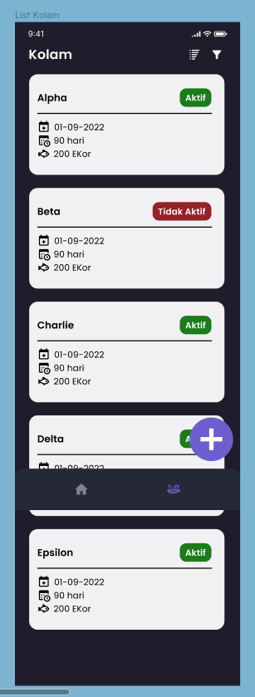
Quiz
Make the app read the value of Pond Activation from real server through REST
Use Axios package, a standard in JS environment to conduct REST transaction

