Slide 1
Wireless Lab 1
Chia-An Lee
calee.cs08g@nctu.edu.tw
March 06, 2020

Slide 2
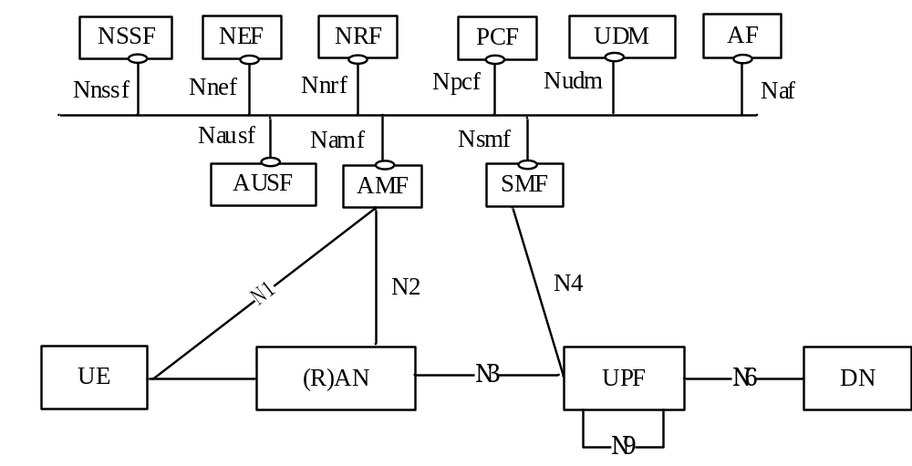

5G core network (5GC)
NF (Network Function)
Service Based Interface (SBI)

Slide 3

free5GC

Slide 4
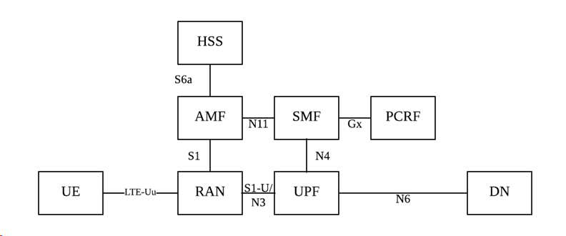
Stage 1
Migrating 4G Evolved Packet Core (EPC) into 5GC Service-Based Architecture (SBA)
Released in January 2019

Slide 5
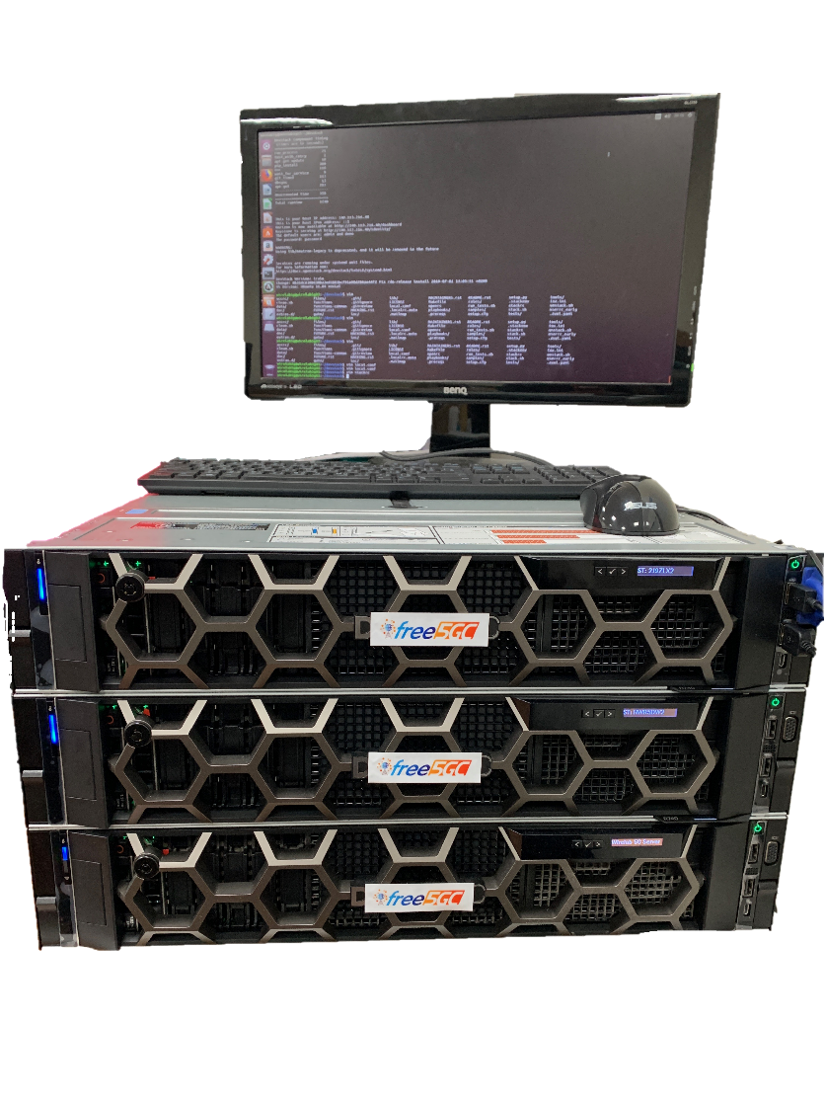
Equipment: Core Network
Dell PowerEdge R740xd: Ubuntu 18.04.02, Intel Xeon Gold 6316, 128G RAM, 5840G HDD
Any laptop/desk should work if
you don’t care about performance.
For minimum requirements,
please refer to:
https://www.free5gc.org/installation

Slide 6
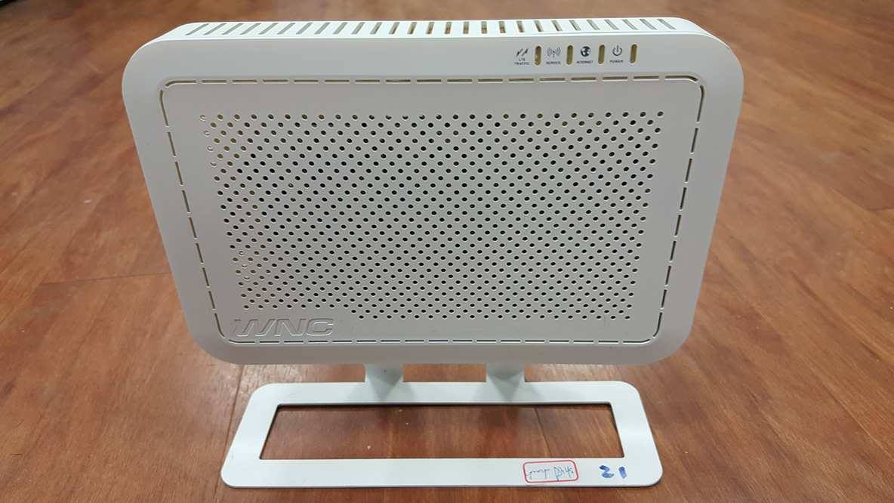
Equipment: Base Station (RAN)
We have tested five commercial eNBs successfully: WNC, D-Link, GemTek, Foxconn, Nokia Siemens Networks
Any eNB/gNB complied
with standard interface
should work.
WNC OSQ4G-01E2, 3GPP Rel-13 compliance

Slide 7

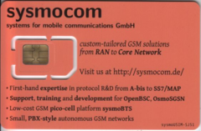
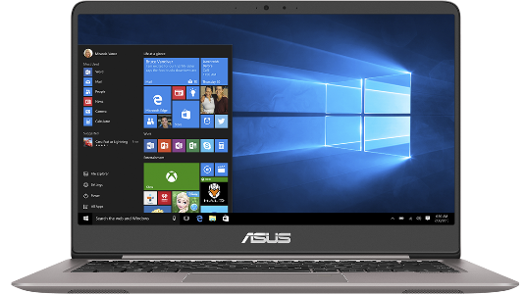
Equipment: User Equipment (UE)
UE 1: Sony Xperia T3 D5103
UE 2: ASUS UX410 & D-Link LTE Dongle
Programmable SIM card programmed by PySIM
Any commercial handsets
should work.

Slide 8

Demo Video

Slide 9
Lab1 Requirement
Pass Self-test (at Home)
Connect to Internet with UE (at Lab)

Slide 10
Installation Details
Install Ubuntu 18.04. You can decide to bare install or using VM. If using VM on Windows, VMware is recommended. At least 4G RAM is needed.
Your Ubuntu must have 2 NIC, one for the Internet and one for RAN access. If using VM, please bridge the RAN end to your physical NIC so that we can connect to our small cells. Your Ubuntu must able to connect to the Internet as well.
Follow the installation guide and install free5GC stage 1(All in One). Remember to tune the network setting and NAT as well.
https://www.free5gc.org/installation

Slide 11
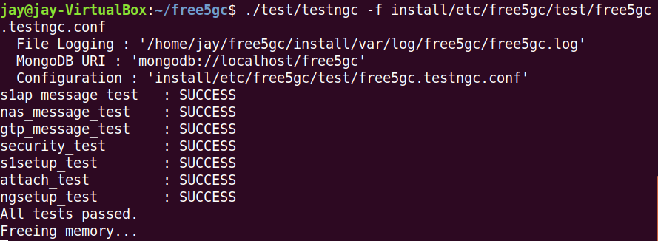
Run Self-test
Please complete the self-test at home before you come to demo.
After you install free5GC stage 1(All in One), you can run:
./test/testngc -f install/etc/free5gc/test/free5gc.testngc.conf
to make sure you have correctly install free5GC.

Slide 12
Connect to the Internet
After you have pass the self-test, you can make an appointment with TAs in EC216
(or maybe other places).
We will help you to connect your 5GC with commercial base station. And we will also provide some well-burned SIM card and commercial UE.
Please show us that you can use your 5GC to connect to the Internet and have some video streaming.
Install dependency of Web User Interface before Lab will shorten your demo time. But you don’t
need to configure it.

Slide 13
Experience
Date: 3/17, 3/19, 3/20
For those who want to experience the lab, you can fill in the blank and bring your VM/CN to EC216 and try to connect with our RAN.
Even if you have failed in installing free5GC, you still can come and ask for TAs’ help. (Experience only)
Please fill in the blank and come on time to make sure there will not be too crowded.
https://docs.google.com/spreadsheets/d/10WlkBKbo4xwU-FzaVOOZvZDcIoOZU7YdJDvg7uyWJ0o/edit?usp=sharing

Slide 14
Lab1 Deadline
04/13(Mon) 18:00 ~ 20:00
For those who pass the demo on experience will not need to come again for demoing.
This is not the experience. You must pass the self-test before demo.
If all of the above time are not available, you should make an appointment with TAs before deadline. TA times are also welcomed.

Slide 15
Details better to know
Although in self-testing you won’t change the configuration, it is better for you to know some more when it comes to settle down the Internet connection test.
What is PLMN
What is IMSI, K, OP, OPc in UE
Network architecture and functional of SMF, UPF, AMF

Slide 16
Notices
If you don’t have laptop, please contact to TAs. We will make an appointment with you to install the environment in lab.
TAs
  ta@wire.cs.nctu.edu.tw
Make good use of the troubleshooting from the document

Slide 17
Reference
https://www.3gpp.org/
https://www.free5gc.org/installation
https://www.youtube.com/watch?v=k5VLiFhz2FE
https://www.youtube.com/watch?v=DWdp5k-VNW8
https://www.youtube.com/watch?v=934WINmgSm8
https://www.youtube.com/watch?v=136yooI4n4A

