Slide 1
Jitter A method-based JIT-Compiler

Slide 2
The Language

Slide 3
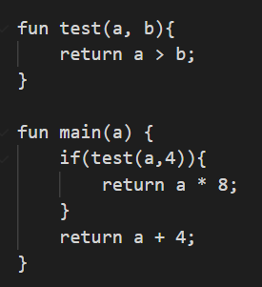
Language
Features
Basics
If-Statements
While-Loop
Function-Calls
Assignment
Operators
+,-,*,/,%,>,>=,||,…
Comments //abc
Integer-based
Predefined functions
Needs main function
0 = false otherwise true
Logic Operators
True = 1
False = 0

Slide 4
CompileR

Slide 5
Structure (Frontend) (Always executed)
Lexer
Parser
Semantic checker
Uses: Logos
Generates Token Stream
Removes comments
Parses numbers
Self-Written
Generates AST
Recursive decent parser
Parses the self-defined grammar
Self-Written
Works on AST
Checks duplicate functions
Use before init
Right amount of arguments

Slide 6
Structure (Middle) (Only execute if function is compiled)
SSA Form
IR
Every variable only assigned once.
Introduction of PHI-Nodes
AST-Form
Linearization of the AST
Uses Instruction similar to assembly
Resolves the PHI-Nodes from the SSA-Form
Lifetime-Analysis

Slide 7
Structure (BACKEND) (Only execute if function is compiled)
ASM Generation
Transforms IR to ASM instructions
Uses library: iced_x64
AST-Form
Outputs binary coded assembly
Uses Life-time-checker for LSR

Slide 8
INNER WORKINGS

Slide 9
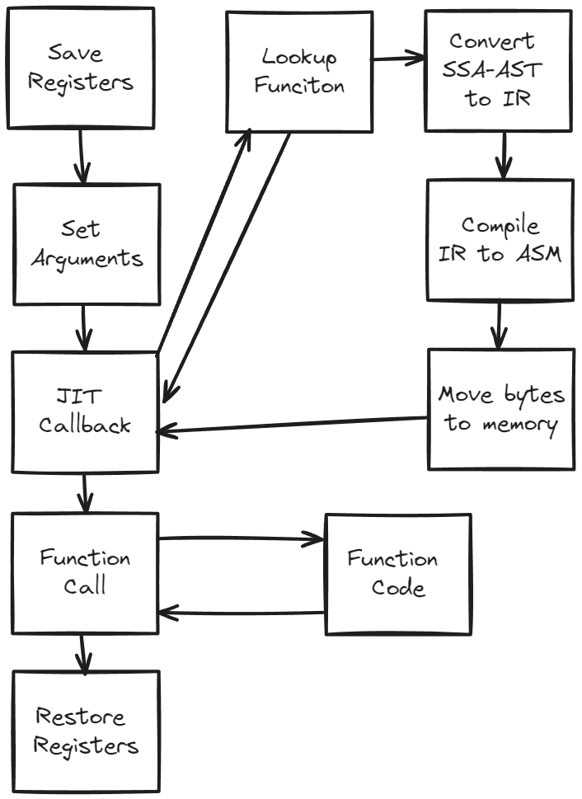
Function CALLS
New functions
Compiled functions
Callback to JIT
Transform SSA-AST to IR
Compile IR to ASM
Move to memory
Return Address
Call function
Callback to JIT
Lookup function address
Return address
Call function

Slide 10
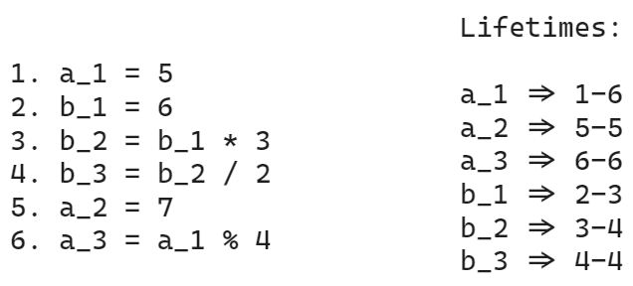
LifeTIME ANALYSIS
Every variable is only assigned “once”
Done on the IR
If the lifetime is passed the register counts as free again and is added to the free register list.

Slide 11
DEMO

Slide 12
Questions?

