Slide 1
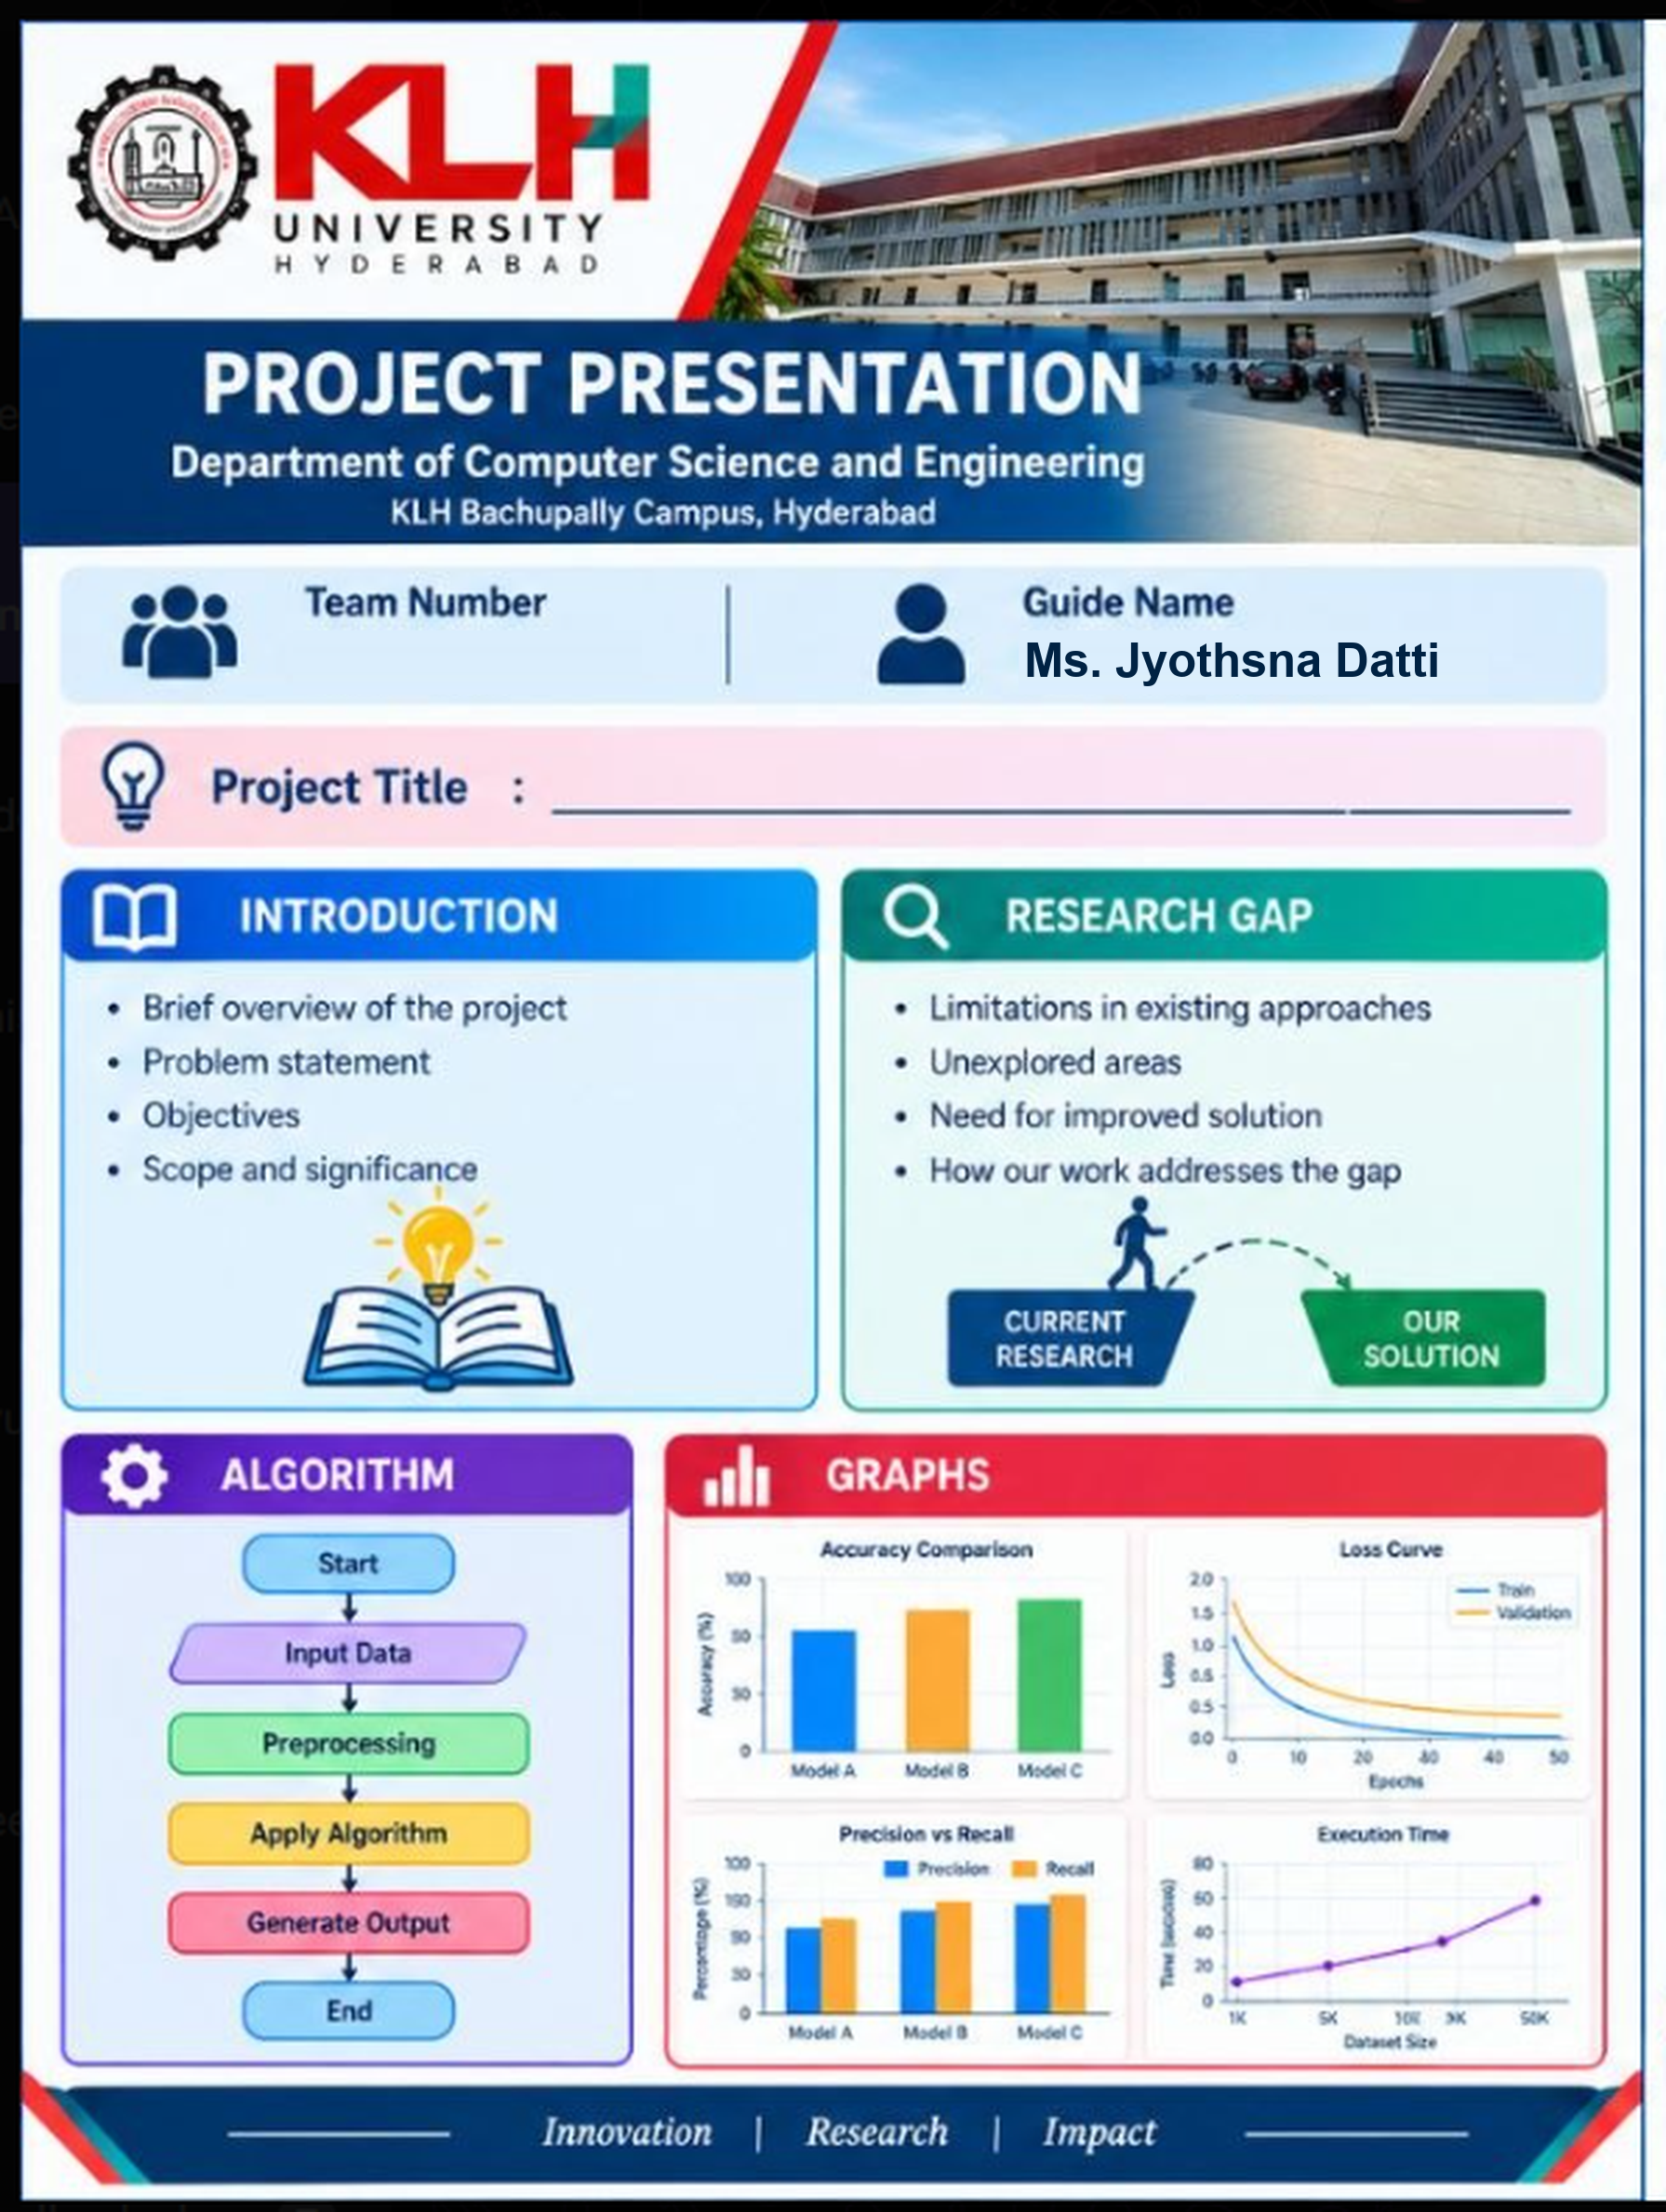
Heart Disease Prediction Using Logistic Regression, SVM, and KNN
• Overview: AI-driven diagnostic screening system analyzing 1,025 cardiac patient profiles.
• Problem Statement: Cardiovascular disease is the leading global cause of death; manual diagnosis is invasive and delayed.
• Objectives: Develop and benchmark Logistic Regression, SVM, and KNN classifiers for early detection.
• Significance: Non-invasive, instantaneous decision support reducing clinical diagnostic latency.
• Existing Limitations: Traditional heuristic scoring models rely on linear thresholds with high false negative rates.
• Unexplored Areas: Limited comparative multi-metric evaluation across linear, margin, and distance-based classifiers.
• Need for Solution: Accurate probability calibration combined with interpretable clinical decision thresholds.
• Our Contribution: Robust preprocessing, hyperparameter optimization, and a real-time web portal.

