Slide 1





Abhyas
SMART INDIA HACKATHON 2026 · GRAND FINALE
First try it on the computer. Then do it on the road.
A testing tool for Bengaluru traffic decisions — built on top of 20+ years of Indian traffic research, not from zero.
[Team name] · [Problem statement ID] · [College]
Notes:
Open simple: in Bengaluru, every big traffic change is tried directly on the road. Abhyas lets you try it on the computer first. And this time we are very clear: we did not start from zero. We built on more than twenty years of Indian traffic research. Most of today's pitch is about exactly that.

Slide 2





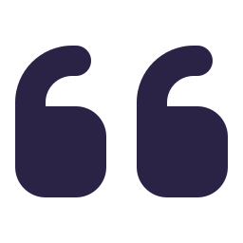
What the jury told us
LAST ROUND FEEDBACK
THE BIG ONE
“Not solving enough problems. What if government puts 10,000 e-buses?”
“Who is this for? ‘Civil engineer’ is not a real buyer.”
“Others already made traffic simulators. Where is your research?”
We answer this on slides 13 and 14
We answer this on slide 12
Slides 3 to 10. Most of today is about this one.
Notes:
Three things the jury told us. All three are fair. The third one hurt the most: we claimed nobody had done traffic simulation like this, and that was simply not true. So this time, the research comes first.

Slide 3
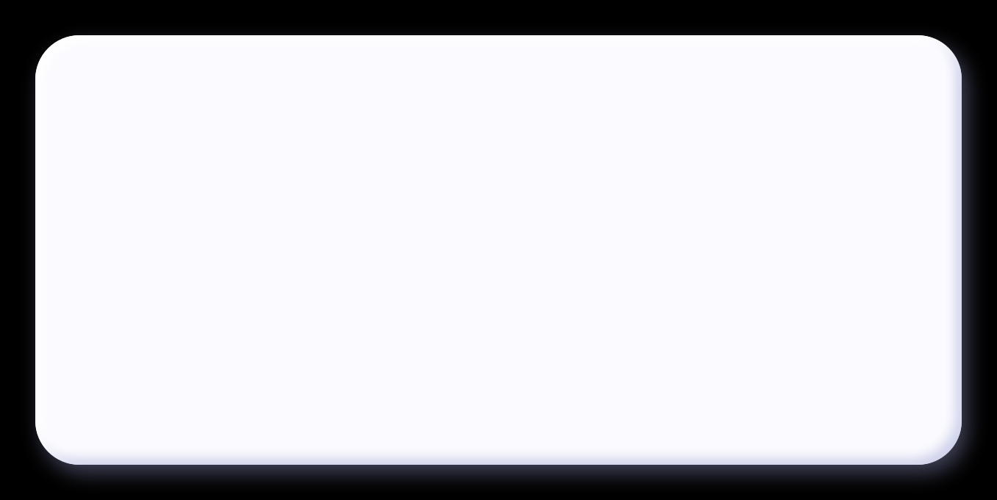


Honestly? The jury was right.
We said nobody had done this before. That was wrong.
People have been simulating Indian traffic for more than 20 years — at IIT Madras, IIT Bombay, IISc, CSIR-CRRI, and now Google and C-DAC too.
So we went back, read their work, and built Abhyas on top of it. Not from zero.
8 earlier projects
18 sources cited
2 Indian standards
Notes:
Say this plainly, no excuses. We were wrong to call this new. Then show that we did the homework. Note to presenter: the counts on the right are what this deck cites; adjust if your team read more.

Slide 4



Who came before us
OUR HOMEWORK
IN RESEARCH LABS
2000s
Early 2010s
2017
2019
HETEROSIM
IIT Madras
SiMTraM
IIT Bombay
Indo-HCM
CSIR-CRRI
IISc Bengaluru
Prof. Ashish Verma's lab
First simulator built for mixed Indian traffic. Used to work out PCU values.
Cut each lane into thin strips so many bikes can share one lane, inside SUMO.
India's own road capacity manual. Real vehicle sizes and gap timings.
Simulated 3 city junctions for better signal timing. Built a city travel-demand model.
ALREADY ON INDIAN ROADS
Since 2021
2022
2024
Ongoing
Google Green Light
Bengaluru, Kolkata
WRI e-bus guidebook
WRI India
B-ATCS
C-DAC + Traffic Police
ASTraM
Traffic Police + Arcadis
AI suggests signal timings from Maps data. Up to 30% fewer stops.
A method to pick which routes should get e-buses first.
Signals that adjust on their own, at 169 Bengaluru junctions.
Live monitoring of traffic and incidents across the city.
Notes:
Two rows. Top row is research: IIT Madras built HETEROSIM for mixed traffic back in the 2000s. IIT Bombay's SiMTraM let many bikes share one lane inside SUMO. CSIR-CRRI gave us Indo-HCM in 2017, India's own capacity manual. IISc simulated Bengaluru junctions and built a city demand model. Bottom row is what is already running on our roads: Google Green Light in Bengaluru and Kolkata, WRI's e-bus route guide, B-ATCS adaptive signals at 169 junctions, and ASTraM for live monitoring.

Slide 5










Plus the big software everyone uses
OUR HOMEWORK
PTV Vissim
Aimsun
SUMO
From Germany. The industry standard for junction simulation. Paid licence per seat.
From Spain. Strong for city-level and junction-level models. Also paid.
Free and open source, from the German Aerospace Center. Abhyas runs on top of SUMO.
What the research papers say
These tools were made for countries where vehicles stay in lanes. Studies from India and Bangladesh say fitting them to our no-lane, bike-heavy traffic is still not fully solved.
Sources: Calibration of VISSIM for Indian heterogeneous traffic (TRID 1279997); VISSIM calibration survey for heterogeneous traffic (engrXiv 4441)
Notes:
Then the paid tools. Vissim and Aimsun are excellent, used by consultants all over India. But they are built for lane-discipline traffic, and many papers say calibrating them for Indian traffic is still hard. SUMO is free and open; we build on SUMO, we don't replace it.

Slide 6







So what is still missing?
THE GAP
Research models
HETEROSIM, SiMTraM, IISc, IIT Madras
Paid software
Vissim, Aimsun
Good: The science is solid. Proved mixed traffic can be simulated.
Missing: Stays inside the paper. One site, checked one time. A traffic officer can't use it.
Good: Very powerful. Used all over the world.
Missing: Costly licence, made for lane traffic, needs an expert to run.
Signal and monitoring tools
Green Light, B-ATCS, ASTraM
E-bus planning studies
WRI guidebook, Shakti Foundation roadmap
Good: Already working on our roads today.
Missing: They fix today's signals. They can't answer “what if 4,500 more buses come?”
Good: Good method for choosing e-bus routes.
Missing: Don't show what happens at the junction when those buses actually reach.
Notes:
Be fair to everyone. Research models are good science but stay in the paper. Paid software is powerful but costly and lane-based. Signal tools fix today's signals but can't test a new bus fleet. E-bus studies choose routes but don't look at the junction. Nobody gives a planner a tested what-if answer in simple language. That is the gap.

Slide 7







Then what is new in Abhyas?
OUR CONTRIBUTION
1. It checks itself
7 checkers compare every result with real TomTom travel times. If the data is not enough, it says “can't say”.
We did not invent traffic simulation.
We joined the proven pieces, and added three things nobody gives together.
And we use Indian numbers (Indo-HCM 2017, IRC), not foreign default settings.
2. It counts people, not vehicles
One full bus carries many people. So a bus lane gets judged fairly, not as “one more vehicle”.
3. Anybody can ask
Type or speak in simple words: “What if this signal is 10 seconds shorter?”
Notes:
This is our honest novelty claim. Not the simulator. Three things: it checks itself against real data and can refuse to answer; it counts people, which is the right way to judge buses; and a normal officer can ask by voice or text. Plus Indian numbers from day one.

Slide 8



What we took from whom
STANDING ON THEIR SHOULDERS
EARLIER WORK
HOW ABHYAS USES IT
HETEROSIM and SiMTraM
IIT Madras, IIT Bombay
Bikes and autos squeeze into gaps instead of being stuck in one lane
Indo-HCM 2017 and IRC:106-1990
CSIR-CRRI, Indian Roads Congress
Vehicle sizes, speeds and gap timings, used as they are, not tuned
Calibrating SUMO for Indian traffic
IIT Madras
Tune using real data, and only change what the data can support
TomTom and Google travel times
Industry data
Used as the answer sheet to check our model
Rolling Out Electric Buses
WRI India
The real questions BMTC asks before putting e-buses on a route
Notes:
Give credit openly. Judges like hearing exactly whose work you used. The bike and auto behaviour comes from the IIT Madras and IIT Bombay line of work. The numbers come from Indo-HCM and IRC. The calibration approach follows IIT Madras's SUMO calibration study. TomTom is our answer sheet. And the e-bus questions come from WRI's guidebook.

Slide 9






Our homework, in numbers
OUR OWN DATA WORK
9,900
2,100
3
TomTom travel-time readings
collected 28 Aug – 5 Sep 2026
incident records
jams and road closures
Bengaluru junctions
Indiranagar CMH Road, Sony World, Ejipura
12
208
5
routes through the junction
each one checked against real data
simulation runs
in one full check, 40 random seeds
mistakes in the map
found in OpenStreetMap, fixed and written down
Notes:
Our own research, not just reading. We collected about 9,900 TomTom travel-time readings and about 2,100 incident records across three junctions between 28 August and 5 September. We checked 12 routes through the Indiranagar junction. One full check is 208 simulation runs. And we found five silent mistakes in the OpenStreetMap data, including a 100 km/h speed limit on an Indiranagar road.

Slide 10






Did our model pass the test?
TESTING HONESTLY
No cheating
We tuned only one number (traffic volume) on 4 straight routes. Then tested on 8 turning routes it never saw: 7 of 8 passed.
10 of 12
routes came within ±15% of the real travel time
Our guesses don't decide it
Nobody counts turning traffic, so we tried a range. 9 of 12 results stay the same either way.
Weekend 9–10 pm slot, Indiranagar, median of 40 runs
We show our misses
West→East is 18% too slow. East→North is 24% too fast. We say it openly, we don't hide it.
Notes:
This is what research looks like in practice. One number is fitted, and only on four straight routes. The eight turning routes are a hidden test; seven of eight pass. Turning splits are not measured anywhere in India, so we sweep them: nine of twelve results survive. And we show the two misses ourselves, before anyone asks.

Slide 11




Bengaluru roads are already over-full
THE PROBLEM
36 min
168 hours
3.5×
to go just 10 km
2nd worst city in the whole world (TomTom 2025)
lost per person in peak hour
in 2025. That's about 7 full days.
more traffic than Sarjapur Road was built for
Traffic Police peak-hour study (ORR: 2.2×)
And now thousands more buses are coming on the same roads.
Sources: TomTom Traffic Index 2025; Bengaluru Traffic Police ORR–Sarjapur Road study (via Deccan Herald)
Notes:
Quick on the problem, everybody in the room knows it. 36 minutes for 10 km. 168 hours a year lost in peak hour. Sarjapur Road carries three and a half times what it was designed for. No slack is left.

Slide 12






Who will actually use this?
WHO IT'S FOR
BMTC
Bus planning team
Traffic Police
Signals and diversions
BMLTA
Approves big transport projects
“Where to put 4,500 new buses? Which routes, stops and depots will choke first?”
“If buses get priority at Silk Board, how long will the Hosur Road queue become?”
“Will this flyover or tunnel move more people, or only more cars?”
Today: experience and Excel sheets
Today: try it on the real road. They've also tendered a ₹1 crore digital twin.
Today: one consultant report per project, no common model
Not “civil engineers” in general. The officer who has to sign off on the change.
Notes:
Last time we said civil engineers. That's too vague. The real users are three agencies who must sign off before anything changes on the road: BMTC for buses, Traffic Police for signals and diversions, and BMLTA, which by law has to approve big transport projects since 2023.

Slide 13






What if 10,000 e-buses come?
THE JURY'S QUESTION
This is not a “what if”. It is already happening. Under PM e-Drive, Bengaluru gets 4,500 e-buses. Across 5 cities, it's 10,900.
1
2
3
4
Put the buses in
Find where it chokes
Zoom in close
Compare the fixes
All 4,500 buses on BMTC routes and timings: 3,800 big (12 m) and 700 small (9 m).
City-level view shows where buses queue behind buses, stops overflow, depots jam roads.
Full detail at Silk Board, Hebbal, Iblur — with bikes, autos and trucks around.
Bus lane? Signal priority? Move the stop? Small bus? Ranked by people moved.
Notes:
Direct answer to the jury. Their example is real policy: 4,500 e-buses for Bengaluru, 10,900 across five cities. We don't simulate every vehicle in the city at full detail; nobody sensible does. We use a city-level view to find the trouble spots, then full detail only where it matters. The output is a ranked list of fixes, judged by how many people move.

Slide 14












Why Bengaluru is tricky to copy into a computer
BENGALURU'S STRUCTURE
Bikes go into every gap
Lanes are only a suggestion
Flyovers, underpasses, one ring road
So bikes and autos can move sideways, like real life.
No forced lanes for small vehicles. Lanes only for buses and trucks.
Built from the map, with the mistakes fixed and noted.
A bus is not a truck
Cows, breakdowns, digging
Nobody counts turning traffic
Separate behaviour: bus stops, waiting time, real size.
Blockages taken from real incident records.
We try a range, and only trust what holds every time.
Notes:
This answers 'can it understand Bangalore's complex structure'. Six things that break foreign tools, and what we do for each. The last one is important: since nobody measures turning traffic, we don't pretend. We try a range and only report what stays true across it.

Slide 15




Every answer comes with an honesty tag
TRUST
SURE
Matches real travel times on this road. You can quote it.
7 checkers behind every answer
Is the data good enough to check against?
Tune traffic volume to match real times
Compare all 12 routes, one by one
Is the slow direction right?
How wrong would one single run be?
Do results survive when guesses change?
Which signal plan does the data support?
ROUGH IDEA
Based on our guesses. Good to compare options, don't quote the number.
CAN'T SAY
Data is not enough. Abhyas will tell you that straight.
Notes:
The biggest danger with any computer model is a confident wrong answer going into a government file. So every answer leaves with a tag: sure, rough idea, or can't say. Seven checkers decide the tag.

Slide 16





One junction → full city, checked at every step
SCALE
Junction
Road
Area
Full city
Indiranagar, CMH Road × 100 Feet Road
ORR, Silk Board to KR Puram
ORR–Sarjapur Road, Iblur
All BMTC routes + the e-bus fleet
Checked with: TomTom times on 12 routes
Checked with: bus speeds on the existing ORR bus lane
Checked with: Traffic Police peak-hour counts
Checked with: bus GPS and adaptive-signal data
Working today
Same 7 checkers at every level. Trust grows step by step, it is not assumed.
Notes:
Scaling is not just more roads, it's more real data to check against. At each level there is a real dataset: TomTom at the junction, bus speeds on the ORR bus lane, the Traffic Police study for ORR–Sarjapur, and bus GPS plus signal data for the whole city.

Slide 17






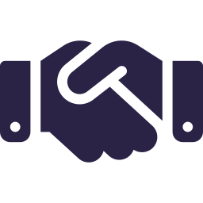

How it actually reaches the road
ADOPTION
The door is already open
Runs on government servers
Traffic Police have tendered a ₹1 crore Mobility Digital Twin. BMLTA must check big projects under Section 19.
Open-source base, no per-seat licence fee. The data stays with the department.
How it pays for itself
Next cities, same engine
Yearly support and re-checking for each department, plus fixed-price studies: e-buses, bus lanes, signals.
Delhi 2,800 · Hyderabad 2,000 · Ahmedabad 1,000 · Surat 600 e-buses. New city = new map + new checks.
Sources: PM e-Drive city allocations; BMLTA Act 2022, Section 19; Bengaluru Traffic Police Mobility Digital Twin tender
Notes:
Two doors into government already exist: the Traffic Police digital twin tender and BMLTA's legal duty to check big projects. Since the base is open source and runs on government servers, there's no licence problem and data stays with them. And PM e-Drive gives the same question to four more cities.

Slide 18


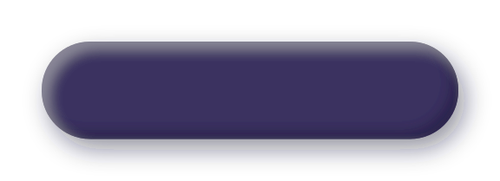



Before putting 4,500 buses on the road, test it once on the computer, no?
Abhyas gives the answer — and tells you honestly when it doesn't know.
OUR ASK
A pilot with BMTC and Bengaluru Traffic Police on the ORR bus lane, with access to bus GPS and signal data.
Notes:
End with the one line and the ask, then stop and take questions. Likely questions: How long for a new road? The map part is automatic; checking needs a few weeks of travel-time data. Can it run the full city live? It's a planning tool, not a signal controller. Who owns the data? The department, it runs on their servers. What's new versus Vissim or HETEROSIM? Go back to slide 7.

Slide 19
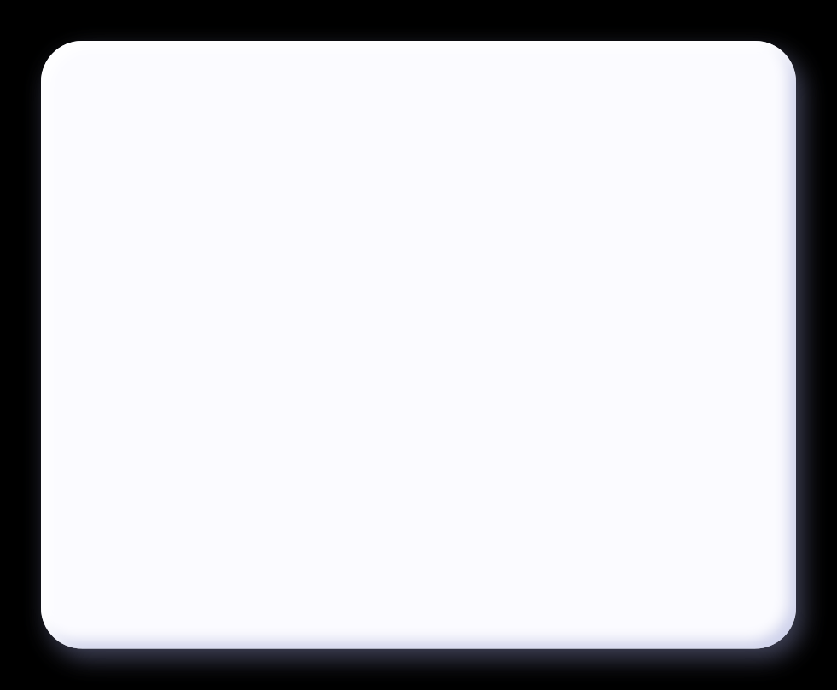
References
APPENDIX
Research and standards
Deployments, policy and data
Arasan, V.T. & Koshy, R.Z. (2005). Methodology for modeling highly heterogeneous traffic flow. J. Transp. Eng., ASCE 131(7). [HETEROSIM, IIT Madras]
Arasan, V.T. & Arkatkar, S.S. Modelling heterogeneous traffic flow on upgrades of intercity roads. Transport (VGTU).
SiMTraM: strip-based mixed-traffic extension for SUMO. IIT Bombay.
Calibration of SUMO for Indian heterogeneous traffic conditions. IIT Madras (publications.iitm.ac.in).
Indo-HCM (2017). Indian Highway Capacity Manual. CSIR-CRRI.
IRC:106-1990. Guidelines for capacity of urban roads in plain areas. Indian Roads Congress.
Calibration of VISSIM for Indian heterogeneous traffic conditions. TRID 1279997.
Calibration methodologies of VISSIM-based models for heterogeneous traffic: a survey. engrXiv 4441.
IISc (2019). Beating the Jam. connect.iisc.ac.in; IISc CiSTUP – BTP data MoU (Deccan Herald).
Google Research. Project Green Light (Bengaluru, Kolkata). blog.google.
WRI India (2022). Rolling Out Electric Buses: route prioritisation and implementation planning.
Shakti Foundation. Roadmap for the electrification of public transportation in Bengaluru.
Indian Infrastructure (Apr 2026). Bengaluru Adaptive Traffic Control System case study.
Arcadis. ASTraM – Actionable Intelligence for Sustainable Traffic Management.
TomTom Traffic Index 2025 (via Deccan Chronicle).
Bengaluru Traffic Police ORR–Sarjapur Road capacity study (via Deccan Herald).
PM e-Drive e-bus allocation (Energetica India); fleet mix (Global Mass Transit).
BMLTA Act 2022, Section 19 (Citizen Matters).
Notes:
Keep this slide for questions about where any claim came from.

