Slide 1
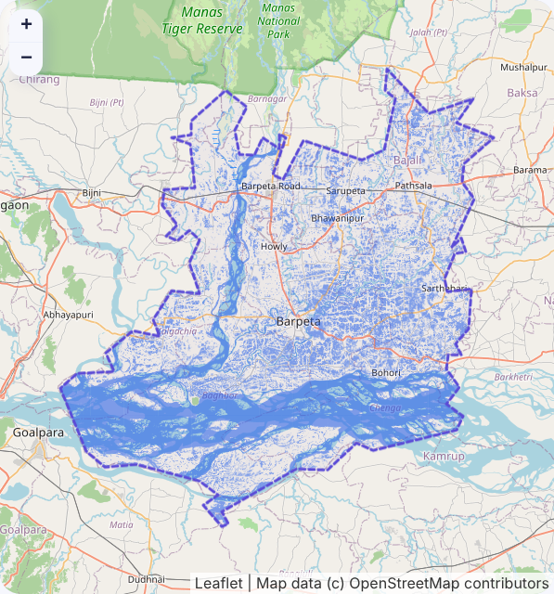
Stardust
Tellio
An answer you can check
Ask a question about floods in your district. Get the answer from satellite radar, with the proof, or an honest "we can't tell yet".
~300 flood maps for 700+ districts 60%+ monsoon cloud 800 to 1,200 geospatial graduates (2013)
Sai Bhuwan S · Yashita Mandavilli · Raj Venkat · Nikhil S Rao · Shashwat Mittal · Sasanuru Anirudh
Barpeta, Assam · Sentinel-1 · 11 Jul 2024 · live run
Notes:
Tellio in one line: plain-language flood questions answered with measured, checkable evidence, or an honest refusal. The map on the right is a real run on the Sentinel-1 pass over Barpeta on 11 July 2024. Note: that water figure includes the river and permanent wetlands; it is water extent, not verified flood extent.

Slide 2




The Problem That Does Not Go Away
Stardust
WHO LOSES TIME TODAY
WHY TODAY'S AI DOES NOT FIX IT
District disaster officials
Central maps only: about 300 in 2024 for 700+ districts. In the Kosi breach, updates came every 3 to 4 days.
Crop insurance officers
A parliamentary committee named claim delays a top PMFBY problem and urged satellite sampling.
Town planners
65% of 7,933 towns have no master plan; up to 42% of planner posts are vacant.
Journalists, fact-checkers
Free tools assume you know which sensor and band to use.
60%+
800 to 1,200
Sources: VLEO-Bench (GPT-4V, specialist), GEOBench-VLM (GPT-4o, EarthDial), GeoChat paper. Benchmarks differ.
32 to 64%
of remote-sensing VLM answers contain hallucinations, judged by experts (RSHallu, 2026). None states when not to trust it.
cloud cover over most of India in the monsoon, so optical often cannot see the flood
geospatial degree-holders in India (2013). A 2025 talk still reports an "acute shortage"
Notes:
Whose problem: district officials, insurance officers, fact-checkers. Why it lasts: questions are local and constant, answers are produced centrally; specialists are scarce; monsoon clouds return every year. Sources (docs/reference/problem-evidence.md, checked 2026-10-04 unless noted): Kosi 3 to 4 day updates, #4; PMFBY committee, #11 and #12 (re-read 2026-10-28); NITI Aayog planner figures re-read 2026-10-28; 2013 task force count, #21. Why chat AI does not fix it: it is fluent but cannot locate what you asked about, and it never tells you when to distrust it. Chart values are read from each paper's tables; benchmarks differ, so compare orders of magnitude.

Slide 3
More Radar Data Than People to Read It
Stardust
SUPPLY OF RADAR IS RISING
AND THE DEMAND IS STATED
16 states
970,000
Radar is the flood standard
NRSC prefers SAR for flood mapping: it sees through cloud, day and night.
had floods mapped near-real time in 2024, with ~300 maps and products issued (ISRO at UN COPUOS, 2025)
geospatial jobs projected in India by 2025, set against an "acute shortage" of skilled people (GSI 2025)
NRSC itself asks for this
Its researchers propose a multilingual Bhuvan chatbot for policymakers who lack GIS skills (ISPRS Annals, 2025). It is a proposal, not a service.
6 days
30 Jul 2025
Official maps carry caveats
NRSC Assam maps are labelled preliminary, with no ground verification. Users already expect stated limits.
Sentinel-1 revisit since June 2026 with the C and D satellites; the data is free and open
NISAR launched: ISRO's S-band and NASA's L-band radar, built to watch land change
The missing step
Few people can turn a radar scene into an answer. Tellio takes a plain question and returns one, with its evidence.
Sources: ISRO statement to UN COPUOS STSC 2025; Mathur, GSI 2025; CDSE news 28 May 2026; NISAR launch coverage (Down To Earth, Jul 2025); Saxena and Rao 2025; NDEM Assam maps 2024.
Notes:
16 states and ~300 maps: ISRO statement to the 62nd UN COPUOS STSC, item 6 (re-read 2026-10-28). 970,000 jobs and 'acute shortage': Rajesh Mathur, GSI 2025 slides (re-read 2026-10-28); the slide says 'expected to grow to 970,000 by 2025', a projection, not a count. 6-day Sentinel-1 revisit and free access: CDSE news 28 May 2026 and CDSE terms (problem-evidence.md #41 and #43, checked 2026-10-04). NISAR launched 30 July 2025 on GSLV-F16; the 'first dual-frequency' phrasing is widely repeated but we did not trace it to NASA, so the slide does not use it. NRSC chatbot proposal: Saxena and Rao, ISPRS Annals X-5/W2-2025 (#29, #56). NDEM Assam map caveats: #40. Things we do NOT claim: that any team was paid extra for Assam SAR work (no source found; COPUOS is a UN committee that sets no pay), or that India leads the world in SAR (no ranking source found). Safe wording: India co-built NISAR and runs operational SAR flood mapping.

Slide 4
How an Answer Is Made
Stardust
Every number comes from a measured, versioned instrument on the real radar pass. The language model never makes a number up.
1
Ask
CONFIDENCE ≥ 0.60
CONFIDENCE < 0.60
"How much of Barpeta was under water on 11 July?"
914 km²
water in Barpeta, 11 Jul 2024
Not enough evidence
"Did the flood spread?" abstained at 0.23. Tellio offered what would help instead: the two single-date extents (413 and 914 km²), each published with its own confidence.
2
Find the pass
Public STAC catalogues; Sentinel-1 radar first in monsoon
Sentinel-1 scene + date
3
Measure
117 of 117 tiles
SAR water instrument per 5 km tile, on CPU
confidence 0.62
4
Calibrate
receipt re-runs identically
Score to probability, fitted on hand labels
Water extent, includes the river and wetlands; not yet checked against NRSC maps.
Why a receipt: UNOOSA (Sep 2025) calls for provenance, metadata and audit trails on AI-derived satellite products.
Notes:
The core design flip: in chat assistants the model produces the answer. In Tellio a transparent instrument measures, a calibration fitted on hand-labelled flood chips turns its score into a probability, and the card is published only at 0.60 or above. Below that it says so and offers the next useful question. Both cards on this slide are from real runs on live Sentinel-1 data.

Slide 5
It Works on Held-Out Data
Stardust
WHAT A USER GETS
RISK VS COVERAGE (82 HELD-OUT CHIPS)
45% → 26%
43%
wrong area answers, always answering vs publishing only at 0.60
of questions answered; the rest honestly abstain
8 / 8
77 to 98 s
demo receipts re-ran to identical output hashes (713 tiles)
per district on 2 CPU cores, no GPU, 0.5 s cached. An NRSC Assam map came 2 days after its pass.
Sen1Floods11 test split. Answer counted right if area is within ±20% of hand labels. Our detector itself is ordinary: per-chip IoU 0.36, same as the published Otsu baseline (0.36).
Notes:
Always answering, 45% of area answers on held-out chips are wrong. Publishing only at calibrated confidence 0.60 or above, Tellio answers 43% of questions and 26% of those are wrong (95% bootstrap interval 12 to 41%). We are clear that the detector is not better than published baselines: per-chip IoU 0.362 vs 0.359 for Otsu in the Sen1Floods11 paper. The contribution is how answers are gated, receipted and reproduced.

Slide 6
Trust Must Be Calibrated Locally
Stardust
South Asian floods fool a globally calibrated system.
Fitted on other regions, Tellio would be over-confident on India by 20 points and publish 52% of Indian answers with 55% of them wrong.
+20 → +1
over-confidence after refitting on just 8 Indian chips
55% → 28%
wrong among published Indian answers
52% → 13%
answered: the honest price of a weak instrument
Notes:
This is the result we think matters beyond our system. Leave one flood event out, fit the calibration on the rest, and test on the held-out event. All three South Asian events are over-confident; the USA is under-confident. Any assistant that states a confidence without local calibration has this problem. Refitting only the intercept on eight labelled Indian chips removes the over-confidence and cuts wrong published answers from 55% to 28%, but the honest system then answers only about 13% of Indian questions. Limitation: the 64 Indian chips come from one Sen1Floods11 event.

Slide 7
Why This Is Different
Stardust
READ IN FULL: NO OTHER SYSTEM HAS MORE THAN ONE
NEXT
 | Tellio | Copernicus GFM | RSure-Agent | EO-Gym | Google Earth AI
Calibrated confidence per answer | ● | ◐
Abstains with a next step | ● | ◐ | ◐
Scene receipts that re-run | ● | ◐ | ◐ | ◐
Radar chosen under cloud | ● |  |  | ◐
CPU or offline | ● |  |  | ◐
Plain-language questions | ● |  | ◐ | ◐ | ●
Better instrument
Terrain (HAND) and permanent-water masks, per-pixel water probability
Indian labels
Label chips from Assam and Bihar events; test across events
User study
10 to 15 non-GIS users: cards vs map tools, timed
● has it ◐ partial. Based on full reads of the 37 closest papers. Access today: Google Earth AI for US subscribers, Earth Copilot for NASA researchers, ArcGIS assistants paid.
Publish
Honest limits: the detector is a classic split-based threshold chain; Indian labels come from one event; no user study yet; the 914 km² figure includes the river and wetlands.
Workshop paper (draft ready, IEEE format) and open release
Notes:
Why it matters: every ingredient exists somewhere in partial form, but after reading the 37 closest papers in full, no research system delivers more than one of these six in full, and none tells a non-expert when not to trust an answer. The bottleneck we found is local labels and instrument quality, not bigger language models. Next: improve the instrument, gather Indian labels across events, run a small user study, and submit the paper.

