Slide 1
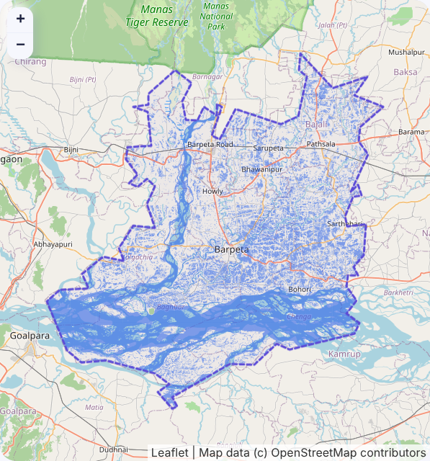
Stardust
SatClip
Satellite answers you can check
Ask about floods in any Indian district in plain words. Get an area measured from the actual Sentinel-1 radar pass, with scene, date, map and a calibrated confidence, or an honest "not enough evidence".
Sai Bhuwan S · Yashita Mandavilli · Raj Venkat · Nikhil S Rao · Shashwat Mittal · Sasanuru Anirudh
Barpeta, Assam · Sentinel-1 · 11 Jul 2024 · live run
Notes:
SatClip in one line: plain-language flood questions answered with measured, checkable evidence, or an honest refusal. The map on the right is a real run on the Sentinel-1 pass over Barpeta on 11 July 2024. Note: that water figure includes the river and permanent wetlands; it is water extent, not verified flood extent.

Slide 2



The Problem That Does Not Go Away
Stardust
WHO LOSES TIME TODAY
WHY TODAY'S AI DOES NOT FIX IT
District disaster officials
Wait for central maps: about 300 flood products in 2024 for 700+ districts.
Crop insurance officers
Claims stay pending while yield data and satellite checks arrive late.
Journalists, fact-checkers
Free tools assume you know which sensor and band to use.
Sources: VLEO-Bench (GPT-4V, specialist), GEOBench-VLM (GPT-4o, EarthDial), GeoChat paper. Benchmarks differ.
60%+
~10x
31 to 64%
of remote-sensing VLM answers contain hallucinations, judged by experts (RSHallu, 2026). None states when not to trust it.
monsoon cloud cover over most of India
gap: 25 to 50k trained GIS users vs 500k more needed
Notes:
Whose problem: district officials, insurance officers, fact-checkers. Why it lasts: questions are local and constant, answers are produced centrally; the skills gap is about tenfold; monsoon clouds return every year. Why chat AI does not fix it: it is fluent but cannot locate what you asked about, and it never tells you when to distrust it. Chart values are read from each paper's tables; benchmarks differ, so compare orders of magnitude.

Slide 3
Instruments Answer, AI Only Asks
Stardust
Every number comes from a measured, versioned instrument on the real radar pass. The language model never makes a number up.
1
Ask
CONFIDENCE ≥ 0.60
CONFIDENCE < 0.60
"How much of Barpeta was under water on 11 July?"
914 km²
water in Barpeta, 11 Jul 2024
Not enough evidence
"Did the flood spread?" abstained at 0.23. SatClip offered what would help instead: the two single-date extents (413 and 914 km²), each published with its own confidence.
2
Find the pass
Public STAC catalogues; radar first in monsoon
Sentinel-1 scene + date
3
Measure
117 of 117 tiles
SAR water instrument per 5 km tile, on CPU
confidence 0.62
4
Calibrate
receipt re-runs identically
Score to probability, fitted on hand labels
Water extent, includes the river and wetlands; not yet checked against NRSC maps.
Notes:
The core design flip: in chat assistants the model produces the answer. In SatClip a transparent instrument measures, a calibration fitted on hand-labelled flood chips turns its score into a probability, and the card is published only at 0.60 or above. Below that it says so and offers the next useful question. Both cards on this slide are from real runs on live Sentinel-1 data.

Slide 4
It Works on Held-Out Data
Stardust
WHAT A USER GETS
RISK VS COVERAGE (82 HELD-OUT CHIPS)
45% → 26%
43%
wrong area answers, always answering vs publishing only at 0.60
of questions answered; the rest honestly abstain
8 / 8
77 to 98 s
demo receipts re-ran to identical output hashes (713 tiles)
per whole district on 2 CPU cores, no GPU; 0.5 s cached
Sen1Floods11 test split. Answer counted right if area is within ±20% of hand labels. Our detector itself is ordinary: per-chip IoU 0.36, same as the published Otsu baseline (0.36).
Notes:
Always answering, 45% of area answers on held-out chips are wrong. Publishing only at calibrated confidence 0.60 or above, SatClip answers 43% of questions and 26% of those are wrong (95% bootstrap interval 12 to 41%). We are clear that the detector is not better than published baselines: per-chip IoU 0.362 vs 0.359 for Otsu in the Sen1Floods11 paper. The contribution is how answers are gated, receipted and reproduced.

Slide 5
Trust Must Be Calibrated Locally
Stardust
South Asian floods fool a globally calibrated system.
Fitted on other regions, SatClip would be over-confident on India by 20 points and publish 52% of Indian answers with 55% of them wrong.
+20 → +1
over-confidence after refitting on just 8 Indian chips
55% → 28%
wrong among published Indian answers
52% → 13%
answered: the honest price of a weak instrument
Notes:
This is the result we think matters beyond our system. Leave one flood event out, fit the calibration on the rest, and test on the held-out event. All three South Asian events are over-confident; the USA is under-confident. Any assistant that states a confidence without local calibration has this problem. Refitting only the intercept on eight labelled Indian chips removes the over-confidence and cuts wrong published answers from 55% to 28%, but the honest system then answers only about 13% of Indian questions. Limitation: the 64 Indian chips come from one Sen1Floods11 event.

Slide 6
Why It Matters, and What Is Next
Stardust
NO SYSTEM IN 225 PAPERS HAS MORE THAN TWO OF THESE
NEXT
 | SatClip | EO-Gym | NRSC maps | SHRUG-FM | RS-VLMs
Calibrated confidence per answer | ● |  |  | ◐
Abstains with a next step | ● |  |  | ◐
Scene receipts that re-run | ● |  | ◐
Radar chosen under cloud | ● | ● | ●
CPU or offline | ● | ◐ | ● |  | ◐
Plain-language questions | ● | ● |  |  | ●
Better instrument
Terrain (HAND) and permanent-water masks, per-pixel water probability
Indian labels
Label chips from Assam and Bihar events; test across events
User study
10 to 15 non-GIS users: cards vs map tools, timed
● has it ◐ partial form. From our 225-paper archive review (NOVELTY.md, section 5.3).
Honest limits: the detector is a 2016-style threshold chain; Indian labels come from one event; no user study yet; the 914 km² figure includes the river and wetlands.
Publish
Workshop paper (draft ready, IEEE format) and open release
Notes:
Why it matters: every ingredient exists somewhere, but no system in our 225-paper archive delivers more than two of these six together, and none tells a non-expert when not to trust an answer. The bottleneck we found is local labels and instrument quality, not bigger language models. Next: improve the instrument, gather Indian labels across events, run a small user study, and submit the paper.

