Slide 1
SatClip
SIH26167 | SatQueryAI | Space Technology
Ask the satellite a plain question. Get evidence, not guesses.
Live Sentinel-1 and 2
Abstains when unsure
Runs on a CPU
Team Stardust, RVITM Bengaluru
Notes:
SatClip answers plain-language questions about Indian land, like how much of a district was under water on a date, from live Sentinel data. Each answer is an evidence card: a measured number, a map, scene IDs and dates, a calibrated confidence and a receipt anyone can re-run. When the evidence is weak it says so instead of guessing.

Slide 2



Three people who need a satellite answer today
District disaster official
Agriculture and crop-insurance officer
Journalist or fact-checker
"Which parts of my district are under water since Tuesday, and is it spreading?"
"Did the crop in these blocks really decline between sowing and harvest?"
"Was this village really flooded on the date in the viral post?"
Today: Waits for central NRSC flood maps: about 300 products for all of India in 2024, delivered same day to two days later.
Today: Relies on slow crop-cutting experiments; satellite yield estimates are disputed without an independent check.
Today: Needs GIS skills and hours of data wrangling, or trusts a fluent AI answer that cites no scene.
Notes:
Source: SOLUTION.md section 1 and the evidence brief (docs/reference/problem-evidence.md, claims E2, E5, E6, E11, E16). The beachhead is monsoon flood and crop questions at district level.

Slide 3
Why this problem does not go away
735
Questions are local; maps are made centrally
~500k
The skills gap closes slowly
districts, each with its own polygon and dates
more geospatial users India needs, against 25k to 50k trained
>60%
Optical fails exactly in the monsoon
6 days
Data is not the bottleneck; trust is
cloud cover over most of India, June to September
Sentinel-1 radar revisit, free and open
Notes:
735 is the number of districts in SatClip's gazetteer (geoBoundaries ADM2). Skills gap: India's geospatial task force (E21, E22). Cloud cover: E30. Sentinel-1C and 1D restore a 6-day revisit (E42, E43). Fluent AI makes this worse: GPT-4V localisation about 0.16 mIoU (A013); 2026 RS hallucination benchmark reports 47 to 61% hallucination rates (A203).

Slide 4





One question in, one evidence card out
Ask
Find scenes
Measure
Calibrate
Publish or abstain
Plain English, Hinglish or Hindi; district and dates
Live STAC search; radar when clouds block optical
Transparent instrument on every map tile
Confidence fitted on labelled floods
Card with scenes, mask, receipt, or a next step
The core idea: instruments answer, the language model only asks and explains.
Every number comes from a named, versioned instrument run on an identified Sentinel scene (SAR water threshold, log-ratio change, NDVI difference). A vision-language model never produces the number, because benchmarks show they localise and count poorly.
Notes:
This refines the submitted deck: the LoRA-tuned VLM moves from the centre to the language layer (SOLUTION section 8). Evidence: GeoChat, EarthDial and GEOBench-VLM results (A001, A003, A014); RSHBench 2026 (A203).

Slide 5
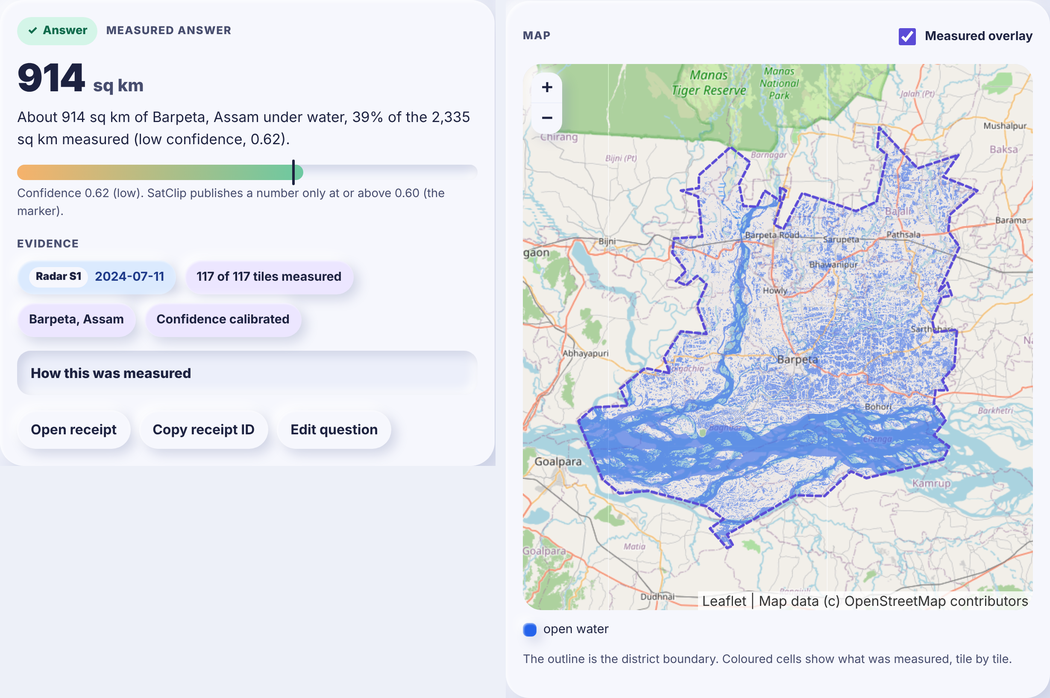
Demo 1: Barpeta flood extent, 11 July 2024
914 sq km
under water, 39% of the district measured
0.62
calibrated confidence, just above the 0.60 bar
77 s
cold, 117 radar tiles on a 2-core CPU; 0.5 s warm
Notes:
Live run, docs/demo/TRANSCRIPT.md: scene S1A_IW_GRDH_1SDV_20240711T115715 (Sentinel-1, chosen automatically because of monsoon cloud), receipt 5d27fcc87150f848. Honest caveat: the 914 sq km includes the Brahmaputra channel and permanent wetlands; it has not been checked against an independent flood map.

Slide 6
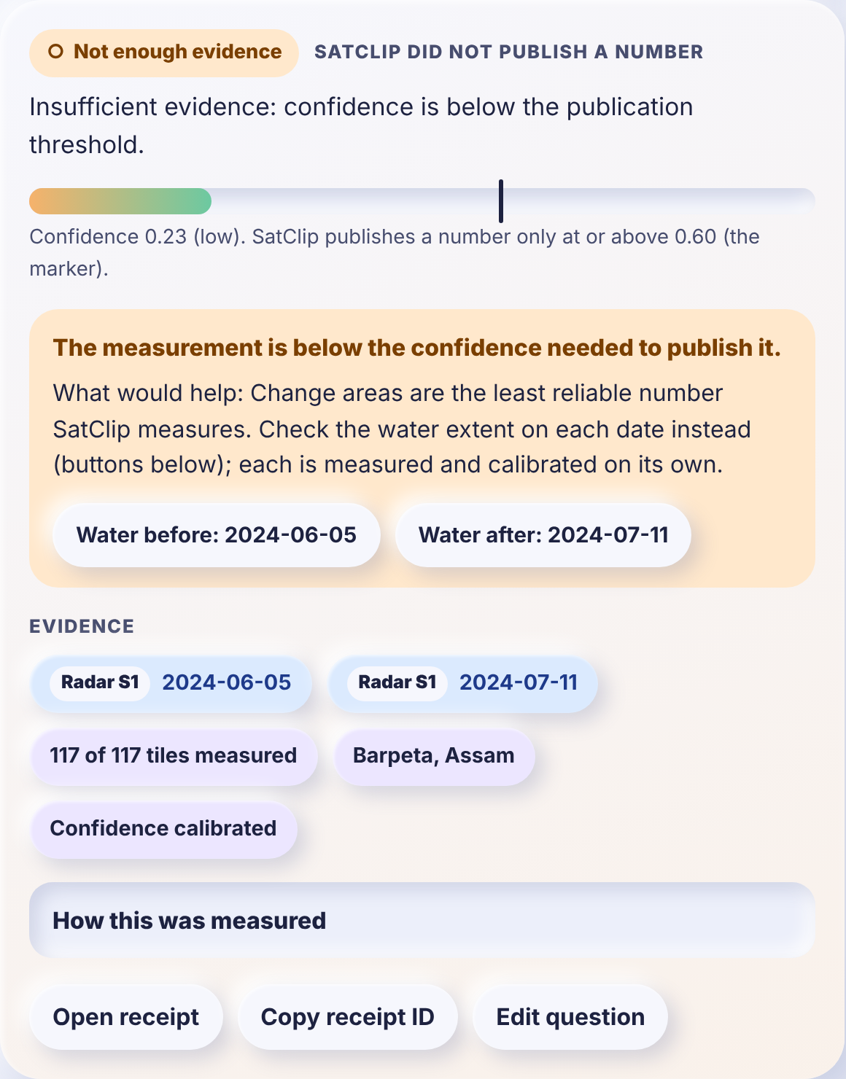
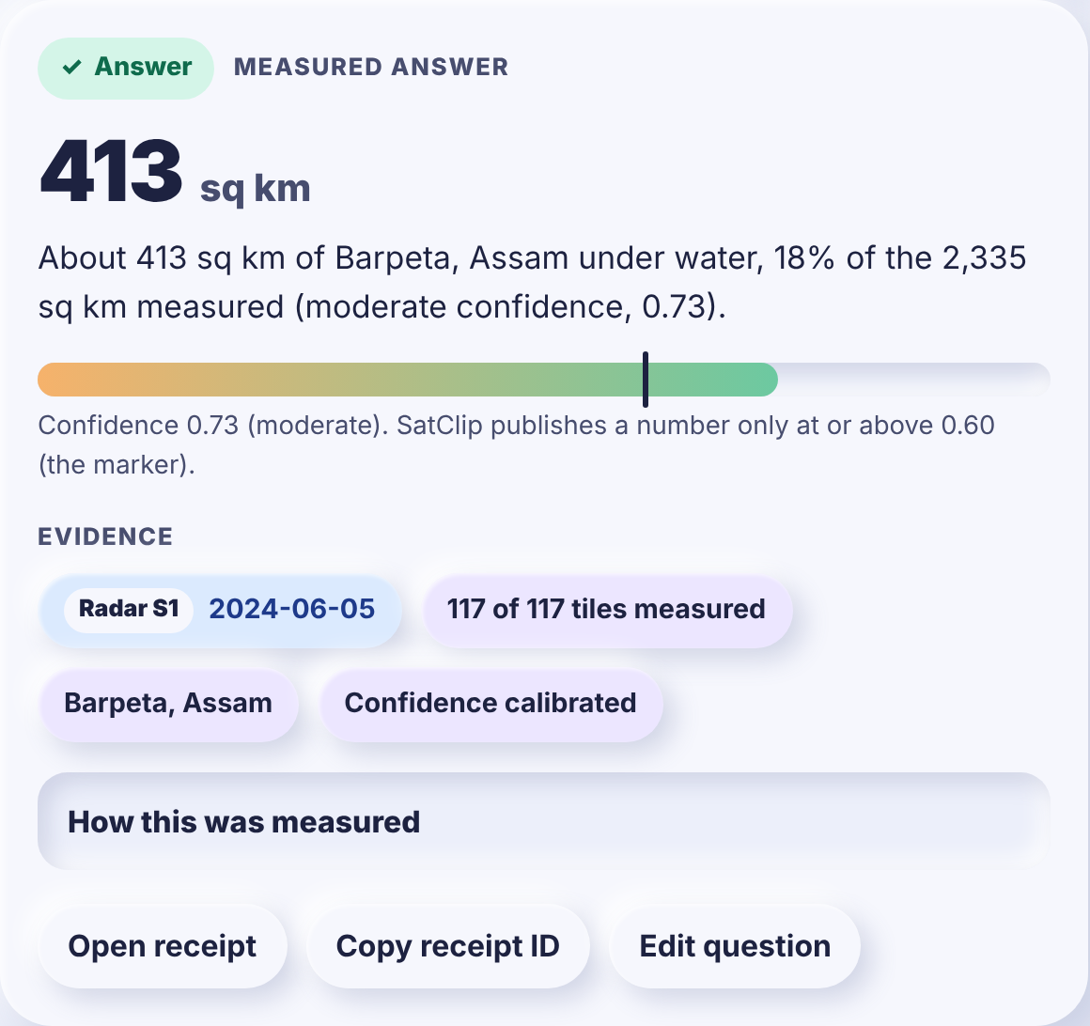
Demo 2: when the evidence is weak, SatClip says so
"Did the flood spread?" Not enough evidence (0.23)
One click: before 413 sq km (0.73), after 914 sq km (0.62)
Notes:
Change areas are the least reliable number SatClip measures (Kuro Siwo calibration: 75% of flood chips undercounted by more than 20%). Instead of a confident wrong number, the card explains why and offers two extent questions, each measured and calibrated on its own. Source: TRANSCRIPT.md, receipts 4b761f62146d6e6d and 3af7eb6ef03ed33a.

Slide 7
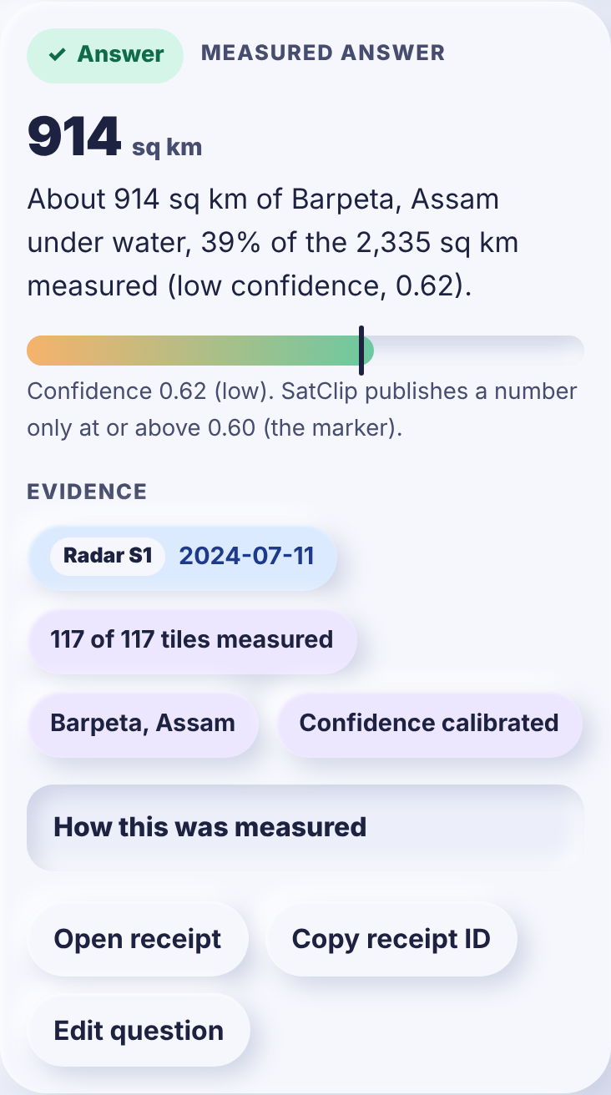

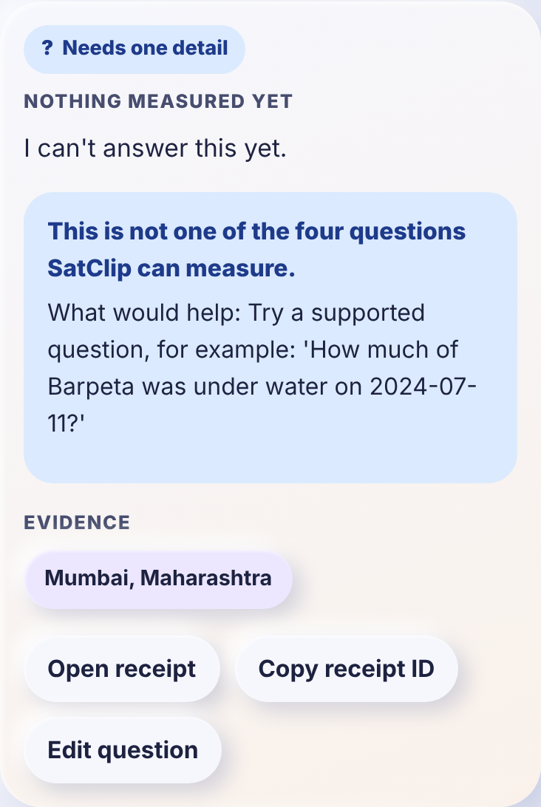



Designed for a phone, a hurry and no GIS training
Needs one detail
Ambiguous district names (Aurangabad) ask which one, in 0.01 s, before any data is fetched.
Out of scope, by design
"How many cars are parked in Mumbai?" is refused with what SatClip can answer instead.
Accessible
Keyboard path tested end to end, ARIA district picker, light and dark themes, plain-language confidence.
Indian formats
11/07/2024, "11th July", Hindi month names and Hinglish keywords give the same card as English.
Notes:
Screenshots are from the prototype (docs/screenshots). Keyboard walkthrough: tools/ui_keyboard_check.py. Parser accuracy on 44 hand-written questions (English, Hinglish, Hindi): 0.68 full match with the rule parser; the LoRA parser (training/) is meant to raise this.

Slide 8
The innovation is ease, not a bigger model
GIS workflow
Chat with a VLM
SatClip
Find scenes, check clouds
Download, calibrate, reproject
Threshold, map, measure
Hours to days, needs an analyst
Upload an image you already have
Get a fluent paragraph
No scene ID, date or mask
47 to 61% hallucination in RS tests
Type the question
Scenes found, radar if cloudy
Number, map, confidence, receipt
About a minute on a CPU
Accurate, but out of reach
Easy, but unverifiable
Easy and checkable
Free-form EO agents pick the right tool parameters only 26 to 35% of the time. SatClip's fixed router to versioned instruments cannot make that error.
Notes:
Agent figures: Earth-Agent with GPT-5 (A094) and ThinkGeo with GPT-4o (A092). Hallucination rates: RSHBench 2026 (A203). Day-one value needs no training: instruments are physics-based or pretrained and the data is free (SOLUTION section 4).

Slide 9


Why the card can be trusted, measured
Calibrated
Water ECE 0.074; change ECE 0.214 to 0.041 with per-regime maps
Abstains
Below 0.60 no number is published, and the card says what would help
Reproducible
8 of 8 demo receipts (713 tiles) re-ran to identical outputs
Notes:
Sources: training/calibration/reports/sar_water_otsu.md (v1.0 vs v1.1), fit_change report (Kuro Siwo, grouped cross-validation by event), docs/quality/reproducibility.json. The reproducibility check caught a real defect in run 8 (GDAL decimation under concurrency) which is fixed. Crop-change confidence is still a labelled placeholder: no open Indian crop-decline labels exist.

Slide 10
Scales out, or runs offline on state servers
Web UI
Phone first, no build step
Stateless API
FastAPI; parse, route, cache
Tile queue
Redis lists, one job = many tiles
Workers
Instruments on COG windows
Public STAC
Planetary Computer, Earth Search, CDSE
Near-linear scale-out: Reads dominate; adding workers adds throughput
Cheap per worker: About 86 MB RAM each; Redis 13 MB
Fast repeats: Warm 144-tile job in 0.01 to 0.2 s
Offline ready: Docker compose; point STAC at an on-prem mirror
Notes:
Source: docs/QUALITY.md and docs/quality/loadtest.json (2 vCPU sandbox). Compute is about 0.1 s per tile; with simulated 400 ms reads, 1, 2 and 4 Redis workers gave 2.0, 4.0 and 7.8 tiles/s. Parse-only API: 84 requests/s, p50 14 ms. Architecture: docs/ARCHITECTURE.md.

Slide 11
225 papers read: nobody combines all of it yet
VisTA (2024): has change answers with masks; no confidence, no live data
EO-Gym (2026): has switches optical to SAR; no abstention or receipts
SHRUG-FM (2026): has rejects unreliable flood maps; scores not calibrated, optical
UnivEARTH (2026): has agents fetch live imagery; best 64.5% accuracy, never abstains
TerraScope (2026): has pixel-grounded area answers; GPU, no calibration or provenance
Notes:
Full archive: archive/README.md and archive/index.csv, one entry per paper with what it means for SatClip. Closest prior work: VisTA A179, EO-Gym A176, SHRUG-FM A202, UnivEARTH A204, TerraScope A201. The novelty claim (NOVELTY.md) is the combination: calibrated confidence, threshold abstention with a next step, scene receipts, live Sentinel retrieval with automatic SAR fallback, on CPU, for Indian non-experts.

Slide 12
What it does not do yet, and what comes next
Known limits, stated on the card
HAND and permanent-water exclusion mask; per-pixel water probability
Next
Flood extent includes rivers, wetlands and paddy (no HAND terrain mask yet)
Urban flooding is missed by radar intensity alone
Crop-change confidence is a placeholder: no open Indian labels
Flood change areas are often undercounted, so they abstain
LoRA intent parser trained on Colab; Hindi district names
Then
One district disaster office in Assam or Bihar through a monsoon
Pilot
On-prem STAC mirror on state infrastructure; more instruments
Scale
Notes:
Limits: SOLUTION.md section 9 (risks 12 and 17), archive A210 (HAND), A211 (exclusion maps), A212 (probabilistic flood mapping), A214 and A215 (urban flood coherence; Planetary Computer RTC has no phase, so coherence is not available today). Training code is ready to run: training/colab/satclip_lora.ipynb.

Slide 13
Team Stardust
SB
Sai Bhuwan S
YM
Yashita Mandavilli
RV
Raj Venkat
NR
Nikhil S Rao
SM
Shashwat Mittal
SA
Sasanuru Anirudh
Notes:
Team Stardust, RVITM Bengaluru, Smart India Hackathon 2026, problem statement SIH26167.

Slide 14
Every answer, with its evidence
Open source, free data, runs on a CPU. Code, archive and receipts: github.com/UnKnownnPasta/satclip
Measured number
Scenes, dates, map
Confidence or abstain
Notes:
Close on the evidence card. Offer to run a live question for the jury's own district.

