Slide 1
The Battle of Neighbourhoods
By Wei Wang

Slide 2
Background:
According to UN Department of Economic and Social Affairs (DESA), there are nearly 272 million international migrants worldwide in 2019.
Toronto and Shanghai, two major well known cities in Canada and China, are the economic centers and financial capitals of their countries. In 2019, Toronto welcomed 117,000 immigrates while Shanghai’s population is growing at the rate of 700,000 people a year.
Despite the fact that Toronto and Shanghai are far away from each other, it is still possible to find the similarities between these two cities.
Notes:
Insert a map of your country.

Slide 3
Business Problem:
Environment and culture shock are big concerns for migrants when moving to another city.
Tt is advantageous to find a similar neighborhood in the new city as the one they live in before.
In this project, we will adopt machine learning tools to cluster Toronto and Shanghai neighborhoods in order to recommend the neighborhoods which are the best choices for migrants based on surrounded essential facilities such as school, hospital, and stores etc.
Audiences: anyone who is planning to move from one city to another / stakeholders who are interested in citing a business in a new city.
Notes:
Insert a picture of one of the geographic features of your country.

Slide 4
Data:
Toronto.csv that consists of Toronto’s postcodes boroughs, neighborhoods.
Data source: https://en.wikipedia.org/wiki/List_of_postal_codes_of_Canada:_M
Shanghai.csv that consists of Shanghai’s city name, districts and subdistrict.
Data source: https://en.wikipedia.org/wiki/List_of_township-level_divisions_of_Shanghai
A csv file that has the geographical coordinates of each postal code for neighbourhoods in Toronto is provided.
Data source: http://cocl.us/Geospatial_data
Foursquare API search feature will be used to collect neighborhood venues information, which will be used to explore and compare geographical locations of Toronto and Shanghai.
Notes:
Insert a picture illustrating a season in your country.

Slide 5
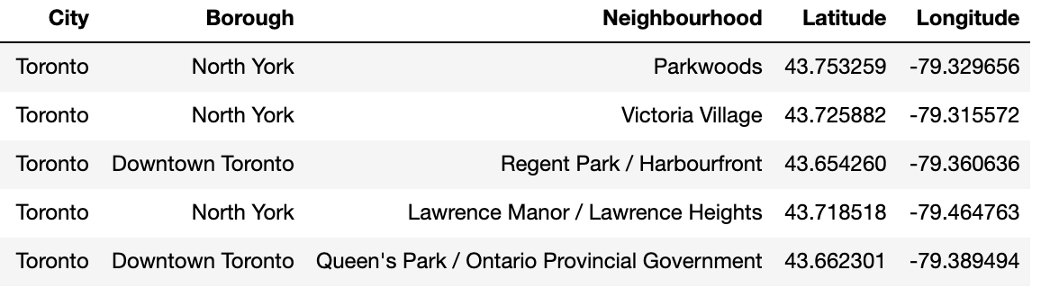
Methodology:
Obtain Coordinates
Obtain latitude and longitude coordinates of each neighbourhood. Given that Geocoder package can be very unreliable, we will use a csv file that has the geographical coordinates of each postal code for neighbourhoods in Toronto. The geographical coordinates for neighborhoods in Shanghai are not provided; therefore, we will use Geopy library and Nominatim API.
Notes:
Insert a picture of an animal and or plant found in your country.

Slide 6
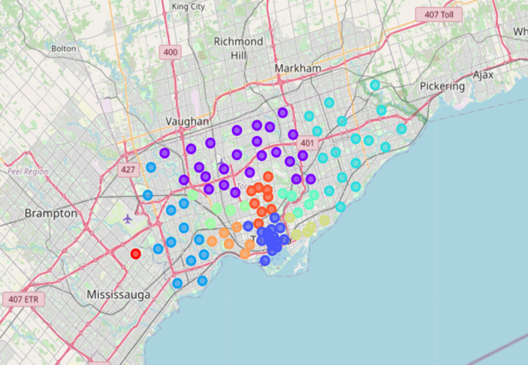
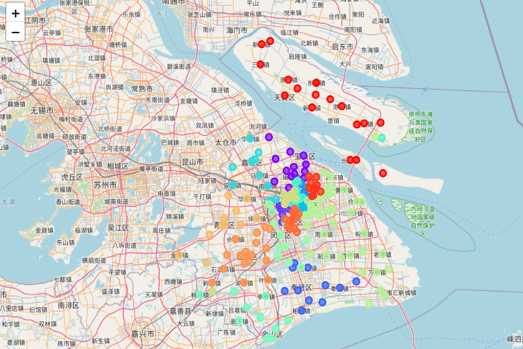
Methodology:
Data Visualization
Use Folium library to plot a map of all the neighbourhoods in each city. The neighbourhoods belong to the same borough are plotted with the same color.
Outliers will be cleaned out for better analysis.
Toronto
Shanghai
Notes:
Insert a picture of an animal and or plant found in your country.

Slide 7
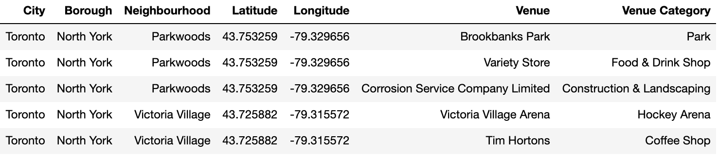
Methodology:
Foursquare API Search Feature
Use Foursquare API and Geopy data to locate nearby venues within 500 meters of each neighbourhood in Toronto and Shanghai. Only venue names and categories will be extracted from the results.
Notes:
Insert a picture of an animal and or plant found in your country.

Slide 8
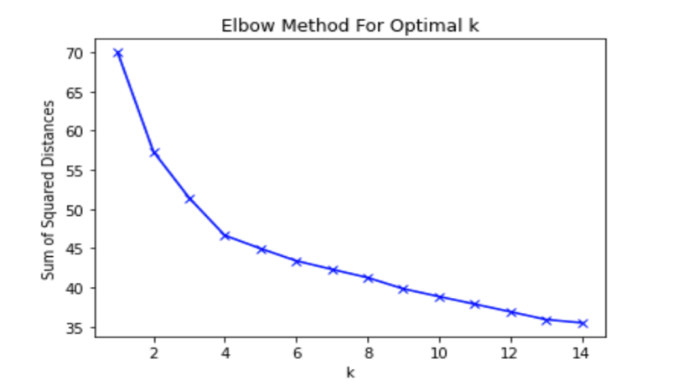
Methodology:
Machine Learning Models
Apply K-Means model to segment and cluster all the neighborhoods in Toronto and Shanghai based on the similarity of the venue types.
Use Elbow method to determine the right value of K.
The elbow point of the line chart is determined as the right K for clustering. Here K equals to 4.
Notes:
Insert a picture of an animal and or plant found in your country.

Slide 9
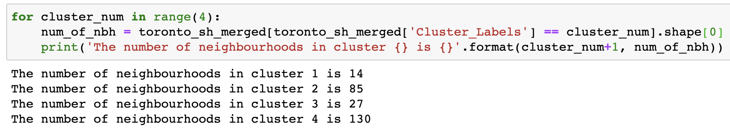
Results:
Cluster 1 are mostly suburb areas where have access to hotels, airports and football stadium.
Cluster 2 are basically residential areas with parks, grocery stores, pharmacy and restaurants.
Cluster 3 includes neighbourhoods with restaurants and distribution centers.
Cluster 4 are mostly downtown areas where surrounded by lots of restaurants, cafeteria, bars, convenience stores and different kinds of shops.
Notes:
Insert a picture of an animal and or plant found in your country.

Slide 10
Conclusion:
To improve model performances and result in a better clustering, we will need further data such as more detailed venues information in Shanghai provided by China.
This recommendation system can be applied to any other cities rather than Toronto and Shanghai.
People in the world are nowadays moving more frequently than before, I hope this analysis will help you to make a decision of choosing the neighbourhood in the destination city that fit for your needs.
Furthermore, this research can be useful for real estate business if combined with Price Paid data, or city security solution if combined with crime data, etc.
Notes:
Add key points in the history of your country to the timeline.

