Slide 1
Role of Sex in Childhood Diarrheal Disease
The ATGC Team: S. Breaux, Y. Chen, F. Tuz Jhohura, T. Severson

Slide 2
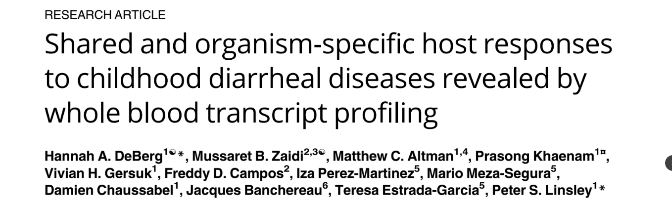
Purpose of study
Paper Aims: To determine biomarkers to predict the severity and causative organism
Diarrhea one of the leading causes of child death worldwide
Diagnosis made by clinical observation and a battery of molecular tests
Hypothesis: “pathogens causing diarrheal diseases would elicit distinct patterns of gene expression in host peripheral blood that could be used to characterize immune responses associated with each pathogen and with disease severity”
Our Aims: To determine whether sex of patient influences response to pathogen.
Recreate several analyses from the original paper as a reality check.
Build a classifier to predict pathogen type based on differentially expressed genes.
Notes:
Study took place in yucatan mexico

Slide 3
Study Design
2010-2014 in Yucatan, Mexico at General O’Horan Hospital
Children less than 10 years old
However, they did not include their final processed data set
Case (N=193) | Control (N= 29)
Acute community acquired diarrhea Had it for <8 days No underlying GI or immune issues No recent GI surgery Positive culture with only 1 pathogen (not Campylobacter or Vibrio) | Age matched In for immunization or simple fractures Negative for pathogens
Notes:
Libraries produced from globin reduced RNA
Ran on illumina HiSeq2500 sequencer
50-58 cycles
Single Read sequencing
Truseq single read cluster kit v4

Slide 4
Key Findings
no age-associated differences in expression
no relationship between disease severity and complement or interferon signaling genes
relationship between leukocytes and days past on set
relationship between gene expression and cell type proportions varies according to pathogen and gene function

Slide 5
Data Processing
Count data from samples uploaded to GEO at two different times - intermixed with count data from samples lacking metadata.
Data contained a lot of NA values
Tested imputation and removal of NA values
NA removed more closely matched what we expected
We converted to RPKM for initial analyses
Gene enrichment analyses and classifier development
Counts filtered and normalized using edgeR (cpm > 1 in 3 or more samples)
Limma-voom and eBayes
Approach matched method described by authors
Notes:
As the data was missing not as random and mostly within the controls imputation introduced a lot of artificial variability related to infection type
“To filter for sample quality, a sample library was selected for further analysis if the fraction of unpaired reads examined compared to total FASTQ reads was >75%, median coefficient of variation of coverage was <1, and the library had >1 million reads. To filter for lowly expressed genes, genes expressed at a level of counts per million >1 in less than 3 samples were removed”

Slide 6
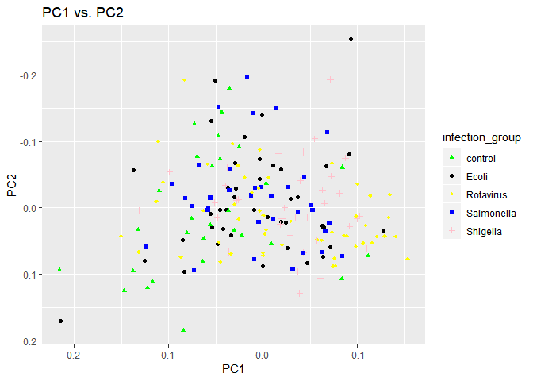
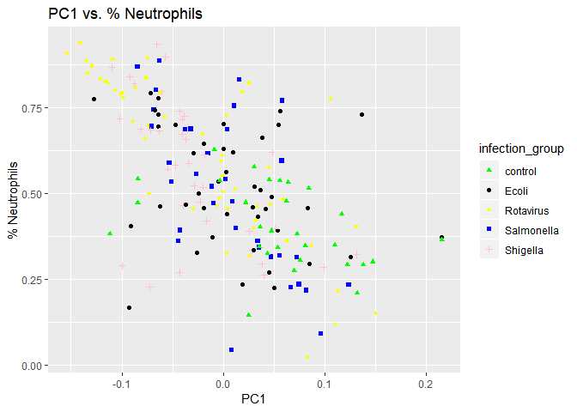
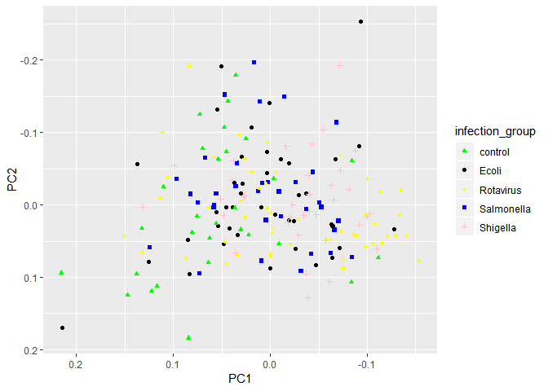
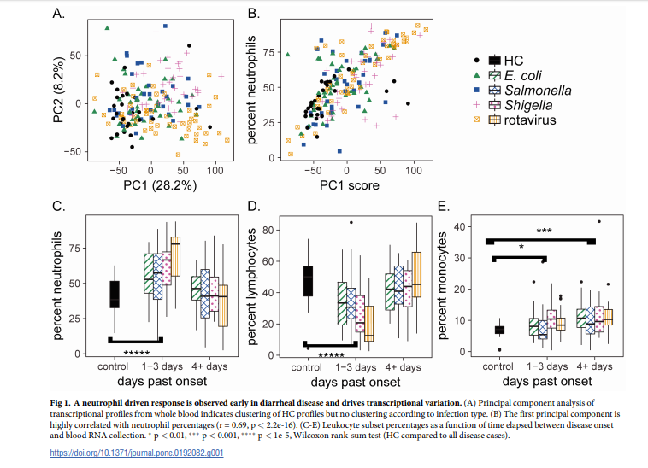
PCA
Notes:
PCA analysis of our RNA-seq data demonstrated
overlap of profiles from HCs and individuals infected with each of the 4 infectious
agents. This finding suggests global differences in host gene expression patterns in
individuals with infectious diarrhea compared to HCs.
To determine whether gene expression could be linked to clinical parameters, we searched
for clinical correlates of PC1, which explained 38% (PC2 explained 10%) of the variability in the RNA-seq data
Correlation between neutrophil percentages and the first principal component of variation in
the RNAseq data (Pearson's r = .40 vs the 0.69 in paper, pvalue same for both =2.2e-16)--have a strong correlation

Slide 7
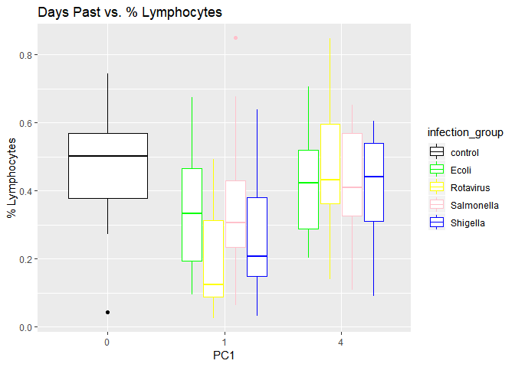
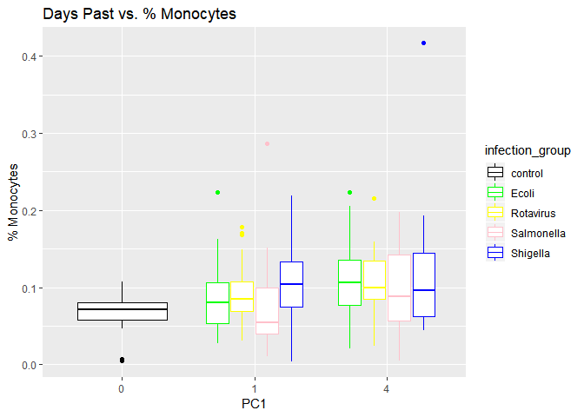
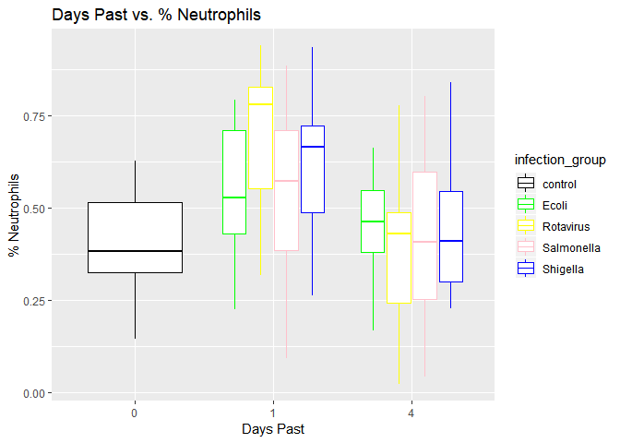
PCA Analysis
Notes:
% of white blood cells were also found to be correlated to days past on set
Neutrophiles tend to rise at the begin of the disease and expression lowers as time goes on. Lymphocytes have an opposite correlation while monocyte levels remain fairly constant and this is what we would expect knowing how these cell types function

Slide 8
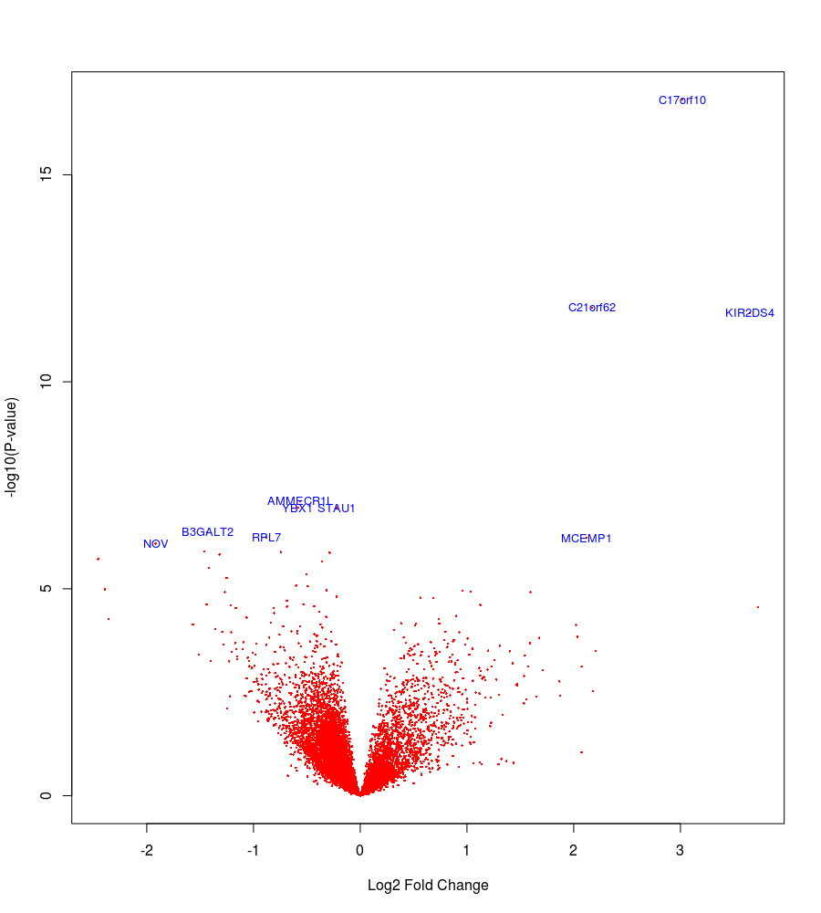
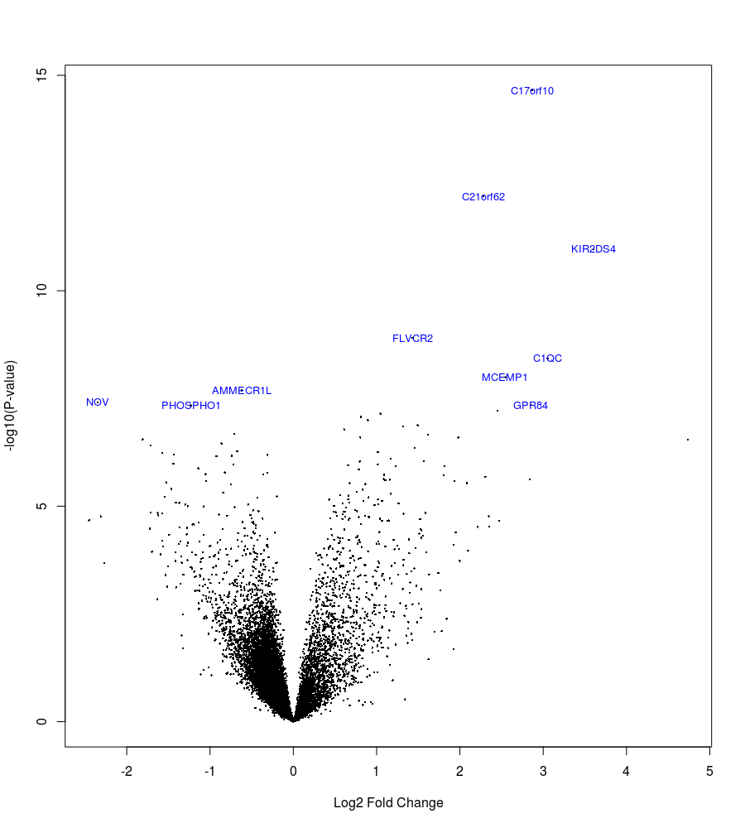
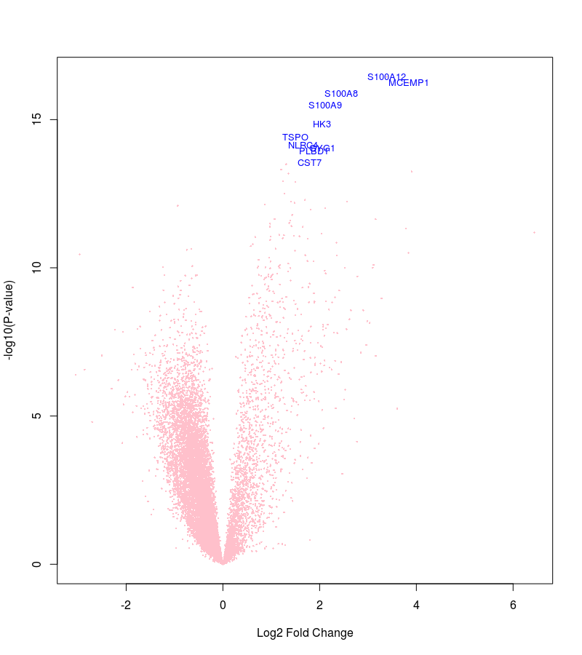
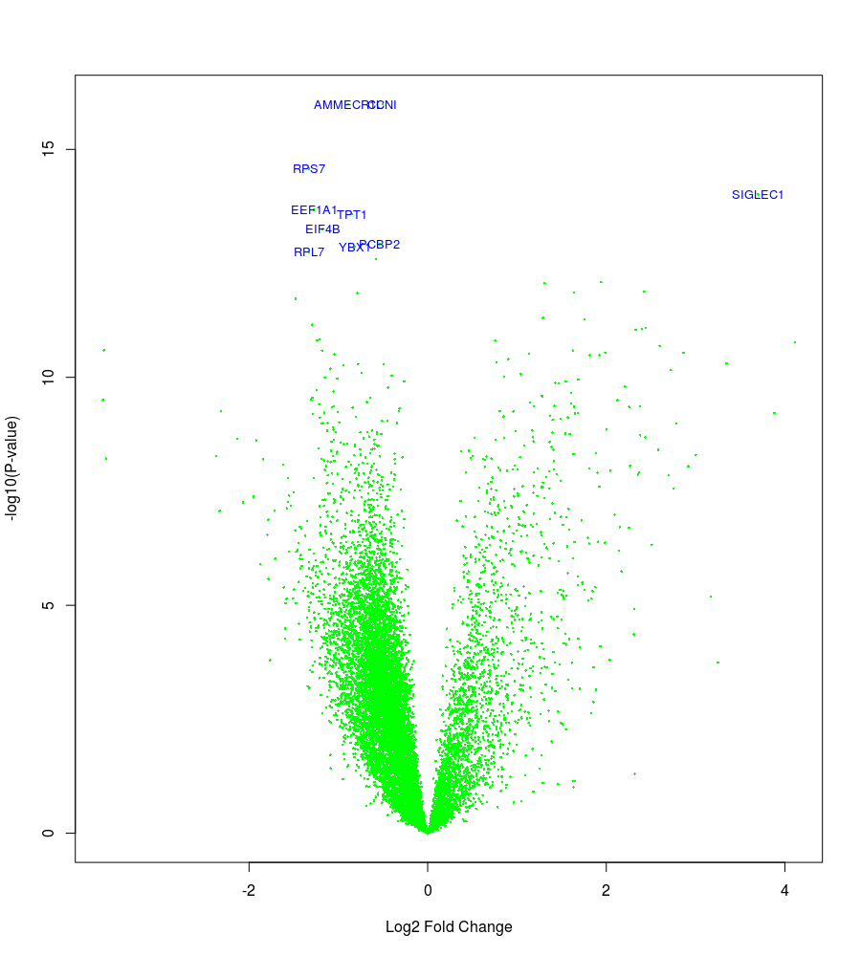
DEG
Rotavirus VS HC
E Coli VS HC
Salmonella VS HC
Shigella VS HC
Log10P
5
-2
2
-2
2
-2
2
-2
-2
Notes:
DEG Comparing different infection type with the Healthy control.
What is shown here is that the number and the type of DEG is different

Slide 9
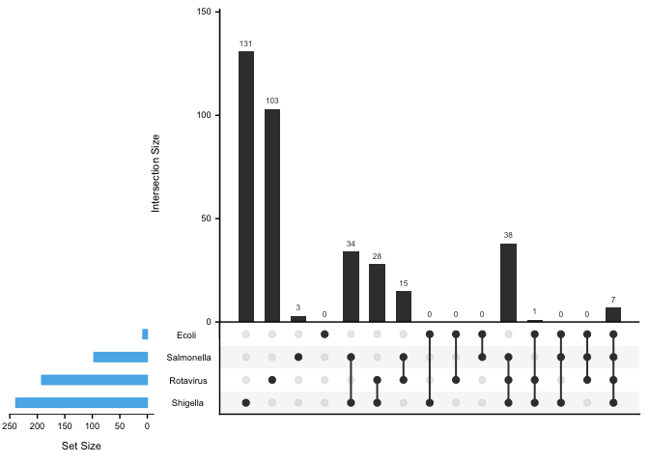
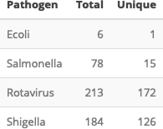
Replication of Findings
8 E. coli
97 Salmonella
192 Rotavirus
239 Shigella
Notes:
One of our reality checks was involved determining the number of total and unique differentially expressed genes. The fitted additive model included age, sex and infection group, as well as dpo and batch to control confounding. Venn diagrams become less digestible with 4 sets or more, this is an Upset plot. Numbers aren’t identical, but are in the ballpark. Discrepancies probably indicate that our models or filtering methods differed slightly.

Slide 10
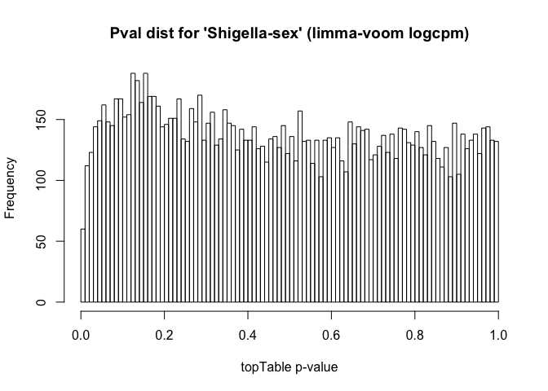
Effect of patient sex on response to pathogen
Representative plot of p-value distribution for interaction between patient sex and response to Shigella
No interaction observed for this or any other diarrhoeal pathogen
Notes:
Our primary hypothesis was that patient sex could play a role in moderating response to diarrheal pathogens. The model fitted included infection group, sex, age and interaction terms for sex and infection group. A look at the p value distribution for is consistent with uniform.

Slide 11
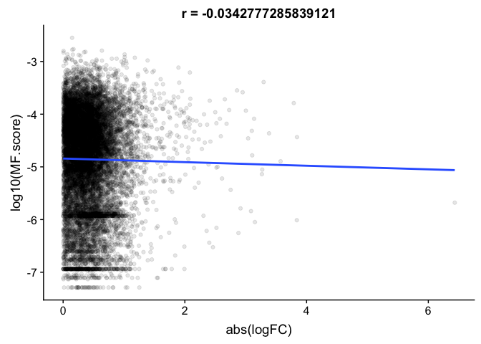
Low bias due to multifunctionality
How do Shigella gene enrichment results hold up to multifunctionality?
ErmineR package
Small negative correlation
Notes:
After learning about the implications of multifunctionality, I was curious about whether our enriched biological process categories would hold.

Slide 12
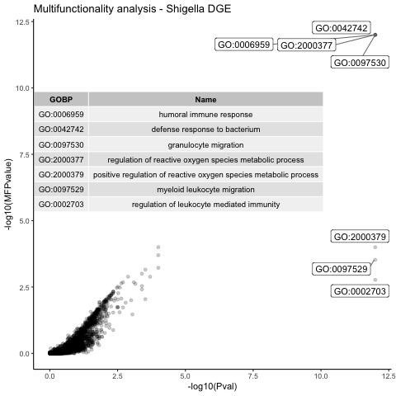
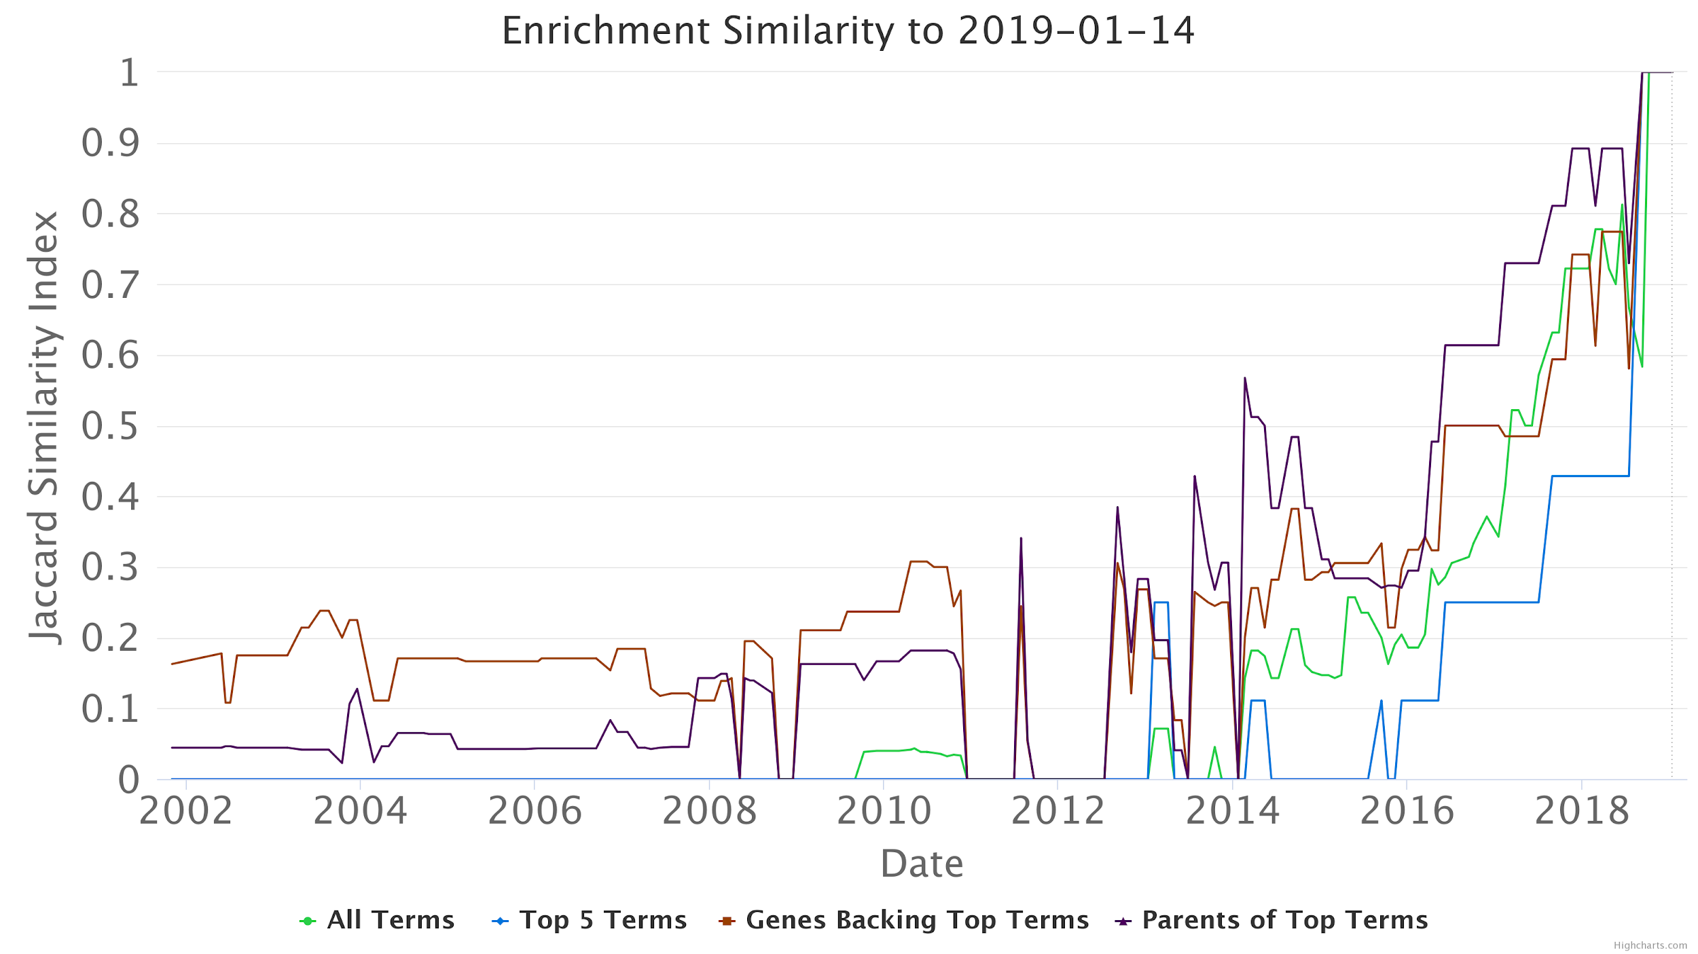
Multifunctionality analysis
Most significant biological processes related to immunity
Significance of 3 GO categories reduced for multifunctionality

Slide 13
A classifier for pathogen type
Challenges:
High Dimensional Data
Sample size is small, Multiple response variable
Gene selection
Manual genes selection
Regularization: Not implemented
Category(pathogen type) reduction

Slide 14
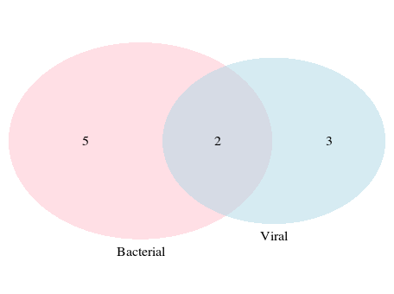
Gene Selection
Rotavirus 3 fold change P.val <0.01
Bacterial 2 fold change P.val <0.05
C17orf100
C21orf62-AS1
MCEMP1
GPR84
ARG1
SIGLEC1
OTOF
DNAAF1
KIR2DS4
CD177

Slide 15
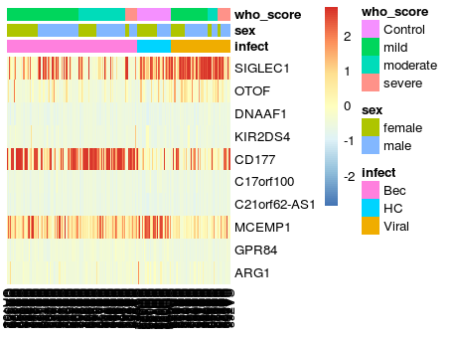
Rationale of Classifier
Notes:
Original category vs Reduced category.
Some genes expression vary among the group,

Slide 16
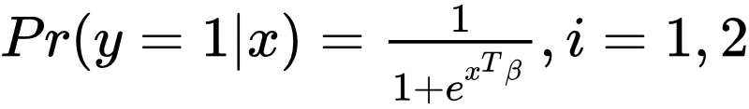
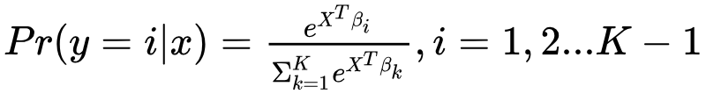
A classifier for pathogen type
Logistic Regression
Multinomial Regression
 | HC | Bac | Viral | Total
Fold1 | 14 | 54 | 26 | 94
Fold2 | 15 | 58 | 25 | 98
 | Training Accuracy | Validation Accuracy
Fold1 | 75% | 76%
Fold2 | 81% | 71%
Notes:
In the case where the response variable is not continuous: we have logistic regression or Multinomial Regression.

Slide 17
Conclusions
Relative numbers of differentially expressed genes similar to DeBerg et al. 2019
many but not all of significant genes discussed in paper appear in our top genes
Sex of patient does not influence response to any of the pathogens
Significance of three GO categories adjusted downward due to multifunctionality
Our classifier uses 8 genes to predict pathogen type with 70% accuracy

Slide 18
THANK YOU!
Questions?

