Slide 1

Kinnect for Windows v2 Hackathon
4th September’14
Amsterdam
Welcome To The World Of Ripple Let us create Ripples together

Slide 2
A
What is Kinect Ripple?
Ripple is a dual projection based infotainment system that comes with fully customizable interactive floor and screen.
Ripple simple UI framework allows you to quickly add, edit and build integrated experiences on top of it.
As the name suggests, ‘Ripple’ has the power to create new waves by integrating multiple, unique experiences in a single set-up through ‘gamification of knowledge’.
The system is portable with quick setup (msi), auto-calibration of hardware with software and SDK, and easy customization with Content Editor.
It can be best explained by getting a feel of it.

Slide 3
B
Where can it be used?
Retail
Bidding
Casinos/Malls
Education
Gaming

Slide 4
What is in it for Developers?
B
Ripple is not just an infotainment system but it is a framework on which you can develop custom apps.
All you need to know is HTML5 , CSS , JS and trust us that’s it.
Ripple comes with SDK built in javascript that takes care of handling gestures, message passing between screens and generates events which you can listen to and write code for.

Slide 5
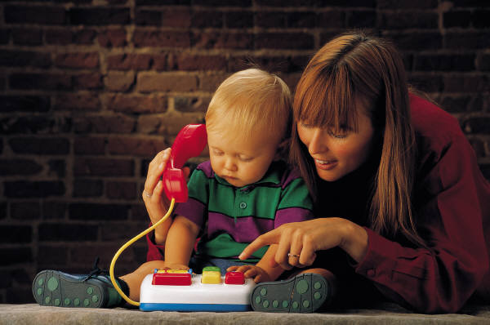
TECH KNOW HOW For Ripple
C
Ripple works as two WPF applications (one for floor and one for screen).
You get a browser control in both the applications, so you can write HTML5 apps (as you would write for browser)
You can communicate between screens by using Ripple SDK Message Passing mechanism

Slide 6


RIPPLE SDK – Introduction
D
Ripple SDK comes with two javascript files one for floor and one for screen.
You have to include these javascript files in your respective htmls to interact with Ripple.
Ripple SDK (will be shared) with you.
As you move on floor , mouse moves along with you and mousemove event is fired !IMPORTANT

Slide 7
Ripple SDK Capabilities
E
Gesture Support (All Gestures are received in floor app).
Message Passing(Dual Message passing between floor and screen is available).
Timer functions to start stop timer.
Text To Speech function (available for floor app).
Go To Start function for exiting application.
Debug Mode for development.

Slide 8
How to use Ripple SDK?
F
Include this in your html file.
” <script src="rippleFloor.js"></script>” – For floor app
“<script src="rippleScreen.js"></script>” – For screen app
DO NOT FORGET THE META TAG
<meta http-equiv="X-UA-Compatible" content="IE=10">
WHY Meta Tag is important??

Slide 9
Ripple Helper is your best friend.
G
Once you have included our javascript file , ‘rippleHelper’ is your best friend.
rippleHelper is a javascript object which has some methods and properties that makes developing apps for Ripple a piece of cake.

Slide 10
Ripple Helper -> Debug Mode / Emulator Mode
H
rippleHelper.setDebugMode(true); // This is very handy for development purposes.
rippleHelper.setDebugMode(true); // helps when run inside Ripple emulator i.e by loading floor and screen in ripple emulator page
When you are developing and running your application out of ripple framework in debug mode ,this will print all the actions in javascript console.

Slide 11
I
Gestures Available
Supported Gestures
Left Swipe
Right Swipe

Slide 12
J
Take Actions on Gestures
All gestures are fired as an event at document level.
To listen to a gesture:
//Example Usage: Take Action On Right Swipe
document.addEventListener("RightSwipe", function (evt) {
//Take Action
});

Slide 13
K
Example: Exit An App On Right Swipe
//Example Usage: Exit on Right Swipe
document.addEventListener("RightSwipe", function (evt) {
rippleHelper.goToStart();
});

Slide 14
L
Screen Communication
-> Use sendCommandToFrontScreen to send Message From floor to screen.
-> Use sendCommandToFloor to send Message from screen to floor.
Syntax:
sendCommandToFrontScreen(commandName, Parameters)
commandName – String
Parameters – Parameters is an array of strings

Slide 15
M
Example Usage
rippleHelper.sendCommandToFrontScreen("CommandFromFloor", ["Parameter1", "Parameter2"]);
//On Front Screen Side:
document.addEventListener("CommandFromFloor", function (evt) {
//commandParameters is an array of parameters received from Screen
console.log(evt.commandParameters);
});

Slide 16
N
Moving wheel on right swipe
document.addEventListener("RightSwipe", function (evt) { rippleHelper.sendCommandToFrontScreen(“moveWheel", [ ]);
});
//On Screen
document.addEventListener(“moveWheel", function (evt) {
//TAKE ACTION TO MOVE WHEEL
});

Slide 17
O
Text To Speech
rippleHelper.textToSpeech("Welcome Message From Ripple");
//Does Text To Speech for you ☺

Slide 18
P
Timer
//Ripple Timer
//Measures time in seconds
//Has Methods
//timer.startTimer() // to start the timer from initial value 1
//timer.stopTimer() // to stop the timer
//timer.getTime() // to get time in seconds
var timer = rippleHelper.timer();

Slide 19
Q
Keyboard Input
//Ripple Keyboard Input
//Enable Keyboard input
rippleHelper.enableKeyboardInput(true);
var lastInput = null; // you may not need to do this based on your scenario
document.addEventListener("keyboardInput", function (e) {
var input = e.input;
if (input != lastInput) {
//Do something with input
lastInput = input;
}
});

Slide 20
R
Ripple Important Points
Ripple is a single user system.
We are not biased towards resolution.
Both floor and screen are preferred in a 4:3 ratio.

Slide 21

E
ASK US
If you have any questions
E-mail: smbehl@Microsoft.com
We will be here to help you.

