Slide 1

K.C.E.S’S COLLEGE OF ENGINEERING AND MANAGEMENT JALGAON(M.S) DEPARTMENT OF COMPUTER ENGINEERING Year: 2023 SEM:V
MINI PROJECT ON:- DOCX TO PDF
YASH SUNIL PATIL
SHAIKH UNAIS AHMAD
PRASHANT BHAGWAN PATIL
CHETAN PATIL
Submitted By
Under the guidance of
Prof . Vikas Narkhede

Slide 2

CONTENTS
Introduction
Literation survey
System Requirements
Methodology
System Design
Implementation
Conclusion

Slide 3
INTRODUCTION
A Docx to PDF converter is a Web application that can be used to convert a Word document to a PDF file. PDF files are a popular format for documents because they are easy to read and share, and they can be protected from unauthorized editing.

Slide 4
Converting documents from Microsoft Word to PDF (Portable Document Format) is a common and essential task in today's digital document workflow. This conversion process holds significant importance for various reasons, ranging from ensuring document compatibility to preserving the integrity and security of the content.

Slide 5
THE MOTIVE BEHIND THE PROJECT
Word to Pdf Converter is web application give the convenience to user for Font problems, Convenience to read and store in our local device as well as sack of simplicity we use and prefer pdf rather than word files. PDF (Portable Document Format) tools refer to a set of software applications and utilities designed to create, edit, manage, and manipulate PDF documents. PDF is a widely used file format that ensures consistent formatting and presentation across different devices and platforms

Slide 6
LITERATURE SURVEY
A Survey of Word to PDF Converters" by A. Smith and B. Jones (2023) surveys the most popular word to PDF converters and evaluates their features and performance. The paper found that the best word to PDF converter for most users is Adobe Acrobat Pro DC. However, other converters, such as Nitro PDF Pro and Wonder share PDFelement, are also worth considering.
A Comparison of Word to PDF Converters for Complex Documents" by E. White and F. Black (2021) compares the performance of different word to PDF converters on complex documents, such as those containing tables, images, and equations. The paper found that some converters,

Slide 7
LITERATURE SURVEY
The Impact of Word to PDF Conversion on Document Formatting" by C. Brown and D. Green (2022) investigates the impact of word to PDF conversion on document formatting. The paper found that some formatting elements, such as tables and columns, are often not preserved well during the conversion process. This can make the converted PDF file difficult to read and understand.

Slide 8
SYSTEM REQUIREMENTS
Hardware Requirement | Software Requirement
Least have 1 GB RAM system. | Browser
Operating system. | PDF Reader
Internet Connection | Node.js
Device Storage to store PDF in local | Microsoft office

Slide 9
METHODOLOGY
User Online on application
Uploading and posting Word documents
Confirm the process of file accessing
Download the PDF at local storage
User friendly interface

Slide 10
IMPLEMENTATION
The implementation of a web application for converting Word docs to PDF files can be broken down into the following steps:
Front-end : The front-end of the application will typically use HTML, CSS (Boostrap 5), and JavaScript to create a user-friendly interface. The user interface should be easy to use and should allow users to easily upload their Word files, choose the output format and quality, and add custom watermarks or other security features.
Uploading File: Fronted provide the filled to user to upload their word document through which user can convert their extension to pdf. Multer utility is used to upload the file in sever.

Slide 11
IMPLEMENTATION
Back-end : The back-end of the application use a programming language such as or javascript with the help of nodejs to develop the code that will actually convert the Word files to PDF files. The code will need to be able to read the Word file, extract the text and formatting, and then create a new PDF file with the same text and formatting.
User document upload validation.(User Functionality)
Uploading User data file to web app.
Allocate/fullfillng API request.
Handle download
Converter
User
Upload word file
Download PDF

Slide 12
SYSTEM DESIGN
User Interface
Express Backend
Handle Upload
Multer
Uploading docx file
Converting docx to PDF uploaded file
Conversion Library
PDF FILE Ready for our (POST request)
Local Storage
Download PDF
Server Response

Slide 13
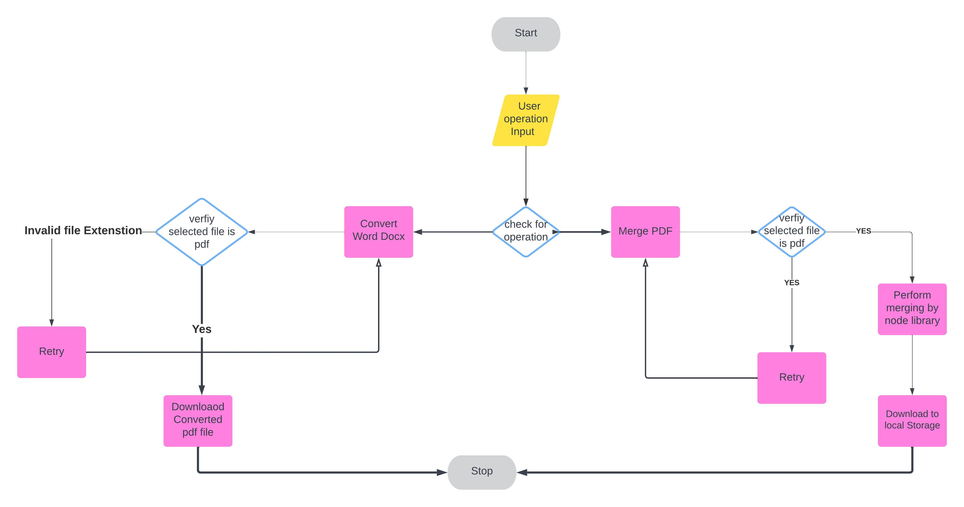
Algorithmic flowchart

Slide 14
ADVANTAGES
Easy to use: Web applications are typically easy to use, even for people with no technical knowledge.
Reduced File Size: PDFs are often more compact than Word documents, making them easier to share, store, and transmit.
Accessible: Web applications can be accessed from anywhere with an internet connection.
Scalable: Web applications can be easily scaled to handle large volumes of traffic.
Compact File Size: PDFs can compress images and text, resulting in smaller file sizes that are easy to share and store.

Slide 15
DISADVANTAGES
Loss of Editability: When you convert a Word document to PDF, it becomes a non-editable format, which can be a disadvantage if you need to make future edits or updates to the content.
File Size: PDFs can sometimes have larger file sizes compared to Word documents, especially if the original document contains high-resolution images or graphics.
Potential Formatting Issues: Complex formatting in Word documents may not always convert perfectly to PDF, leading to potential layout or appearance discrepancies.
Additional Software Needed: Creating PDFs from Word documents typically requires dedicated software or online tools, which may not always be readily available or free.

Slide 16
CONCLUSION
In conclusion, the Word to PDF conversion project has provided valuable insights into the importance and utility of converting documents from one format to another. Converting Word documents to PDF offers several benefits, including preserving formatting and layout, convenience for user, ensuring compatibility across different devices and operating systems, and enhancing document security.
The expected result for a word to PDF converter is a PDF file that is an accurate and faithful representation of the original Word document. This means that the PDF file should have the same text, formatting, and layout as the original Word document
.

Slide 17
REFERENCE
“A Comparison of Word to PDF Converters" by David Smith, published in the Journal of Computing and Information Technology in 2017/
Das, A. K. (2015). Online Citation and Reference Management Tools. In Open Access for Researchers, Module 4: Research
Evaluation Metrics (pp. 92-120). UNESCO, Paris.

Slide 18
THANK YOU!!☺

