Slide 1
Mugi Value Level Parallelism For Efficient LLMs
Daniel Price, Prabhu Vellaisamy*, John P. Shen*, Di Wu
UCF, CMU*

Slide 2
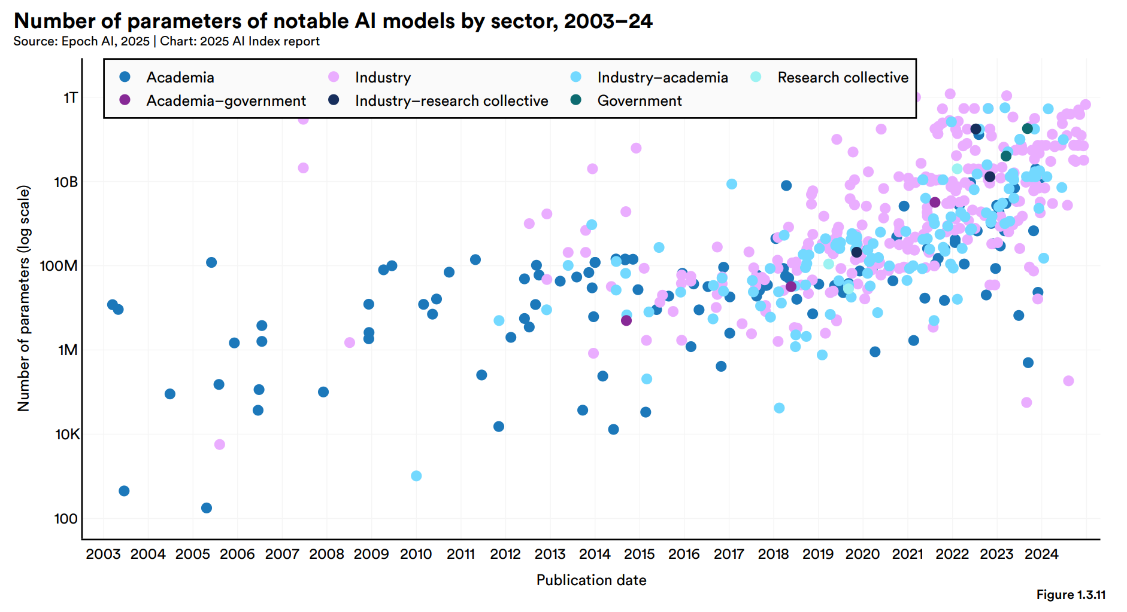
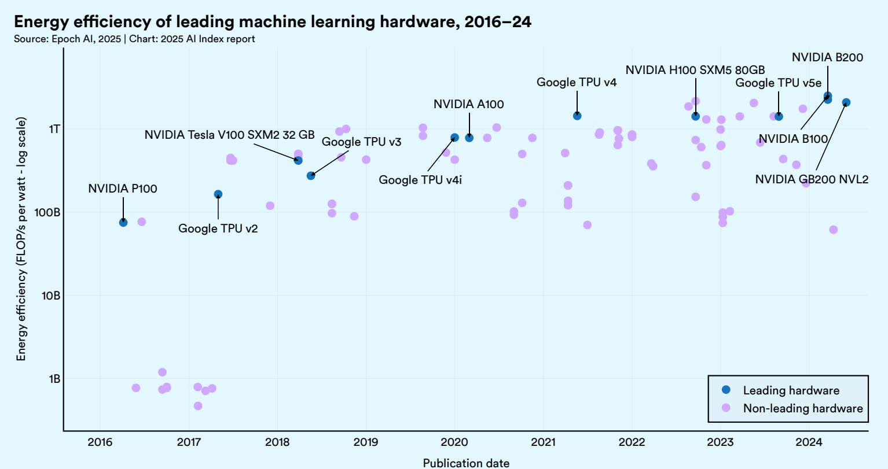
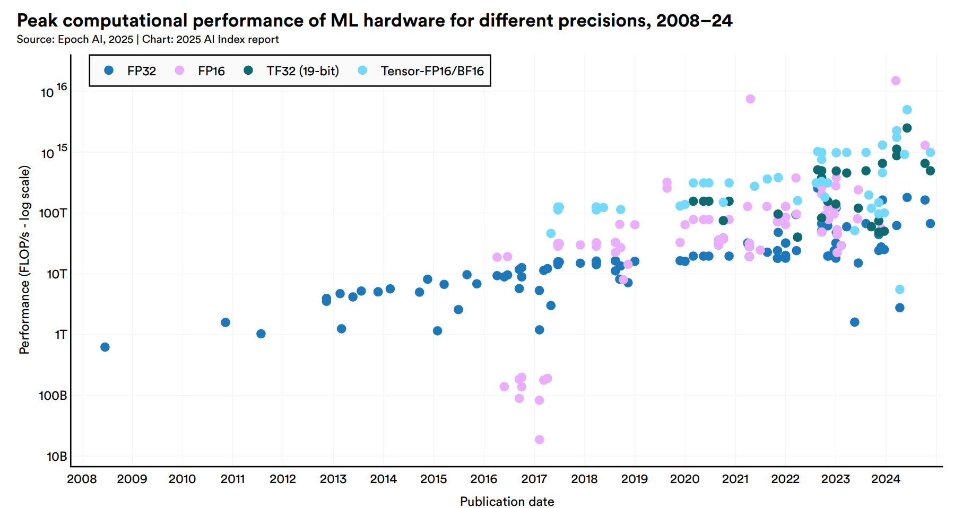
AI–Hardware Scaling Gap
Model parameters increasing
Hardware scaling lags
Hardware efficiency stagnates
https://hai.stanford.edu/ai-index/2025-ai-index-report
Notes:
Parameter counts growing Hardware throughput growing slower Energy efficiency nearly stagnant
How can we improve throughput and efficiency at the same time?

Slide 3
LLMs and VLP
LLM challenges
Opportunities
Nonlinear operations in LLMs
Value level parallelism (VLP)

Slide 4
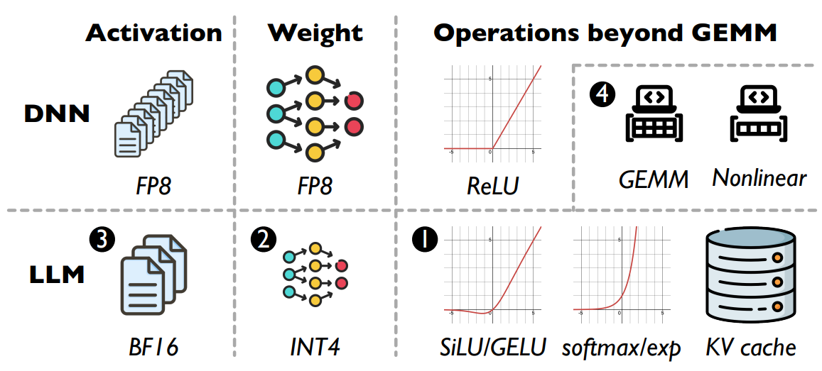
Challenges for LLM Inference
 | DNN | LLM
1. Operations beyond GEMM (Nonlinear) | Simple | Complex
2. Weight/Activation datatypes | Symmetric | Asymmetric
 | Existing Architecture | Mugi
3. Batch Size | Large batch | Small batch
4. Operations beyond GEMM (Nonlinear) | Separate GEMM/nonlinear hardware | Integrated
Notes:
DNN contains simple nonlinear (relu) LLM contains complex nonlinear (softmax, silu)
DNN weights and activations are symmetric (same size) LLM are asymmetric (weight only quantization popular option)
DNN small weights large batch LLM large weights small batch
Hardware for nonlinear and gemm separate

Slide 5
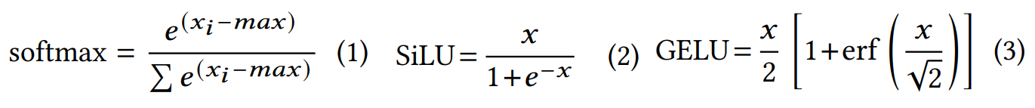
Nonlinear Operations in LLMs
Existing solution
Precise computation
Costly
Hardware approximations
Taylor series, piece-wise linear, etc.
Inaccurate

Slide 6
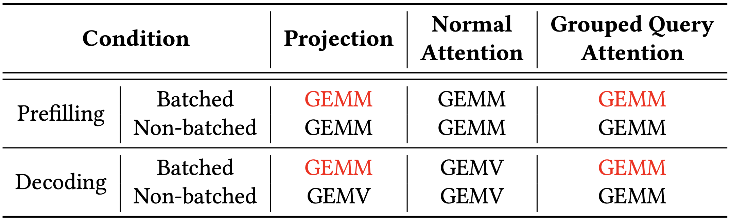
Opportunity – Small Batch GEMM in LLMs
Small batch decoding
e.g., 8~16
GQA for KV Cache GEMM
Notes:
Small batch GEMMs in LLMs
General hardware are underutilized
This small batch size aligns with Mugi row width to fully saturate the array
GQA converts attention from GEMV to GEMM, shown in next slide

Slide 7
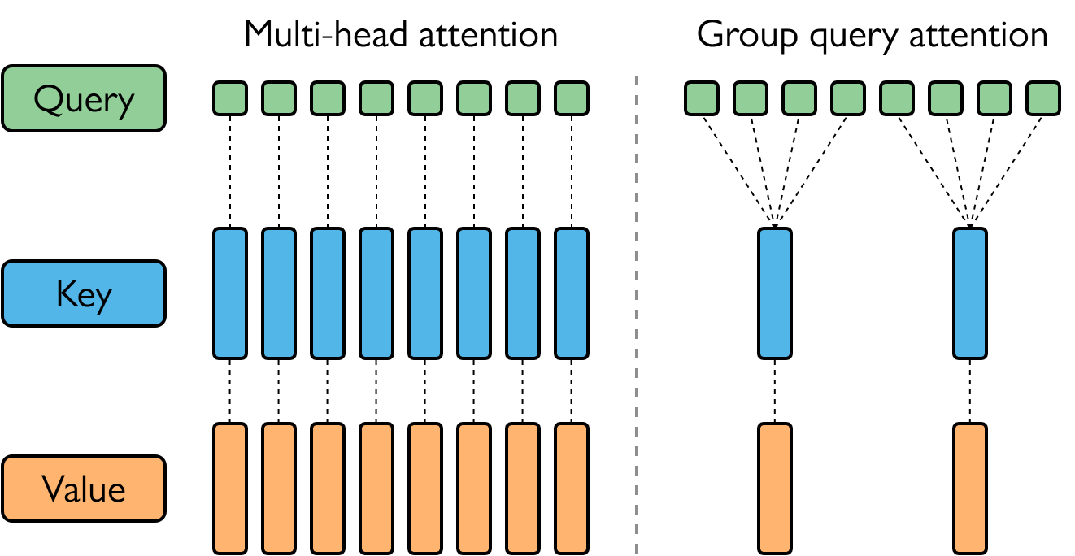
Opportunity – Group Query Activation
Multi-head attention
1 token
Low utilization
Group query attention
Multiple key/value pairs
Reduces KV cache size
Increases utilization
KV Cache quantization
INT4
Notes:
GQA shares key value groups to multiple querys
Reduces kv cache size
Increases util by converting to GEMM
Common size of 8 aligns with batch size, thus aligns with mugi array
KV cache can be quantized, discussed in next slide

Slide 8
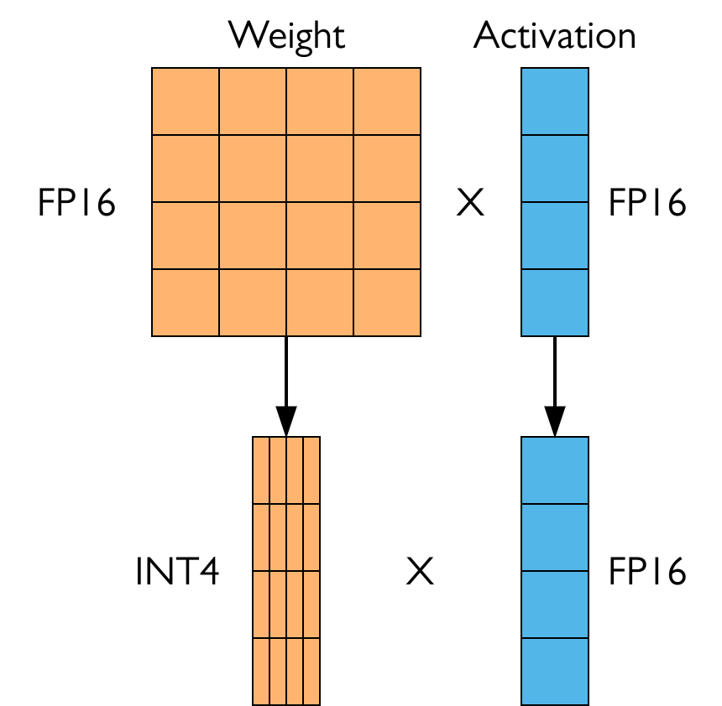
Opportunity – Weight Only Quantization
Large weight matrices
Quantize weight
INT4 = 16 possible values
Full precision activation
KV Cache quantization
Aligns with WOQ
Notes:
WOQ decreases the large weight matrices size
Decreases memory requirements
Reduces possible value range
Leveraged by VLP

Slide 9
Value Level Parallelism
First proposed in Carat, ASPLOS 2O24
Beneficial at lower bitwidth
Vector dimension 1024, UINT4 data format
Only 16 unique products
1024/16=64x more than necessary
Notes:
First proposed in ASPLOS 2024
16 possible products
Can there be any value reuse?

Slide 10
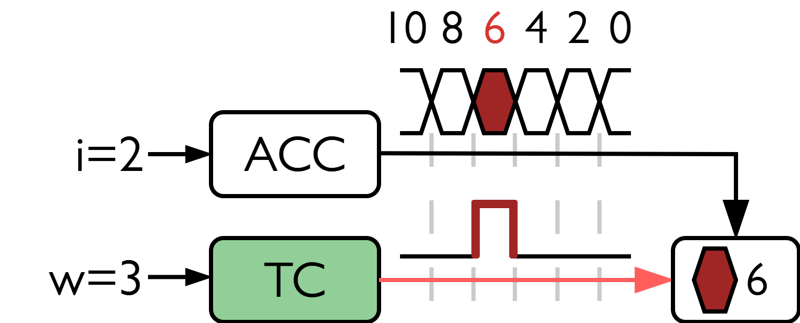
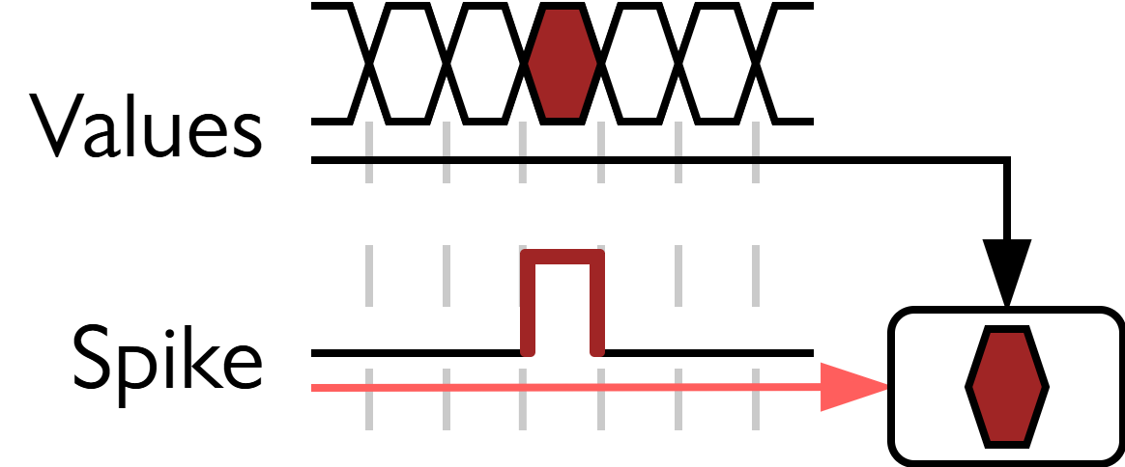
Value Level Parallelism
Temporal subscription
Select output when cycle matches input
Empowered by small value range
VLP multiplication
TC converts w to spike
Accumulation over n cycles
VLP subscribes product

Slide 11
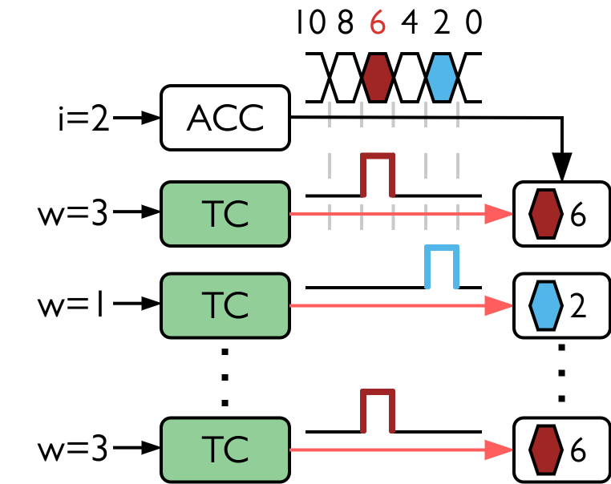
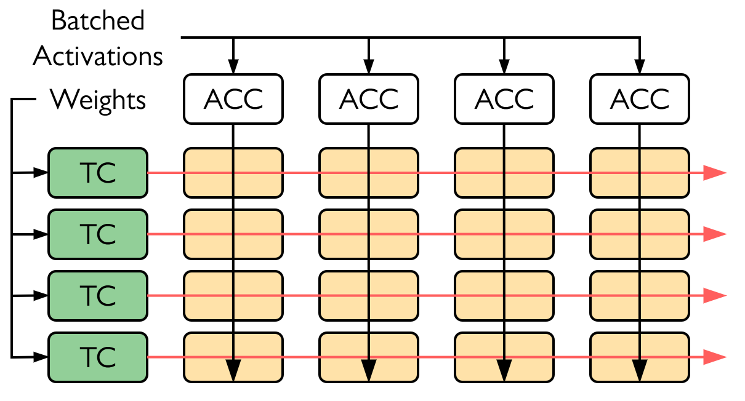
VLP Vectorization
Value reuse
Rows share column values
VLP array
Multiple Columns
Column width of 8
2^bitwidth
Notes:
UINT4 without sign is 8 possible values

Slide 12
Mugi
Nonlinear approximation
Small batch, low precision GEMM
Unified architecture

Slide 13
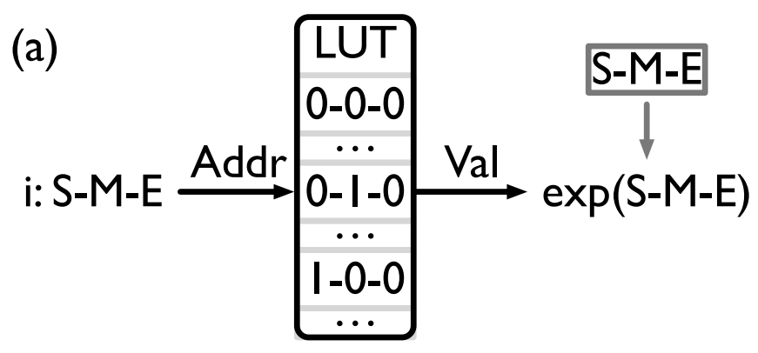
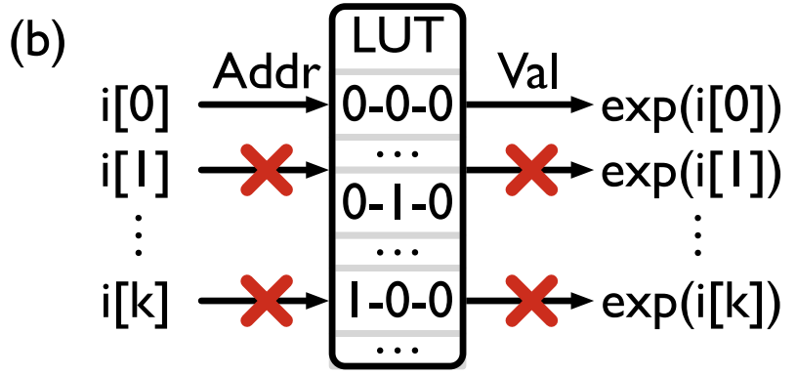
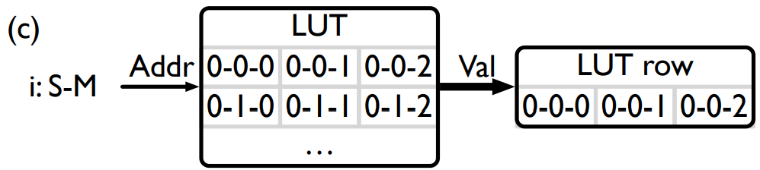
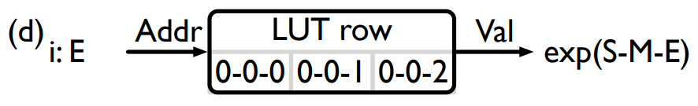
VLP for Nonlinear Approximation
LUT
Precompute and store costly nonlinear operations
Standard LUT
Doesn't allow parallel accesses
Two stage spatial LUT
Sign-Mantissa subscription
Exponent subscription

Slide 14
VLP for Nonlinear Approximation
LUT
Precompute and store costly nonlinear operations
Standard LUT
Doesn't allow parallel accesses
Two stage spatial LUT
Sign-Mantissa subscription
Exponent subscription

Slide 15
VLP for Nonlinear Approximation
LUT
Precompute and store costly nonlinear operations
Standard LUT
Doesn't allow parallel accesses
Two stage spatial LUT
Sign-Mantissa subscription
Exponent subscription

Slide 16
VLP for Nonlinear Approximation
LUT
Precompute and store costly nonlinear operations
Standard LUT
Doesn't allow parallel accesses
Two stage spatial LUT
Sign-Mantissa subscription
Exponent subscription
Notes:
Row width of 8, more than 8 exponents

Slide 17
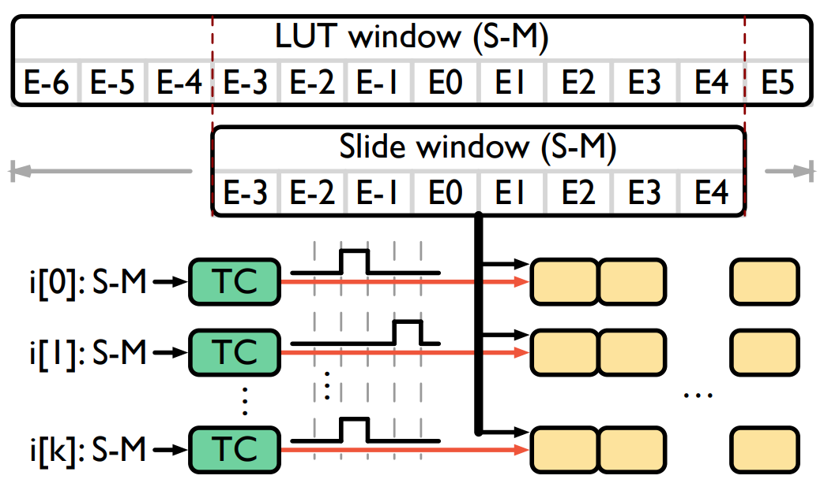
Selecting a Window
Mugi array < LUT row
Select a window by the minimum exponent
Outlier values processed (rounded, truncated)

Slide 18
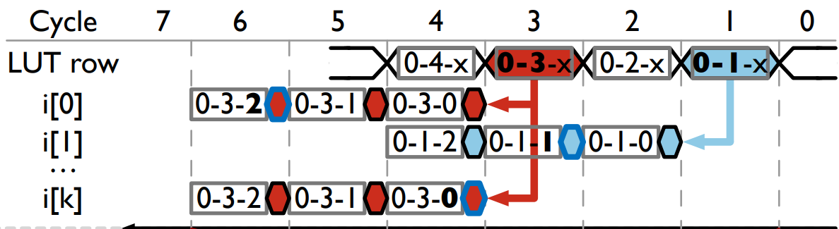
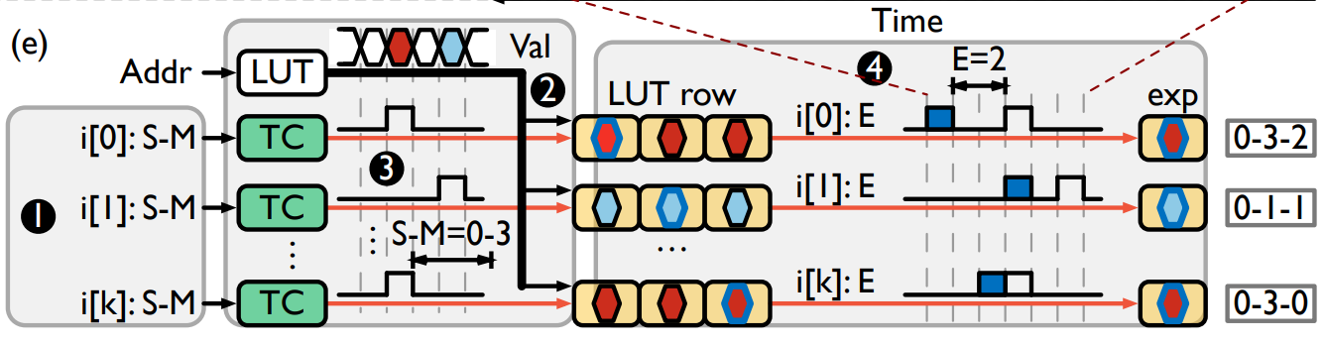
VLP Approximation
Four phases
Input field split (approximation)
Value reuse
Mantissa temporal subscription
Exponent temporal subscription

Slide 19
VLP Approximation
1. Input field split (approximation)

Slide 20
VLP Approximation
2. Value reuse

Slide 21
VLP Approximation
3. Mantissa temporal subscription

Slide 22
VLP Approximation
4. Exponent temporal subscription

Slide 23
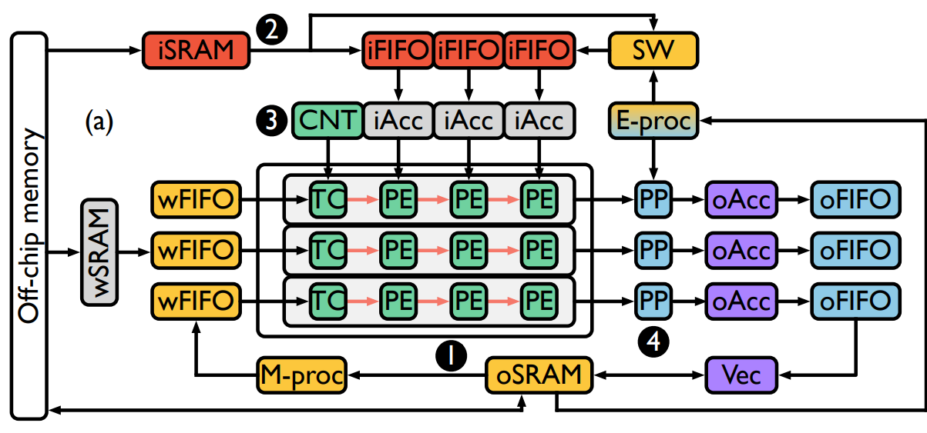
Mugi Architecture
- corresponds to the four phases of VLP approximation
Purple: Accumulation and vector computation
Red: Activation and LUT loading
Yellow: weight and nonlinear loading
Green: Compute array
Blue: Postprocessing
1
4
Notes:
Make dark circles to align with figure

Slide 24
Mugi GEMM Mapping
Activations feed into columns
Weights feed into rows

Slide 25
Mugi GEMM Mapping
Compute array subscribes to accumulated values

Slide 26
Mugi GEMM Mapping
Accumulate output tiles

Slide 27
Mugi GEMM Mapping
Accumulated tiles are scaled and stored
Notes:
Remove outline

Slide 28
Mugi Nonlinear Mapping

Slide 29
Mugi Nonlinear Mapping
Input field split
Activation separates into S-M and E

Slide 30
Mugi Nonlinear Mapping
Value reuse
Precomputed LUT loads from iSRAM
Window selected

Slide 31
Mugi Nonlinear Mapping
Mantissa temporal subscription
Compute array subscribes to LUT values with S-M

Slide 32
Mugi Nonlinear Mapping
Exponent temporal subscription

Slide 33
Mugi Nonlinear Mapping
Additional vector operations and storing
i.e. softmax accumulation

Slide 34
Results
Nonlinear
GEMM
End-to-end

Slide 35
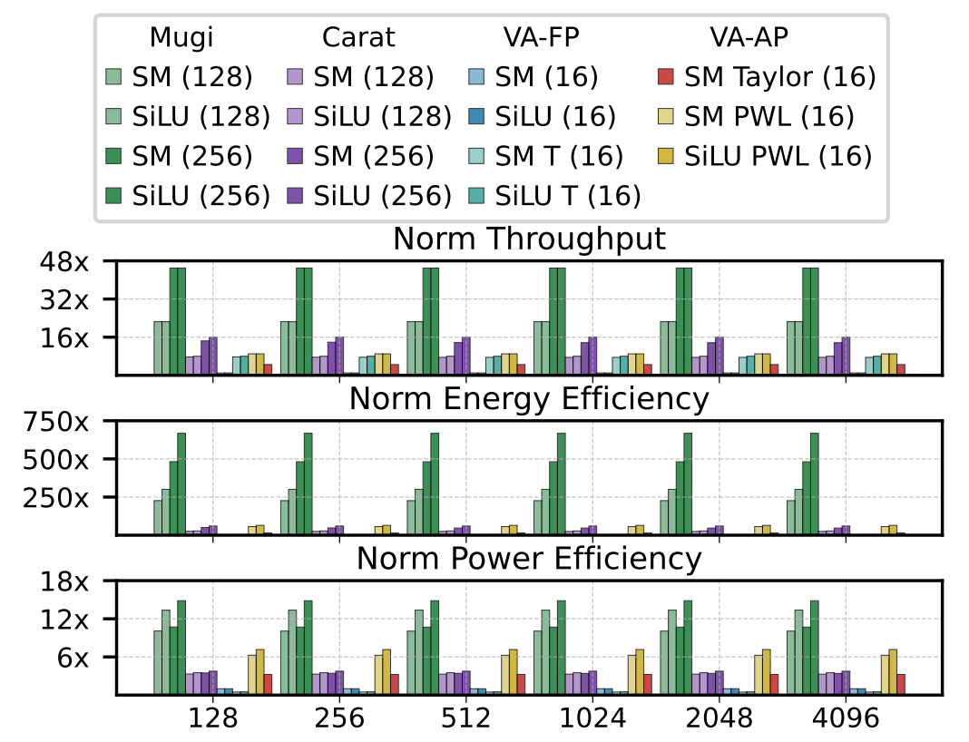
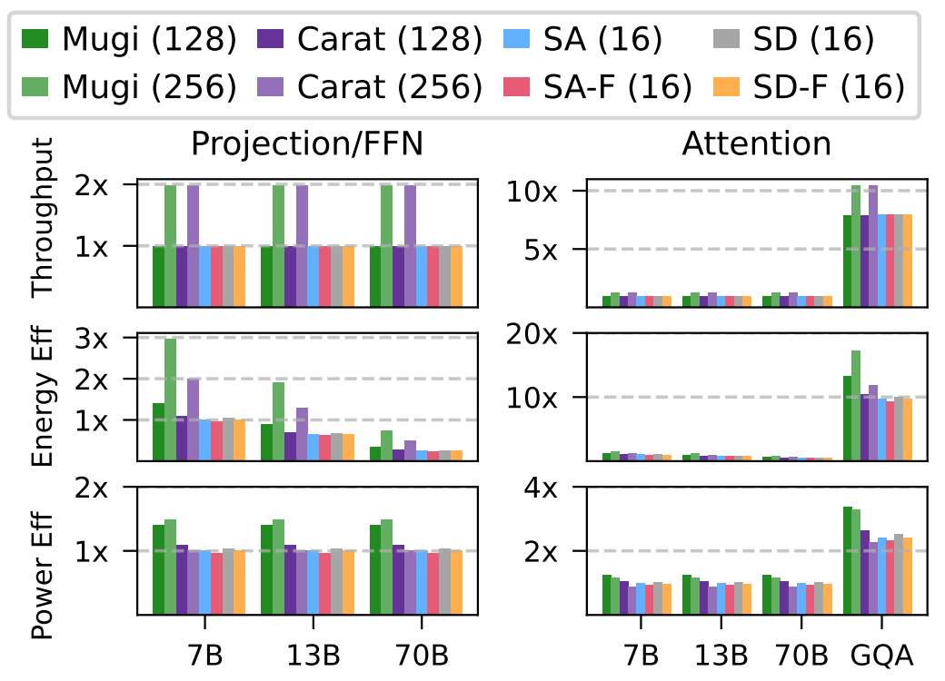
Iso-Area Nonlinear and GEMM
Carat: Previous VLP work
SA: Systolic Array
SD: SIMD Array
-F: Figna INT-FP multiplier
SM: Softmax
T: Tensor core
VA-FP: Precise vector array
VA-AP: Approximate vector array
Notes:
Nonlinear
Memory bandwidth limits the vector array
Other approximations have longer per operator compute time, where we are pure lookup, significantly increasing efficiency
Gemm
Similar trends, but smaller difference
Gain comes from lack of additional vector unit (eff)
Full utilization at small batch size

Slide 36
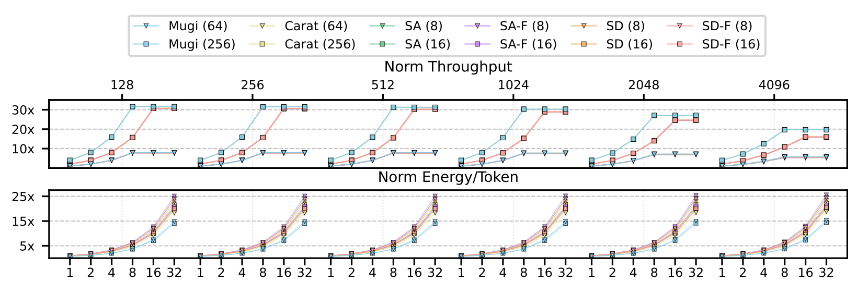
Iso-Throughput Batch Size Study
Carat: Previous VLP work
SA: Systolic Array
SD: SIMD Array
-F: Figna INT-FP multiplier
Notes:
Mugi saturates at 8 vs saturates at 16 (SA/SD 16)
Values are overlapping as the throughput is the same

Slide 37
Q & A

