Slide 1
Presentation on Tetris Game
By:
KSHITIZ POUDEL [THA076BCT018] NISHANT UPRETY[THA076BCT023]
PRINSA JOSHI [THA076BCT031] SAMIR SHRESTHA[THA076BCT039]
Under the guidance of:
Er.Rama Bastola
DEPARTMENT OF ELECTRONICS AND COMPUTER
ENGINEERING
THAPATHALI CAMPUS,INSTITUTE OF ENGINEERING
Presentation Date: March 1,2020

Slide 2
Outline
Motivation
Objectives
Introduction / Background
Methodology
Demo with sample data
Conclusion and Further works
References (IEEE format)

Slide 3
Motivation
After getting the opportunity for a project, first thing that strike our minds was why don’t we develop a game. Most of us have once dreamt of developing a perfect game ,we have always found a unsatisfying factor in every game.
Due to time constraints and limited resources, it still remained a dream, but we could at least work on a game. We couldn’t think of any other than the game that defined most part of our childhood for most of us, Tetris.

Slide 4
Objectives
To make a more user configurable Tetris Game.
To bring nostalgia among friends with this game.

Slide 5
Introduction/Background
Tetris is an addictive puzzle that started it all, embracing our universal desire to create order out of chaos. the Tetris game provides intellectual sport that combines continuous fun with mental stimulation.
In 1984, Tetris was born from the imagination of computer programmer Alexey Pajitnov. Pajitnov created an electronic game that let players arrange puzzle pieces in real time as they fell from the top of the playing field. Pajitnov called this game “Tetris,” a combination of “tetra” (the Greek word meaning “four”) and “tennis” (his favorite sport).

Slide 6
Methodology
Two methods were used to solve the problem:
Procedural/Functional Programming
Object Oriented Programming

Slide 7
Procedural/Functional Programming
The game was broken down into procedures, or small logical functions that perform one task each. All procedures were taken together and the game was prepared.
Here,different shapes of the tetriminoes ,the backgrounds were created in separate modules and were passed together in the main functions

Slide 8
Object Oriented Programming
Here the game revolves around a rectangular board .The tetriminoes are rotated, moved within the board so using the pointers the separately created tetriminoes were bought together.They get stored, cleared all within the board.

Slide 9
Demo Samples
Loading Screen
How to Play Screen
Main Menu Screen
Game play

Slide 10
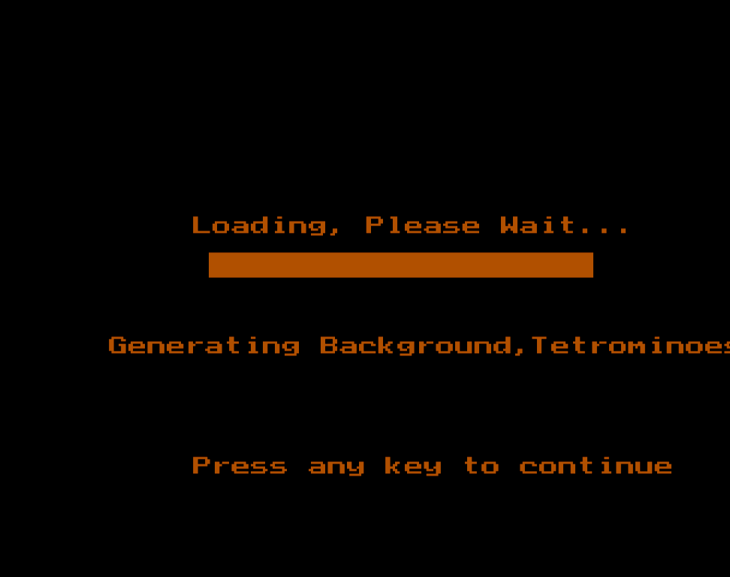
Loading Screen
This is the first screen of the game. As it would be absurd to launch the game directly without any screen before it so we have decided to add the screen.

Slide 11
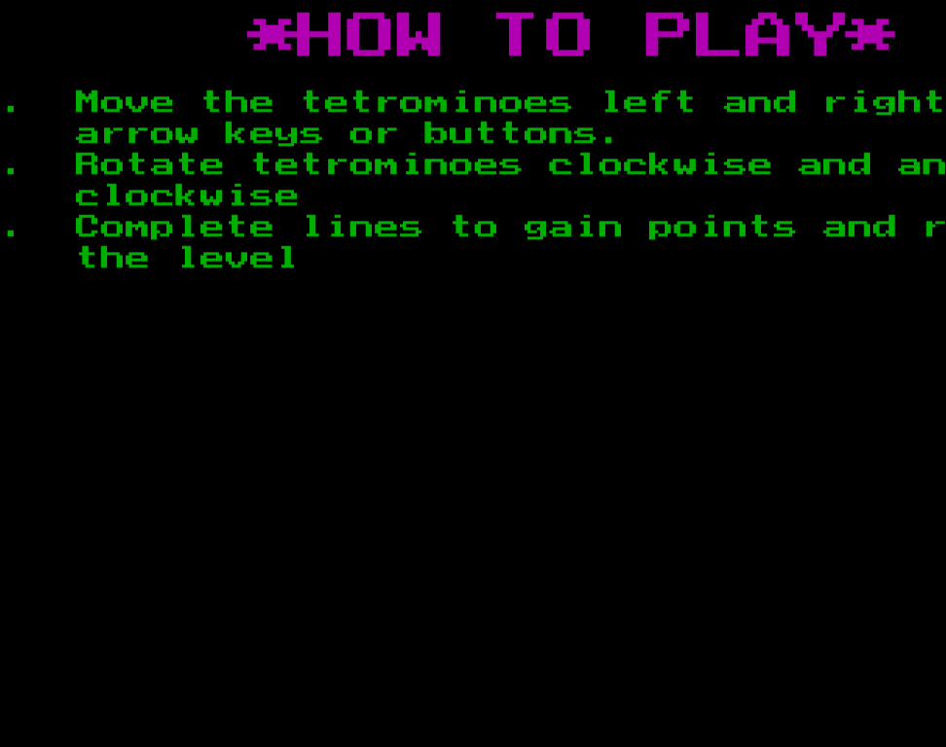
How to play
This is the second screen on the console window where the objective/method of playing the game is shown.

Slide 12
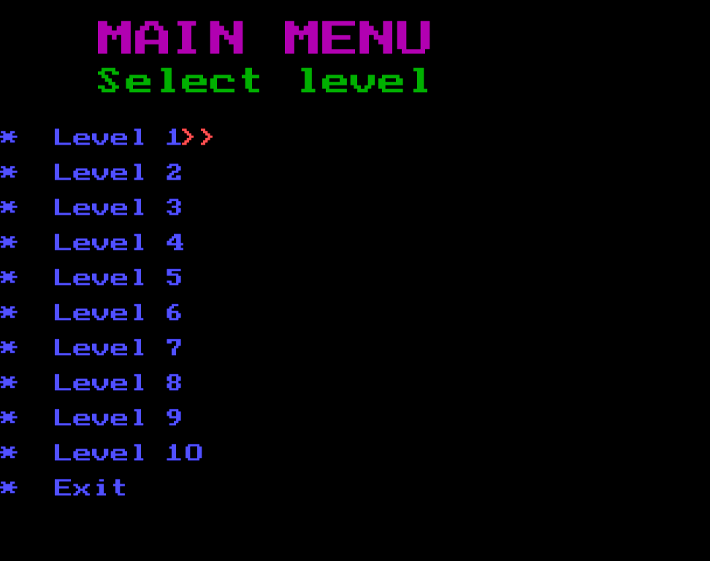
Main Menu
This screen allows users to configure the speed of the game or the difficulty level in the game. We have added 10 difficulties levels with different scoring system to make the game more user configurable as it is the objective of the game.

Slide 13
Gameplay
Video of Game play 😅

Slide 14
Conclusion and further works
With the development of the software it has been a great experience for the team to learn the use of graphics, logical thinking and team co-ordination. The thrill has been both challenging and joyful. This project gave us the real insight of the software development as it was the first for all of us. We are very glad that we could complete it with the help of available resources and help of seniors and our respected teacher Er. Rama Bastola.

Slide 15
References
[1].History and Background of Tetris Game:
https://tetris.com/about-us
[2].Graphics in C Tutorials:
https://www.techcrashcourse.com/2015/08/c-graphics-programming-tutorial.html
[3].Programming Methodology:
https://www.tutorialspoint.com/programming_methodologies/programming_methodologies_introduction.htm

