Slide 1
Presentation on Password Manager
By:
Ashish Kumar Sah [THA076BCT018] Arun Subedi [THA076BCT023]
Grishma Raj Khanal [THA076BCT031] Nishant Uprety [THA076BCT039]
Under the guidance of:
Er.Saroj Shakya
DEPARTMENT OF ELECTRONICS AND COMPUTER
ENGINEERING
THAPATHALI CAMPUS,INSTITUTE OF ENGINEERING
Presentation Date: October 25 ,2021

Slide 2
Outline
Motivation
Objectives
Introduction / Background
Methodology
Demo with sample data
Conclusion
References

Slide 3
Motivation
Unless you’ve been living in a bubble, chances are you have at least caught a glimpse of news regarding a couple of significant data breaches lately. From Facebook to the Marriot – organizations large and small have experienced data loss of varying volumes.
Surprisingly, as years pass and technologies improve, more and more data is lost each day.

Slide 5
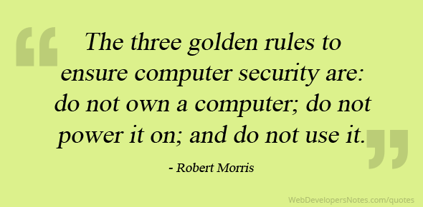

Slide 6
Objectives
To encourage the use of Password Managing Software.
To develop healthy password practices.

Slide 8
Introduction/Background
A password manager is essentially an encrypted digital vault that stores secure password login information people use to access apps and accounts on your mobile device, websites and other services. In addition to keeping your identity, credentials and sensitive data safe. It will free user the stress of remembering passwords or even worse writing in physical paper.
Passwords have a much longer history than just the digital era. Sentries for centuries would use watchwords to identify friend or foe. The Roman military reportedly used passwords as a way to distinguish friend from foe.

Slide 9
Methodology
Two methods were used to solve the problem:
Object Oriented Programming
SFML Graphics library

Slide 10
Demo Samples
Loading Screen
New User Screen
Existing User Screen
User Data

Slide 11
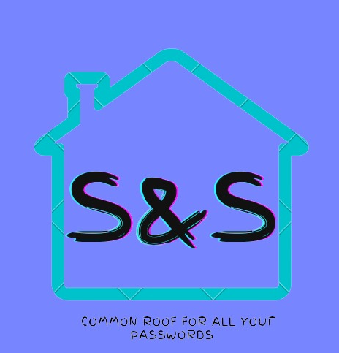
Loading Screen
This is the first screen of the the program aka the loading screen or the logo to our program.

Slide 12
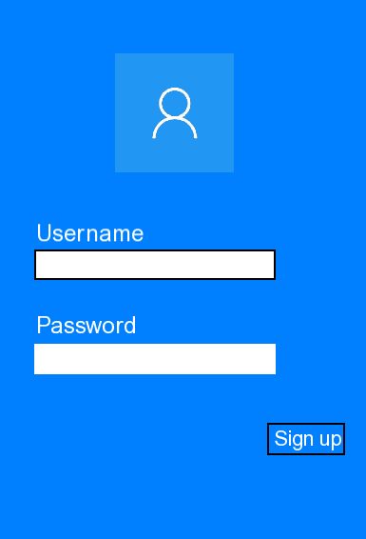
New User Screen
This is the second screen on the console window where the objective/method of playing the game is shown.

Slide 13
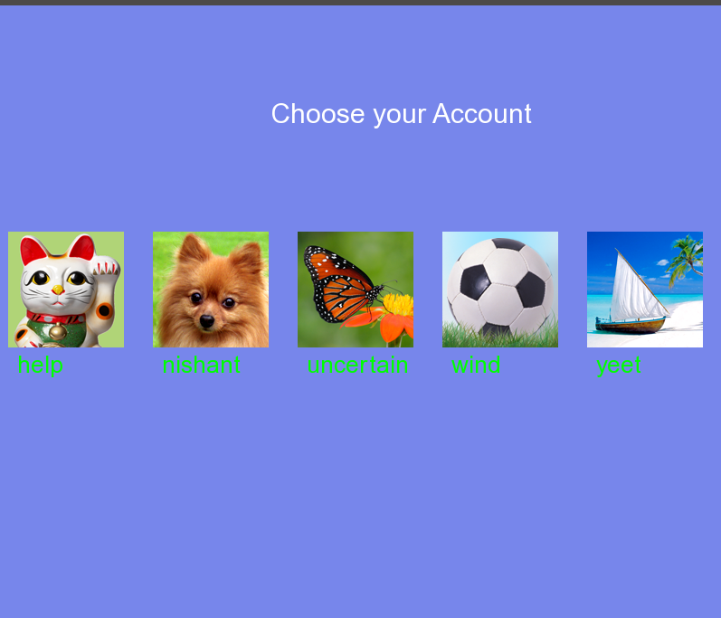
Existing Users
This screen is for the returning users as it supports multiusers

Slide 14
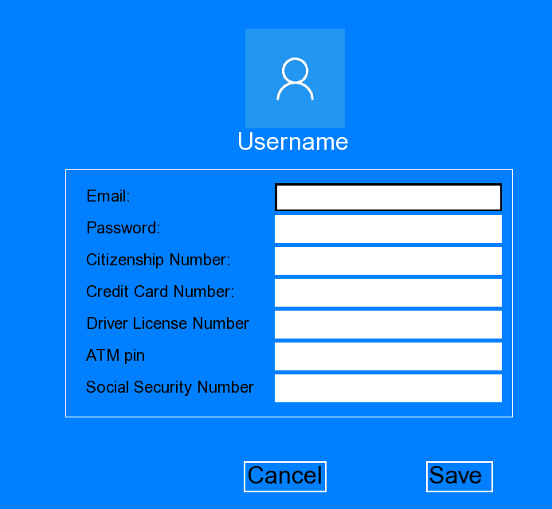
User Data
Users are prompted to the page where they store their user data

Slide 15
Conclusion
Our program mainly encourages the use of Password Managing software and healthy password practices. The program provides some sense of security but due to limited time period and availability of resources we aren’t safe to various cyber attacks. In the end we can say that we managed to create a prototype, that can be used in every day and has a high security by having multiple layers and is easy to use.

Slide 16
References
[1]. Annual number of data breaches in the United States
https://www.statista.com/statistics/273550/data-breaches-recorded-in-the-united-states-by-number-of-breaches/
[2]. Most Common Passwords
https://SplashData.com/
[3]. OOP and SFML
https://sfml-dev.org/index.php

Slide 17
Thank YOU ☺
ANY QUESTIONS?

