Slide 1
Presentation on Plagiarism Detection using NLP
By:
Ankit B.K. [THA076BCT006] Ayush Batala [THA076BCT011]
Mishan Thapa Kshetri [THA076BCT019] Nishant Uprety [THA076BCT023]
Under the guidance of:
Er.Umesh Kanta Ghimire
DEPARTMENT OF ELECTRONICS AND COMPUTER
ENGINEERING
THAPATHALI CAMPUS,INSTITUTE OF ENGINEERING
Presentation Date: January 6 ,2022

Slide 2
Outline
Motivation
Objectives
Scope of Project
Methodology
Expected Results
Project Application
Timeline and Budget Estimation
References

Slide 3
Motivation
Existing tools mainly relies on databases
Students copy and paste assignments from each other
Traditional plagiarism detection tools cannot identify instances of plagiarism

Slide 4
Objectives
To accurate and quickly identify instances of plagiarism.
To assist students and educators in addressing plagiarism.

Slide 5
Scope of Project
Identify paraphrased text as well as copied text.
Be user-friendly and available on multiple platforms.
Serve primarily university teachers.

Slide 6
Methodology
Four feature extraction techniques
Word Pair of N-gram Technique
Extraction of Word Similarity
Fingerprint Similarity
Latent Semantic Analysis
Machine Learning Algorithm
Naïve Bayes Classifier
Support Vector Machine

Slide 7
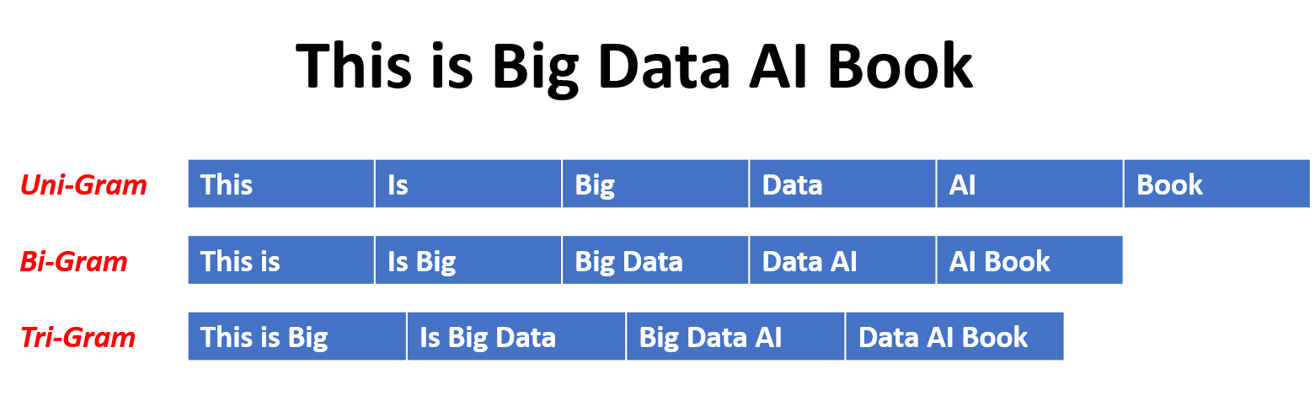
Word Pair or N-grams Technique
N-grams are contiguous sequences of n items from a given sample of text or speech.

Slide 8
Word Pair or N-grams Technique
Effective at capturing the context and structure of the text
Quickly identifies instances of plagiarism in real-time,
Most common feature extraction technique used
Ppchecker uses this technique[1]

Slide 9
Implementation of N-gram Technique
The suspicious document is split into sentences.
Each sentence is split into individual n-grams.
The original document is directly converted into n-grams.
Suspicious document are compared with original document to identify similarities.

Slide 10

CALCULATION OF WORD SIMILARITY VALUE
Percentage of word similarity between texts from original and suspicious document.​
Calculated using Jaccard Similarity Coefficient.
Paragraph resolved into sentence using sentence segmentation

Slide 11
CALCULATION OF WORD SIMILARITY VALUE
Different preprocessing technique to create the metadata.
Using WordNet to create a list of similar words.​
Matching of words is done through POS tag.​
Finally, Jaccard Similarity Coefficient is calculated
Higher the coefficient, higher is the word similarity

Slide 12
Fingerprint Similarity
Fingerprints are unique identifiers for documents.​
Technique to identify and compare the similarity of documents.​
Identification of document depends upon its content and structure.​
Winnowing Algorithm for Fingerprint Similarity.

Slide 13
Implementation of Fingerprint Similarity
Original Document and Suspicious Document taken as input.​
K-grams algorithm returns an array of k-subsequences.​
Hash value is given to each subsequences.​
Calculate text similarity using Jacquard Coefficient.[3]

Slide 14
Latent Semantic Analysis
What is LSA?​
Method to analyze association.​
Create structured data from a collection of unstructured texts.

Slide 15
Latent Semantic Analysis
How is it implemented?​
Preprocess the documents​
Term by document matrix from ​
Assign weight to matrix entries​
Singular Value Decomposition(SVD) is performed​
Compute Jaccard/cosine similarity value

Slide 16
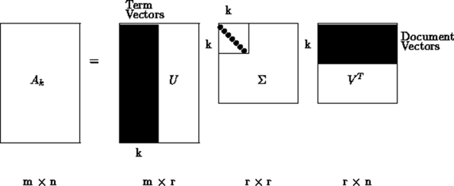
Latent Semantic Analysis
What is SVD?​
Factorization of matrix into three matrices​
Tool for dimension reduction

Slide 17
Naïve Bayes
Probabilistic classification of original vs. copied text.​
Trained on labeled document dataset.​
Makes predictions based on word probabilities.​
Effective with preprocessing and feature selection.

Slide 18
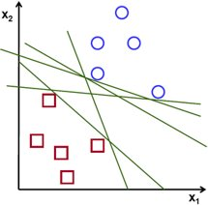
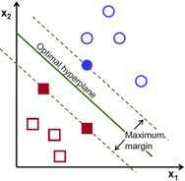
Support Vector Machine
Classification algorithm using hyperplane.​
Finds the hyperplane that maximally separates two classes.[2]

Slide 19
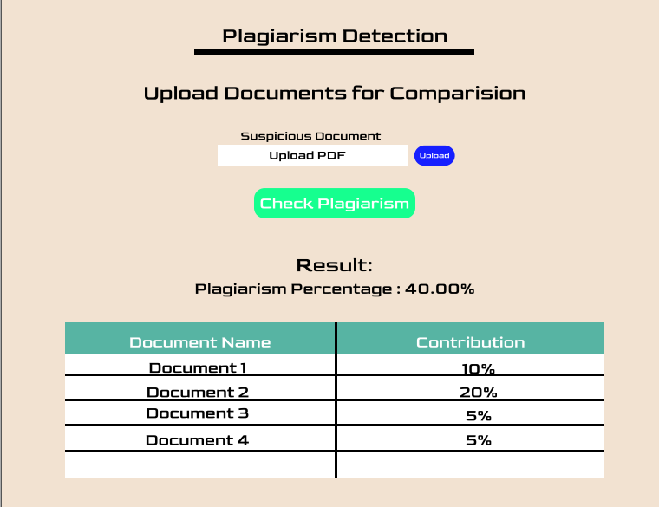
Expected Output
Fig: Expected Output

Slide 20
Project Application
Assist educators in the online education setting
Prevents instances of copied and pasted text and light paraphrasing of texts.
User-friendly and available on multiple platforms and devices.

Slide 21
Timeline and Budget Estimation
Dec 1 Dec 15 Jan 1 Jan 15 Feb 1 Feb 15 Feb 28
Research
Dataset Preparation
Training model
Model Implementation
Website Development
Testing and debugging
Documentation

Slide 22
Timeline and Budget Estimation
Necessary resources easily available to us.
No need for any additional code or specialized equipment.

Slide 23
References
Kang, N., Gelbukh, A., “PPChecker: Plagiarism Pattern Checker in Document Copy Detection", Springer, Heidelberg (2006)
R. Gandhi, “Towards Data Science,” 7 Jun 2018.[Online]. Available: www.towardsdatascience.com
B. N. A. S. a. N. H. Eva Y Puspaningrum, "Detection of Text Similarity Using Winnowing Algorithm Based K-gram and Jaccard Coefficient," Journal of Physics: Conference Series, 2019.

