Slide 1
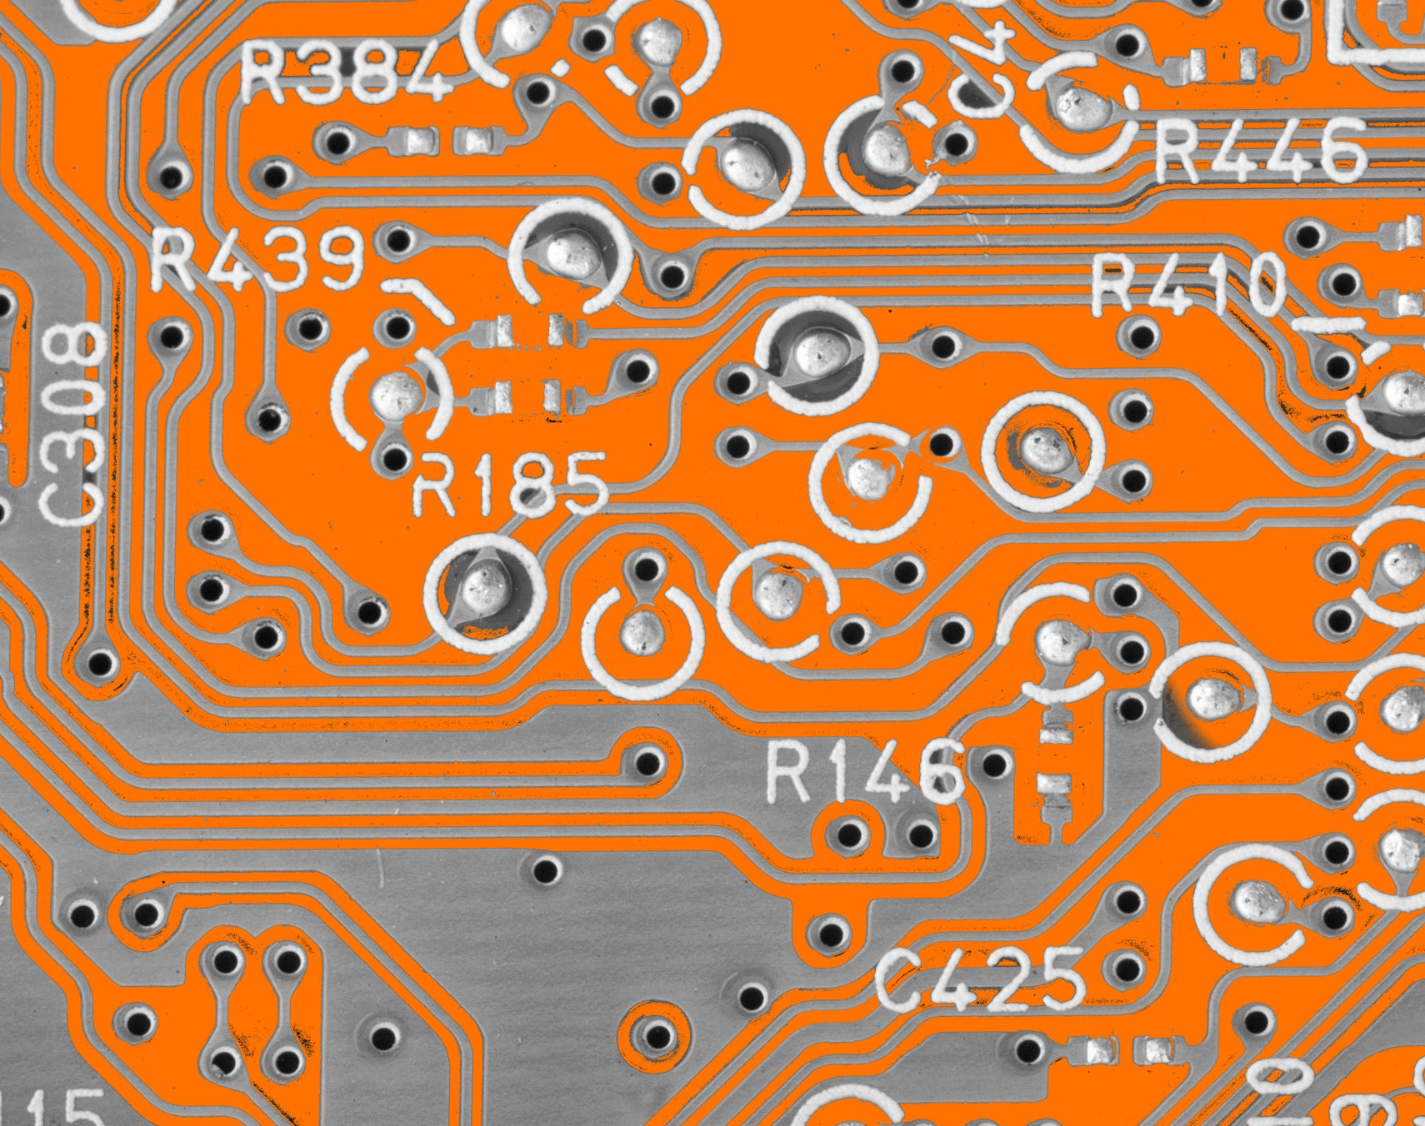
CEIS150 Module 1
Software Environment Setup

Slide 2
Rubric
Activity | Requirement(s) | Points
GitHub Repository | Picture of GitHub repository page. | 15
Development Environment and Starter Files | Screenshot of software installed with Starter Files loaded. | 15

Slide 3
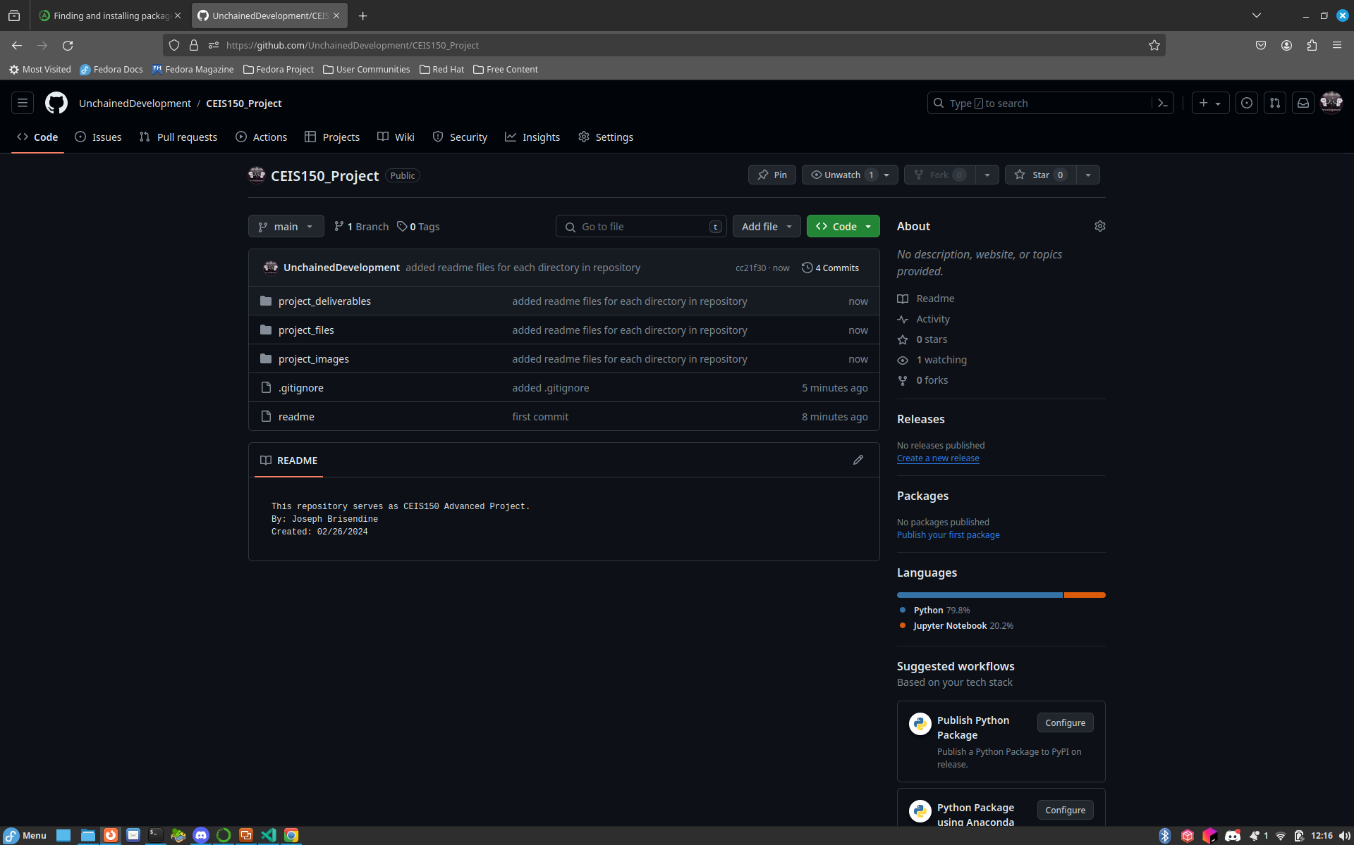
GitHub
Screen shot of GitHub project repository.

Slide 4
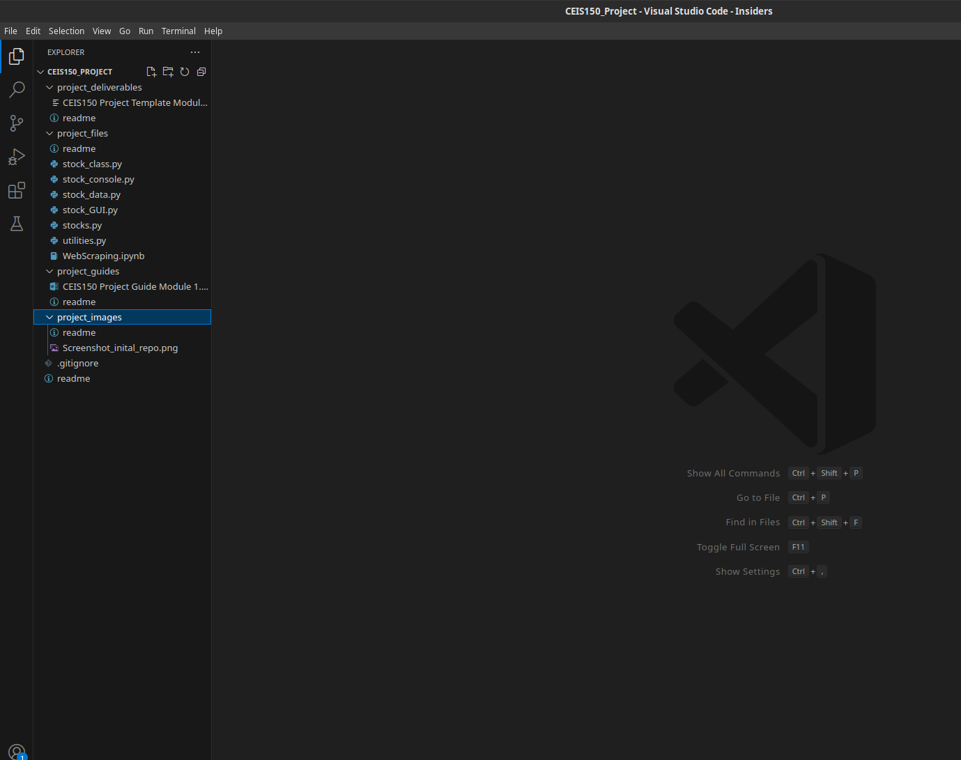
IDE & Starter Files
Screen shot of your IDE (Spyder or VS Code) with the project Starter Files loaded.

