Slide 1
Git introduktion CJ Sveningsson (HiQ) - Hermods 2015-02-19

Slide 2





Vem är Carl-Johan Sveningsson?
CV i korthet:
1981-2000 – född och uppvuxen i Gnosjö, Småland
2000-2006 – civ.ing. datateknik Chalmers
2006-2011 – startups i Tallinn, Estland
2011 – teknisk projektledare etc. för HiQ, sveriges justaste konsultbolag. Tidigare uppdrag: Miljöansvarig, SCRUM Master, säkerhetsarkitektur, inbäddade system etc.

Slide 3
Why and what of Configuration Management?

Slide 4
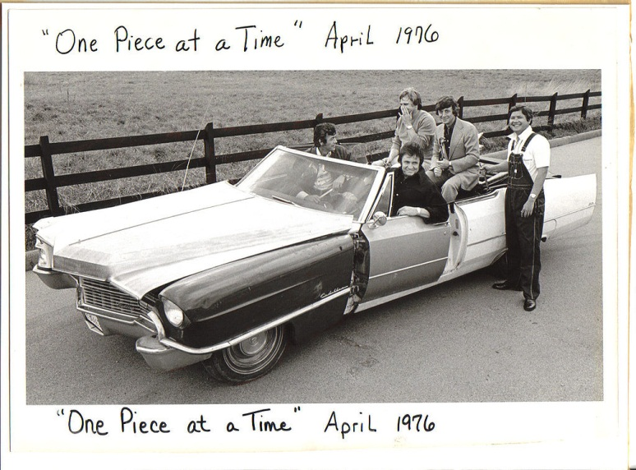
CM why and what - Intro
“Now, up to now my plan went all right
'Til we tried to put it all together one night
And that's when we noticed that something was definitely wrong
The transmission was a '53 and the motor turned out to be a '73
And when we tried to put in the bolts all the holes were gone
So we drilled it out so that it would fit
And with a little bit of help with an adapter kit
We had that engine runnin' just like a song
...
You might say I went right up to the factory
And picked it up, it's cheaper that way
Uh, what model is it?
Well, it's a '49, '50, '51, '52, '53, '54, '55, '56 '57, '58' 59' automobile
It's a '60, '61, '62, '63, '64, '65, '66, '67 '68, '69, '70 automobile”
https://www.youtube.com/watch?v=rWHniL8MyMM
"One Piece At A Time“, Johnny Cash (1976)
http://en.wikipedia.org/wiki/One_Piece_at_a_Time

Slide 5
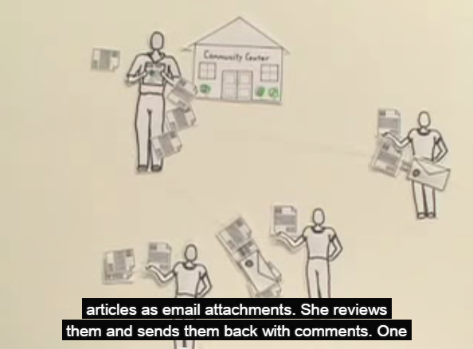
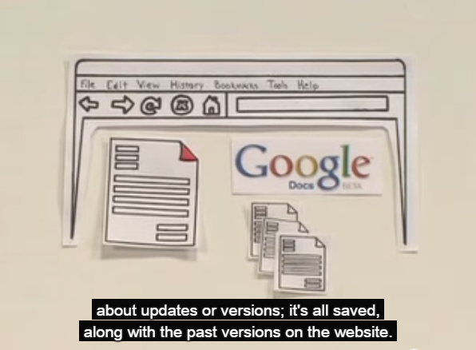
CM why and what - Intro
https://www.youtube.com/watch?v=eRqUE6IHTEA
Google Docs has (single-branch) version control in a shared repository
Office ”Track changes” and CM options aren’t half bad! (?)
Semantically aware diff/merge is exciting!

Slide 6
CM why and what - Definitions
Configuration Management
Change Management (ITIL)
Software Configuration Management
Revision Control / Version Control / Source Control
Distributed Revision (/Version) Control System
List of revision control software

Slide 7
The Ultimate Goal
Developer : Product == 1:1
… but our dealings are complex
Review
Testing
Static program analysis
Release
Experimental development
Integration
Build quality in
Issue tracking
Update / Hotfix / Service pack
Continuous integration
Continuous delivery / DevOps

Slide 8
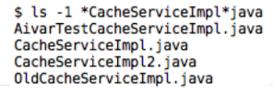
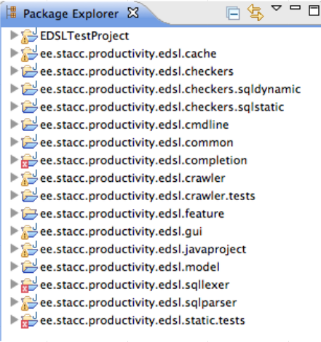
The Ultimate Goal – Build quality in
You can have experiments and cruft which you may one day want, but keep it out of the product
Keep pruduct a pristine environment

Slide 9


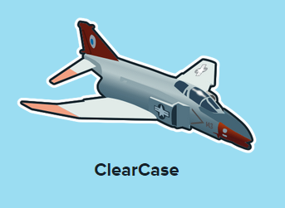
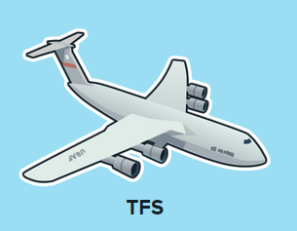
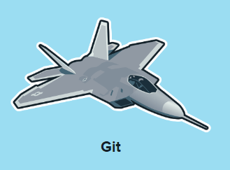
https://www.plasticscm.com/version-control-history.html

Slide 10

What Git is
A distributed version control system
Created in 2005 by Linus Torvalds to move the Linux kernel development away from BitKeeper
Linus promptly calls Subversion ”the most pointless project ever started” (for wanting to ”do cvs right”)
GitHub becomes the world’s most popular site for open source collaboration

Slide 11
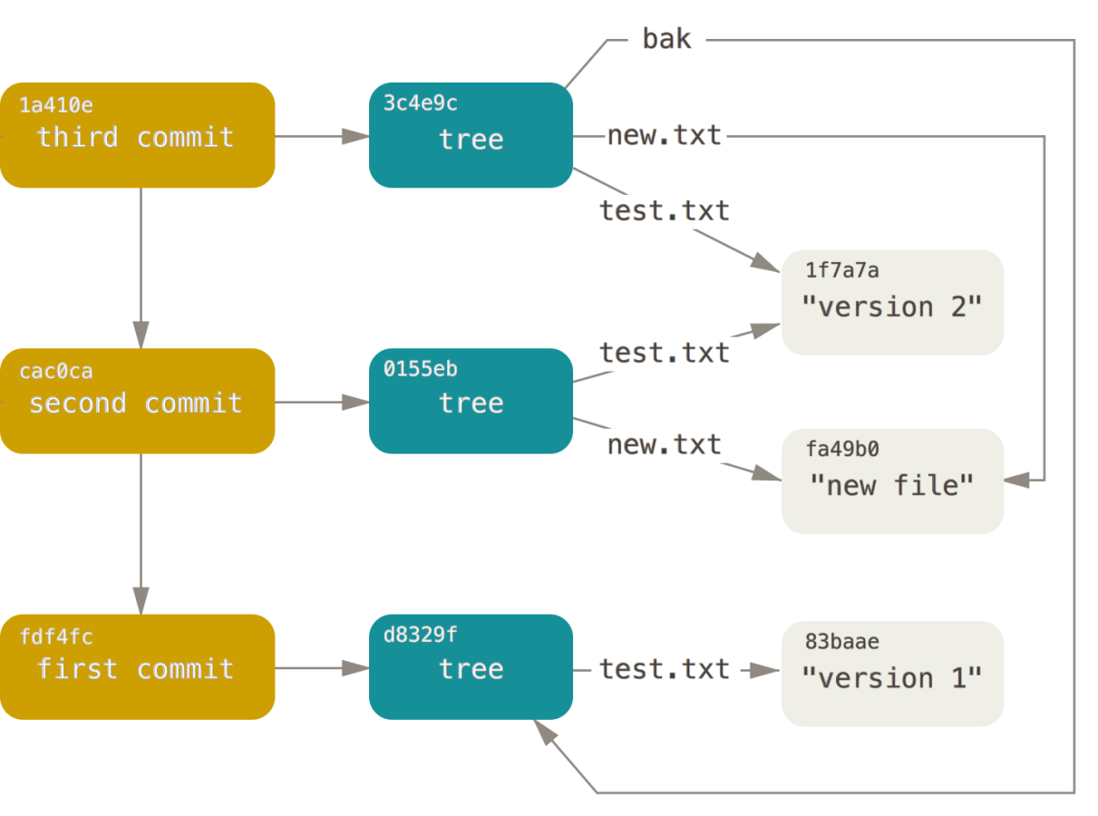
GIT commits
A repository is a cryptographically (SHA-1) linked graph of commits, trees (directories) and blobs (files)
Each commit reflects the entire workspace
Blobs are delta compressed into packfiles (but that is transparent to the user)
You do not have to fetch everything (see shallow or single-branch clone)
http://git-scm.com/book/en/v2/Git-Internals-Git-Objects

Slide 12
GIT state operation
Working directory
Staging area (index)
.git directory
(repo)
Remote repo
Add
Commit
Push
Fetch
Checkout
Pull

Slide 13
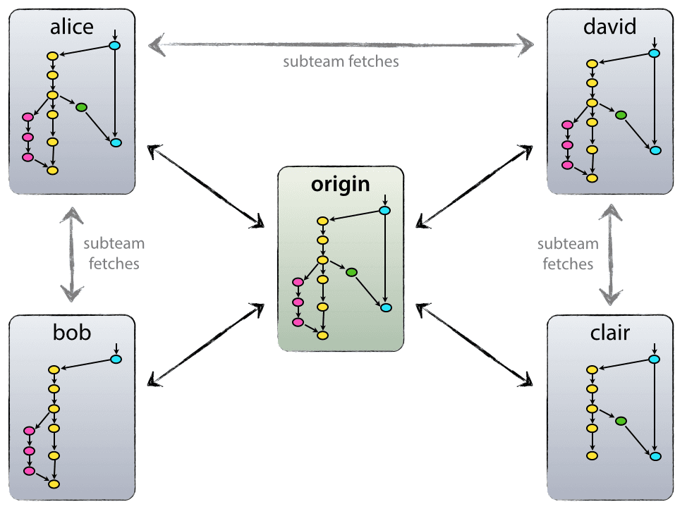
How to collaborate with Git
Git doesn’t need the network
But there are many ways to collaborate:
Patches / bundles
SSH / network share
Gitosis server
Github / Bitbucket / other
This focus to do only CM and do it right and reliably has contributed to the popularity of Git and Github: http://www.wired.com/2012/02/github-2/all/

Slide 14
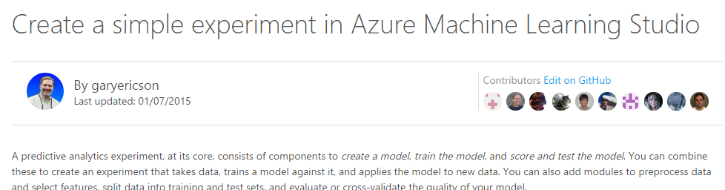
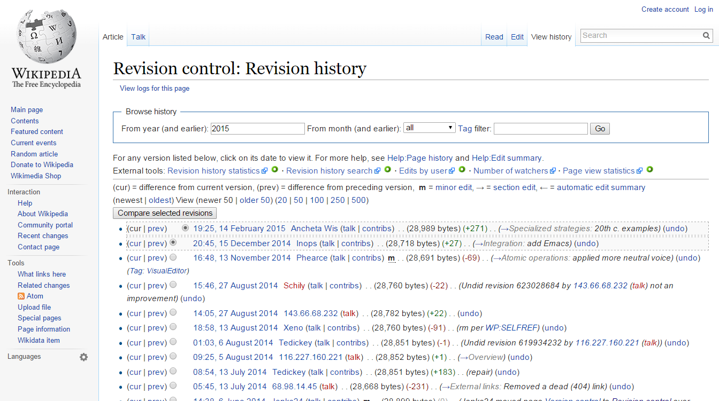
https://github.com/Azure/azure-content

Slide 15

With Git, you set the rules
"It is easy to shoot your foot off with git…
…but also easy to revert to a previous foot and merge it with your current leg.“
Branching strategy is usually the first thing teams realize they lack
But if you can manage the CM, it has proven very powerful, fast and flexible for many

Slide 16
Public service announcement
We can’t teach you all of Git
There's so much, ...
We learnt it because we're curious and want to be helpful
Cooperating in Git can be a great way to learn anyway!
git clone https://github.com/UncleCJ/hicollegegit.git

Slide 17
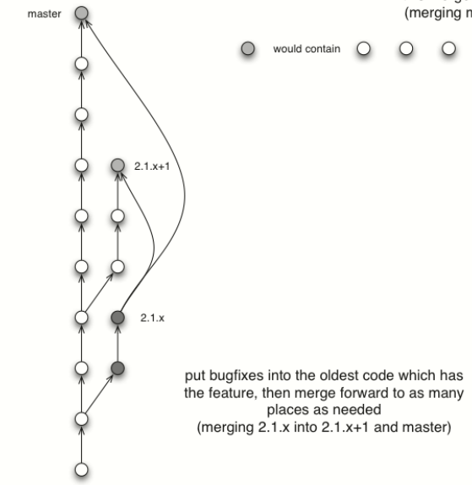
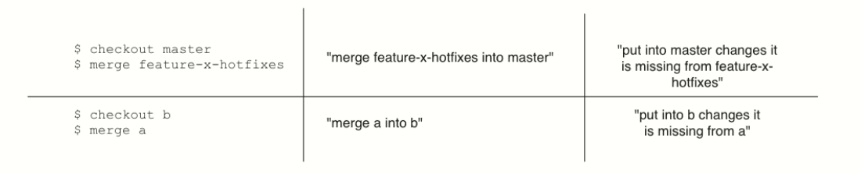
A few words about direction of merging

Slide 18
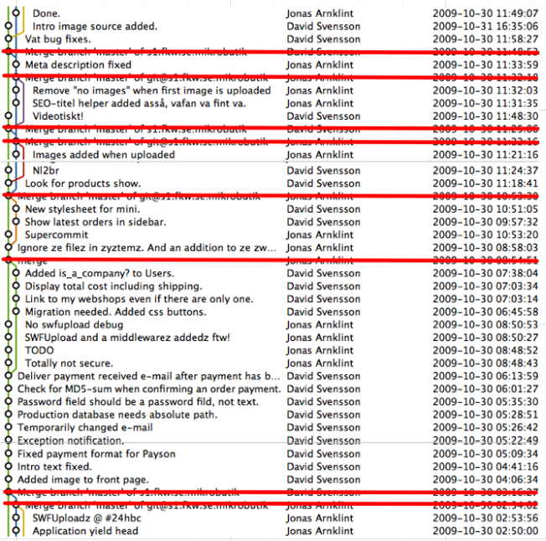
Don’t always merge - rebase
Avoid merge commits within the same branch
Use eg. pull --rebase
Commit history is supposed to be topological not always chronological

Slide 19
CM and Git
tools showcase

Slide 20
GIT GUI clients
GIThub for MAC
Tower
GITbox
Atlassian Sourcetree
Git cola
Gitg
Find and use the one you are most comfortable with
Download link: http://git-scm.com/download/gui/linux

Slide 21
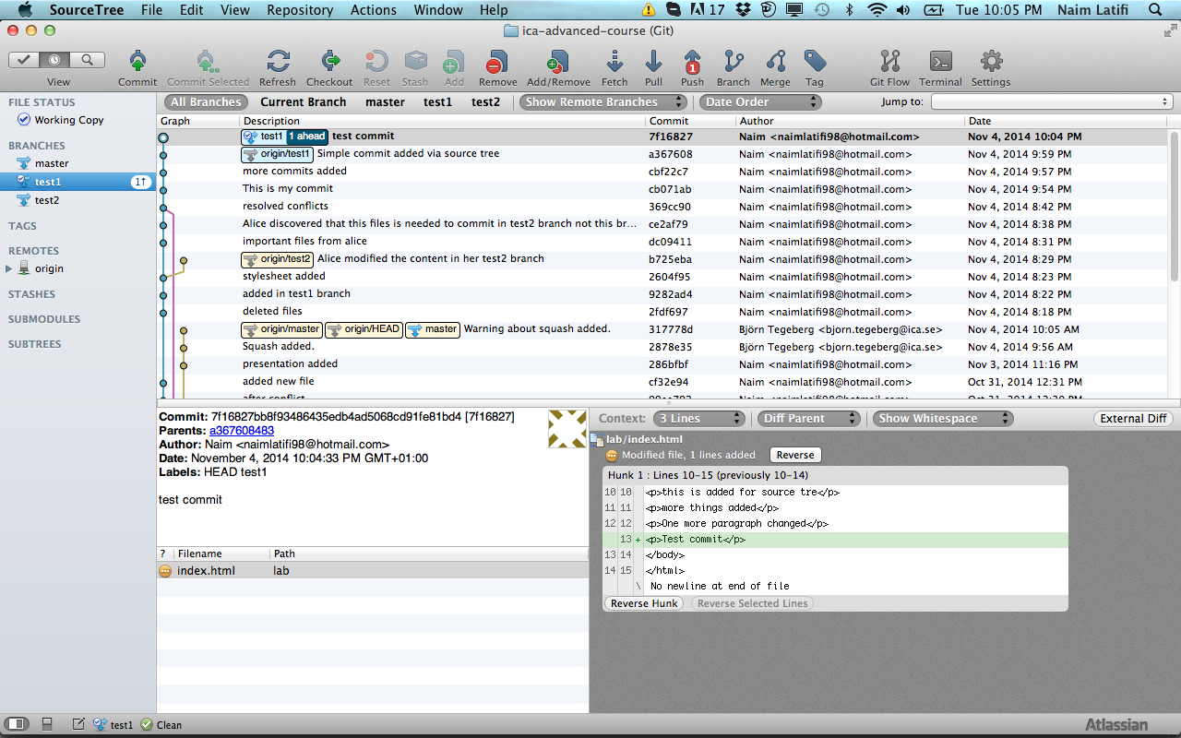
Source tree (Windows/Linux/OS X)
Stash
Checkout
Remove
Cherry-pick
Pull
Fetch
Push
Merge
Ignore
Add
Commit
Discard
Stash
Unstage
Stage

Slide 22
Merging tool - Kdiff3
Merging is necessary when several people work on the same files in a project.
Kdiff3 can be used to merge two or three input files by selecting the buttons A/B/C from the button bar and choose the source that should be used.
Saving is disabled until all conflicts are resolved.
Merge case– either B or input C changed but not both then change source automatically will be selected; if both has changed in the same line the conflict occurs and need to be resolved; B,C the same but not A then C is selected.

Slide 23
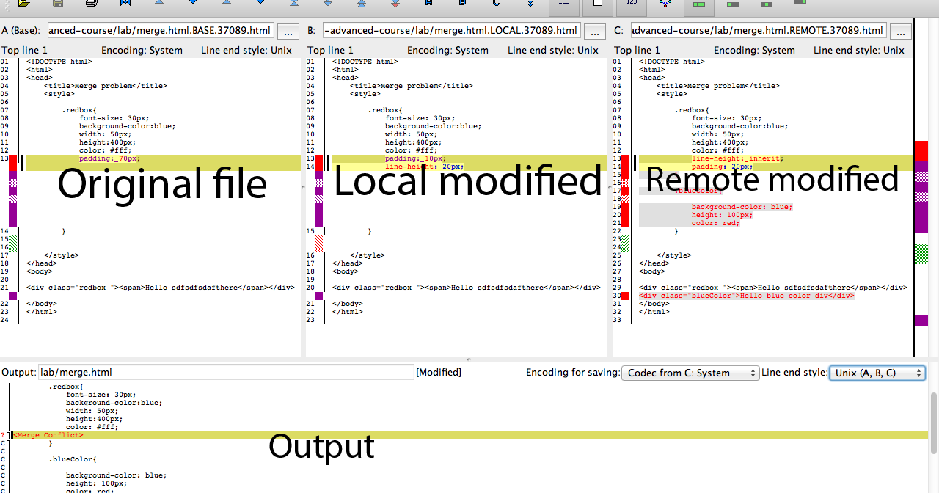
Kdiff3

