Slide 1
11-10-11

Slide 2

GIT state operation
.
Working directory
Staging area
GIT directory
(repo)
Remote repo
Stage files
commit files
Push
Checkout
Fetch
Pull
Untracked
unmodified
modified
staged

Slide 3
Branch & merge - a case scenario !
.
Alice’s branches:
8cf9d22
HEAD
file.x
master
test
file.x
HEAD
fa00e44
eb97f66
HEAD
fa00e49
CONFLICT
HEAD
fa00e49
79c6e38
a82bc13
HEAD
fa00e49
HEAD
Notes:
Merge the remote branch to local master branch *(if any conflicts fix them and commit)

Slide 4
GIT commits
.
ab3342
tree
Working directory
Staging area
Tree object
Blob-stores data
ab3342c
SHA-1 checksum
ab3354c
abffs42c
Commit - ad5643
Commit - ad4435
tree – 1csd32
tree – ab3342
parent – ad4435
author Alice
author……
Message “test commit”
Commit – 637ddx
tree – 321dzr

Slide 5



An example scenario
Origin
dsf
Boxes
master
Remote repo
Boxes
fetch
fetch
master
master
Local repo
Local repo
push
push
Boxes
clone
Local repo
master
Boxes
Alice
John
George

Slide 6
LAB work
Github repository thing here and the scenario we will demonstrate in the second day together with people of the course

Slide 7
GIT GUI clients
GIThub for MAC
Tower
GITbox
Source tree
Git cola
Gitg
Find and use the one you are most comfortable with
Download link:
http://git-scm.com/download/gui/linux

Slide 8
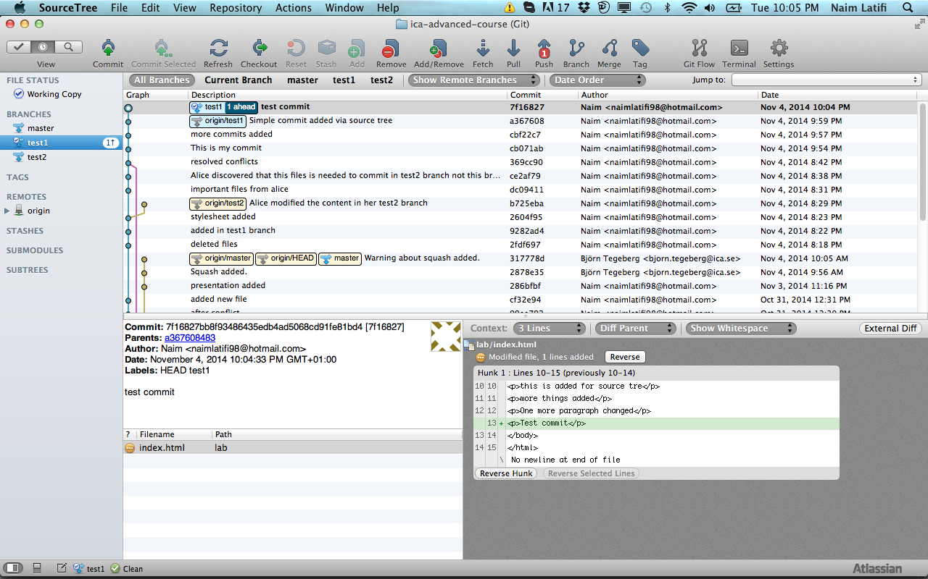
Source tree
Stash
Checkout
Remove
chery-pick
Pull
Fetch
Push
Merge
.ignore
Add
Commit
Discard
Stash
Unstage
Stage

Slide 9
Merging tool - Kdiff3
Merging is necessary when several people work on the same files in a project.
Kdiff3 can be used to merge two or three input files by selecting the buttons A/B/C from the button bar and choose the source that should be used.
Saving is disabled until all conflicts are resolved.
Merge case– either B or input C changed but not both then change source automatically will be selected; if both has changed in the same line the conflict occurs and need to be resolved; B,C the same but not A then C is selected.

Slide 10
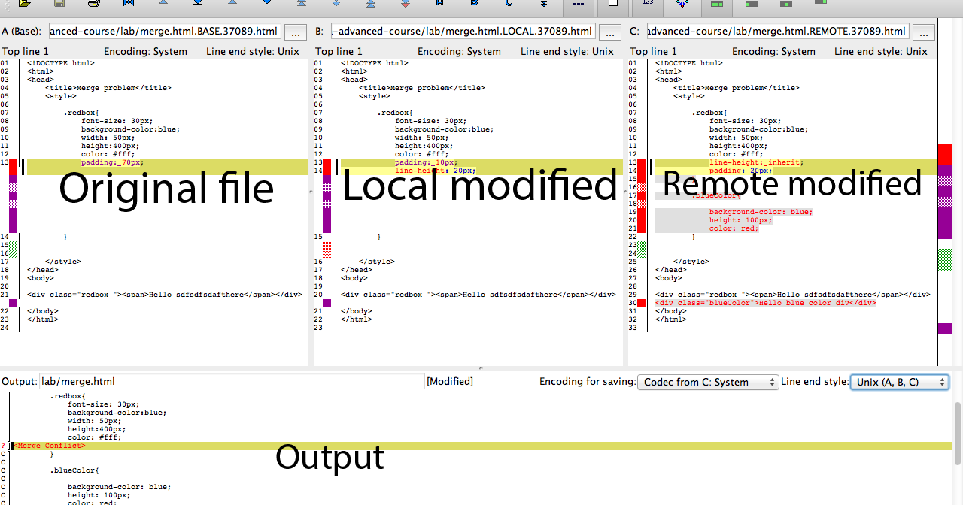
Kdiff3

