Slide 1
Introduction to configuration management and Git
2014-11-17

Slide 2
Session one
– 2014-11-17 18:00-20:00

Slide 3
Why and what of Configuration Management?

Slide 4
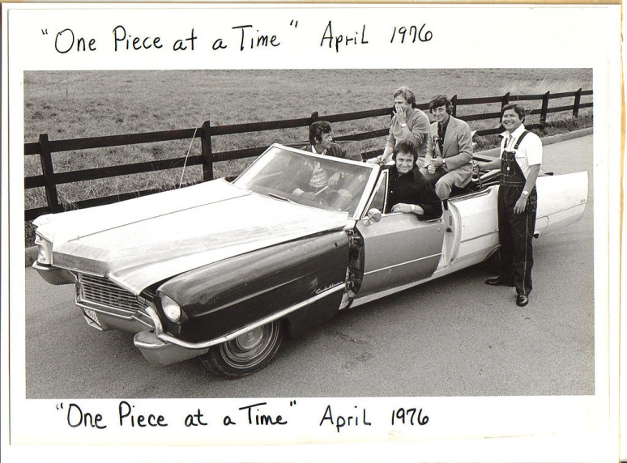
CM why and what, intro
“Now, up to now my plan went all right
'Til we tried to put it all together one night
And that's when we noticed that something was definitely wrong
The transmission was a '53 and the motor turned out to be a '73
And when we tried to put in the bolts all the holes were gone
So we drilled it out so that it would fit
And with a little bit of help with an adapter kit
We had that engine runnin' just like a song
...
You might say I went right up to the factory
And picked it up, it's cheaper that way
Uh, what model is it?
Well, it's a '49, '50, '51, '52, '53, '54, '55, '56 '57, '58' 59' automobile
It's a '60, '61, '62, '63, '64, '65, '66, '67 '68, '69, '70 automobile”
"One Piece At A Time“, Johnny Cash (1976)
http://en.wikipedia.org/wiki/One_Piece_at_a_Time
https://www.youtube.com/watch?v=rWHniL8MyMM

Slide 5
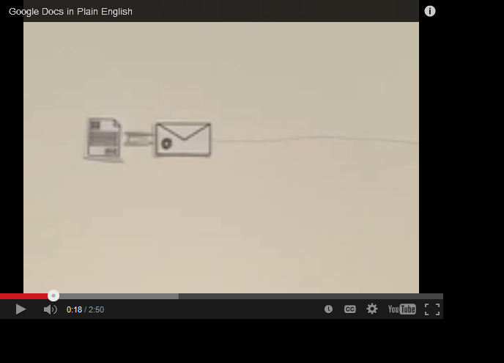
CM why and what, intro

Slide 6
CM why and what, intro (cont.)
Configuration Management - http://en.wikipedia.org/wiki/Configuration_management
Change Management - http://en.wikipedia.org/wiki/Change_management
Software Configuration Management - http://en.wikipedia.org/wiki/Software_configuration_management
Revision Control / Version Control / Source Control - http://en.wikipedia.org/wiki/Revision_control
Distributed Revision (/Version) Control System http://en.wikipedia.org/wiki/Distributed_revision_control
http://en.wikipedia.org/wiki/List_of_revision_control_software

Slide 7
The Ultimate Goal
Developer : Product == 1:1
Review - http://en.wikipedia.org/wiki/Code_review
Testing
Static program analysis - http://en.wikipedia.org/wiki/List_of_tools_for_static_code_analysis
Release
Experimental development
Integration
Build quality in - http://www.allaboutagile.com/7-key-principles-of-lean-software-development-2/
Issue tracking
Update / Hotfix / Service pack
http://en.wikipedia.org/wiki/Continuous_integration
http://en.wikipedia.org/wiki/Continuous_delivery
http://en.wikipedia.org/wiki/DevOps

Slide 8
Public service announcement
We can’t teach you all of Git
There's so much, ...
We learnt it because we're curious and want to be helpful
Cooperating in Git can be a great way to learn anyway!
git clone https://github.com/UncleCJ/hicollegegit.git

Slide 9
A machinery to do CM
– Git state operation

Slide 10

GIT state operation
.
Working directory
Staging area
GIT directory
(repo)
Remote repo
Stage files
commit files
Push
Checkout
Fetch
Pull
Untracked
unmodified
modified
staged

Slide 11
Branching and merging
– a case scenario

Slide 12
Branch & merge - a case scenario !
.
Alice’s branches:
8cf9d22
HEAD
file.x
master
test
file.x
HEAD
fa00e44
eb97f66
HEAD
HEAD
fa00e49
CONFLICT
HEAD
fa00e49
79c6e38
HEAD
a82bc13
HEAD
fa00e49
HEAD
Notes:
Merge the remote branch to local master branch *(if any conflicts fix them and commit)

Slide 13
GIT commits
.
ab3342
tree
Working directory
Staging area
Tree object
Blob-stores data
ab3342c
SHA-1 checksum
ab3354c
abffs42c
Commit - ad5643
Commit - ad4435
tree – 1csd32
tree – ab3342
parent – ad4435
author Alice
author……
Message “test commit”
Commit – 637ddx
tree – 321dzr

Slide 14



An example scenario
Origin
dsf
Boxes
master
Remote repo
Boxes
fetch
fetch
master
master
Local repo
Local repo
push
push
Boxes
clone
Local repo
master
Boxes
Alice
John
George

Slide 15
Session two – 2014-11-18 18:00-19:30

Slide 16
Refreshing last session
CM why and what, intro (CJ)
The ultimate goal (CJ)
Roleplay a CM scenario? (Naim)
Git / CM glossary and cheat sheet (Naim)
What you need to use git (Any)
Distributed / centralized systems (Naim?)
Git and the other tools, what fits where (CJ?)

Slide 17
LAB work - simple exercise
A github repository (CJ can you create one and paste the link here ?)
Clone a repository
Create three boxes green , yellow and red in default master branch
Create a new branch called “your_name_branch” and add another box model with color black (or any you like), share with all others.
.
default_ branch
default_
branch
default_
branch
yourname_
branch

Slide 18
GIT GUI clients
GIThub for MAC
Tower
GITbox
Source tree
Git cola
Gitg
Find and use the one you are most comfortable with
Download link:
http://git-scm.com/download/gui/linux

Slide 19
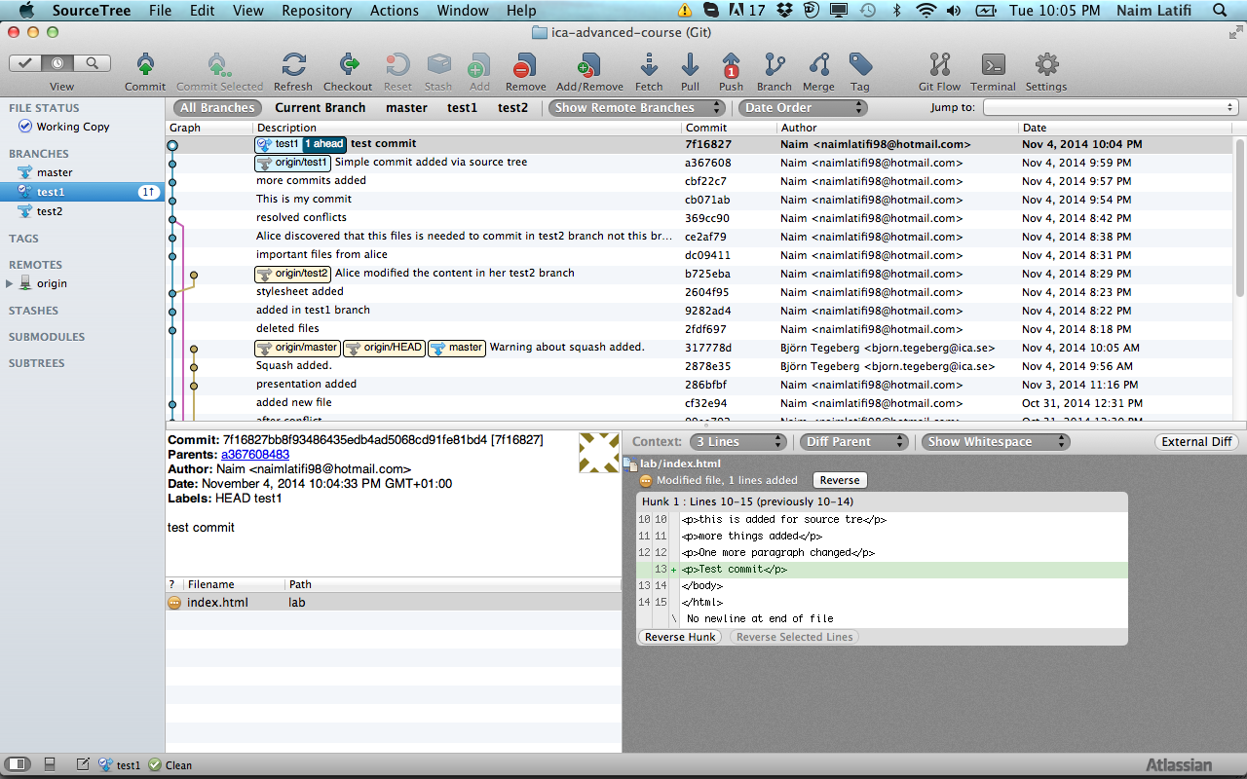
Source tree
Stash
Checkout
Remove
chery-pick
Pull
Fetch
Push
Merge
.ignore
Add
Commit
Discard
Stash
Unstage
Stage

Slide 20
Merging tool - Kdiff3
Merging is necessary when several people work on the same files in a project.
Kdiff3 can be used to merge two or three input files by selecting the buttons A/B/C from the button bar and choose the source that should be used.
Saving is disabled until all conflicts are resolved.
Merge case– either B or input C changed but not both then change source automatically will be selected; if both has changed in the same line the conflict occurs and need to be resolved; B,C the same but not A then C is selected.

Slide 21
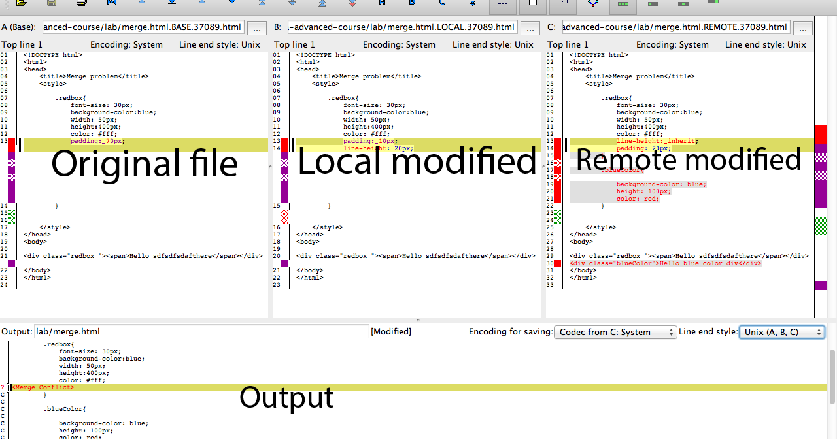
Kdiff3

