Slide 1
Git Open Space
CJ Sveningsson, Naim LatiFI, Erik Lundgren
2015-10-06

Slide 2
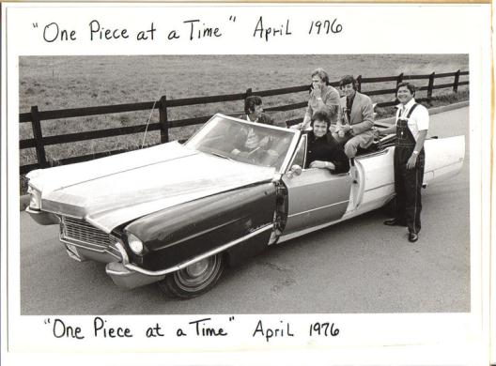
CM why and what - Intro
“Now, up to now my plan went all right
'Til we tried to put it all together one night
And that's when we noticed that something was definitely wrong
The transmission was a '53 and the motor turned out to be a '73
And when we tried to put in the bolts all the holes were gone
So we drilled it out so that it would fit
And with a little bit of help with an adapter kit
We had that engine runnin' just like a song
...
You might say I went right up to the factory
And picked it up, it's cheaper that way
Uh, what model is it?
Well, it's a '49, '50, '51, '52, '53, '54, '55, '56 '57, '58' 59' automobile
It's a '60, '61, '62, '63, '64, '65, '66, '67 '68, '69, '70 automobile”
https://www.youtube.com/watch?v=rWHniL8MyMM
"One Piece At A Time“, Johnny Cash (1976)
http://en.wikipedia.org/wiki/One_Piece_at_a_Time

Slide 3
CM why and what - Definitions
Configuration Management
Change Management (ITIL)
Software Configuration Management
Revision Control / Version Control / Source Control
Distributed Revision (/Version) Control System
List of revision control software

Slide 4



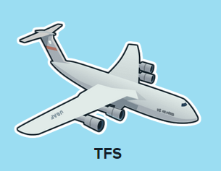
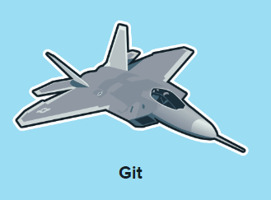
Git is a 5th generation version control system
https://www.plasticscm.com/version-control-history.html
There were many before Git
Git was the first to be fast, reliable, flexible and popular with developers (?)
Git is not a solution in every situation
Git is not the final solution

Slide 5

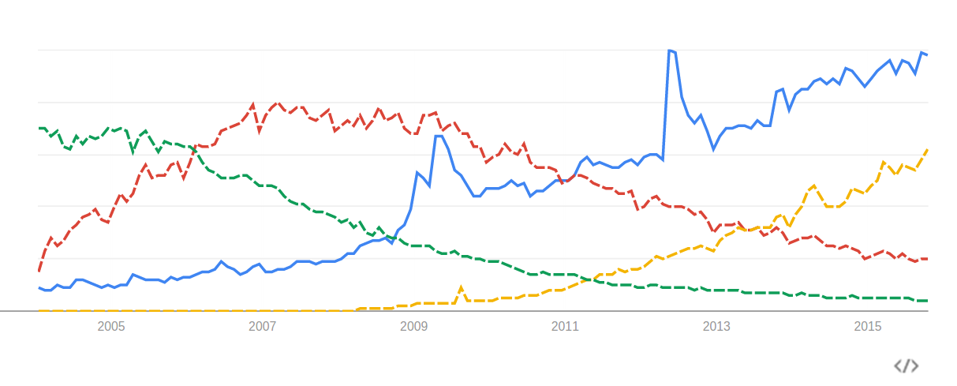
Why we talk about Git and Github today
http://www.google.com/trends/explore#q=Git%2C%20%2Fm%2F012ct9%2C%20%2Fm%2F04g0kcw%2C%20%2Fm%2F02p0tdp&cmpt=q&tz=Etc%2FGMT-2

Slide 6

What Git is
A distributed version control system
Created in 2005 by Linus Torvalds to move the Linux kernel development away from BitKeeper
Linus promptly calls Subversion ”the most pointless project ever started” (for wanting to ”do cvs right”)
GitHub becomes the world’s most popular site for open source collaboration

Slide 7
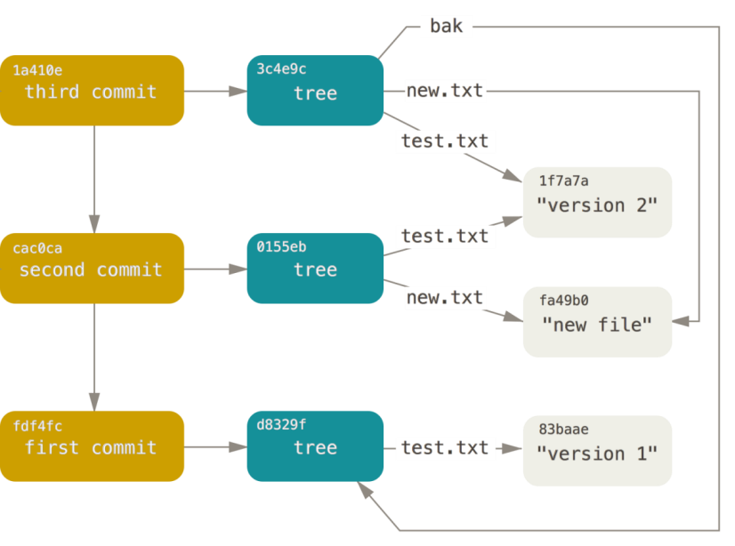
GIT commits
IMPORTANT!
A repository is a cryptographically (SHA-1) directed acyclic graph of commits, trees (directories) and blobs (files)
Each commit reflects the entire workspace
Git enables you to do CM locally (and collaborate however you want)
"It is easy to shoot your foot off with git…
…but also easy to revert to a previous foot and merge it with your current leg.“
http://git-scm.com/book/en/v2/Git-Internals-Git-Objects

Slide 8
The Ultimate Goal
Developer : Product == 1:1
… but our dealings are complex
Review
Testing
Static program analysis
Release
Experimental development
Integration
Build quality in
Issue tracking
Update / Hotfix / Service pack
Continuous integration
Continuous delivery / DevOps

Slide 9
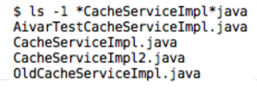

The Ultimate Goal – Build quality in
You can have experiments and cruft which you may one day want, but keep it out of the product
Keep pruduct a pristine environment
Good CM is essential to enable the lean principles
Stop the line so the line never stops (and keep the floors clean)
Branching strategy is usually the first thing teams realize they lack
But if you can manage the CM, it has proven very powerful, fast and flexible for many
http://nvie.com/posts/a-successful-git-branching-model/
https://www.atlassian.com/git/tutorials/comparing-workflows/gitflow-workflow

Slide 10
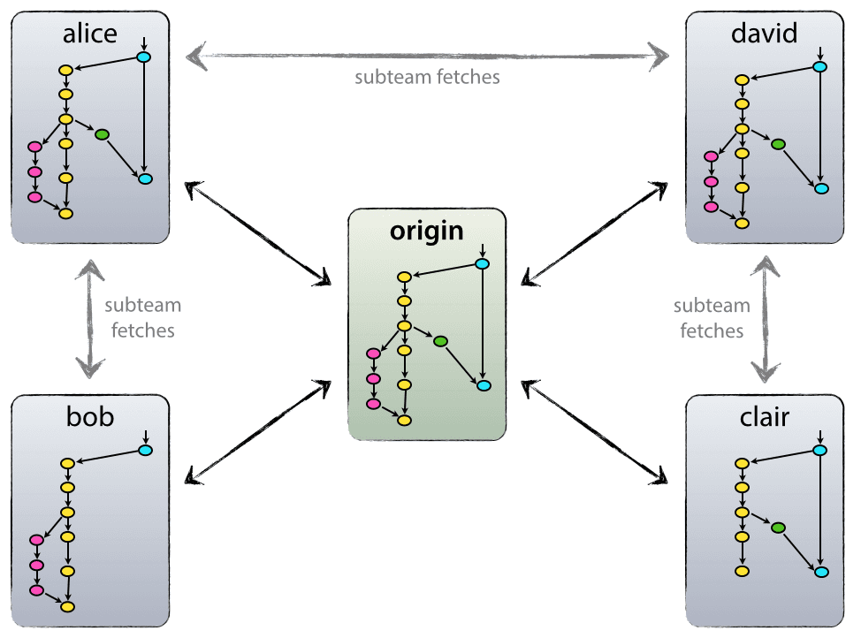
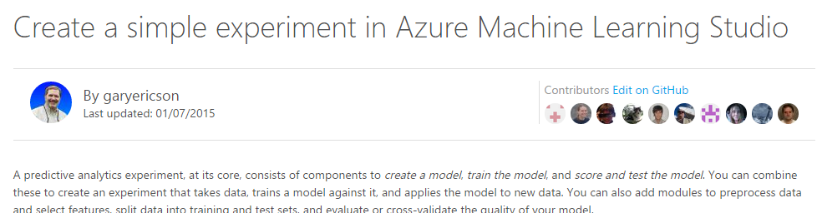
How to collaborate with Git
Git doesn’t need the network
But there are many ways to collaborate:
  Patches / bundles
  SSH / network share
  Gitosis server
  Github / Bitbucket / other
The focus to do only CM and do it right and reliably has contributed to the popularity of Git and Github:
http://www.wired.com/2012/02/github-2/all/
https://github.com/Azure/azure-content

Slide 11
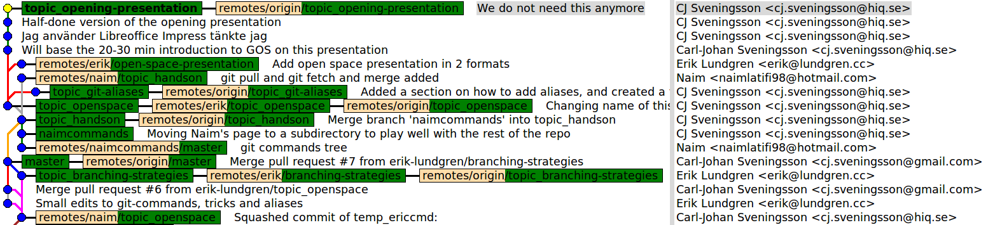
Children of the shoe-maker...
Sometimes it's hard to practice what you preach...
… but with Git, we make it work.
Looking forward to your contributions!

Slide 12
What about Git at HiQ?
We don't need no internal infrastructure (?!)
https://github.com/orgs/HiQStockholmAB
… and some in Bitbucket?
The competence exist, but is spread out, until we gather it

Slide 13
Things related to Git
[Github](https://github.com/) (probably most popular public hosting)
[BitBucket](https://bitbucket.org/) (another place where you can do private hosting)
[Gerrit](http://code.google.com/p/gerrit/) (code review)
[Gerrithub](http://gerrithub.io/) (Gerrit+Github)
[Github pages](https://pages.github.com/) (publish web pages straight from your repo)
[Github dotfiles](https://dotfiles.github.io/) (save your preferences and share them)
[Github gist](https://gist.github.com/) (CM'ed pastebin service - CM everything!)
[Gitorious server](https://gitorious.org/) (private repository server)
[Semantic Merge](http://www.semanticmerge.com/) (semantically aware merge/diff tool by the authors of Plastic SCM)
[Araxis Merge](http://www.araxis.com/merge/) (Merge office docs etc, Windows & OS X)
[Deltawalker](http://www.deltopia.com/compare-merge-sync/macosx/) ([et al...](http://www.git-tower.com/blog/diff-tools-mac/))
[Travis CI](https://travis-ci.com/), [BuildHive](http://en.wikipedia.org/wiki/BuildHive), Jenkins (continuous integration servers)
[Puppet](http://en.wikipedia.org/wiki/Puppet_\(software\)) ("Conventional" CM server software)
[Jira](http://en.wikipedia.org/wiki/JIRA) ([Issue tracking](http://en.wikipedia.org/wiki/Comparison_of_issue-tracking_systems) server)

Slide 14
How to do open space?

Slide 15

Open space – How does it work
The law of two feet:
Foot of passion
Foot of responsibility
Four principles:
Whoever comes is the right people
Whatever happens is the only thing that could have
Whenever it starts is the right time
When it’s over, it’s over
Prepare to be surprised!

Slide 16

Open space – Schedule
Opening (we did this already)
Marketplace of ideas
  Suggest branch
  Choose time slot
  Explain branch
Break out sessions
  Choose your adventure (you can choose multiple adventures!)
  Utilize the Law of two feet
  Contribute (to the repository or otherwise)
Closing (20:45)
  Fill in feedback papers

Slide 17
Let’s go g.o.s
THANK YOU FOR LISTENING!
Fork the repo!
https://github.com/UncleCJ/hicollegegit

