Slide 1
Time for a few Cyriak Videos
Cycles (2010)
https://www.youtube.com/watch?v=-0Xa4bHcJu8
Welcome to KittyCity (2011)
https://www.youtube.com/watch?v=jX3iLfcMDCw
Malfunction (2014)
https://www.youtube.com/watch?v=tnWP2Emps1M
Notes:
Video representations of CS concepts
Cycles: Loops
-- (loops get corrupted eventually though…)
Kitty City: Recursion
-- larger constructs are recursive amalgamations of smaller archetypes
Malfunction: Convolution; Building by Composition
-- loops where you can see the smaller recursive copies of the original archetype composing the whole

Slide 2
Time for a Quick Intro to
Iterated Functions
An iterated function is one whose output is repeatedly fed back in as its new input
  e.g. f(x) = x² + 1 x₀ = 0
  e.g.2 f(x) = x² + ½ x₀ = 0
  e.g.3 f(x) = x² + ¼ x₀ = 0

Slide 3
Time for a Review of Complex, or Imaginary Numbers
What is i ?
What is a complex number?
How does math work with complex numbers?
How can I represent a complex number on a graph?
  x-axis
  i-axis
  (3, 2)
3 + 2i

Slide 4
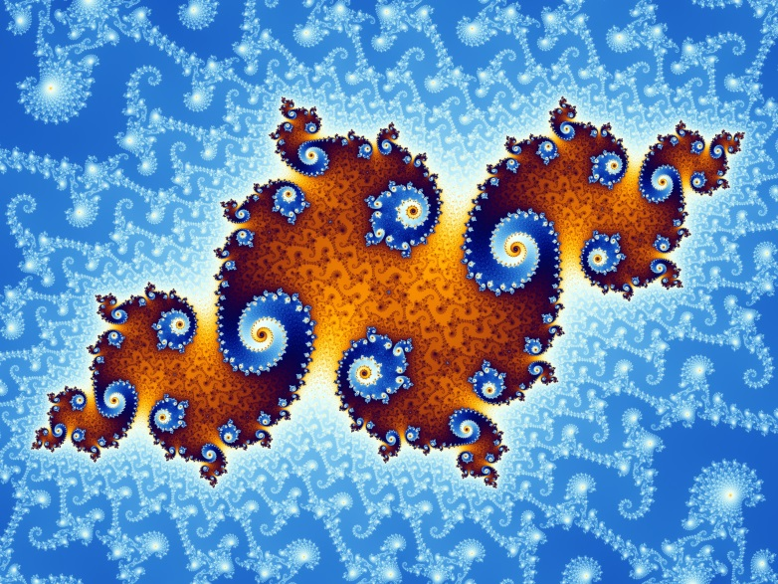

Drawing Mandelbrot and Julia Sets
Event-Driven Programming

Slide 5


Jonathan Coulton – Nerd Troubadour
author of: Portal's "Still Alive"

Slide 6
What Internet Songs can teach us about Complex Dynamics in Math
Jonathan Coulton song animation
  https://www.youtube.com/watch?v=ES-yKOYaXq0
Joco song Lyrics
  http://www.jonathancoulton.com/wiki/Mandelbrot_Set/Lyrics
Take a point called z from the Complex plane
  Let z₁ equal z² plus z
  Let z₂ be z₁² plus z
  Let z₃ be z₂² plus z… and so on
Should the series of zs always stay close to z without trending away, that point is in the Mandelbrot set

Slide 7
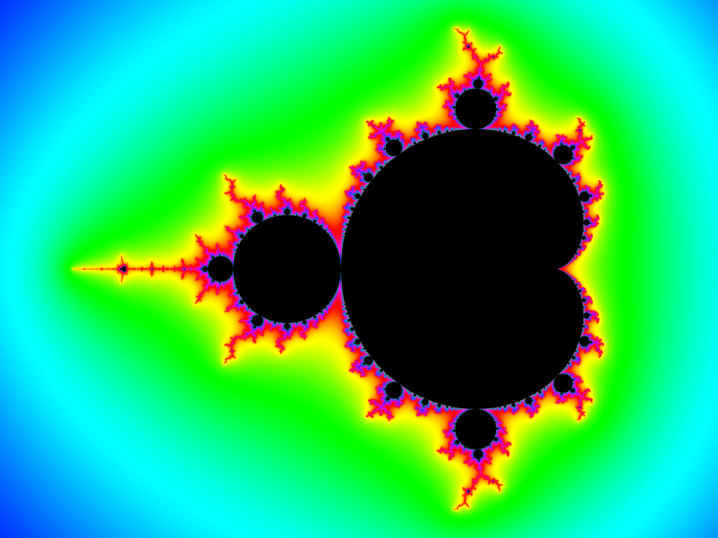
Notes:
https://www.youtube.com/watch?v=cXM9J77StL0

Slide 8
Definition of a Recursive Structure
A structure which, when any small portion of it is magnified, is found to be composed of smaller versions of the same overall structure
  e.g. a Binary Search Tree
Mandelbrot Tour Guide
https://www.youtube.com/watch?v=cXM9J77StL0

Slide 9
A Mandelbrot set Explanation
Dr. Holly Krieger from MIT
https://www.youtube.com/watch?v=NGMRB4O922I

Slide 10
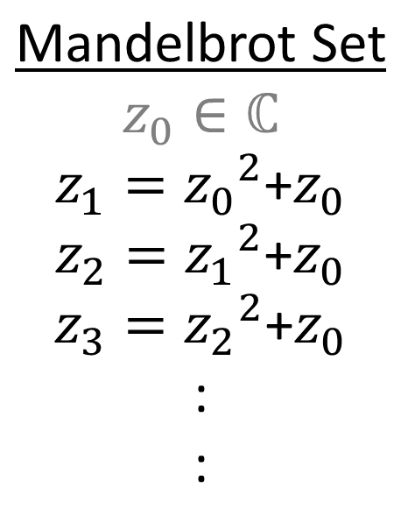
An Iterated Function
Jonathan Coulton song animation
  https://www.youtube.com/watch?v=ES-yKOYaXq0
Joco song Lyrics
  http://www.jonathancoulton.com/wiki/Mandelbrot_Set/Lyrics
Take a point called z from the Complex plane
  Let z₁ equal z² plus z
  Let z₂ be z₁² plus z
  Let z₃ be z₂² plus z… and so on
Should the series of zs always stay close to z without trending away, that point is in the Mandelbrot set
⇐ This is applied to each point z₀
in the complex plane
(Note: z₀ is the converted pixel-address
within the image)

Slide 11
Drawing the Mandelbrot Image
So we have an iterated function: f(z) = z² + z₀
We want to iterate this function for every point z in the complex plane we display within our picture box (-3+2i … +3 - 2i)
Ultimately, we don't care what the values are that we compute
  we only keep track of the number of iterations before the norm (i.e. distance from origin) exceeds 2 or so
  assign a color to the pixel according to that number of iterations before norm threshold exceeded

Slide 12
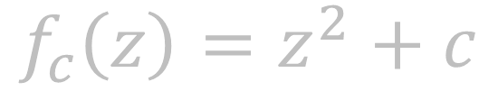
Mandelbrot Set Image Pseudocode
For each point p₀ in the complex plane:
Let c = p₀
count = 0 ("fate")
While Norm(p_{n}) < 2 and count < 10³:
let p_{n+1} = p_{n}² + c
count++
If count = 10³:
set pixel-color to Black
Else:
set pixel-color according to formula: g(count)
Color.FromArgb(count % 128 * 2, count % 32 * 7, count % 16 * 14))

Slide 13
using System.Drawing;
private void Form1_Load(object sender, EventArgs e)
{
Bitmap pic = Mandelbrotset(pictureBox1, 2, -2, 2, -2);
pictureBox1.Image = pic;
}
static Bitmap Mandelbrotset(PictureBox pictureBox1, double Xmax, double Xmin, double Ymax, double Ymin)
{
Bitmap pic = new Bitmap(pictureBox1.Width, pictureBox1.Height);
double zx = 0;
double zy = 0;
double cx = 0;
double cy = 0;
double xzoom = ((Xmax - Xmin) / Convert.ToDouble(pic.Width));
double yzoom = ((Ymax - Ymin) / Convert.ToDouble(pic.Height));
double tempzx = 0;
// square picture
dimensions
// real portion of z
// imaginary portion of z
// converted to local coordinates
// x-interval (at current zoom-level)
// y-interval (at current zoom-level)

Slide 15
Mandelbrot is Derived from the Julia Set
Julia Set images are also created via iterated functions
  but instead of offsetting the function's result by z₀ (the original pixel-location), it is offset by a constant complex number c
The Mandelbrot image is the result of a composition of Julia Set function iteration counts

Slide 16
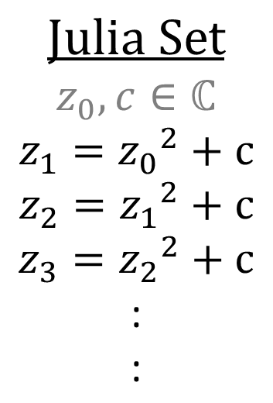
Relation to Julia Sets
FractalMath MandelBrot explanation
  https://www.youtube.com/watch?v=8ma6cV6fw24
Julia/Mandelbrot on Google
  http://juliamap.googlelabs.com/#c=0,0$z=0$p=ffffff,ffffff,ffffff,ffffff,ff0000,ffff00,ffff00,ff00,ff$f=julia0
⇐ This is applied to each point z₀
in the complex plane
(Note: c remains constant)
Notes:
change out this formula-box

Slide 17
Julia Set Image Pseudocode
Choose a complex point c
For each relevant point p₀ in the complex plane:
count = 0 ("fate")
While Norm(p_{n}) < 2 and count < 10³:
let p_{n+1} = p_{n}² + c
count++
If count = 10³:
set pixel-color to Black
Else:
set pixel-color according to formula: g(count)
Color.FromArgb(count % 128 * 2, count % 32 * 7, count % 16 * 14))

Slide 18
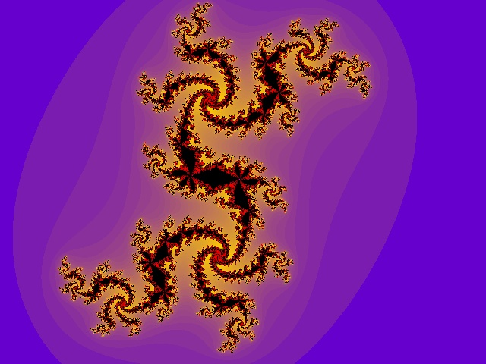
Julia Set Image Pseudocode
Choose a complex point c
For each complex point p₀ in the visible complex plane:
count = 0
While Norm(p_{n}) < 2 and count < 10⁶:
let p_{n+1} = p_{n}² + c
count++
If count = 10⁶:
set pixel-color to Black
Else:
set pixel-color according to formula: g(count)
Color.FromArgb(count % 128 * 2, count % 32 * 7, count % 16 * 14))

Slide 19
Julia Set Iteration Example
Let c = (1, 0.5) = 1 + 0.5i
Imagine you have a 400x600 image representing the complex plane from:
X: -3 … +3
Y: -2i … +2i
Pixel (0,0) is location p₀ = (-3, 2) in the plane
z₀ = -3 + 2i
z1 = 9 – 12i – 4 + 1 + 0.5i = 6 – 11.5i
Now, iterate.
Norm?
Mandelbrot's only difference is: c = p₀.

Slide 20
Setting the Pixel-Color
if (loopcnt != 1000) pic.SetPixel(x, y, Color.FromArgb(loopcnt % 128 * 2, loopcnt % 32 * 7, loopcnt % 16 * 14));
else
pic.SetPixel(x, y, Color.Black);

