Slide 1
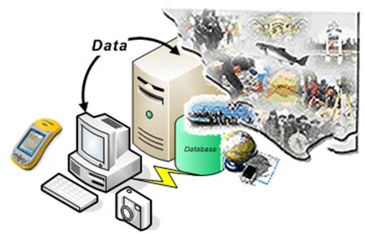
The GIS Database

Slide 2
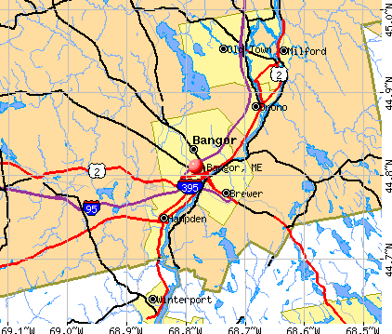
Entity
Bangor
Penobscot County, Maine, United States
Centroid - 44.801N , -6778W
Area 34.4 square miles
Elevation – 158 feet
Population 31,473

Slide 3
What is a database?
A database is any organized collection of data. Some examples common examples:
a telephone book
T.V. Guide
airline reservation system
motor vehicle registration records
papers in your filing cabinet
files on your computer hard drive.

Slide 4
Database Definitions
What is a database?
It’s an organized collection of data, it need not be a computer based system.
What is a database management system (DBMS)?
A software system designed to:
Organize that data in a flexible manner,
Provide tools to add, modify or delete data from the database,
Query the data,
Produce reports summarizing selected contents.

Slide 5
What is the ultimate purpose of a database management system?
Is to transform
Data
Information
Knowledge
Action

Slide 6
Features of a DBMS
Database Management Systems provide features to maintain database:
Data independence - It refers to the immunity of user applications to make changes in the definition and organization of data.
Integrity and security - refers to maintaining and assuring the accuracy and consistency of data over its entire life-cycle

Slide 7
Features of a DBMS
Database Management Systems provide features to maintain database:
Transaction management - A transaction comprises a unit of work performed within a DBMS against a database, and treated in a coherent and reliable way independent of other transactions. Transactions in a database environment have two main purposes:
To provide isolation from other transactions.
To have an “all or nothing” effect.
Transactions must pass the ACID test (atomic, consistent, isolated and durable

Slide 8
Features of a DBMS
Database Management Systems provide features to maintain database:
Concurrency control - ensures that correct results for concurrent operations are generated, while getting those results as quickly as possible.
Backup and recovery
Provides a language for the creation and querying of the database.
A language for writing application programs

Slide 9
Selecting a Database Management System
Database management systems (or DBMSs) can be divided into two categories:
Desktop databases are oriented toward single-user applications and reside on standard personal computers (hence the term desktop).
Server databases contain mechanisms to ensure the reliability and consistency of data and are geared toward multi-user applications.

Slide 10
Relational Databases
The relational database model is the most dominant model in both the corporate and GIS world, due to its flexibility, organization, and functioning..
It was defined by Edgar F. Codd (1970).
It can accommodate a wide range of data types.
It is not necessary to know beforehand the types of processing that will be performed on the database.

Slide 11
Relational Database Terminology
Each table contains the data for a single entity.
Each instance of an entity is a row/record/tuple in the table. This is a specific instance of the entity.
Columns contain attributes/fields that describe the entity.
Attributes in a column must be from the same domain (text, integer, date).
An attribute may have a range (e.g.; 0 ≤ integers ≤ 100)
Column order has no significance.
Tables are related through keys.
Notes:
Column order has no significance.

Slide 12
Attributes
An entity is represented by a set of attributes, that is descriptive properties possessed by all members of an entity set.
Domain – the set of permitted values for each attribute
Attribute types:
Simple and composite attributes.
Single-valued and multi-valued attributes
E.g. multivalued attribute: phone-numbers
Derived attributes
Can be computed from other attributes
E.g. age, given date of birth

Slide 13
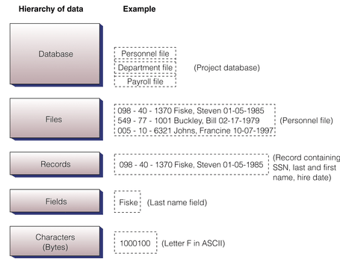
Relational Database Terminology
Entity
Record, row, tuple
A specific instance of the entity
Attribute, column

Slide 14
Keys
A super key of an entity set is a set of one or more attributes whose values uniquely determine each entity.
A candidate key of an entity set is a minimal super key
Customer-id is candidate key of customer
account-number is candidate key of account
Although several candidate keys may exist, one of the candidate keys is selected to be the primary key.

Slide 15
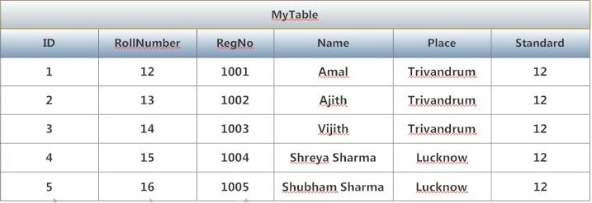
Super Key
ID, RollNumber, RegNo, Name, Place, Standard
ID, RegNo, Name
RegNo, Name, Place, Standard
RollNunmber, Name Place
ID, Place
RegNo

Slide 16
Candidate Keys
ID
RollNumber
RegNo

Slide 17
Primary Key
ID

Slide 18
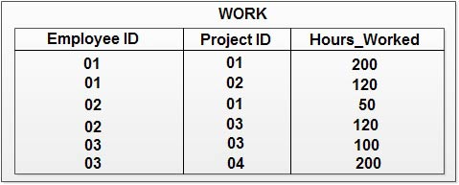
Keys
A composite key/concatenated is a key with more than one attribute.
http://ecomputernotes.com/images/Composite%20Key.jpg

Slide 19
Keys
A foreign key is an attribute that is a key of one or more relations other than the one in which it appears.

Slide 20
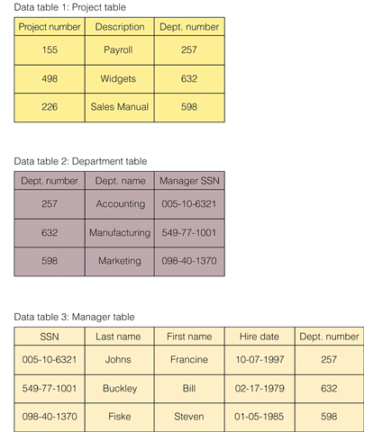
Foreign Key
Primary Key
Foreign Key
Primary Key
Foreign Key
Primary Key
Foreign Key

Slide 21
Keys
Given the importance of keys, there are usually some restrictions on them: e.g., null values are not allowed.
Keys are also used to index a database.
Too few keys may result in difficulty in searching and sorting the database.

Slide 22
Physical Database Structure
The physical design of the database specifies the physical configuration of the database on the storage media.
This includes detailed specification of data elements, data types, indexing options and other parameters residing in the DBMS data dictionary.
It is the detailed design of a system that includes modules & the database's hardware & software specifications of the system.
https://en.wikipedia.org/wiki/Database_design

Slide 23
Logical Database Structure
Several logical data structures are used to express the relationships between individual data elements or records in a database.
Common logical data structures are hierarchical, network, and relational, with relational being predominant.

Slide 24
Conceptual Structure
The conceptual structure is often represented as a schema.
A schema describes the database structure in a shorthand notation.
One example is the entity-relationship (ER) diagram.

Slide 25
Entity Relationship Diagram
Rectangles represent entity sets.
Diamonds represent relationship sets.
Lines link attributes to entity sets and entity sets to relationship sets.
Ellipses represent attributes
Double ellipses represent multivalued attributes.
Dashed ellipses denote derived attributes.
Underline indicates primary key attributes.
ENTITY
RELATIONSHIP
ATTRIBUTE

Slide 26
Entity Relationship Diagram
Name
Address
Name
ID
Phone
Number
Credits
Student
Enrolls In
Courses
Major
GPA
Time
Instructor
Advisor
Credits
Room

Slide 27
Entity Relationship Model
The result is a diagram of all of the entities, their attributes, and the relationships between entities
Each entity becomes a table.
Student table
Course table
Each relationship (usually) becomes a table.
Enrolls, which allows you to join information from both tables.

Slide 28
Types of Relationships between Entities
1:1 – one faculty member is assigned to one office.
1:M (M:1) – one faculty member teaches many courses.
M:N – many students take many courses.
All of these relationships can exist between attribute tables.

Slide 29
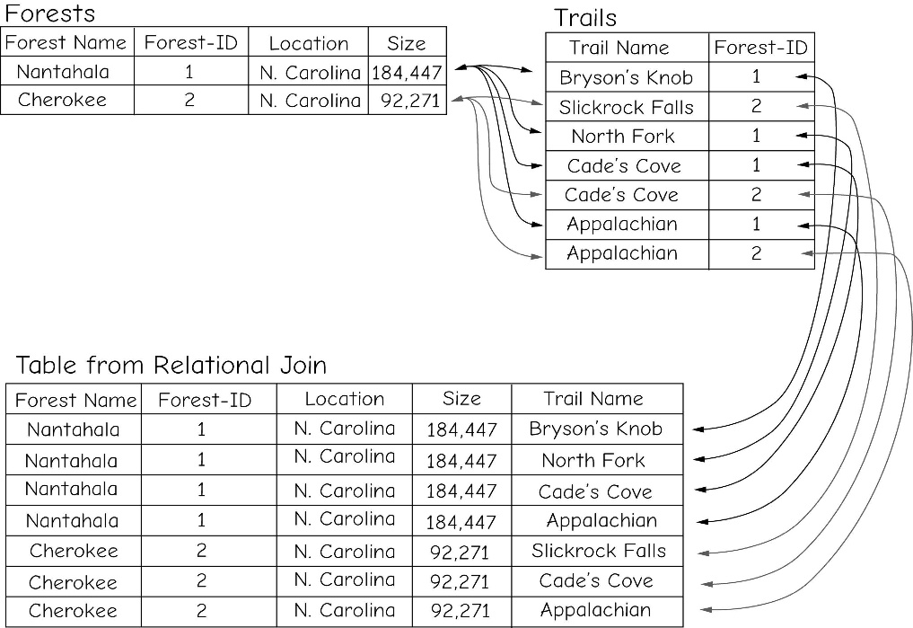
Table Join

Slide 30
Table Joins
Table joins depend on the data not the attribute name.
There are many different types of table joins.
Tables can be joined regardless of the relationship EXCEPT:
When joining to the feature attribute table in a GIS, the relationship must be 1:1 or M:1
Other relationships must use the relate.

Slide 31
One-to-One Join
Employee-id | Job
1 | Digislave
2 | Useless Supervisor
Employee-id | name
1 | Tom
2 | John
Join Employee-id to Employee-id
After join
Employee-id | Job | Name
1 | Digislave | Tom
2 | Useless Supervisor | John
A join does not permanently alter the table structure
Notes:
<number>

Slide 32
Many-to-One Join
Polygon Id | Symbol
1 | Qa
2 | Qa
3 | Pa
4 | Qe
Symbol | Description
Qa | Quaternary Alluvium
Qe | Quaternary Eolian
Pa | Permian Abo
After Join on Symbol
Polygon ID | Symbol | Description
1 | Qa | Quaternary Alluvium
2 | Qa | Quaternary Alluvium
3 | Pa | Permian Abo
4 | Qe | Quaternary Eolian
Notes:
<number>

Slide 33
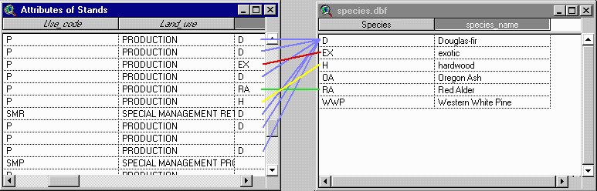
Relate in a GIS
https://courses.washington.edu/gis250/lessons/tables/images_av3/relate_table1.gif

Slide 34
Relational Algebra
Codd’s specification of a relational database relied on relational algebra.
Relational algebra takes tables/relations as inputs and returns tables as outputs.
The algebra combines or splits tables by rows or by columns to generate either a subset of tables or an expanded tables.

Slide 35
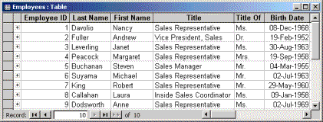
Fundamental Building Blocks
Tables comprise the fundamental building blocks of any database.
The table above contains the employee information for an organization -- characteristics like name, date of birth and title.

Slide 36
Relational Algebra
Five basic operators
select: σ
project: ∏
union: ∪
difference: –
Cartesian product: x
The operators take one or two relations as inputs and produce a new relation as a result.
Notes:
Worboys calls it restrict.

Slide 37
Relational Algebra
Derived Relational operators
Intersection ∩
Divide (not used very often)
Join
These can be expressed using different combinations of the fundamental operators.
Notes:
Worboys calls it restrict.

Slide 38
Select Operation – Example
Relation r
A
B
C
D
α
α
β
β
α
β
β
β
1
5
12
23
7
7
3
10
σ_{A=B ^ D > 5} (r)
A
B
C
D
Select from relation r where A=B AND D>5
α
β
α
β
1
23
7
10
Notes:
Select from relation r where A=B AND D>5

Slide 39
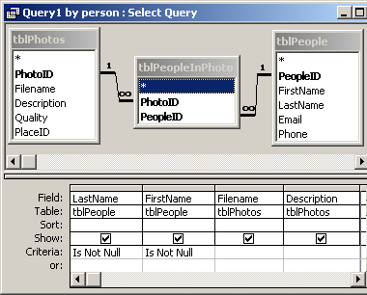
Database Queries
Queries may be made of one table or several tables at the same time.
In many systems querying is facilitated by icons, or menus, or queries by example (QBE – a graphical query language ).

Slide 40
Structured Query Language (SQL)
DDL – Data Definition Language; used to create and manage the database.
DDM – Data Manipulation Language; used to query the database.

Slide 41
SQL
SQL: widely used non-procedural language
E.g. find the name of the customer with customer-id 192-83-7465 select customer.customer-name from customer where customer.customer-id = ‘192-83-7465’
Application programs generally access databases through one of
Language extensions to allow embedded SQL
Application program interface (e.g. ODBC/JDBC) which allow SQL queries to be sent to a database

Slide 42
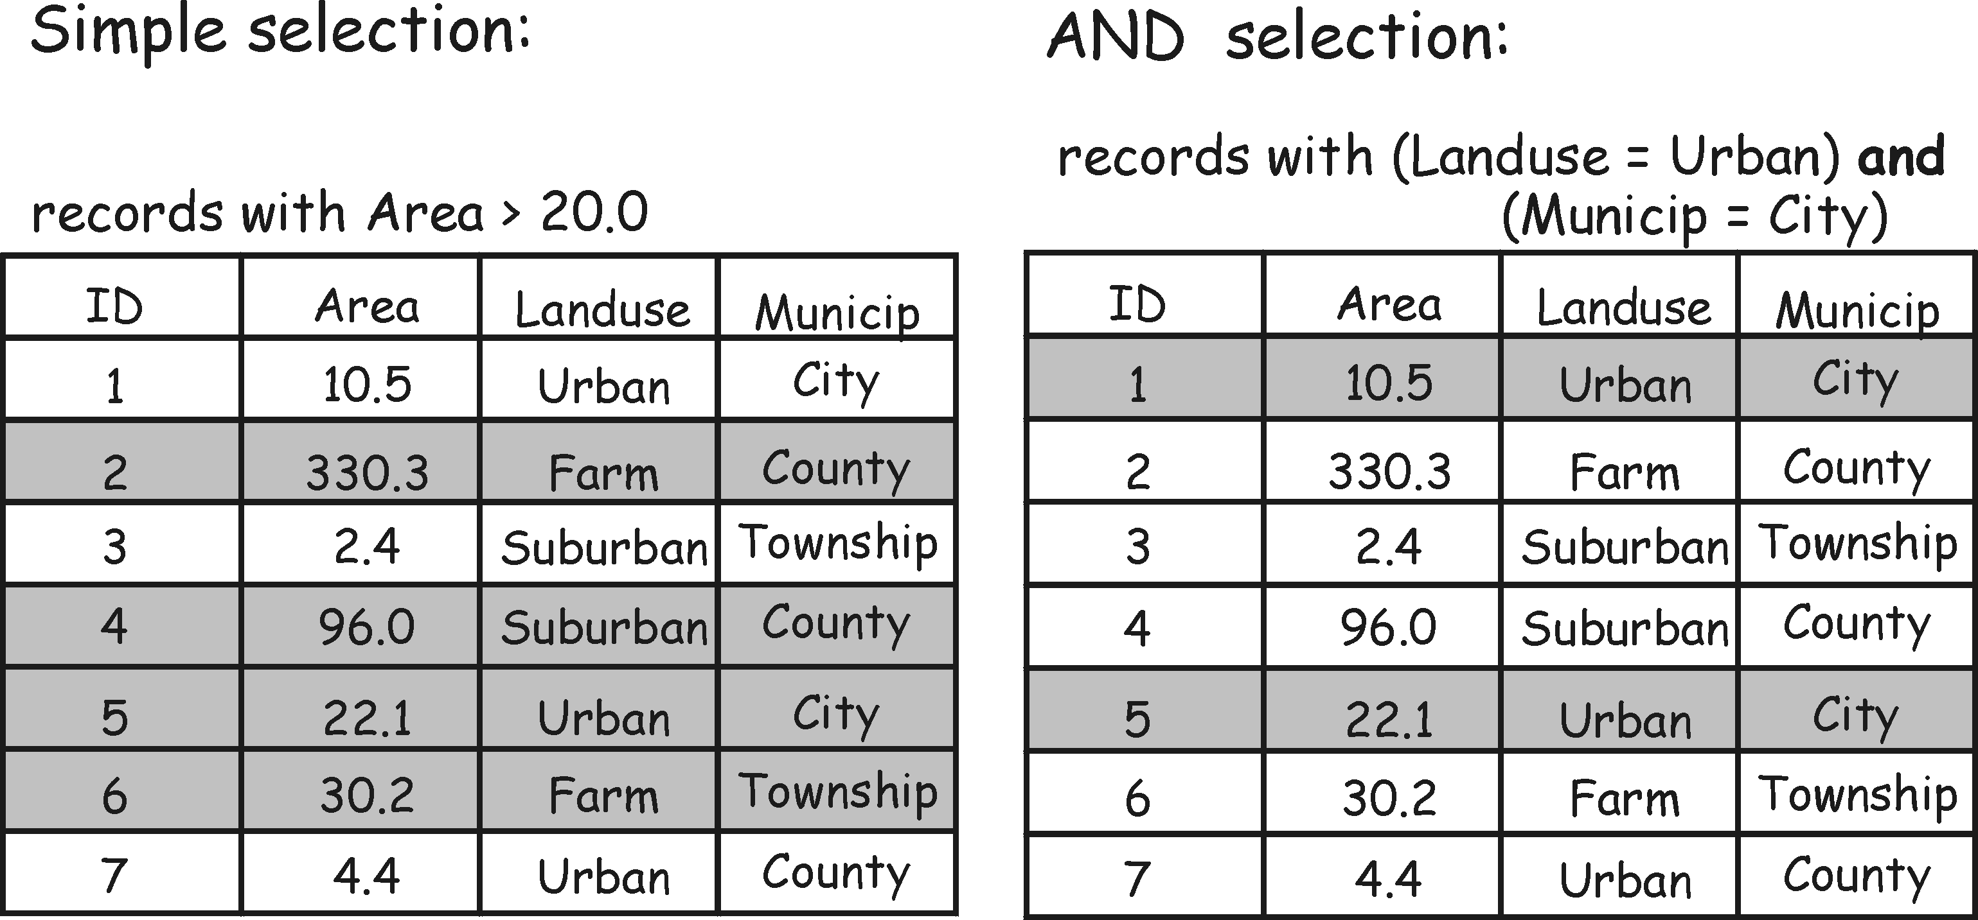
Attribute Queries

Slide 43
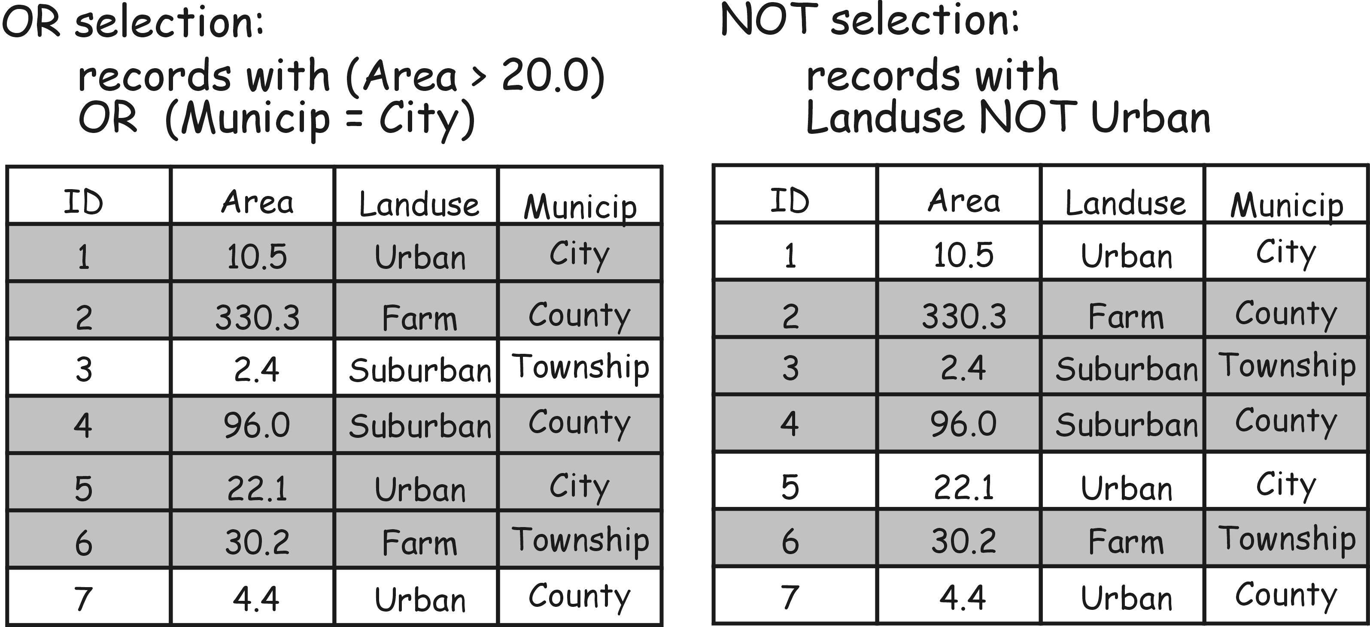

Slide 44
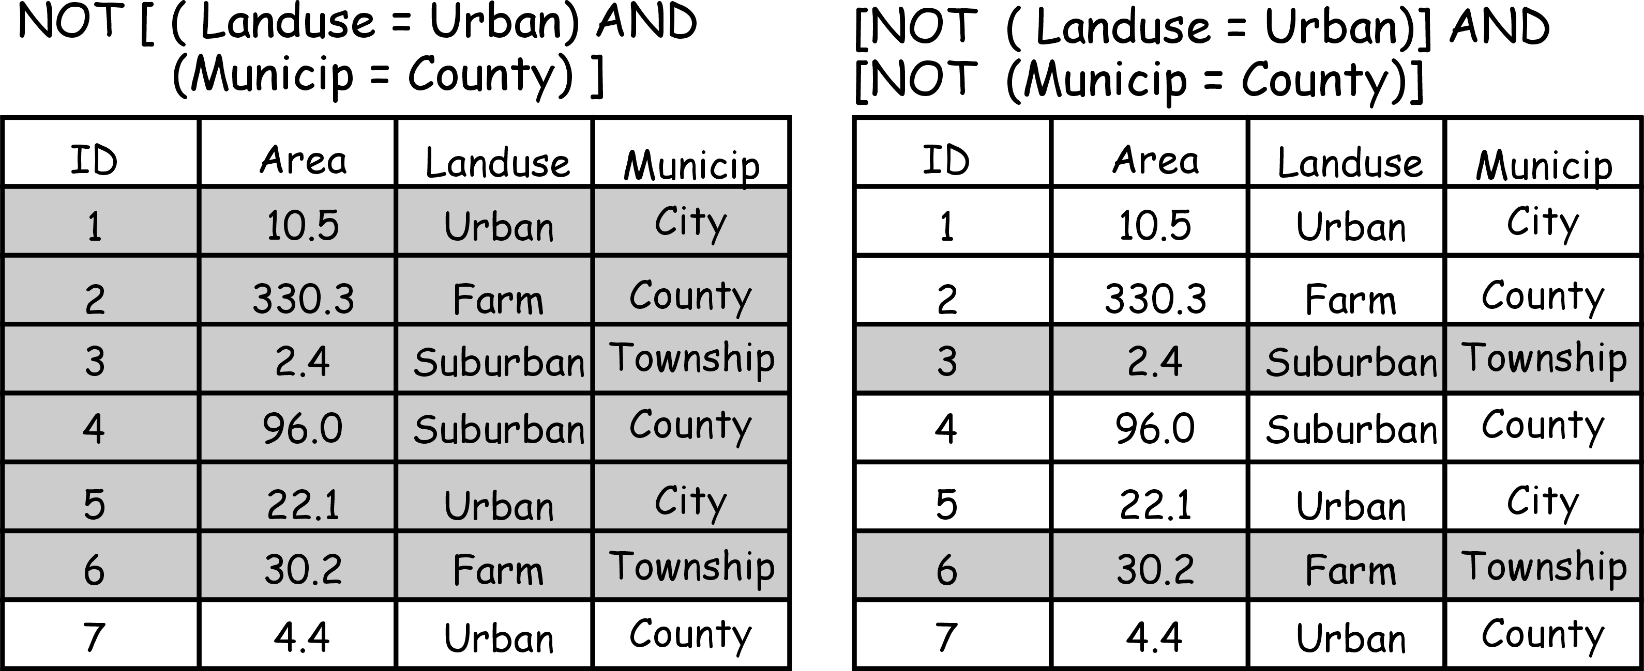
Notes:
<number>
ArcMap would allow you to switch selection

Slide 45
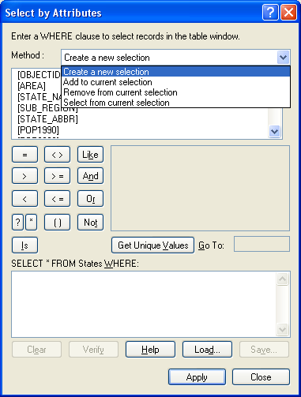
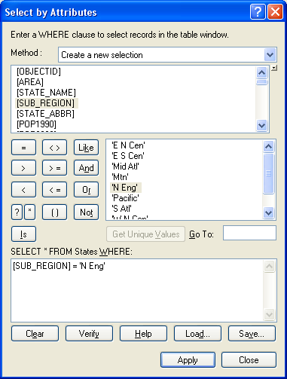
The ArcGIS Attribute Query Interface
State’s Table is Open

Slide 46
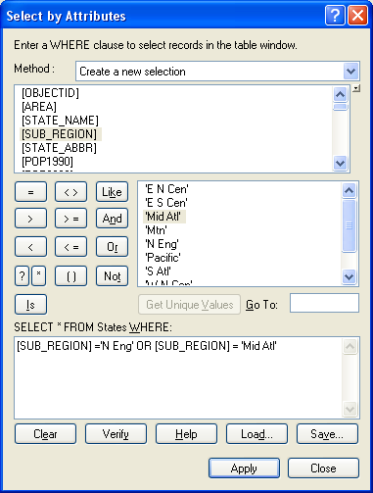
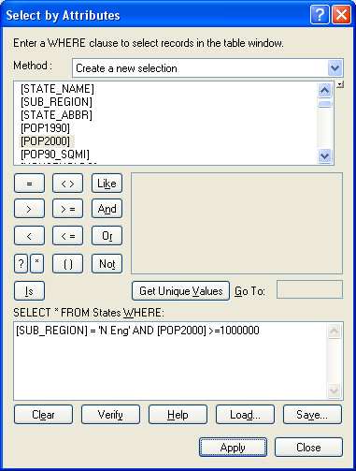

Slide 47
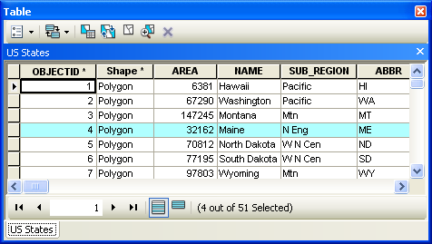
Table is Open
Options
Related tables
Select by attributes
Switch selection
Clear selection
Zoom to selected
Delete Selected
Notes:
<number>
Options
Related tables
Select by attributes
Switch selection
Clear selection
Zoom to selected
Delete Selected

Slide 48
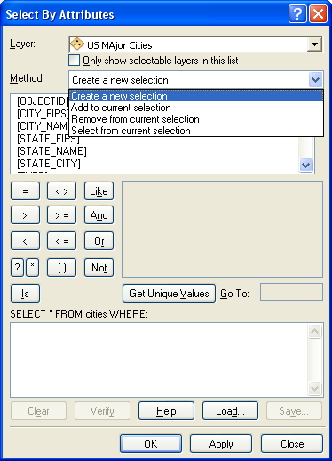
No Table is Open
Selection->Select by Attributes from the Menu Bar

Slide 49
A Spatial Query in SQL
SELECT city.name, city.geometry
FROM city, county
WHERE county.name=‘Penobscot’ AND
city.geometry INSIDE county.geometry
city.population>30000;

Slide 50
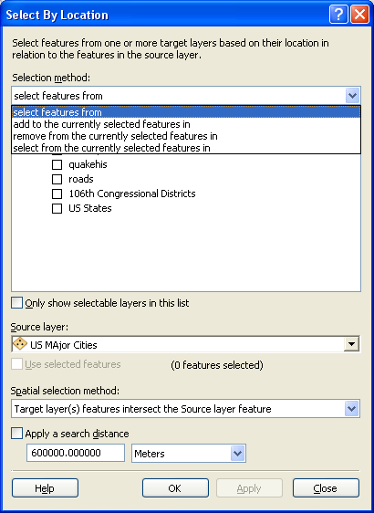
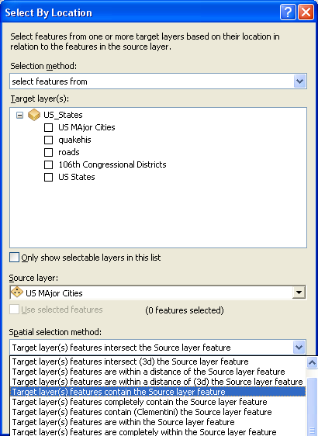
Spatial Selection

Slide 51
Spatial Data
Spatial data has a structure that does not necessarily fit with tabular structure.
To construct a spatial object requires several table joins.
Spatial indexing is very different from the type of indexing used in a relational database.

Slide 52
Spatial Types – OGC Simple Features
Geometry
SpatialReferenceSystem
Composed
Type
Relationship
Point
Curve
Surface
GeometryCollection
LineString
Polygon
MultiSurface
MultiCurve
MultiPoint
Line
LinearRing
MultiPolygon
MultiLineString
Notes:
Open Geospatial Consortium

Slide 53
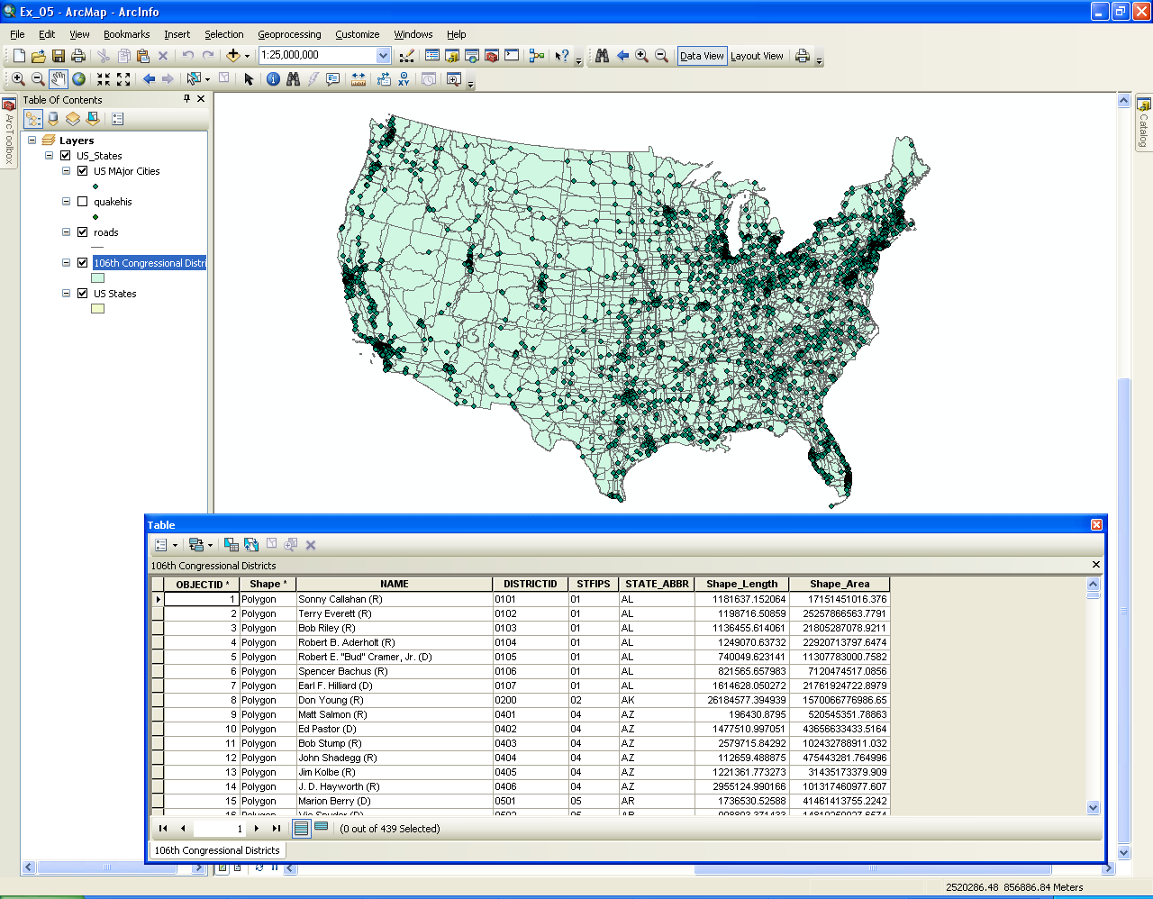
Standard GIS Data Model
Linked spatial and attribute (tabular) data.
Notes:
Each layer typically a 1 to 1 correspondence between each geographic feature and records in the table.

Slide 54
File-based Data Models
Geographic coordinates and attributes
are stored in separate but linked files
Arc
Info
Coverages
Developed for workstation Arc/Info ~ 1980
Complex structure, proprietary format
Attributes in Info tables
Shapefiles
Developed for ArcView ~ 1993
Simpler structure in public domain
Attributes in dBase (.dbf) tables

Slide 55
Storing Data
Coverages
Shapefiles
Maine
Maine
Counties
Counties.shp
Counties.shx
Counties.dbf
MCD
MCD.shp
MCDshx
MCD.dbf
Info

Slide 56
Coverages and Shapefiles
Coverages are stored partially in their own folder and partially in the common INFO folder.
Shapefiles are stored in three to five files (with extensions .shp, .shx, .dbf, .sbx and .sbn).
Coverages store common boundaries between polygons only once, to avoid redundancy.
Shapefiles store all the geometry of each polygon regardless of redundancy.
Coverage features are single lines or single polygons.
Shapefiles allow features to have multiple, disconnected, intersecting and overlapping components.

Slide 57
Geodatabase Model
Stores geographic coordinates as one attribute (shape) in a relational database table
Uses MS Access for “Personal Geodatabase” (single user)
Uses a file system for a “File Geodatabse” (FGDB).
Uses Oracle, Sybase, Ingress or other commercial relational databases for “Enterprise Geodatabases” (many simultaneous users)

Slide 58
There are some differences in queries between shapefiles and geodatabases
"STATE_NAME" LIKE 'Miss%' * in a geodatabase
"OWNER_NAME" LIKE '_atherine smith' ?
UPPER("LAST_NAME") = 'JONES'
UCASE ("LAST_NAME") = 'JONES' geodatabase
"POP2000" IS NULL
"POP2000" IS NOT NULL
"HOUSEHOLDS" > "MALES" * ("POP90_SQMI" + "AREA")

Slide 59
The ArcGIS Geodatabase
Key Characteristics | ArcSDE | File Geodatabase | Personal Geodatabase
Number of Users | Multiuser | Single user & small workgroups | Single userS
Storage Format | Oracle Microsoft SQL Server IBM DB2 IBM Informix | Each dataset is a separate file | Microsoft Access File
Versioning Support | Supported | Not supported | Not supported
Database Administration Tools | Full DBMS functions | File system management | Windows file system management

Slide 60
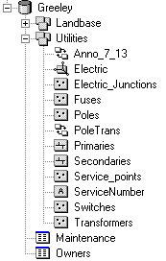
Elements of a Geodatabase
Geometric Network
Feature Dataset
Relationship Class
Feature Class
Annotation Class
Object Class

Slide 61
Elements of a Geodatabase
Objects , Object Classes
Features , Feature Classes
Feature Datasets
Validation Rules, Domains
Relationships , Relationship Classes
Spatial References
Geometric Networks

Slide 62
Objects and Object Classes
An object is an instance of an object class
All objects in an object class have the same properties and behavior
An object can be related to other objects via relationships

Slide 64
Features
Spatial object
Location
Attribute of type Geometry
Spatial relationships
Instance of a feature class

Slide 65
Feature Classes
Same type of geometry
Same type of spatial reference system
Store spatial objects (features)

Slide 66
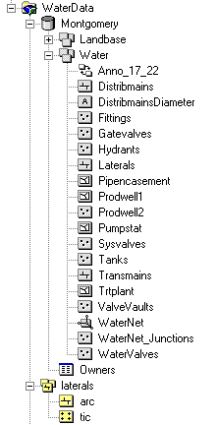
Feature Datasets
Container
Same spatial reference
Analogous to a coverage

Slide 67
Assignment
Read Chapter 8
Problems: 1, 2, 4, 5, 9, 10, 11, 12, 15

