Slide 1

PROJECT DESIGN
aUTOMaTed STUdeNTS
aTTeNdaNCe MaNaGeMeNT
SYSTeM USING bLe TeCHNOLOGY
MEMBERS
MR. JOVIN .J KAMALA
ROBINSON E. ANTHONY

Slide 2
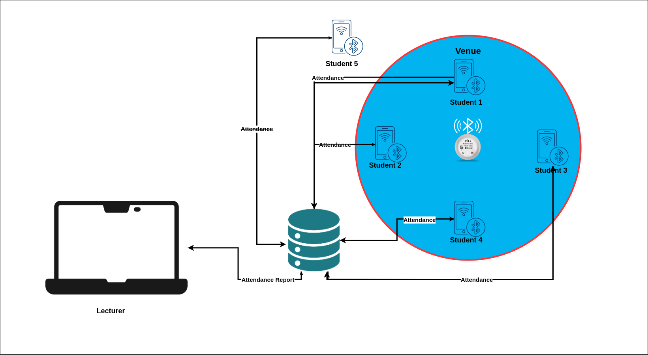
Conceptial diagram

Slide 3

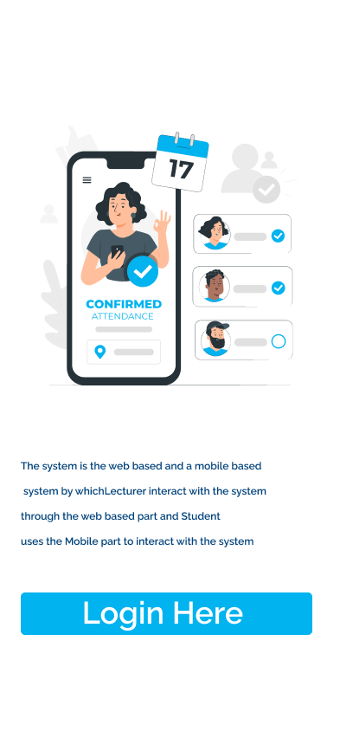
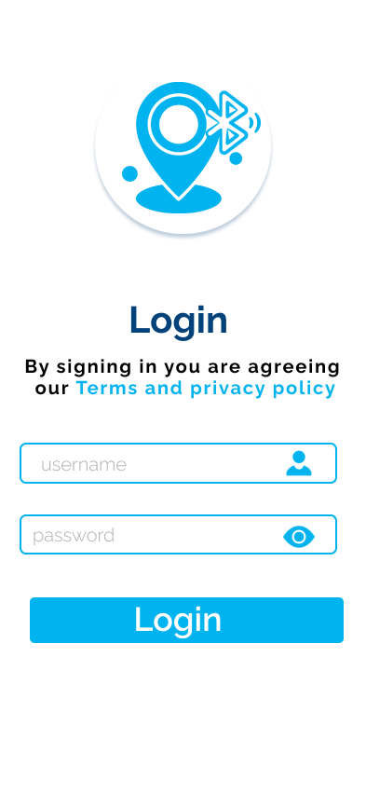
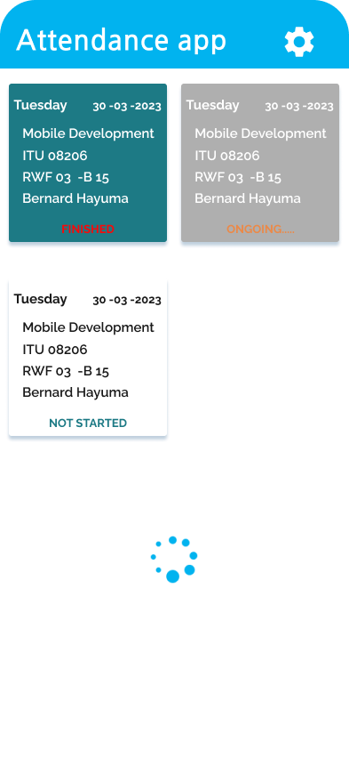
User interface

Slide 4
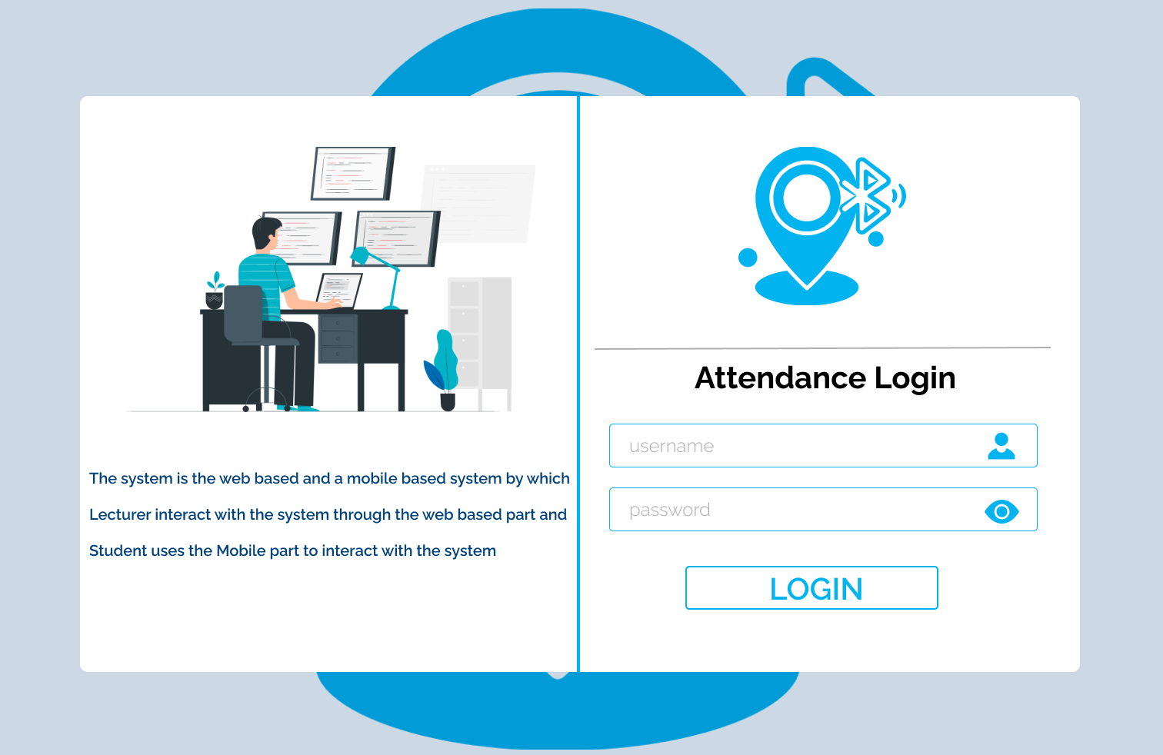
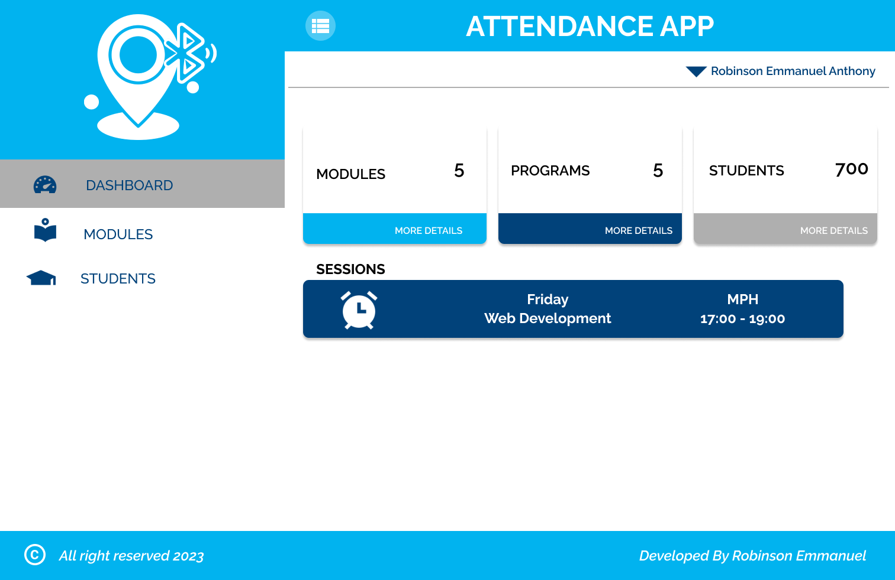
User interface

Slide 5
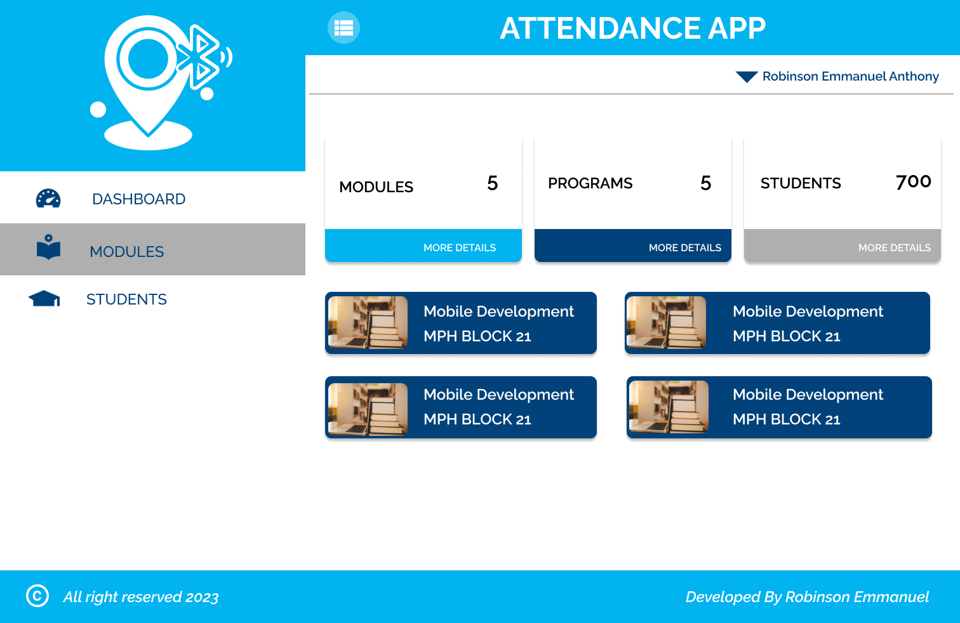
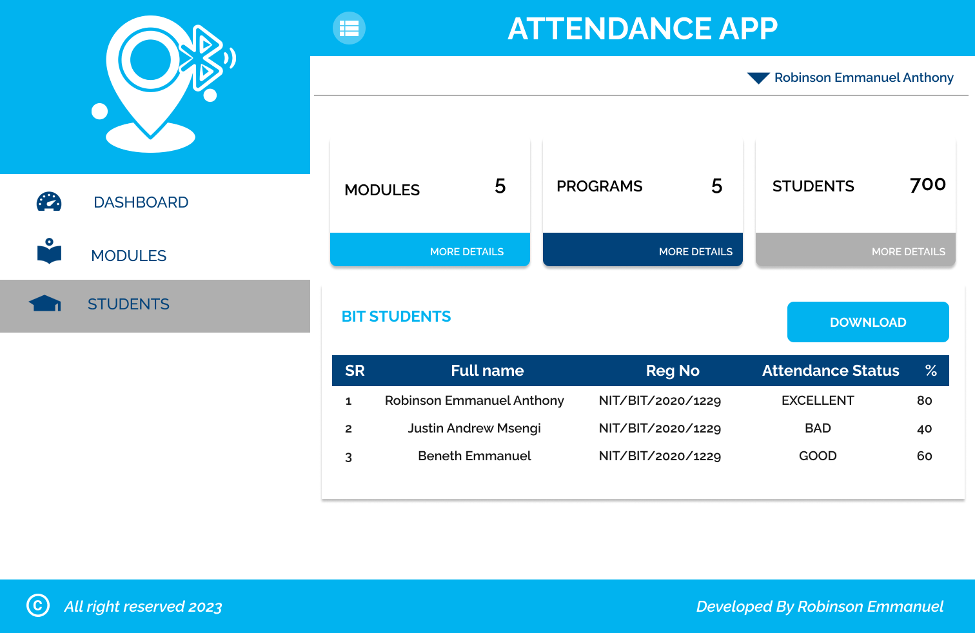
User interface

Slide 6






technologieS

Slide 7
THANK YOU ALL
FOR LISTENING ME

