Slide 1

Django Templates
SoftUni Team
Technical Trainers
Software University
https://softuni.bg

Slide 2
Table of Contents
Templates
Custom Filters
Custom Tags
Template Inheritance
Static Files
2

Slide 3
Have a Question?
sli.do
#python-web

Slide 4

Templates
Generate HTML Dynamically

Slide 5
Django Template
A text document or a Python string marked-up using the Django template language
Django defines a standard API for loading and rendering templates regardless of the backend
Loading consists of finding the template for a given identifier and preprocessing it
Rendering means interpolating the template with context data and returning the resulting string

Slide 6
Django Template Language
It is Django's own template system
Meant to express presentation, not program logic
The syntax involves four constructs
Variables
Filters
Tags
Comments

Slide 7
Variables (1)
Outputs a value from the context (dict-like object)
Variables are surrounded by {{ and }}
The name of a variable:
Cannot have spaces or punctuation characters
May not have a dot in it
May not be a number
Variable attributes that begin with an underscore may not be accessed

Slide 8
Variables (2)
Displaying an information for an employee
Example context
Employee names: {{ first_name }} {{ last_name }}
Department: {{ department }}
Email Adress: {{ email_address }}
context = {
"first_name": "John",
"last_name": "Smith",
"department": "Marketing",
"email_address": "john.smith@company.com"}

Slide 9
Filters
Modifies variables for display
Use a pipe "|" to apply a filter to a variable
Filters can be "chained"
The output of one filter is applied to the next
Some filters take arguments
Use colon ":" to mark arguments
Django provides about sixty built-in template filters

Slide 10
Commonly Used Filters (2)
Converts text to lowercase
Display the first N words of a string
Join list elements
Format a date according to the given format
{{ value|lower }}
{{ value|truncatewords: N }}
{{ list|join:", " }}
Click for more date format strings
{{ my_date|date:"Y-m-d" }}

Slide 11
Commonly Used Filters (1)
If a variable is false or empty, use given default
Otherwise, use the value of the variable
Returns the length of the value (string or list)
Formats the value like a "human-readable" file size
{{ value|default:"nothing" }}
{{ value|length }}
{{ value|filesizeformat }}
More built-in filters: https://docs.djangoproject.com/en/4.0/ref/templates/builtins/#built-in-filter-reference

Slide 12
Tags
A template tag is a function which returns a value to be displayed
Provide custom logic in the rendering process
Surrounded by {% and %}
Most tags accept arguments
Some tags require beginning and ending tags

Slide 13
if Tag (1)
Evaluates a variable, and if that variable is "true" (exists, not empty or not false)
Requires beginning and ending tags
{% if employees_list %}
Number of employees: {{ employees_list|length }}
{% elif selected_candidates %}
Number of candidates {{ selected_candidates|length }}
{% else %}
No employees or candidates!
{% endif %}

Slide 14
if Tag (2)
In it could be used "and", "or" or "not"
Use of both "and" and "or" clauses within the same tag is allowed, with "and" having higher precedence than "or"
Use of parentheses in the if tag is invalid syntax
{% if employees_list and deparments or selected_candidates %}
...
{% endif %}

Slide 15
if Tag (3)
Use operators
"==", "!=", "<", ">", "<=", ">="
"in", "not in", "is", and "is not"
Use filters in the if expression
{% if employees_list|length > 10 %}
...
{% endif %}
More about Boolean operators: https://docs.djangoproject.com/en/3.0/ref/templates/builtins/#boolean-operators

Slide 16
for Tag
Sorry, no athletes in this list.
Requires beginning and ending tags
It can take an optional {% empty %} clause whose text is displayed if the given array is empty or could not be found
{% for employee in employees %}
<li>{{ employee.first_name }}</li>
{% empty %}
<li>No employees in this list.</li>
{% endfor %}

Slide 17
ifchanged Tag
Sorry, no athletes in this list.
Checks if a value has changed from the last iteration of a loop
It is used within a loop
{% for employee in employees_list %}
{% ifchanged %}{{ employee.name }}{% endifchanged %}
{% ifchanged employee.month_of_employment %}
<h1>{{ employee.month_of_employment }}</h1>
{% endifchanged %}
{% endfor %}

Slide 18
csrf_token Tag
Cross-site Request Forgery protection
Used inside the <form> element
Cross-site request forgeries:
type of malicious exploit
unauthorized commands are performed on behalf of an authenticated users
More about Cross-site Request Forgery
18

Slide 19
Comments
Comments are surrounded by {# and #}
A multi-line comment can be written using a {% comment %} tag
{# this is a comment #}
{% comment %}
This is a
multi-line
comment
{% endcomment %}

Slide 20

Custom Filters

Slide 21
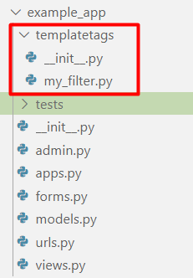
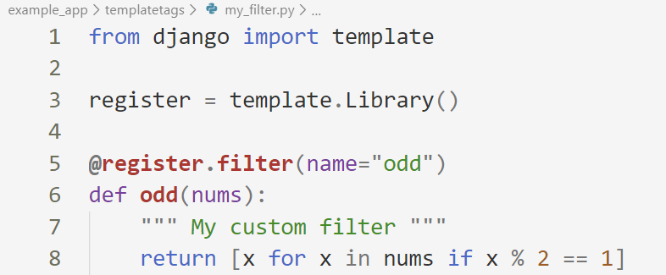
Create templatestags Folder
In your application create a templatestag module with your custom filter file
Write your own filter function

Slide 22
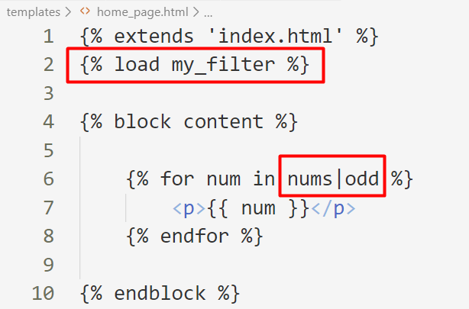
Use Your Custom Filter
Load the filter in your template and use it
Use the name of your file

Slide 23
Custom Tags
{% my_tag %}

Slide 24
Template Tags Helper Functions
Django provides us with helper functions that allow us to create our custom template tags
simple_tag - processes the data and returns a string
inclusion_tag - processes the data and returns a rendered template
assignment_tag - processes the data and sets a variable in the context

Slide 25
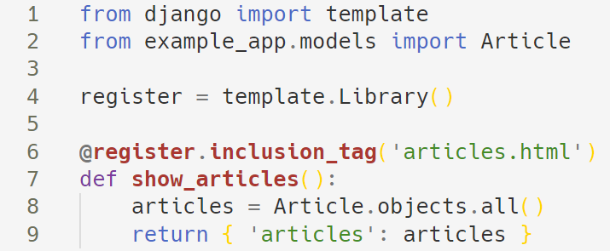
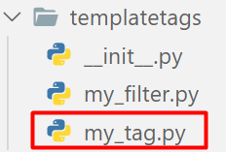
Creating Custom Template Tags
To create a custom template tag, we need again create a templatetags package
Here is an example of an inclusion custom tag

Slide 26
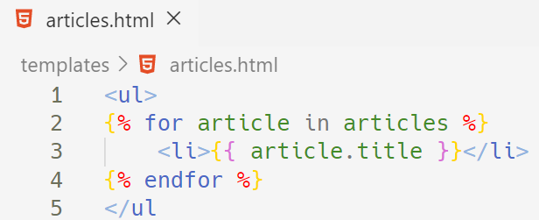
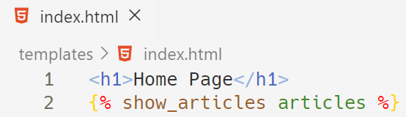
Using the Template Tag
Create the 'article.html' template and make a loop through the articles
After that, use your tag in your main template

Slide 27

Template Inheritance
block, endblock, extends

Slide 28
Template Inheritance
Template inheritance allows us to build a base skeleton template
The base template contains all the common elements and defines blocks that child templates can override
Typically, header, footer etc. remain the same in the whole app
Using template inheritance, we can reuse the common parts of our app

Slide 29
Example: Template Inheritance
base.html
<!DOCTYPE html>
<html lang="en">
<head>
<link rel="stylesheet" href="style.css">
<title>My amazing site</title>
</head>
<body>
{% block content%}
{% endblock %}
</body>
</html>
blogs.html
{% extends "base.html" %}
{% block content %}
{% for entry in blog_entries %}
<h2>{{ entry.title }}</h2>
<p>{{ entry.body }}</p>
{% endfor %}
{% endblock %}

Slide 30
Using include in templates
We can also use the include tag to include an existing template
blogs.html
{% extends "base.html" %}
{% block content %}
{% for entry in blog_entries %}
{% include "blog_header.html" %}
<h2>{{ entry.title }}</h2>
<p>{{ entry.body }}</p>
{% endfor %}
{% endblock %}

Slide 31
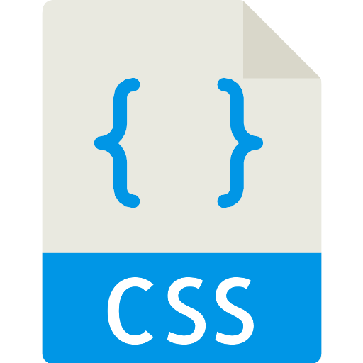
Static Files in Django
Managing Static Files

Slide 32
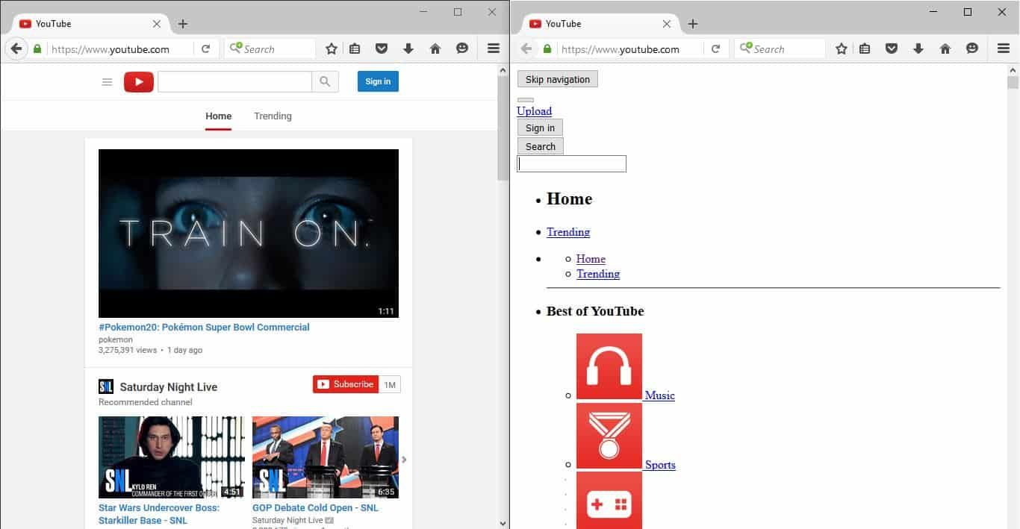
A Word About Static Files
Most of the times, your application would need to serve external files such as JavaScript, CSS, etc.
This type of files are called "static files"
Youtube with and without CSS

Slide 33
Configuring Static Files in Django
First, make sure that your application is in INSTALLED_APPS
Make sure you have STATIC_URL variable
Make sure you have STATICFILES_DIRS variable
STATIC_URL = '/static/'
STATICFILES_DIRS = [
os.path.join(BASE_DIR, 'static'),
]

Slide 34
Using Static Files
To include your CSS for example you will need the following code
To include images, we use the same approach
Path to the CSS file
{% load static %}
<link rel="stylesheet" href="{% static './css/style.css' %}"/>
Path to the image
{% load static %}
<img src="{% static './my_image.png' %}" alt="My image">

Slide 35

Bootstrap
CSS Framework
Developing Responsive
Mobile-first websitesa
Booststrap 4 website
35

Slide 36

Demo
Live Exercises in Class

Slide 37

Summary
Templates are used to generate HTML dynamically
Filters allow us to modify variables before displaying them in the browser
Template tags are functions that returns a value to be displayed
Template inheritance allows us to build a base skeleton template

Slide 38
Questions?
Notes:
38

Slide 39











SoftUni Diamond Partners

Slide 40


Educational Partners

Slide 41

License
This course (slides, examples, demos, exercises, homework, documents, videos and other assets) is copyrighted content
Unauthorized copy, reproduction or use is illegal
© SoftUni – https://softuni.org
© Software University – https://softuni.bg
Notes:
41

Slide 42
Trainings @ Software University (SoftUni)
Software University – High-Quality Education, Profession and Job for Software Developers
softuni.bg, softuni.org
Software University Foundation
softuni.foundation
Software University @ Facebook
facebook.com/SoftwareUniversity
Software University Forums
forum.softuni.bg
42
Notes:
42

