Slide 1

Internet and HTTP
SoftUni Team
Technical Trainers
Software University
https://softuni.bg

Slide 2
Table of Contents
Introduction to Internet
Important Definitions
HTTP Basics
URL
Tools for Developers
MIME
HTTP Request and HTTP Respond

Slide 3
Have a Question?
sli.do
#python-web

Slide 4

Introduction
An Introduction to the Internet

Slide 5
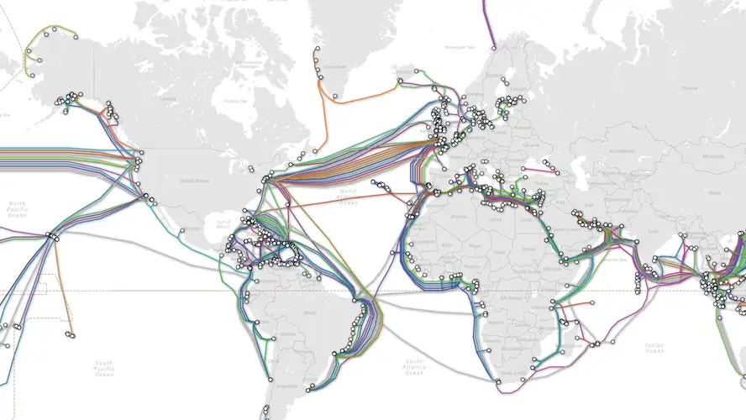
What is the Internet?
Vast network that connects billions of devices together all over the globe
Through fiber optics, copper, satellites or cell phone network
We get indirectly connected though ISPs (Internet Service Providers)

Slide 6
Networks and Internet
Network is a group of two or more devices that can communicate
The internet is made of hundreds of thousands of networks
These different systems connect to each other, communicate with each other and work together because of standards for how data is sent

Slide 7



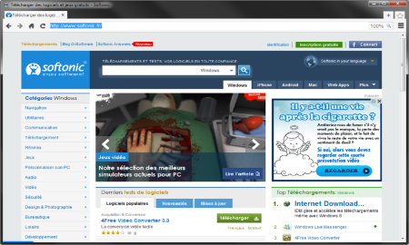





Web Server Work Model
Web Client
Web Server
Technology
Request
Response
Web Resources
Database
HTML, PDF, JPG…

Slide 8

Important Definitions

Slide 9

Servers and Clients
Servers are the machines that provide services to other machines
Clients are the machines that are used to connect to those services

Slide 10

Network Protocol
Set of rules and standards, that allow communication between network devices
Include mechanisms for devices to identify and make connections with each other
Example for standard network protocols:
TCP, UDP, IP, ARP
HTTP, FTP, TFTP, SMPT, SSH

Slide 11
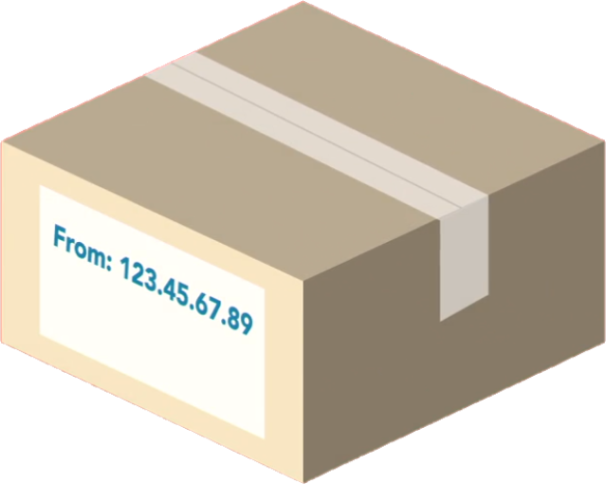
Packets
Every message, file or stream of information sent over computer networks is broken down into small chunks called packets
Each packet contains important information inside of it called a header:
Contents
Origin
Destination

Slide 12


Internet Protocol (IP)
All the devices on the Internet have IP Addresses
Each IP address is unique to each computer or a device at the edge of the network
IP Address:
192.168.10.5
IP Address:
192.168.0.1

Slide 13
IP Address
An IP Address has many parts, organized in a hierarchy
This version of IP Addressing is called IPv4
Provides more than 4 billion 32 bits unique addresses
Subnetworks
192.168.14.120
Device address

Slide 14
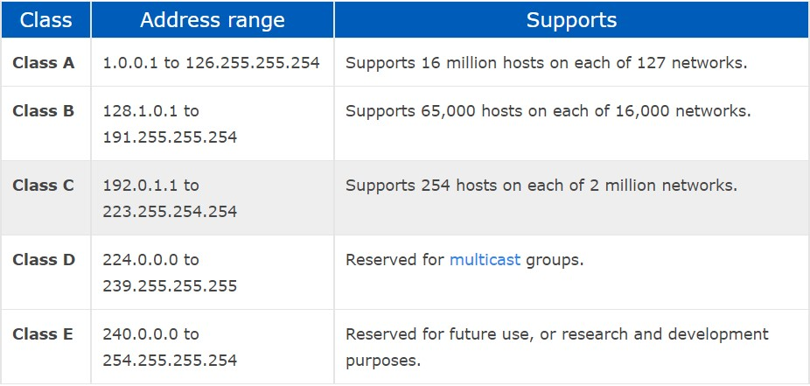
IP address classes

Slide 15
Classless Inter-Domain Routing
CIDR is an IP addressing scheme that improves the allocation of IP addresses
Replaces the old system based on classes A, B, and C
Helps greatly extend the life of IPv4
CIDR | IP address range | Class
10.0. 0.0/8 | 10.0. 0.0 – 10.255. 255.255 | A
172.16. 0.0/12 | 172.16. 0.0 – 172.31. 255.255 | B
192.168. 0.0/16 | 192.168. 0.0 – 192.168. 255.255 | C

Slide 16
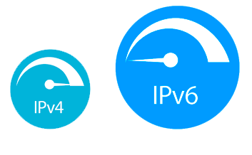
IPv6
IPv6 uses 128 bits
Example of a full IPV6 address:
3FFE:F200:0234:AB00:0123:4567:8901:ABCD
The leading zeros can usually be left out
Provides about 340 undecillion unique addresses

Slide 17
Domain Name Server
The domain name is a human way to access IP addresses for devices and websites around the world
When a domain name is entered in the browser, a request is made the DNS
IP Address | Domains
216.58.214.46 | Google.com
217.174.159.195 | Softuni.bg

Slide 18


Transmission Control Protocol (TCP)
Designed to send packets across the internet and ensure the successful delivery of data and messages over networks
Uses a process, where it looks at all the packets in a message and checks them
TCP verifies that all the packets are:
In the right order
Free of any issues
After that it certifies the data, and the packets are merged to recreate the original file that was on the sender's device

Slide 19

TCP vs UDP
TCP places reliability in a higher priority than speed
For instances where reliability isn't as important, but speed is, there is another protocol called UDP (User Datagram Protocol)
UDP doesn't do excessive reliability checks, but it can send information at a faster rate

Slide 20
Open System Interconnect Model
OSI Model consists of 7 layers
Each layer serves the layer above it and in return, it is served by the layer below it
Understanding each layer of the model helps us with:
Troubleshooting
Communicating better with technical and non-technical individuals about any system

Slide 21
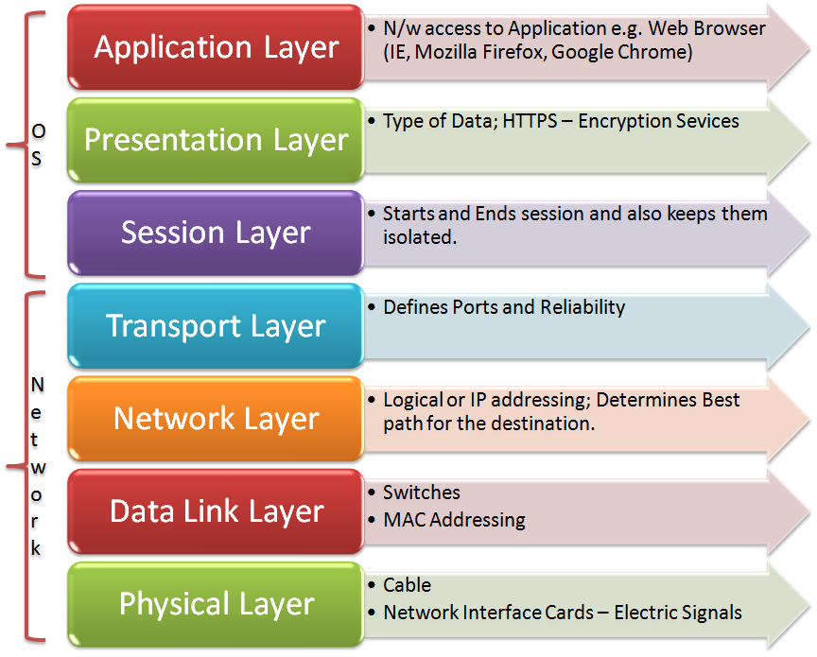
OSI Layers
OSI Model consists of 7 layers:
Example Protocols
HTTP, DNS, FTP, SMTP
TLS, SSL, compression
NetBIOS, PPTP, Sockets
TCP, UDP
IP, IPsec
ATM, Ethernet, MAC, LLC
USB, Bluetooth, 802.11a/b/g/n

Slide 22
Basic Hardware Components
Cables - transfer data from one device to another
Routers - transfer data packets between different computer networks (operates on level 3 of OSI)
Repeaters, Hubs and Switches - connect network devices together so that they can function as a single segment
Network Interface Card (NIC) - computer component that connects the device to the network

Slide 23
HTTP Basics
http://
Web Communication Explained

Slide 24


Hyper Text Transfer Protocol
Request
Response
HTTP
HTTP
TCP
TCP
IP
IP
Ethernet
Media (wires / air / fiber)
Ethernet
Notes:
HTTP == Hyper Text Transfer Protocol
Client-server protocol for transferring Web resources (HTML files, images, styles, scripts, data, etc.)
The widespread protocol for Internet communication today
Request-response model (client requests, server answers)
Text-based format (human readable)
Relies on unique resource URLs
Provides resource metadata (e.g. encoding)
Stateless (cookies and Web storages can overcome this)

Slide 25
HTTP Request Methods
Method | Description
POST | Create / store a resource
GET | Read / retrieve a resource
PUT | Update / modify a resource
DELETE | Delete / remove a resource
Other HTTP Methods
CONNECT
HEAD
OPTIONS
TRACE
The four basic functions of persistence storage.

Slide 26
HTTP Conversation: Example
GET /courses/javascript HTTP/1.1
Host: www.softuni.bg
User-Agent: Mozilla/5.0
<CRLF>
HTTP request:
HTTP response:
The empty line denotes the end of the request headers
HTTP/1.1 200 OK
Date: Mon, 5 Jul 2010 13:09:03 GMT
Server: Microsoft-HTTPAPI/2.0
Last-Modified: Mon, 12 Jul 2014 15:33:23 GMT
Content-Length: 54
<CRLF>
<html><title>Hello</title>
Welcome to our site</html>
The empty line denotes the end of the response headers

Slide 27
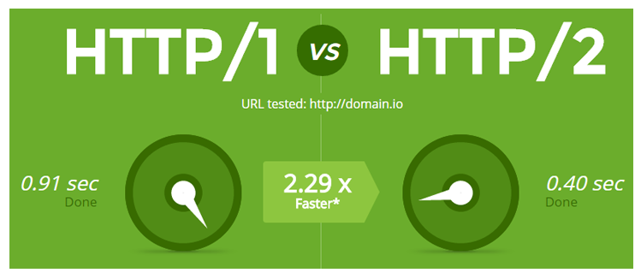
What's HTTP/2.0
Major revision of the HTTP network protocol used by the World Wide Web
Supported by most of the popular web browsers
Fast and optimized, meets modern web usage requirements
Completely Backwards-Compatible
As of Jan 2021, almost 50% of all the websites support HTTP/2 (W3Techs statistics).

Slide 28

URL
Uniform Resource Locator

Slide 29
Uniform Resource Locator (URL)
A URL is a reference to a web resource that specifies its location on a network and a mechanism for retrieving it
A URL is a specific type of URI (Uniform Resource Identifier)
http://localhost:8080/demo/index.html?id=27&lang=en#lecture
Protocol
Host
Port
Path
Query String
Fragment

Slide 30
URL Encoding
URLs are encoded according RFC 1738:
Safe URL characters: [0-9a-zA-Z], $, -, _, . , +, *, ', (, ), ,, !
All other characters are escaped by:
Space is encoded as "+" or "%20"
URL-encoded string:
Char | URL Encoding
space | %20
щ | %D1%89
" | %22
# | %23
$ | %24
% | %25
& | %26
%[character hex code]
Наков-爱-SoftUni
%D0%9D%D0%B0%D0%BA%D0%BE%D0%B2-%E7%88%B1-SoftUni

Slide 31

Tools for Developers
Dev Tools

Slide 32
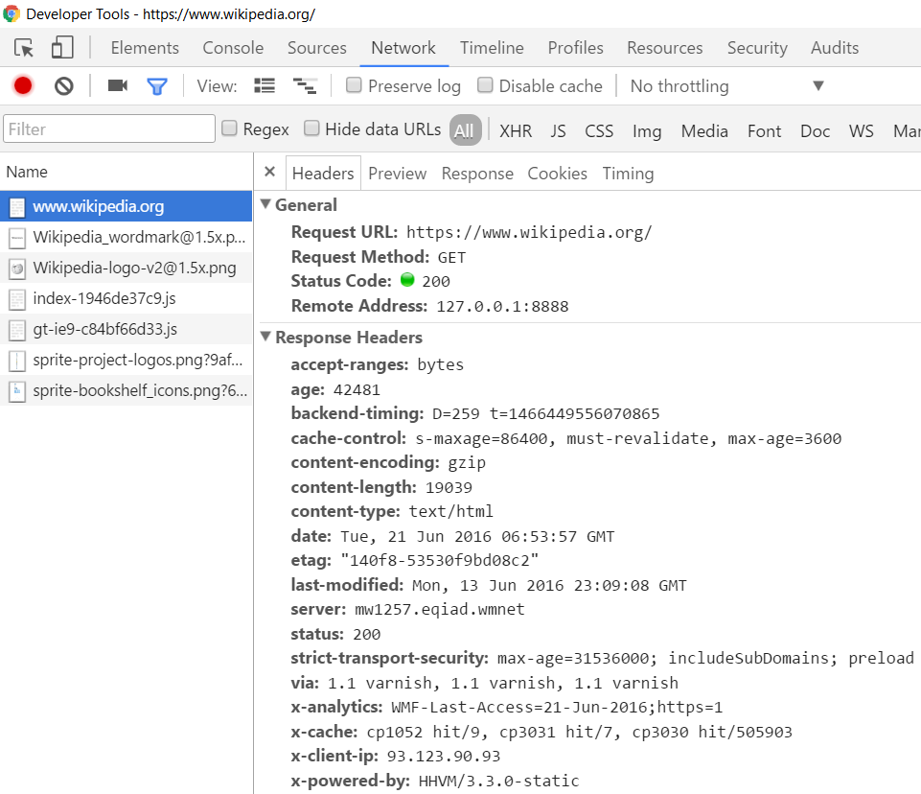
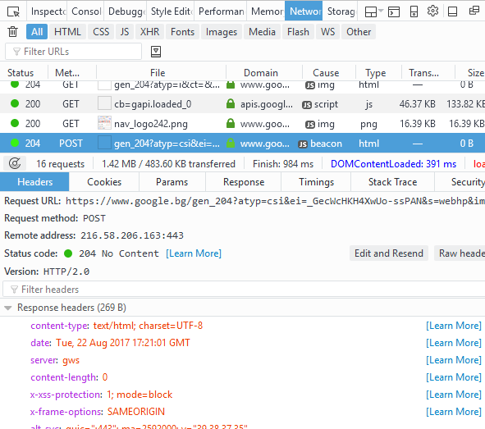
Tools for Developers – Browser Dev Tools
Chrome Developer Tools
Mozilla Developer Tools

Slide 33

Tools for Developers – Browser Add-ons
</>
Postman - Chrome
Rested - Firefox

Slide 34

Multi-Purpose Internet Mail Extensions
MIME and Media Types

Slide 35
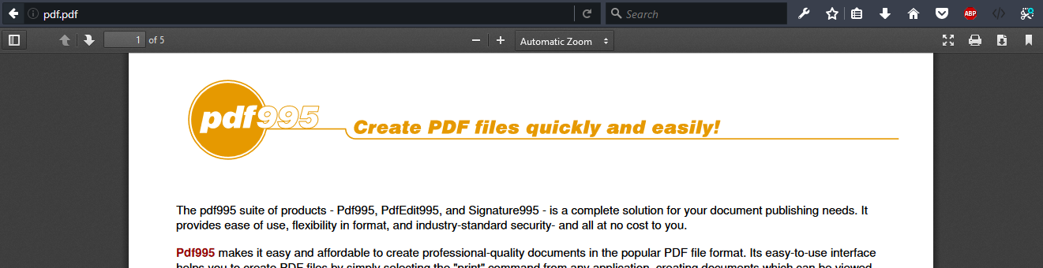
What is MIME?
MIME == Multi-Purpose Internet Mail Extensions
Internet standard for encoding resources
Originally developed for email attachments
Used in many Internet protocols like HTTP and SMTP

Slide 36
Common MIME Media Types
MIME Type / Subtype | Description
application/json | JSON data
image/png | PNG image
image/gif | GIF image
text/html | HTML
text/plain | Text
text/xml | XML
video/mp4 | MP4 video
application/pdf | PDF document

Slide 37
HTTP Request / HTTP Respond

Slide 38
HTTP Request Message
Request message sent by a client consists of:
HTTP request line
Request method (GET / POST / PUT / DELETE / …)
Resource URI (URL)
Protocol version
HTTP request headers
Additional parameters
HTTP request body – optional data e.g., posted form fields
<method> <resource> HTTP/<version>
<headers>
(empty line)
<body>

Slide 39
GET Request Method – Example
<form method="get">
Name: <input type="text" name="name" />
Age: <input type="text" name="age" />
<input type="submit" />
</form>
HTTP request line
GET /HTTP/1.1
Host: localhost
<CRLF>
HTTP request headers
The request body is empty

Slide 40
POST Request Method – Example
The POST method transfers data in the HTTP body
POST can send text and binary data e.g., upload files
HTTP request line
POST /login HTTP/1.1
Host: localhost
Content-Length: 59
<CRLF>
username=mente&password=top*secret!
<CRLF>
HTTP request headers
The request body holds the submitted form data

Slide 41
HTTP Response Message
The response message sent by the HTTP server consists of:
HTTP response status line
Protocol version
Status code
Status text
Response headers
Provide meta data about the returned resource
Response body
The content of the HTTP response (data)
HTTP/<version> <status code> <status text>
<headers>
<CRLF>
<response body – the requested resource>

Slide 42
HTTP Response Codes
HTTP response code classes
1xx: informational (e.g., "100 Continue")
2xx: successful (e.g., "200 OK", "201 Created")
3xx: redirection (e.g., "304 Not Modified", "301 Moved Permanently", "302 Found")
4xx: client error (e.g., "400 Bad Request", "404 Not Found", "401 Unauthorized", "409 Conflict")
5xx: server error (e.g., "500 Internal Server Error", "503 Service Unavailable")

Slide 43
HTTP Response – Example
Example of HTTP response from the Web server:
HTTP response status line
HTTP/1.1 200 OK
Date: Fri, 17 Jul 2010 16:09:18 GMT+2
Server: Apache/2.2.14 (Linux)
Accept-Ranges: bytes
Content-Length: 84
Content-Type: text/html
<CRLF>
<html>
<head><title>Test</title></head>
<body>Test HTML page.</body>
</html>
HTTP response headers
HTTP response body

Slide 44
HTTP Response – Example
Example of HTTP response with error result:
HTTP/1.1 404 Not Found
Date: Fri, 17 Nov 2014 16:09:18 GMT+2
Server: Apache/2.2.14 (Linux)
Connection: close
Content-Type: text/html
<CRLF>
<HTML><HEAD><TITLE>404 Not Found</TITLE></HEAD>
<BODY>
<H1>Not Found</H1>
The requested URL /img/logo.gif was not found on this server.<P> <HR><ADDRESS>Apache/2.2.14 Server at Port 80</ADDRESS>
</BODY></HTML>
HTTP response status line
HTTP response headers
The HTTP
response body

Slide 45
Browser Redirection
HTTP GET requesting a moved URL:
The following HTTP response (301 Moved Permanently) tells the browser to request another URL:
GET / HTTP/1.1
Host: http://softuni.org
User-Agent: Gecko/20100115 Firefox/3.6
<CRLF>
HTTP/1.1 301 Moved Permanently
Location: http://softuni.bg
...

Slide 46
Content-Type and Disposition
With Content-Type response header the server specifies how the output should be processed
Examples:
UTF-8 encoded HTML page. Will be shown in the browser.
Content-Type: text/html; charset=utf-8
Content-Type: application/pdf
Content-Disposition: attachment; filename="Report-April-2016.pdf"
This will download a PDF file named Report-April-2016.pdf

Slide 47

Summary
…
…
…
Internet, Definitions of Internet
Sending and Receiving Information
What is HTTP
What is URL
Browser Tools for Developers
What is MIME

Slide 48
Questions?
Notes:
48

Slide 49











SoftUni Diamond Partners

Slide 50


Educational Partners

Slide 51
Trainings @ Software University (SoftUni)
Software University – High-Quality Education, Profession and Job for Software Developers
softuni.bg, about.softuni.bg
Software University Foundation
softuni.foundation
Software University @ Facebook
facebook.com/SoftwareUniversity
Software University Forums
forum.softuni.bg
Notes:
51

Slide 52

License
This course (slides, examples, demos, exercises, homework, documents, videos and other assets) is copyrighted content
Unauthorized copy, reproduction or use is illegal
© SoftUni – https://about.softuni.bg/
© Software University – https://softuni.bg
Notes:
52

