Slide 1
📊 Sales & Order Analysis
Power BI
Kaggle Sales Forecasting Dataset

Slide 2
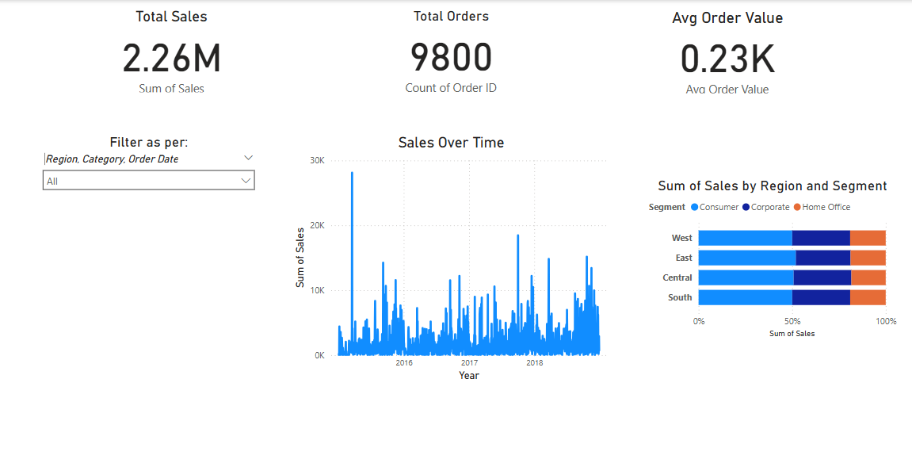
🔢 Key KPIs
• Total Sales: 2.26M
• Total Orders: 9,800
• Average Order Value: 0.23K

Slide 3
📈 Visual Overview

Slide 4
🔍 Key Insights
Sales peak seasonally (notable spikes in 2015 and 2017)
Consumer segment leads across all regions
West and East regions bring in most revenue
Average order value remains steady across time
Consistent growth trend signals stable demand

Slide 5
🚀 What’s Next?
• Incorporate profit metrics once available
• Predict future sales trends using forecasting models
• Analyze customer behavior with segmentation
• Design an executive summary report for stakeholders

