Slide 1
UNC - Schedule
A proactive solution to an underlying issue

Slide 2

Problem
The current process of schedule generation is:
Outdated
Time consuming
Tedious

Slide 3
How much time do you waste finding the perfect schedule?

Slide 4
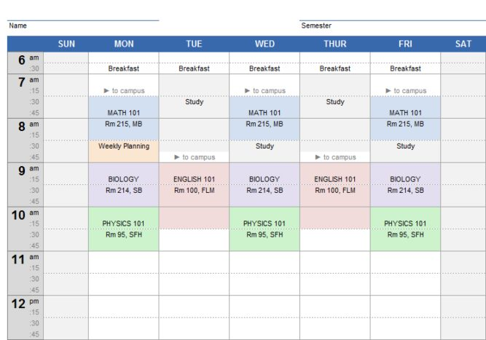
Idea
We propose that through access of SeaNet, our group will possess the power to generate schedule permutations custom to each student

Slide 5
Solution
A web application where users can access a list of classes and choose their optimal schedule.
Stress Less
Enjoy More
Save Time

Slide 6

Competitors
To our knowledge, there is no working software created specifically for UNCW students that enables students a stress ease experience to generate a schedule

Slide 7

Market
This target audience for our product is you
We want our site to be a dynamic experience that only we can offer

Slide 8
Our Team
Our team is full of individuals able to create and deploy a dynamic website that is suitable for a Capstone course in CS
Mark Thompson
Will design the backend logic, and how to parse the data for our structures
Chase Robison
Front end oriented
Capable of creating an interactive front end
Dakota Perryman
Will design the application and map the interactions between Databases, Backend Logic, and the Front End
Acting as a Full Stack Developer

Slide 9
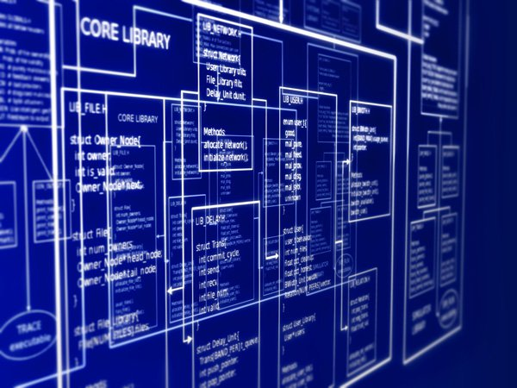
Design
Time permitting, and with agile design, our team would like to create an application that will be able to work with every school in the UNC system.

Slide 10
Questions?

