Slide 1

Game club submission plan (Game name undetermined)
Concept art

Slide 2
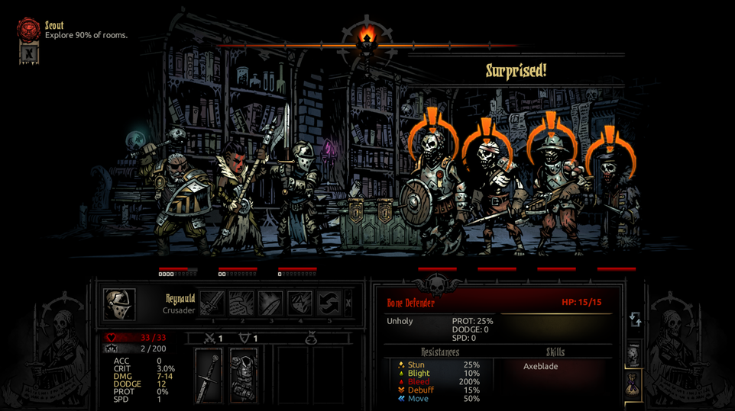
Game?
Concept | According to a randomly determined fate A game to compete for one of the seven deadly sins
Genre | Horror, 3D side scrolling, Real Time battle, Roguelike
View | Side View
Play Time | 1h
Reference Game : Darkest Dungeon

Slide 3

Game Logic
Red – Not a priority
Game Start
Preferences Button
Preferences
Perferences
Game Load
New Game
Volume
Credit
Controller Setting
Player Story Setting
BaseCamp System
BaseCamp
tutorial
Shop Level
Shop
Storage
Recruit Colleagues
Hotel
Dungeon Records
Go Dungeon
Buy/Sell
Bag, warehouse organization
Colleagues' stories and appearances
Recover from fatigue
Battle
Dungeon Progression
Dungeon Clear Reward
Dungeon Clear
If - you filled in the necessary story
If you can't clear it within the given day
Last Boss
Dead
Last Select
Ending Credit

Slide 4
Game Controller Logic
Given that it's a controller, it would be beneficial to utilize gambling mechanisms wherever possible. Below are places where the controller can be utilized (more to be added).
BaseCamp System
Recruit Colleagues
Hotel
Battle
Colleagues' stories and appearances
Recover from fatigue

Slide 5
Karma System 1
Red – Not a priority
The ending changes according to karma. There are four types of karma: Desire, Sloth, Anger, Pride.
Game Start
Perferences
Game Load
New Game
Karma rises according to the player's story
If you release a colleague, Pride up
Player Story Setting
BaseCamp System
BaseCamp
tutorial
Go Dungeon
Karma increases depending on foundation selection
Shop Level
Shop
Storage
Recruit Colleagues
Hotel
Dungeon Records
Buy/Sell
Bag, warehouse organization
Colleagues' stories and appearances
Recover from fatigue
Battle
Dungeon Progression
Karma increases when a colleague dies
Dungeon Clear Reward
Desire up
Sloth up
Dungeon Clear
Karma increases depending on battle style
Karma increases according to the stories of colleagues
If - you filled in the necessary story
Last Boss
Last Select
Ending Credit

Slide 6




Karma System 2
Each type of karma varies and increases according to the player's tendencies and gameplay.
Rising conditions
[Sloth Karma] – When using the lodging system, ignoring options in multiple-choice scenarios, etc.
[Pride Karma] – Dismissing companions or sending the same character into battle consecutively, mocking options in multiple-choice scenarios, etc.
[Desire Karma] – Making consecutive purchases at stores, consuming potions consecutively, offering help in multiple-choice scenarios, etc.
[Anger Karma] – Incapacitation or death occurring, looting in multiple-choice scenarios, etc.
[Common Karma] – Recruiting companions can increase specific types of karma based on the companion's story, etc.

Slide 7
Convenience
System Plan
Red – Not a priority
Skill Setting
Basic
(Max Skill Level5)
System Setting
Save/Load
Enforce
Ability level settings
Skill Setting
Training System
combination system
disassembly system
expedition system
Store
Storage
Bag
Recruit Colleagues
Remove Attribute
Remove status abnormality
Hotel System
Battle
Dungeon Records
Ready to explore

Slide 8
MainScreen
UI/UX Plan
Red – Not a priority
Game Name
If there is no data to proceed with, the text on the left side will be displayed.
Please press any button
New Game
Load Game
16:9

Slide 9
Preferences
UI/UX Plan
Red – Not a priority
Preferences
Volume Setting
Controller Setting
Credit
16:9

Slide 10
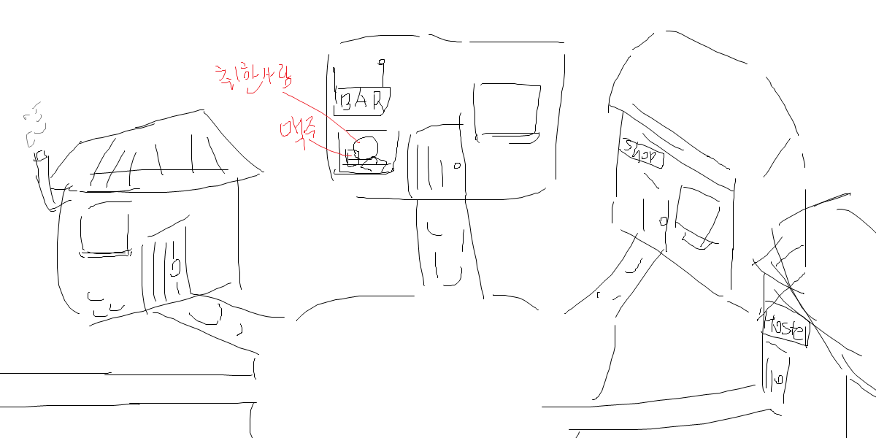
Base Camp
Pressing "Current Party" allows for party switching.
UI/UX Plan
Red – Not a priority
Current Party
Current Story
Face
Colleagues Name
Face
Colleagues Name
Current Days
Remaining days
Face
Colleagues Name
Dungeon Records
Face
Colleagues Name
Ready to explore
Money
Current Karma Level
Smithy
Church
Storage
Store
Recruit Colleagues
Training
Hotel
16:9

Slide 11
BaseCamp Storage
UI/UX Plan
Red – Not a priority
Bag
Bag Openned
Presses ESC to BaseCamp
Organize items with Tetris like Tarkov
Sword
Boa
R
d
Bow
When an item is clicked and the right mouse button is pressed, the object will rotate.
Shield
Table
Defult Bag size
5x5
Defult Storage size
10x10
Upgradable in the future
16:9

Slide 12
BaseCamp Store Buy
UI/UX Plan
Red – Not a priority
Buy
Sell
Store Human
Presses ESC to BaseCamp
Price
Price
Price
Bar Table
Price
Price
Price
Level
Gauge
16:9

Slide 13
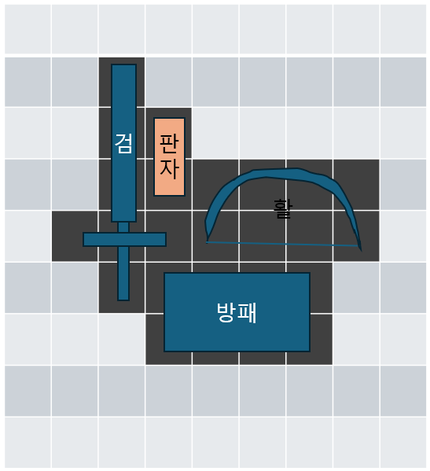
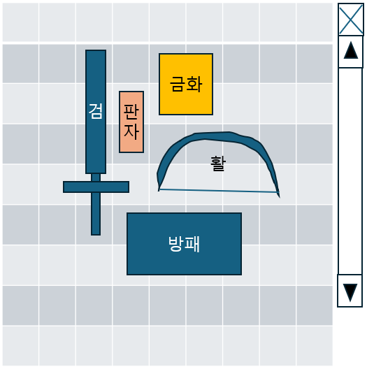
BaseCamp Store Sell
UI/UX Plan
Red – Not a priority
Buy
Sell
Store Human
Presses ESC to BaseCamp
When selected, the selected object becomes darker
Price
Bar Table
Level
Gauge
16:9

Slide 14
BaseCamp Recruit Colleagues 1
UI/UX Plan
Red – Not a priority
Have Money
222
Presses ESC to BaseCamp
Select !
Need Money: 222
(Each time you press the required amount increases.)
16:9

Slide 15
BaseCamp Recruit Colleagues 2
UI/UX Plan
Red – Not a priority
Roll Dice!
First Story
Solid Soul
Fast Soul
Shining Soul
16:9

Slide 16
BaseCamp Recruit Colleagues 3
UI/UX Plan
Red – Not a priority
Roll Dice!
Second Story
In his past life he was blah blah
In his past life he was blah blah
In his past life he was blah blah
16:9

Slide 17
BaseCamp Recruit Colleagues 4
UI/UX Plan
Red – Not a priority
Roll Dice!
Third Story
In his past life, his job was blah blah
In his past life, his job was blah blah
In his past life, his job was blah blah
16:9

Slide 18
BaseCamp Recruit Colleagues 5
UI/UX Plan
Red – Not a priority
Colleagues
Rating: C B A S
Colleagues Story
In his past life he was blah blah, job was blah blah and now his coming for you
OK button
16:9

Slide 19
BaseCamp Hotel
UI/UX Plan
Red – Not a priority
Hotel Human
Face
Face
Face
Face
Face
Face
Presses ESC to BaseCamp
Fatigue:43%
Fatigue:23%
Fatigue:23%
Fatigue:43%
Fatigue:23%
Fatigue:23%
Face
Face
Face
Face
Face
Face
Fatigue:43%
Fatigue:23%
Fatigue:23%
Fatigue:43%
Fatigue:23%
Fatigue:23%
Colleagues
Current Fatigue: 78%
Number of days needed for full recovery: 2days
Colleagues
Current Fatigue: 24%
Number of days needed for full recovery: 1days
Bar Table
Colleagues
16:9

Slide 20
BaseCamp Traning
UI/UX Plan
Red – Not a priority
Traning Human
Face
Face
Face
Face
Face
Face
Presses ESC to BaseCamp
Trainable
possible
possible
Trainable
Trainable
possible
Face
Face
Face
Face
Face
Face
Trainable
possible
possible
Trainable
Trainable
possible
Colleagues
Skill Traning.. Days Remaining: 1days
Colleagues
Skill Taning.. Days Remaining: 2days
Wood Table
Colleagues
16:9

Slide 21
BaseCamp Traning Traning Start
UI/UX Plan
Red – Not a priority
Traning Human
Face
Face
Face
Face
Face
Face
Trainable
possible
possible
Trainable
Trainable
possible
Face
Face
Face
Face
Face
Face
Presses ESC to BaseCamp
Trainable
possible
possible
Trainable
Trainable
possible
Back
Ability Training:
Skill Training:
Ability Point + 2
Random Skill Lv+1
Wood Table
number of days needed:
2days
16:9

Slide 22
BaseCamp Dungeon Records
UI/UX Plan
Red – Not a priority
2-day Dungeon Records
Human
Clear Time: 15m 12s
Use item: (item)x2 (item)x1
Get item: (item)x3 (item)x1 (item)x1
Presses ESC to BaseCamp
Party Status
Face
Face
Face
Face
Fatigue:43%
Str+1
Fatigue:23%
(Skill)+1
Fatigue:23%
Dex+1
Dead
1-day Dungeon Records
Clear Time : 18m 1s
Use item: (item)x1 (item)x1
Get item: (item)x4 (item)x1 (item)x2
Bar Table
Party Status
16:9

Slide 23
BaseCamp Party Setting
UI/UX Plan
Red – Not a priority
Colleagues
Colleagues
Colleagues
Colleagues
Presses ESC to BaseCamp
When a desired part is clicked in the current equipment, the player's inventory opens.
When a skill is acquired, the outline of the companion box glows.
Pressing the companion at the bottom right and then the companion above it will swap their positions.
Colleagues
Name
Current Equipment
Face
Face
Face
Face
Rating
Head
Type
Left Hand
Body
Right Hand
Fatigue:43%
Fatigue:23%
Fatigue:23%
Fatigue:43%
Face
Face
Face
Skill
Leg
ability Setting
Fatigue:23%
Fatigue:23%
Fatigue:23%
Settles
16:9

Slide 24
BaseCamp Party Setting Equipment Setting
UI/UX Plan
Red – Not a priority
Colleagues
Colleagues
동료
동료
Presses ESC to BaseCamp
Colleagues
Name
Current Equipment
동료얼굴
동료얼굴
동료얼굴
동료얼굴
Rating
Head
Type
Left Hand
Body
Right Hand
피로도:43%
피로도:23%
피로도:23%
피로도:43%
동료얼굴
동료얼굴
동료얼굴
Skill
Leg
ability Setting
피로도:23%
피로도:23%
피로도:23%
Settles
16:9

Slide 25
BaseCamp Party Setting ability Setting
UI/UX Plan
Red – Not a priority
Colleagues
Colleagues
동료
ability
Back
동료
STR
7
Remaining ability points
DEX
5
Story
LUK
5
Settles
Presses ESC to BaseCamp
Colleagues
Name
Current Equipment
동료얼굴
동료얼굴
동료얼굴
Cancel
INT
3
동료얼굴
Rating
Head
ATK 12 – 24
DEF 4 – 7
HIT 60 – 80
HP 20/20
MP 10/10
Type
Left Hand
Body
Right Hand
피로도:43%
피로도:23%
피로도:23%
피로도:43%
동료얼굴
동료얼굴
동료얼굴
Skill
Leg
ability Setting
피로도:23%
피로도:23%
피로도:23%
Settles
16:9

Slide 26
BaseCamp Party Setting Skill
UI/UX Plan
Red – Not a priority
Colleagues
Colleagues
동료
동료
Back
Skill
Skill Setting
Skill
Skill description, Damage
Skill Level:1 (4/10)
Skill
Skill description, Damage
Presses ESC to BaseCamp
Skill Level:2 (2/20)
Colleagues
Name
Current Equipment
동료얼굴
동료얼굴
동료얼굴
동료얼굴
Rating
Head
Skill
Skill description, Damage
Skill Level:4 (3/40)
Type
Left Hand
Body
Right Hand
피로도:43%
피로도:23%
피로도:23%
피로도:43%
동료얼굴
동료얼굴
동료얼굴
Skill
Skill
Skill description, Damage
Leg
ability Setting
Skill Level:5
피로도:23%
피로도:23%
피로도:23%
Settles
16:9

Slide 27
BaseCamp Party Setting Skill Acquisition
UI/UX Plan
Red – Not a priority
Colleagues
Colleagues
Back
Skill Acquisition
Face
Skills Acquired
Description of acquired skill, Damage
Presses ESC to BaseCamp
Colleagues
Name
Current Equipment
Have Skill
Have Skill
Rating
Head
Skill Level:1 (4/10)
Skill Level:2 (2/20)
Type
Left Hand
Body
Right Hand
Have Skill
Have Skill
Are you sure you want to change it?
Skill
Leg
Skill Level:4 (3/40)
Skill Level:5
Y/N
ability Setting
Cancel
Settles
Are you sure you want to cancel?
Settles
Y/N
16:9

Slide 28
BaseCamp Party Setting Story
UI/UX Plan
Red – Not a priority
Colleagues
Colleagues
동료
동료
Back
ability
Story
Presses ESC to BaseCamp
Colleagues
Name
Current Equipment
동료얼굴
동료얼굴
동료얼굴
동료얼굴
Rating
Head
Type
Left Hand
Body
Right Hand
피로도:43%
피로도:23%
피로도:23%
피로도:43%
동료얼굴
동료얼굴
동료얼굴
Skill
Leg
ability Setting
피로도:23%
피로도:23%
피로도:23%
Settles
16:9

Slide 29
Ready to explore Dungeon Select
UI/UX Plan
Red – Not a priority
First Map
blah blah
Second Map
blah blah
Third Map
blah blah
Cancel
Settles
16:9

Slide 30
Battle
UI/UX Plan
Red – Not a priority
Dungeon Name
Explored Areas (Map)
Elapsed Time
[Character Window]
Selected character's information
[Map]
The original shape of the map is unknown until it is explored, similar to Isaac.
[Bag]
Item organization like Tetris, as seen in Tarkov.
HP
Shield
Turn Gauge
Player's Side
Numbers Displayed
Select Player
Enemy's Side
Character Face
Character Equipment
Character Status
Decision on Attack Actions
Character Stats
Bag
16:9
Lowering and Raising Buttons

Slide 31
Battle Game: For the King View
UI/UX (2)Plan
Red – Not a priority
Elapsed Time
Dungeon Name
Numbers Displayed
Explored Areas (Map)
[Character Window]
Selected character's information
[Map]
The original shape of the map is unknown until it is explored, similar to Isaac.
[Bag]
Item organization like Tetris, as seen in Tarkov.
HP
Shield
Turn Gauge
Enemy's Side
Select Player
Player's Side
Character Face
Character Equipment
Character Status
Decision on Attack Actions
Character Stats
Bag
16:9
Lowering and Raising Buttons

Slide 32
Room Clear
UI/UX Plan
Red – Not a priority
Dungeon Name
Explored Areas (Map)
Bag
When a room is cleared, the bag opens automatically.
Pressing the bag button opens the bag in the same location.
Items are organized in a Tetris-like manner, similar to Tarkov.
When an item is clicked, pressing the right mouse button rotates the object.
Rooting items
Bag Openned
Boa
R
d
Gold bar
Bow
Minimize
Continue with the dungeon
Bag
16:9

Slide 33
Move Map
UI/UX Plan
Red – Not a priority
Dungeon Name
Explored Areas (Map)
Explored areas.
Current location.
Unexplored areas.
Unknown room.
Altar room.
Boss room.
ㅇ
?
?
ㅇ
ㅍ
Similar to Isaac, the types of adjacent rooms can be known
Please select the direction to proceed.
Bag
16:9

Slide 34

Battle Unknown room Item
UI/UX Plan
Red – Not a priority
Dungeon Name
Explored Areas (Map)
Elapsed Time
Player's Side
Chance of trap monster spawn.
Slide 33.
open
Pass
Bag
16:9

Slide 35
Battle Unknown room Item
UI/UX Plan
Red – Not a priority
Dungeon Name
Explored Areas (Map)
Elapsed Time
Bag
Select ‘open’
Rooting items
Player's Side
Bag Openned
Boa
R
d
Gold Coin
Bow
Minimize
Continue with the dungeon
Bag
16:9

Slide 36
Battle Unknown room trap monster
UI/UX Plan
Red – Not a priority
Dungeon Name
Explored Areas (Map)
Elapsed Time
Player's Side
Numbers Displayed
Select Player
Enemy's Side
Character Face
Character Equipment
Character Status
Decision on Attack Actions
Character Stats
Bag
16:9
Lowering and Raising Buttons

Slide 37

Battle Unknown room Multiple Choice
UI/UX Plan
Red – Not a priority
Dungeon Name
Explored Areas (Map)
Elapsed Time
Create a trap monster with a certain probability
Slide 33
Or
Randomly increase one stat point for one person.
Or
Give money
Or
Give an item
Or
Reduce fatigue
Or
Decrease money
Player's Side
You've encountered a beggar. Will you help them?
Help
Pass
Bag
16:9

Slide 38

Battle Altar Room
UI/UX Plan
Red – Not a priority
Dungeon Name
Explored Areas (Map)
Elapsed Time
With a certain probability
Randomly increase one person's stat point by +1
Or
Reduce fatigue
Or
Buff for this dungeon run (choose one: attack power, defense, or accuracy)
Or
Nothing
Guaranteed increase-
Increase in specific karma
Player's Side
Pray
Pass
Bag
16:9

Slide 39
Dungeon Clear -1-
UI/UX Plan
Red – Not a priority
Dungeon Name
Clear Time
Clear Rating
Get items
<Update Party Status>
Face
Face
Face
Face
Fatigue :43%
Fatigue 78%
Fatigue :24%
Dead
Lv+1 (Skill)Lv+1
Lv+1
(Skill)Lv+1
Colleague has acquired a Skill
Go BaseCamp
16:9

Slide 40
Dungeon Clear -2- Additional explanation about gold coins
UI/UX Plan
Red – Not a priority
When looting in the dungeon, gold appears as an item called gold coins, and it is converted into gold only after clearing the dungeon.
gc
The size of the gold coins varies according to their value.
1x1 = 30g
2x1 = 50g
2x2 = 100g
gc
gc
gold coins
16:9

Slide 41
Battle Plan
Turn Gauge
Fatigue calculation
The turn gauge is full.
Select a companion.
Decide on an attack action.
Type: Normal
Type: Dark
Type: Light
Type: Signature
Attack
Body Slam
Dark Blow
Dark Arrow
Judgment of Light
Heal
(The character's signature attack.)
Kick
Defense
Dark Swarm
Dark Pool
Hammer of Divinity
Sacrifice of Light
Designate a target.
Calculate damage.

Slide 42
Battle Plan(Controller)
The controller activates at each character's combat timing, and the damage dealt varies depending on the number it generates.
Dungeon Name
Explored Areas (Map)
Elapsed Time
Player's Side
Numbers Displayed
The subsequent details may change according to the controller modeling.
Select Player
Enemy's Side
Character Face
Character Equipment
Character Status
Decision on Attack Actions
Character Stats
Bag
16:9

Slide 43
Skill - Normal
Depending on the combat type of the companion, skills are provided as follows: two skills are given under the Normal category, and an additional two skills are randomly assigned from the specific type category.
Normal
Normal - Melee
Normal - Ranged
Normal - Tank
회전공격
심장공격
연속공격
(버프스킬) 빠른장전
도발
철괴
카운터
공격
돌진
회피
(2턴게이지)준비태세
신속한일격
관통공격
(버프스킬) 집중력강화
(버프스킬) 보호막
슈퍼아머
방어
강공
(버프스킬) 광전사
포화공격

Slide 44
Skill - Dark
Depending on the combat type of the companion, skills are provided as follows: two skills are given under the Normal category, and an additional two skills are randomly assigned from the specific type category.
Dark - Normal
Dark - Melee
Dark - Ranged
공격
돌진
회피
스텔스
그림자습격
다크블로우
꺼지지않는 불꽃
방어
강공
독
(디버프)
다크스웜
(2턴게이지 디버프) 혼란
심장죽이기
그림자이동
(2턴게이지 디버프) 공포
그림자베기
(버프) 장막뿌리기
(버프)
다크사이트
암수투척

Slide 45
Skill - Light
Depending on the combat type of the companion, skills are provided as follows: two skills are given under the Normal category, and an additional two skills are randomly assigned from the specific type category.
Light - Normal
Light - Melee
Light - Ranged
빛의심판
(디버프)
심판의사슬
신격의망치
(버프스킬) 블레싱
공격
돌진
회피
(2게이지 버프)
신의기도
빛의희생
(버프스킬)
가벼운몸놀림
방어
강공
성광의찌르기
힐
(디버프스킬) 플래시
도발
(보호막관통)
영혼찌르기

Slide 46
Skill - Signature
Signature consists of unique skills exclusive to this character, which cannot be learned or acquired by other characters.
Signature
(The character's signature attack.)
무협캐릭터
이세계캐릭터
운기조식
금강불괴
이기어검
영역전개
머리가높구나
호접지몽
매화검법
축지법

Slide 47
Balanace Plan 1
Red – Not a priority
Types have affinities with each other.
<Defense Power>
Inverse Increase
No Change in Value
Inverse Decrease
< Affinity >
Light
Melee
Light
Dark
Magic
Signature
Normal
Irrelevant
Dark
Melee
Magic
Normal
Melee
Magic

Slide 48
Balanace Plan 2
Red – Not a priority
Recovery values for the lodging system are based on a companion's fatigue level, which is categorized into risk levels as follows:
Fatigue 0~25%: Risk Level 1
Fatigue 26~50%: Risk Level 2
Fatigue 51~75%: Risk Level 3
Fatigue 76~99%: Risk Level 4
Fatigue 100%: Risk Level 5
The recovery time required for each risk level is:
Risk Level 1: 1 day for full recovery
Risk Level 2: 2 days for full recovery
Risk Level 3: 3 days for full recovery
Risk Level 4: 4 days for full recovery
Risk Level 5: 5 days for full recovery
Players can cancel the recovery for a resting companion at any time. The fatigue is recovered based on the counted number of required days, with 25% fatigue recovery per day.
Face
Face
Face
Face
Face
Face
Fatigue:43%
Fatigue:23%
Fatigue:23%
Fatigue:43%
Fatigue:23%
Fatigue:23%
Face
Face
Face
Face
Face
Face
Fatigue:43%
Fatigue:23%
Fatigue:23%
Fatigue:43%
Fatigue:23%
Fatigue:23%
Colleagues
Current Fatigue: 78%
Number of days needed for full recovery: 2days
Colleagues
Current Fatigue: 24%
Number of days needed for full recovery: 1days
Colleagues

Slide 49
Balanace Plan 3
Red – Not a priority
Fatigue System
When returning from a dungeon, fatigue increases.
When attacked, fatigue increases.
When using certain skills, fatigue increases.
Depending on certain choices in multiple-choice scenarios, fatigue increases.
If dungeon clear fails, fatigue increases.
Default fatigue increase by 10% upon returning from a dungeon.
Default fatigue increase by 2% when attacked.
The increase in fatigue varies when using certain skills (similar to using a colorless cube skill of the dungeon's fighter).
The increase in fatigue varies depending on certain multiple-choice scenarios.
Default fatigue increase by 45% if failing to clear a dungeon.
If fatigue exceeds 100%, the character becomes <Unable to Act> until they use the lodging system for recovery.

Slide 50
Balanace Plan 4
Red – Not a priority
Damage values are still undecided.

Slide 51
Balanace Plan 5
Red – Not a priority
Defense values are still undecided.

Slide 52
Balanace Plan 6
Red – Not a priority
Critical Hit Probability are still undecided.

Slide 53
Balanace Plan 6
Red – Not a priority
Combat Roulette Probability are still undecided.

Slide 54
Balanace Plan 7
Red – Not a priority
Companion Recruitment Probability are still undecided.

Slide 55
Development Schedule
Red – Not a priority
1
1

Slide 56
Position reorganization
Red – Not a priority

