Slide 1
Instructions for Project 1 Phase 3

Slide 2
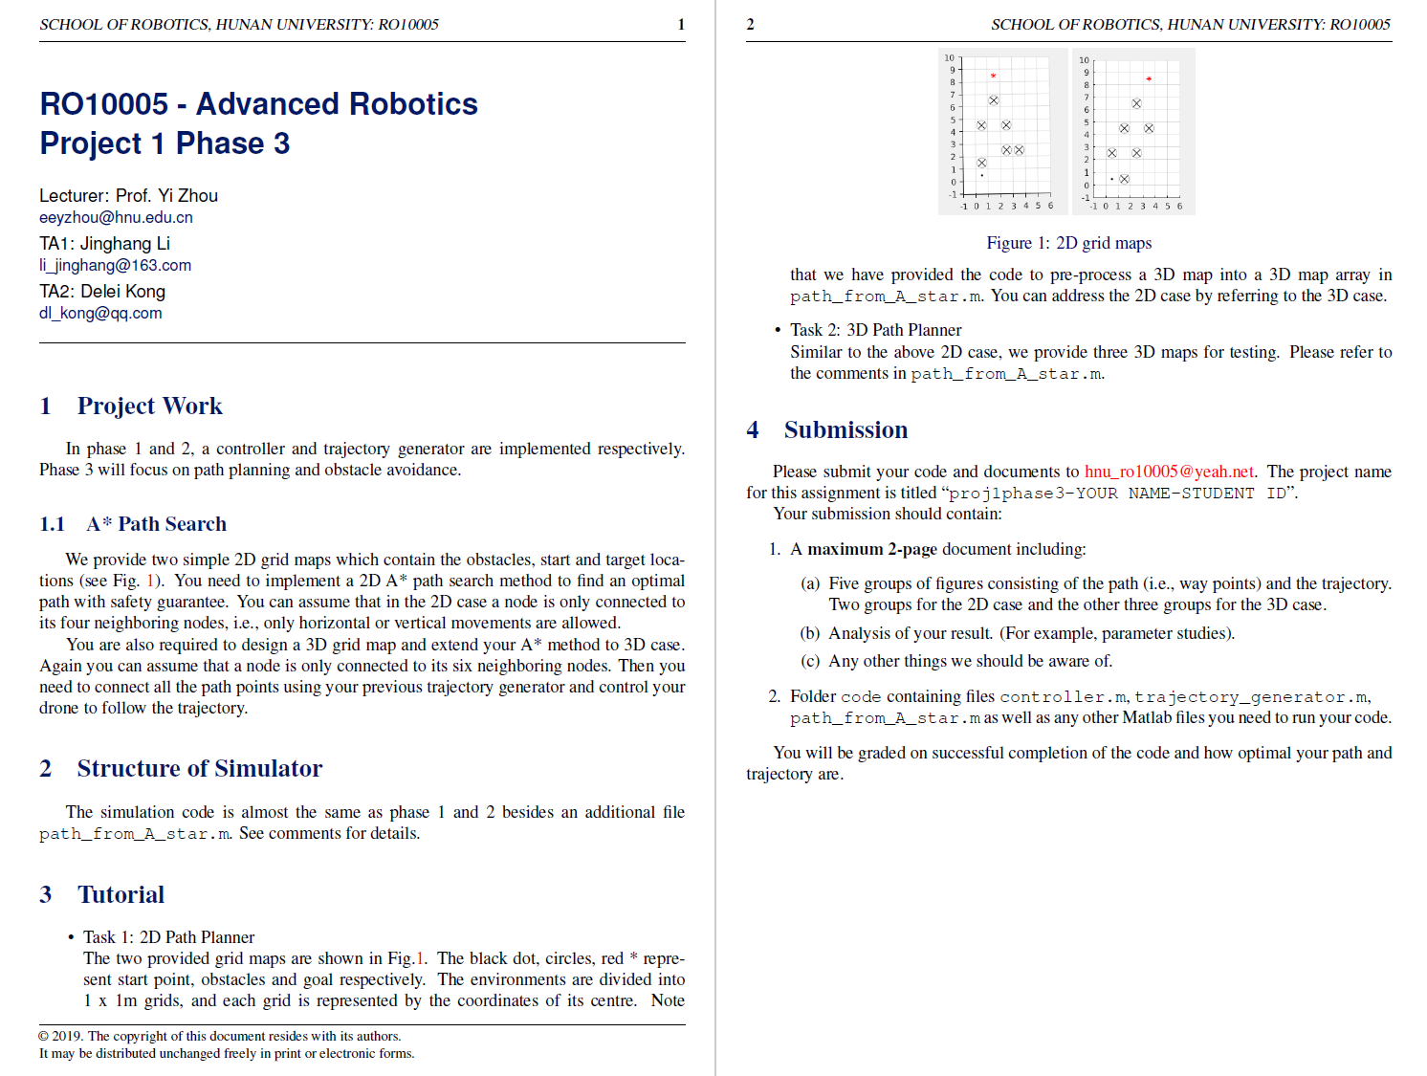

Slide 3
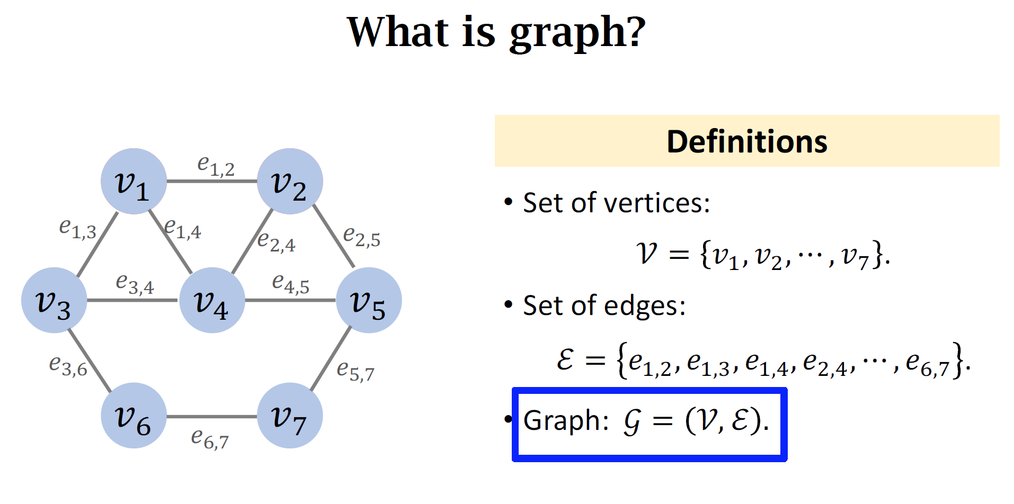
RO 10005: Project 1
https://space.bilibili.com/1369507485/channel/collectiondetail?sid=761574

Slide 4
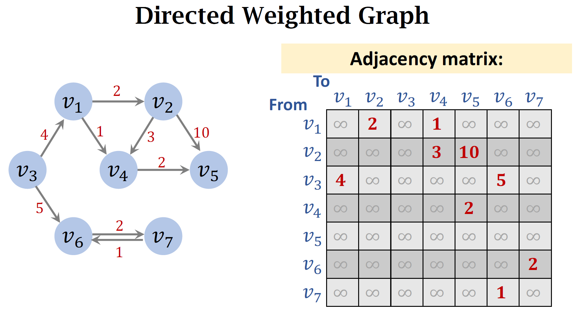
RO 10005: Project 1

Slide 5
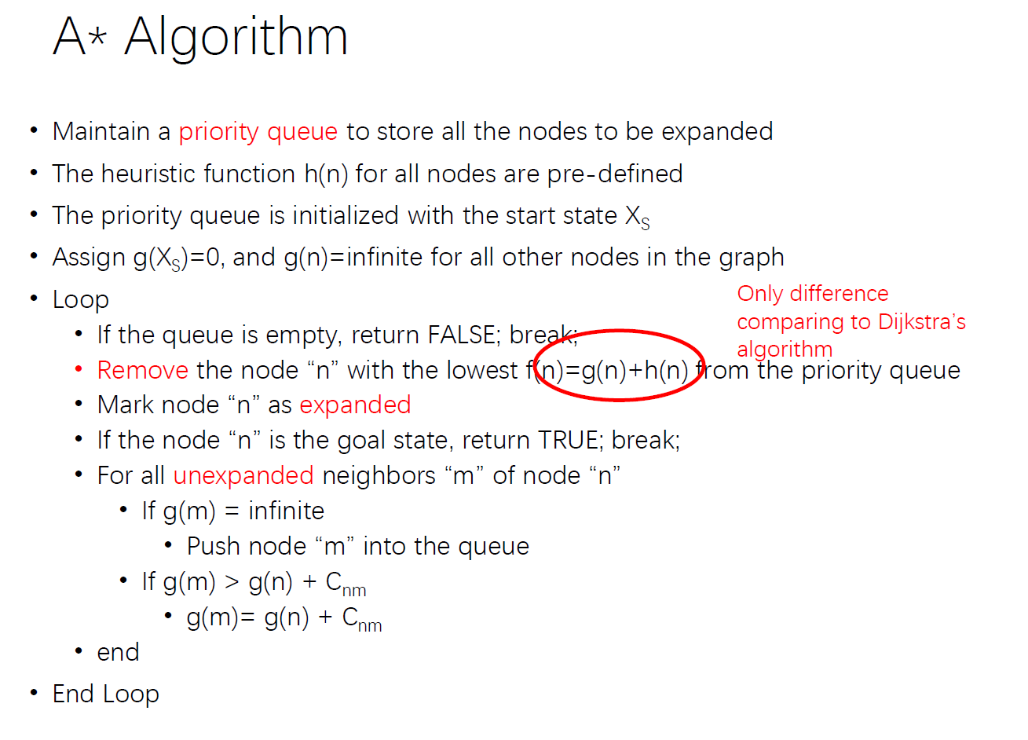
RO 10005: Project 1

Slide 6
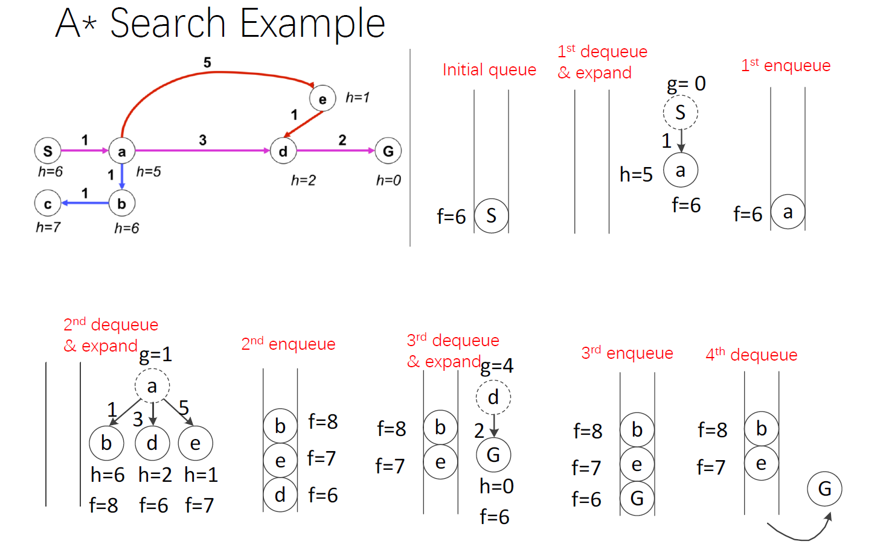
RO 10005: Project 1

Slide 7
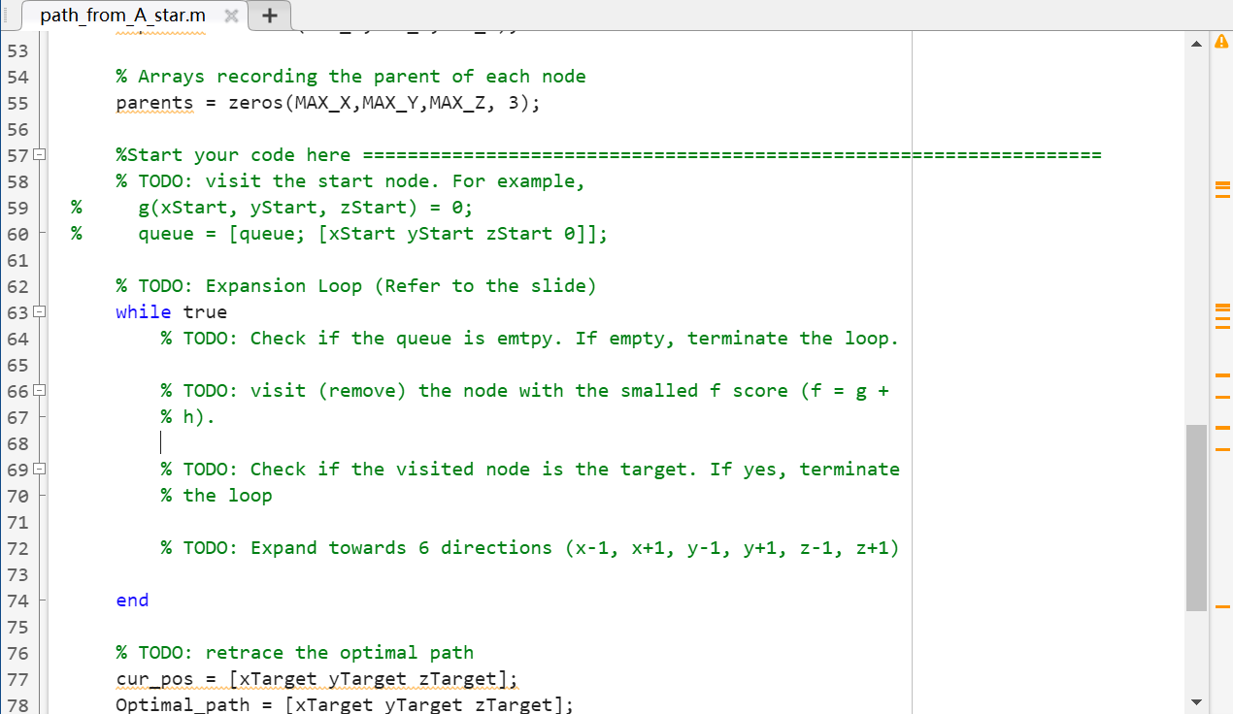
RO 10005: Project 1

Slide 8
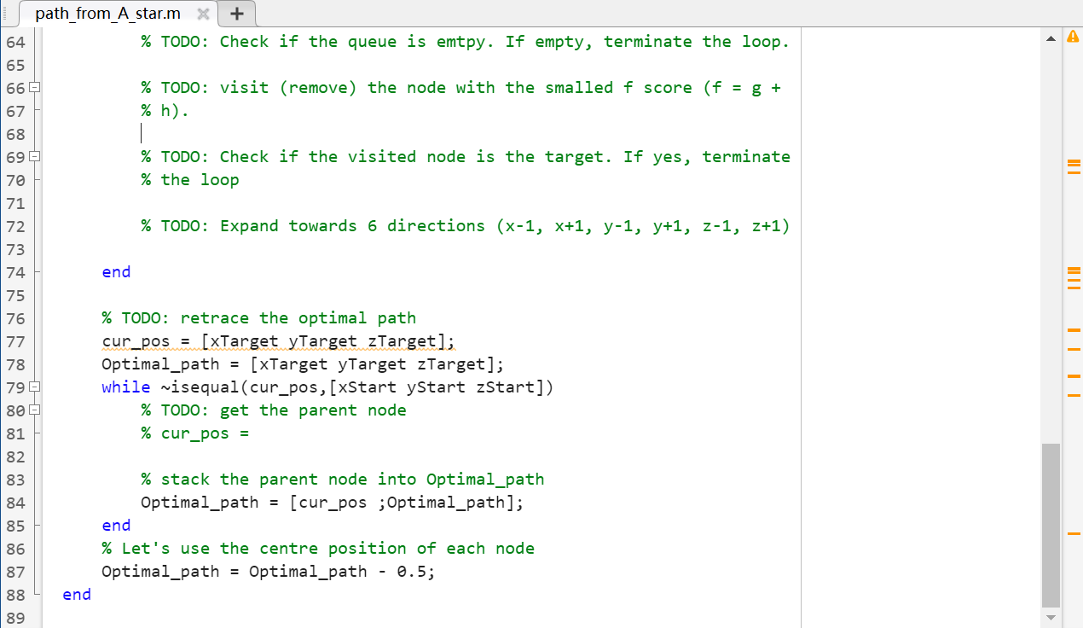
RO 10005: Project 1

