Slide 1
TL;DR Online Safety
You Don’t Have to Outrun the Bear

Slide 2
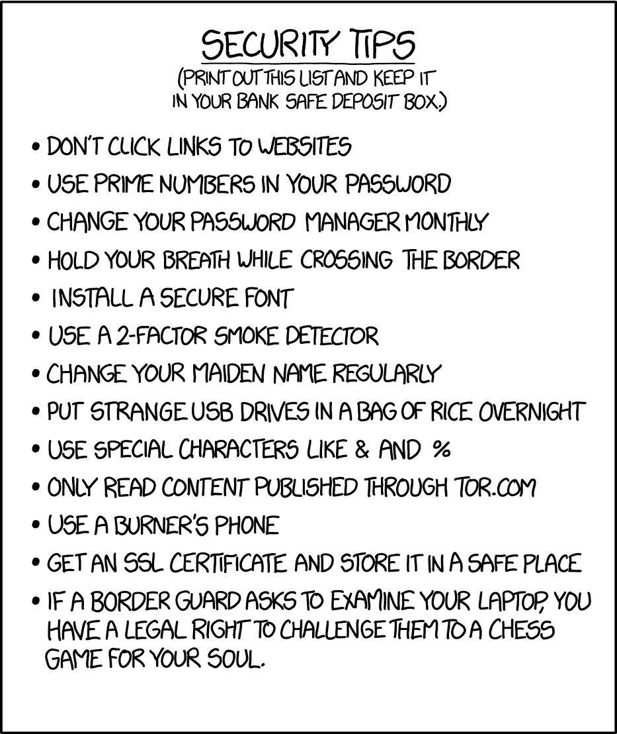
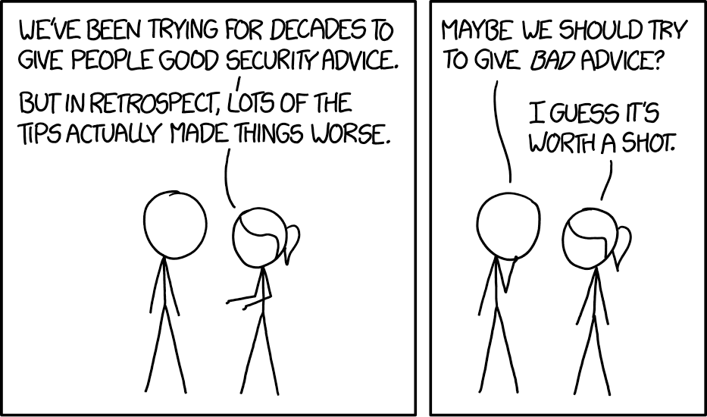

Slide 3
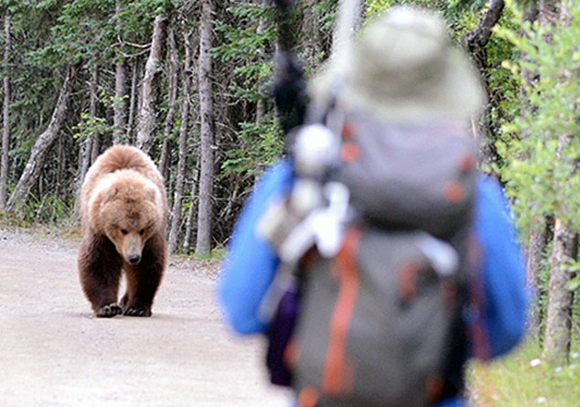
You’re not the target…
…you’re just a target. If you’re safer than 80% of the audience, hackers likely won’t spend the effort.

Slide 4
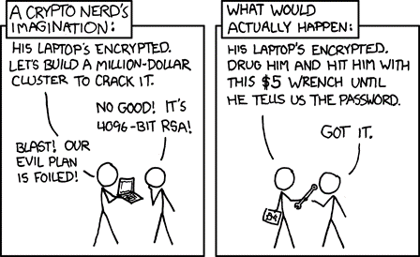
If you are the target…
…you’re probably doomed. ¯\_(ツ)_/¯

Slide 5
TL;DR SAFETY TIPS
Stay patched!
Don’t get phished.
Your password sucks.
In fact, all passwords suck.
Pay attention to physical security too.

Slide 6
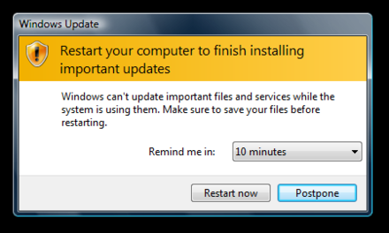
Stay Patched
If you never patch, every bug is a zero-day.

Slide 7
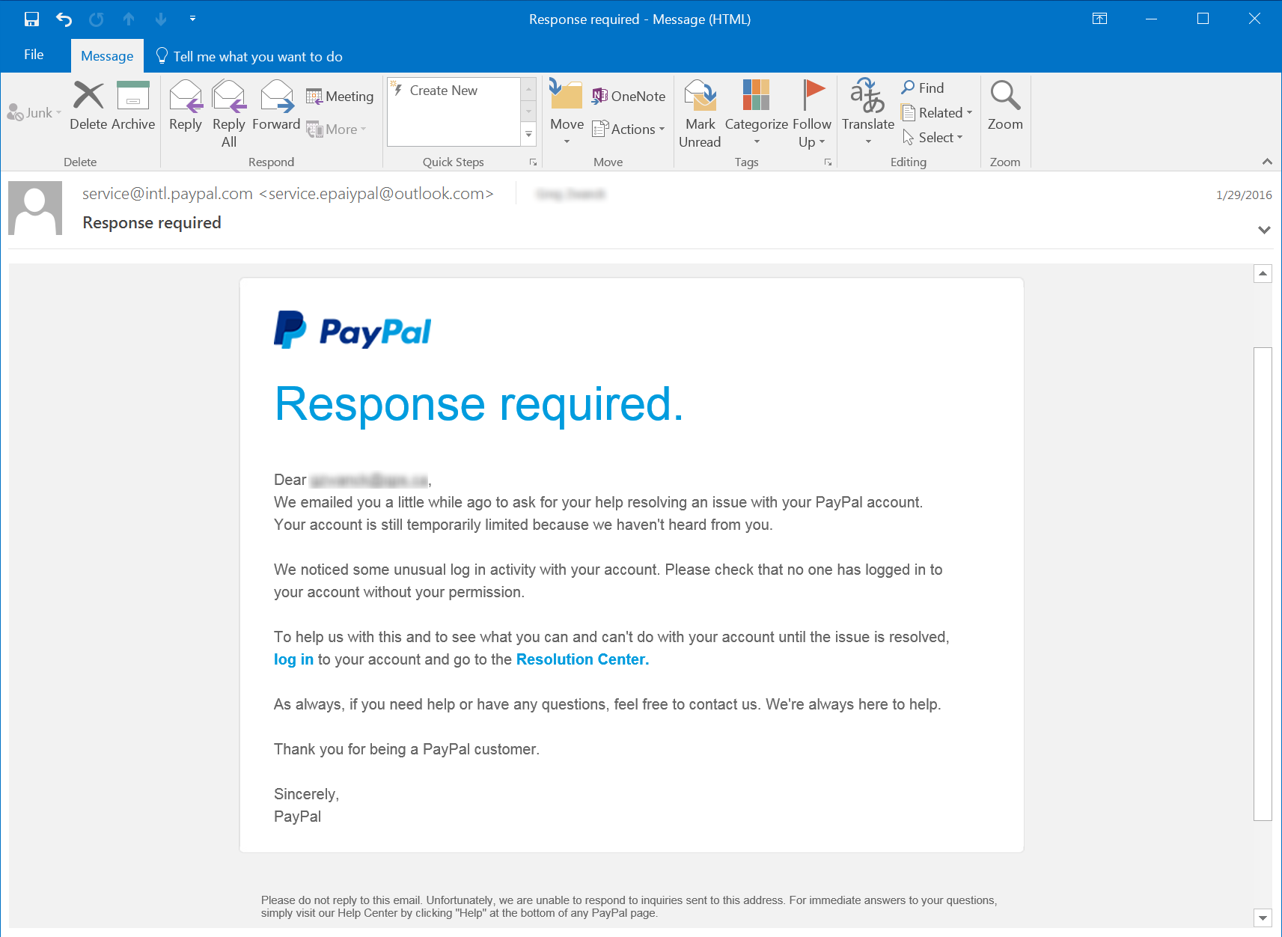
DON’T GET PHISHED
Check domain names carefully
Look for the lock icon
http://www.phishing.org/phishing-examples

Slide 8
Your Password sucks

Slide 9


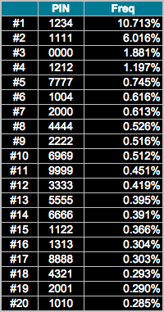

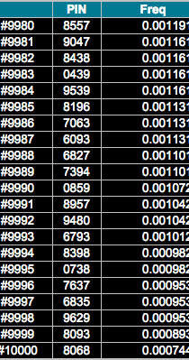
Humans ARE BAD at randomness AND MEMORIZATION
Notes:
The lighter areas corresponding to couplets of numbers that are close to each other. For some reason, people don't like to select pairs of numbers that have larger numerical gaps between them. Combinations like 45 and 67 occur much more frequently than things like 29 and 37
Here we see the line corresponding to 19XX . The intensity the dots relates to the chart we plotted earlier
There are a large number of codes starting with 19, especially towards the higher end.
There is a strong bias towards the lower left quadrant. People love to start their PIN numbers with 0, and even more so with the digit 1.
The chart on the right shows the relative frequency of the first digit of 4-digit pin codes.
As you can see, the digit 1 dominates (and it's not all down to the 19XX phenomenon.)
Little bright specs dot the plot in places corresponding to numerical runs (both ascending and descending) such as 2345 , 4321 and 5678 .
Jumps in steps of two are also visible e.g. 2468
Repeated-pair couplets of numbers are very common, such as XYXY
The hundred sets of repeating couplet pairs represent a staggering 17.8% of all observed PIN numbers.

Slide 10


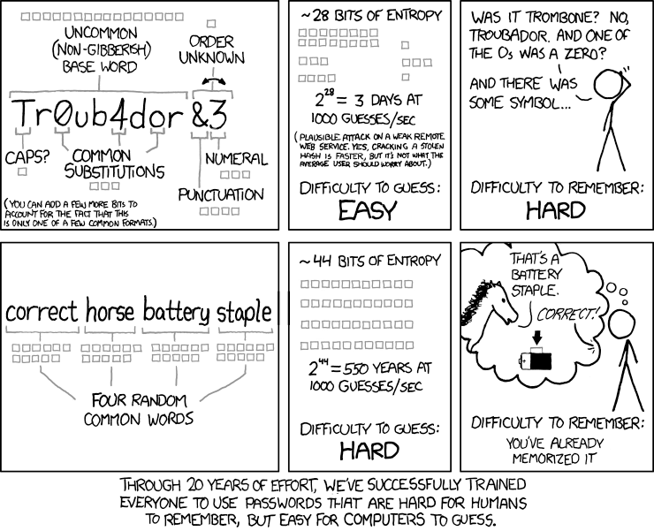
SEARCH SPACE = 2^{entropy}
Notes:
https://gist.github.com/epixoip/a83d38f412b4737e99bbef804a270c40

Slide 11

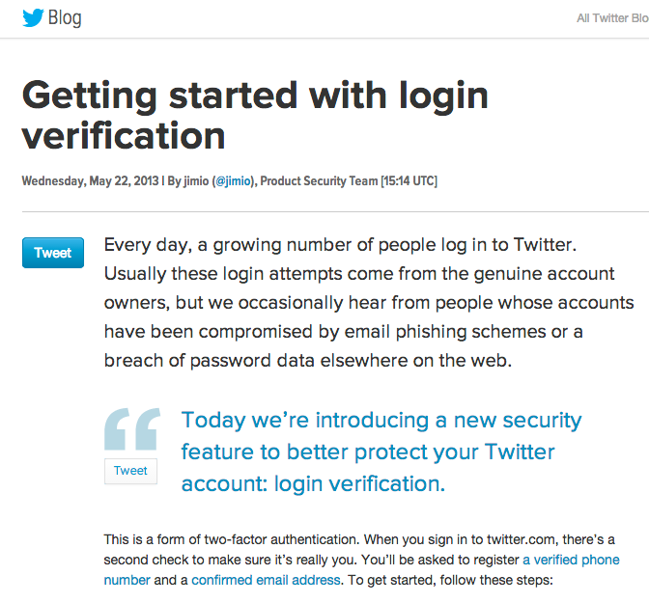

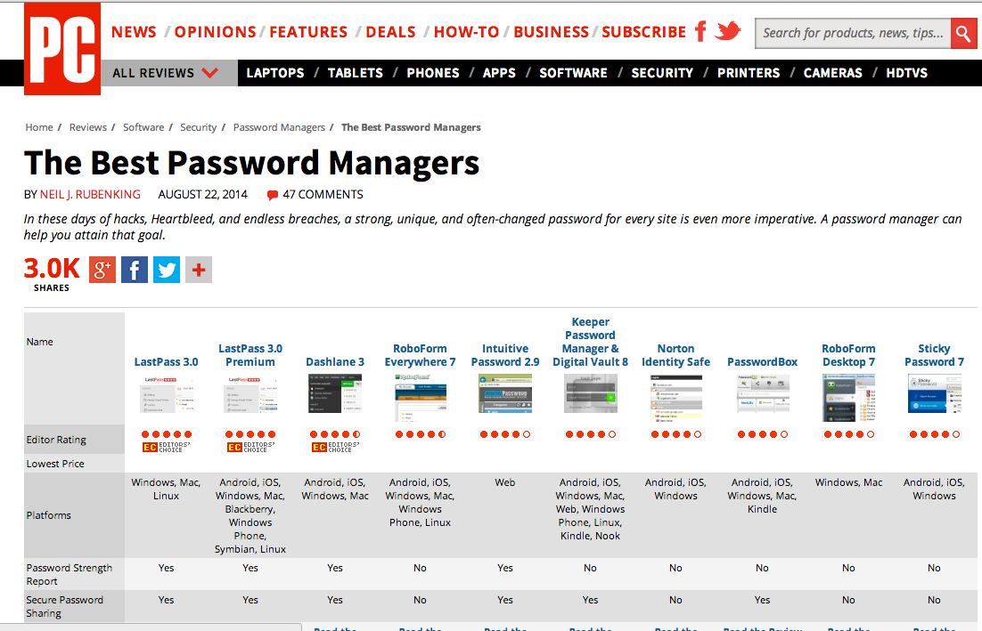

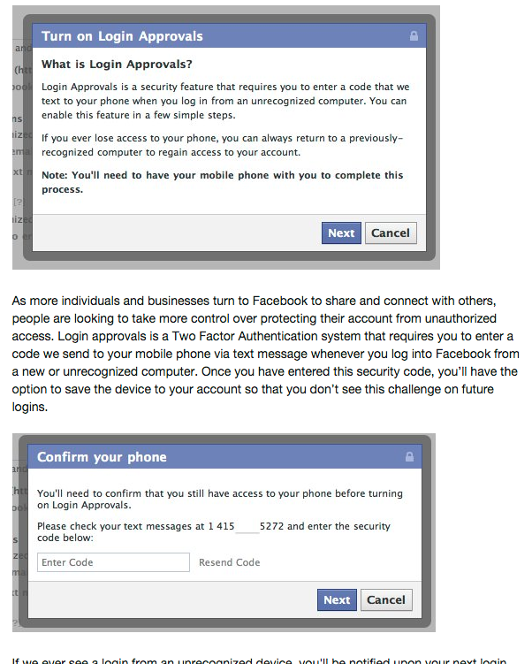
ALL PASSWORDS SUCK

Slide 12
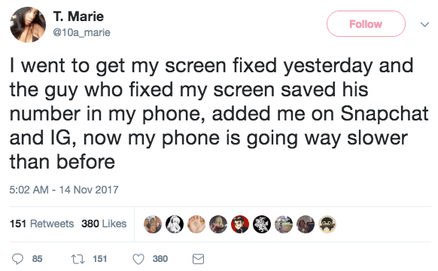
PHYSICAL SECURITY ALSO MATTERS
Backup your phone
Reset before repair, restore after repair
Beware of USB ports

Slide 13
TL;DR SAFETY TIPS
Stay patched!
Don’t get phished.
Your password sucks.
In fact, all passwords suck.
Pay attention to physical security too.

